Slide 1
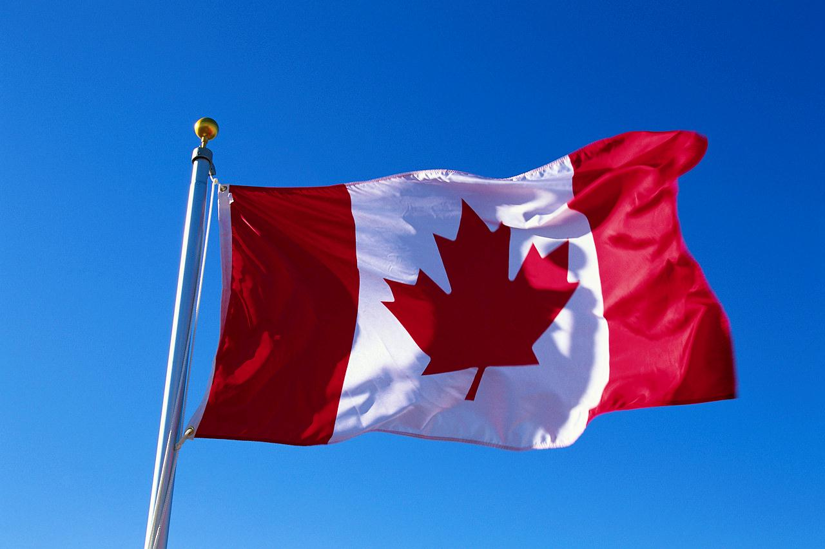

The People We Want to Stay North of the Border
An Assessment of Tuberculosis in Canada

Slide 2
Snapshot of the Canadian Population*
Population: 34,482,800
Female: 17,378,700
Males: 17,104,100
Age 65+: 4,973,400 (14.4%)
Median age: 39.5
Aboriginal Population: 1,172,790 (2006 data)
Born outside of Canada: 6,186,950 (19.8%) (2006 data)
Notes:
2 million people less than the population of California

Slide 3
Demographics
Life Expectancy: 80.7
Males: 78.3
Females: 83.0
People with a Regular Medical Doctor: 84.9%
Mortality Rate due to Chronic Lower Respiratory Diseases: 22.7/100,000 Deaths

Slide 4
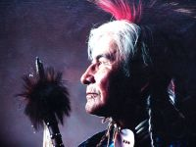
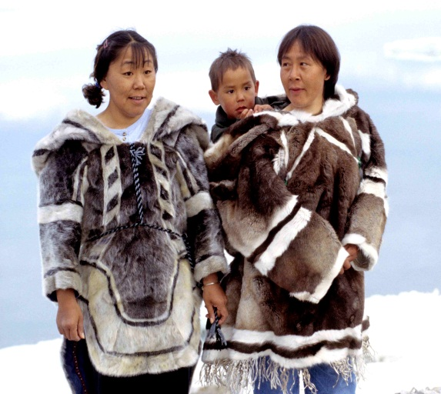
First Nations and Inuit Populations
First Nations people can be related to the Indian tribes of the U.S.
Inuit peoples of Canada are those who were previously known as the Eskimos
Notes:
http://www.aaanativearts.com/canadian_tribes_AtoZ.htm
“The First Nations people of Canada are made up of four main groups, excluding the Inuit in the North and Métis.”
I wanted to explain these cultures because they have some of the highest rates of TB in Canada
“Members of First Nations are known officially as registered Indians if they are entitled to benefits under the Indian Act;”
“There are over 630 First Nation communities in Canada speaking more than 50 languages, divided into six cultural divisions in eight geographical locations.”

Slide 5

Canadian Economic Status
Median Family Income: $53,634.00
Unemployment Rate: 6.6%
Persons in Low Income: 15.3%

Slide 6
Canada’s Health Care System
Lawfully insured persons include anyone who makes Canada their home
Each of the 13 Provinces and Territories have created their own individual Health Care Plans
It is illegal for anyone to sell private health insurance for profit for medically necessary procedures
Coverage must include all medically necessary procedures, however “Medically necessary” is not always uniformly defined
The “Wait Your Turn” Problem
Notes:
Must be a resident of a Province or Territory, not including tourists or visitors to the country. Each province determines it’s own residence rules
The Canada Health Act requires that every province must have interlocking policies so that nationally the Health Care system has basic standards and features. The Health Act limits waiting periods for eligibility, and for waiting period of no longer than 3 months for health benefits.
Delays are often caused because the Most Urgent clients must go first, whereas the US hold up are mainly due to Insurance bureaucracy and approval processes. This is why some Canadians will come to the US for surgeries and pay out of pocket money, so that they can have their procedures done sooner.
Prescriptions drugs, chiropractic, dental care, vision, ambulance services are all at the mercy of Provinces’ individual plans, delivered on their own terms and conditions.
All from: Hc-sc.gc.ca = Health Canada website

Slide 7
Comparing the History of TB in Canada
Past
Present
14,000 New cases a year in 1940s
120 cases per 100,000 people in 1940
TB accounted for 7% of deaths in 1926
1,600 New cases a year
5.3 cases per 100,00 people
TB accounts for less than 1% of deaths
63% of TB cases in Canada occurred in people born outside the country in 2005
Notes:
3 reasons Canada can’t get rid of TB:
1. TB is constantly changing to survive its environment – AEB new strains of TB that are drug resistant
2. Canada’s population is increasing with people who migrate from around the world where drug treatments for TB are not readily available
3. A reservoir for B exists among people in high risk situations: weak immune systems or living in communities that lack proper health services: Inuit, First Nations, immigrants
Anatomy of a Killer, www.cbc.ca/news/health/story/2008/10/03/f-tuberculosis.html

Slide 8
Canadian TB Statistics
1,900 People are living with TB in 2010
1,600 New cases of TB are reported each year
TB rates among First Nation people are 5x higher than overall Canadian TB rates
For First Nation peoples living on reserve TB rates are 8-10x higher than overall Canadian rates
Notes:
Globally there are 12,000,000 people living with TB in 2010. Canada ranks 85th
In comparison: India ranks #1 with 3,100,000; US ranks 49th with 15,000

Slide 9
Cost of TB in Canada
In 2004 Canada spent $74 Million*
This equates to $47,290 per diagnosed case that year
$4.5 million (6%) was used for research
$31 million was used for active cases
60% went toward curative services
40% went toward prevention and control services
Notes:
http://www.tbevidence.org/documents/dxres/models/Menzies%20et%20al%202008.pdf
It is unclear due to all the parties involved (provinces, hospitals, governments, individual providers) as to what is currently actually spent
Comprehensive TB costs have never really been calculated in Canada prior to 2004 and this was taken from a private research study.

Slide 10
Treatment for TB in Canada
An antibacterial regimen of a combination of the following is started upon diagnosis
Isoniazid (INH)
Rifampin (RMP)
Pyrazinamide (PZA)
Ethambutol (EMP)
Streptomycin (STREP)
Once medication is started infectious patients are put into isolation for 2 weeks
The drug combinations are normally prescribed for a period of 6-8 months
Notes:
Because TB strains can be resistant to some of these drugs, a combination of these antibiotics are used to be sure that the TB destroyed completely

Slide 11
Treatment – The DOT Program
Directly Observed Treatment
Helps patients remember to take their TB medications when scheduled
A nurse will come to the home each day or bi-weekly to witness the patient taking their meds
They will assess for side effects and answer questions
Faster cure with medicinal compliance
Notes:
http://www.lung.ca/diseases-maladies/tuberculosis-tuberculose/
Remember it is a drug regimen of 6-8 months…you may need reminding!

Slide 12
An Ounce of Prevention is Worth…
Global Fund to Fight AIDS, TB, and Malaria
Canada made their largest financial commitment of over $1.5 billion to this international health institution to help fight for the “prevention, care and treatment” of these diseases.
(www.acdi-cida.gc.ca)

Slide 13
Preventative Measures
Vaccines
Bacille Camette-Guerin Vaccine (BCG)
Live, attenuated bacteria
Screening
Clinics are available for First Nation children to be tested for TB
TB screenings are done at schools in the 4th grade
Immigration applicants must have a physical including a Chest X-ray (over 10 years old)
Prophylactic Drug Treatments: Isoniazid (INH)
Education
Get Tested, Get Treatment, Get Cured!
Notes:
Used widely in the 1950’s, now mostly given to high risk groups:
repeatedly exposed to TB
groups of people with high rates of TB
health care workers
newborn infants with moms with TB
traveler’s to high risk TB areas
Inactive TB cases are put Prophylactic treatment for 12 months and it reduces the chances of TB becoming active by 93%
Isoniazid – only drug tested positive for this purpose
www.lung.ca/tb/tbtoday/prevention/bcg.html
“Get Tested” brochures are printed for the different Aboriginal tribes

Slide 14
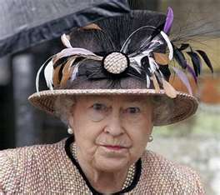
GOD SAVE THE QUEEN!!
THE END…..

