Slide 1

France: Breast & Prostate cancer
June Baker & Libby Fannin

Slide 2
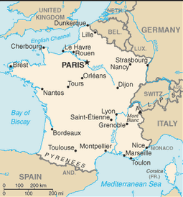
FRANCE - Population 65,312,249 (July 2011 est.) - Median age 39.9 years - Birth rate 12.29 births/1,000 population (2011 est.) - Death rate 8.76 deaths/1,000 population (July 2011 est.) - Infant mortality rate 3.29 deaths/1,000 live births - Life expectancy Total population: 81.19 years male: 78.02 years female: 84.54 years - Religion, largely roman catholic - Primary Language French

Slide 3
Health care -Universal health care plan – everyone is covered - 75% of total health costs paid by public health insurance companies - remaning balance split between patients and private health insurance companies - 97% of physicians conform to tariff references (set prices agreed upon between physician unions and insurance agencies) - Most healthcare reimbursements are for 70-95% of costs - Health expenditures 11.6% of GDP (2010) - Physician’s density 3.497 physicians/1,000 population (2008) - Hospital bed density 7.11 beds/1,000 population (2008) - Obesity - adult prevalence rate 16.9% (2007) - Tobacco use(15+) Males 36% Females 27% - A patient can receive 100 percent coverage under certain conditions, such as having a chronic or acute medical condition (including cancer, insulin-dependent diabetes, heart disease…), requiring long-term care, having a long-standing condition, requiring a hospital stay of more than 30 days. - Average out of pocket cost is 7% of total health care costs (2010) -

Slide 4
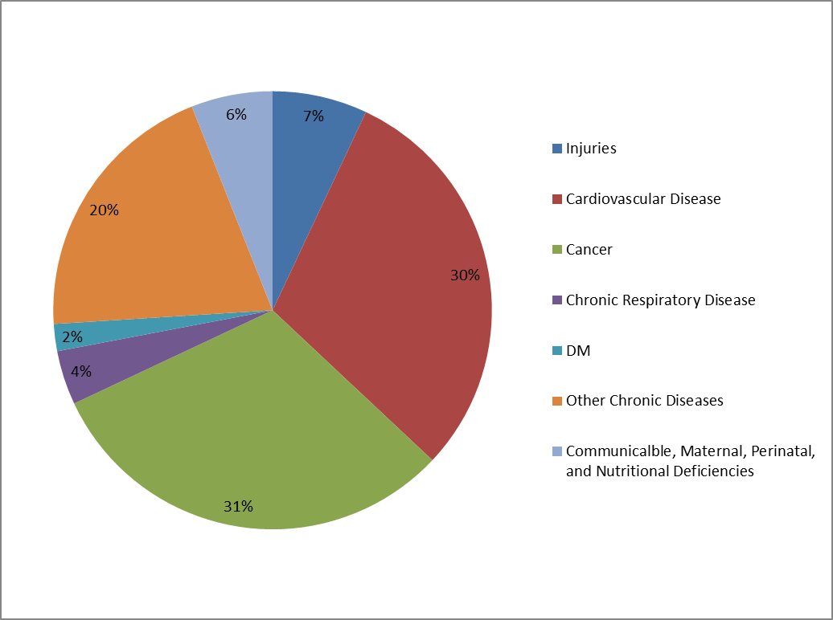
Cancer in France - Cancer is the main cause of premature (before the age of 65) death on the continent, and kills around 960,000 Europeans every year.(All are country averages) - The cost of cancer treatment yearly in the US is 41.6 billion and in the UK 94 million

Slide 5
Breast Cancer in France - Number of people impacted yearly Breast cancer is the most common cancer amongst women in France, accounting for 35.5% of all cancers[3] and has the highest mortality rate of all cancers in France. It is estimated that there are approximately 13,400 new cases of metastatic breast cancer every year in France. - France ranks 3rd worldwide in breast cancer rates with 99.7 per 100,000 people behind Belgium and Denmark, the US ranks 19th with 76 per 100,000 (2008) - 125 new cases diagnosed per day Treatment - Chemotherapy - Radiotherapy - Hormone therapy - Clinical trials - Surgery - Targeted medication therapy
The breast awareness 5-point code
You should know what is normal for you.
Know what changes to look for.
Look and feel.
Tell your GP about any changes straight away.
Go for breast screening when invited.
Guidance issued by the Department of Health, 2009.

Slide 6
Prostate Cancer Facts - Prostate cancer kills 10,000 men in the UK each year - over 40,00 in the UK are newly diagnosed each year - France (Martinique) ranks number one worldwide for prostate cancer rates with 173.7 per 100,000 people and 4th for the metropolitan area with 118.3 per 100,000 people , the US ranks 18th with 83.8 per 100,000 - 250,000 men are living in the UK with prostate cancer Treatment - cryotherapy - hormone therapy - seed breachytherapy - high dose brachytherapy - clinical trials - surgery – prostatectomy - High intensity focused ultrasound - Radiotherapy - Chemotherapy

Slide 7
Prevention - In the UK, women between 50 and 70 are invited for breast screening every three years as part of the National Health Service Breast Screening Programme (NHSBSP) - Recommend yearly - In the UK and US, effective education and screening could save between 12 to 37 lives per day - Smoking is banned in all public places in France - They encourage citizens to … Be as lean as possible without being underweight Be physically active for at least 30 min a day Avoid sugary drinks, limit calorie dense foods Consume a variety of vegetables, fruits, whole grains, and pulses limit consumption of red meat, avoid processed meats limit alcohol consumption to one per day for women, two for men limit sodium rich foods Do NOT take supplements to protect against cancer infants should be breastfed for 6months After treatment of cancer follow recommendations for cancer prevention

Slide 8
Resources
http://www.guardian.co.uk/news/datablog/2011/jan/24/worldwide-cancer-rates-uk-rate-drops
http://www.nationmaster.com/red/country/fr-france/hea-health&all=1
http://prostatecanceruk.org/
http://www.breastcancercare.org.uk
http://www.worldwidebreastcancer.com
https://cia.gov/library/publications/the-world-factbook/geos/fr.html#Econ
http://www.presseportal.de/pm/64962/2286190/new-breast-cancer-treatment-available-in-france
http://www.cdc.gov/

