Slide 1
EKG and Rhythm Interpretation
presented by Fran Brennan, MSN, RN
2013

Slide 2
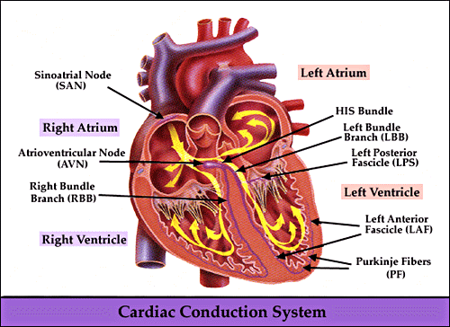
Cardiac conduction

Slide 3
Cardiac conduction system
Sinoatrial (SA)
Atrioventricular AV node
Bundle of His
Right and Left Bundle Branches
Purkinje Fibers

Slide 4
Basic terminology
  WAVEFORM
    Movement away from the baseline in either a positive or negative direction
SEGMENT
  A line between waveforms
INTERVAL
  A waveform and a segment
COMPLEX
  Consists of several waveforms

Slide 5
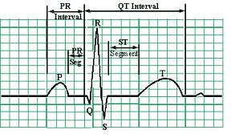
ECG complete waveform

Slide 6
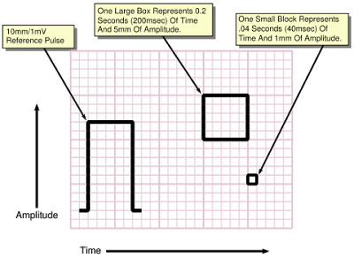
ECG paper measures
The standard paper speed is 25 mm/s. Hence one small square on the ECG is equivalent to 0.04 s; one large square is 0.20 s

Slide 7

Analyzing a rhythm strip
What is the rate?
Is the rhythm regular or irregular?
Is there one P wave before each QRS?
Is the PR interval within normal limits?
Is the QRS narrow or wide?
Identify the rhythm!!

Slide 8
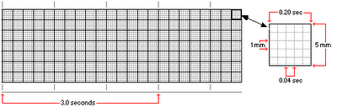
Heart Rate measurement
Six-Second Method
  Count the number of complete QRS complexes within six seconds and multiply by 10. (hint 30 large boxes represent 6 seconds). Simplest, quickest, most commonly used method.
R-R Method #1
  The quickest way to calculate the heart rate is to count the number of large squares between QRS complexes and divide into 300, e.g. if there are three large squares, the heart rate is 100 beats/min.
R-R Method # 2
  Count the number of small squares between two consecutive r waves and divide by 1500.

Slide 9
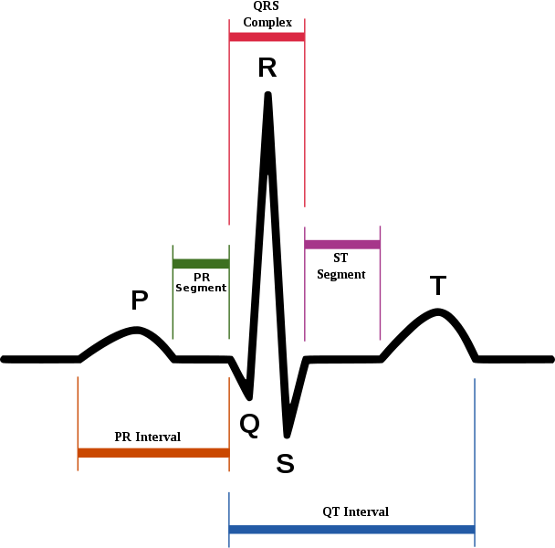
The P wave
Normal characteristics
    Smooth and rounded
    O.5 to 2.5 mm in amplitude
    No more than 0.11 second in duration

Slide 10
PR interval
PR interval is the P wave followed by the PR segment.
The PR interval is measured from the beginning of the P wave to the R wave and is usually 1 large square in duration (0.20 s).
Normal characteristics
  Normally measures 0.12 to 0.20 seconds

Slide 11
QRS Complex
The beginning of the QRS is measured from the point where the first wave of the complex begins to deviate from the baseline. The end of the complex is where the complex begins to level out at, above, or below the baseline.
Normal QRS duration is 0.10 s or less (0.06 to 0.10 seconds)

Slide 12
ST segment
The ST segment begins with the end of the QRS complex and ends with the onset of the T wave.
The ST segment should not be depressed or elevated.

Slide 13
T wave
Slightly asymmetrical
In leads I, II, III is not greater than 5 mm in amplitude

Slide 14
QT interval
Measurement starts at the beginning of the QRS to the end of T-wave.
The QT interval normal duration is 0.36 to 0.44 seconds (two large squares).

Slide 15
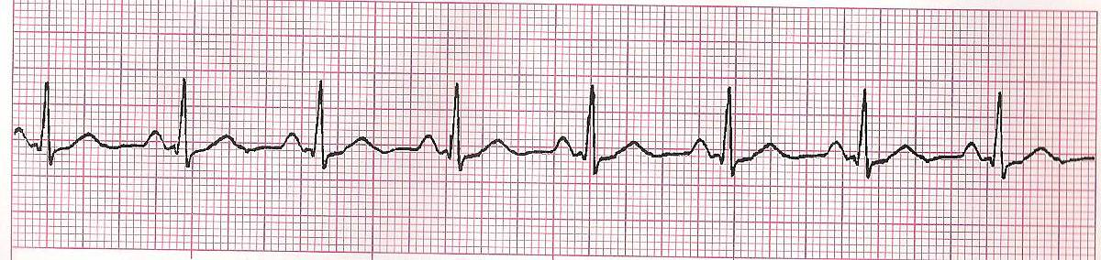
Normal Sinus Rhythm
Normal Sinus Rhythm:
Rate – 60-100 bpm
Rhythm – regular
PR interval - .12-.20
QRS - < .12

Slide 16
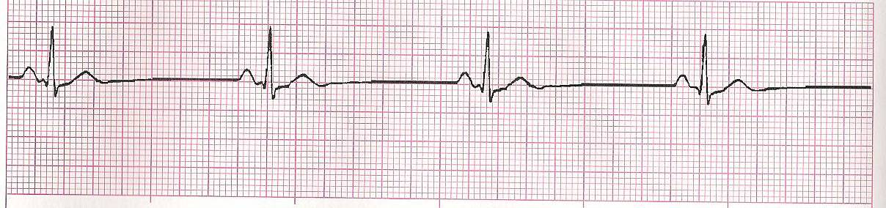
Sinus Bradycardia
Sinus Bradycardia:
Rate - < 60 bpm
Rhythm – regular
PR interval - .12-.20
QRS - < .12

Slide 17
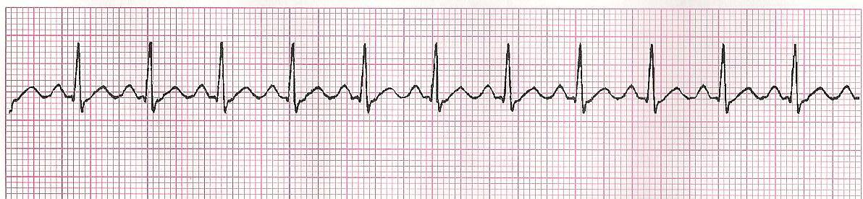
Sinus Tachycardia
Sinus Tachycardia :
Rate - > 100 bpm
Rhythm – regular
PR interval - .12-.20
QRS - < .12

Slide 18
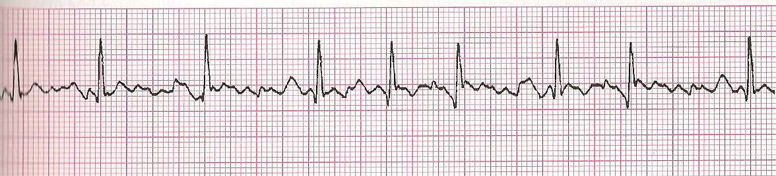
Atrial fibrillation
Atrial Fibrillation:
Rate – variable ventricular rate
Rhythm – usually irregular
PR interval – not measurable (no visible P waves)
QRS - < .12

Slide 19
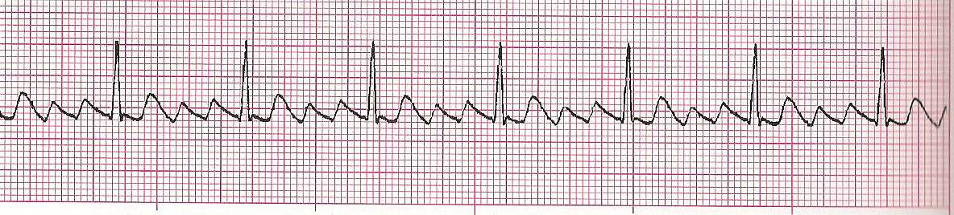
Atrial flutter
Atrial Flutter:
Rate – ventricular rate < 180
Rhythm – regular/irregular
PR interval – not measurable (saw tooth P waves)
QRS - < .12

Slide 20
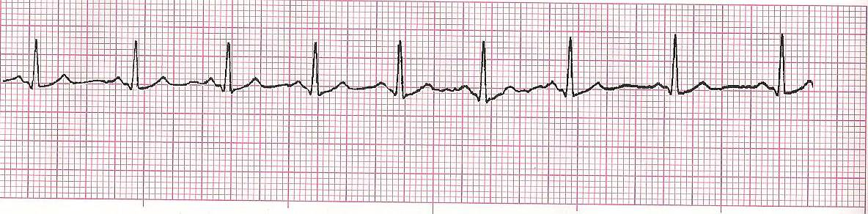
Sinus Dysrhythmia or sinus arrhythmia
Sinus dysrhythmia or sinus arrhythmia :
Rate – usually 60-100 bpm
Rhythm – irregular
PR interval - .12-.20
QRS - < .12

Slide 21
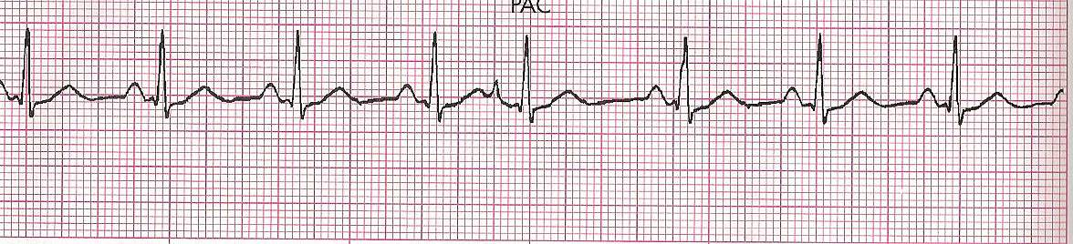
Premature atrial contractions
(PAC’s)
Rate – Usually normal, but depends on underlying rhythm
Rhythm – essentially regular with premature beats
P waves – premature
PR interval – varies from 0.12 – 0.20
QRS – Usually less than 0.10

Slide 22
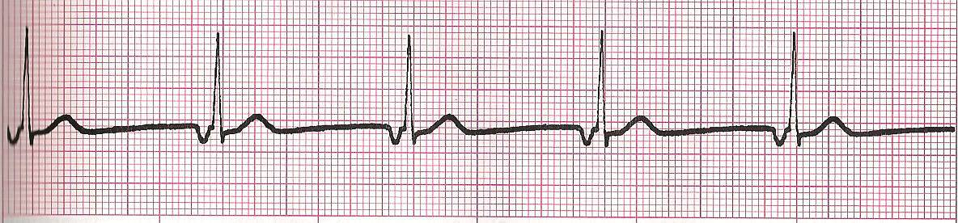
Junctional Rhythm
Rate 40 – 60 bpm
Rhythm – Atrial and ventricular rhythm very regular
P waves – may occur before, during or after the QRS. If visible, the P wave is inverted.
PRI – only if P wave present before QRS, usually less than or equal to 0.12 seconds.
QRS – usually 0.10 seconds or less

Slide 23
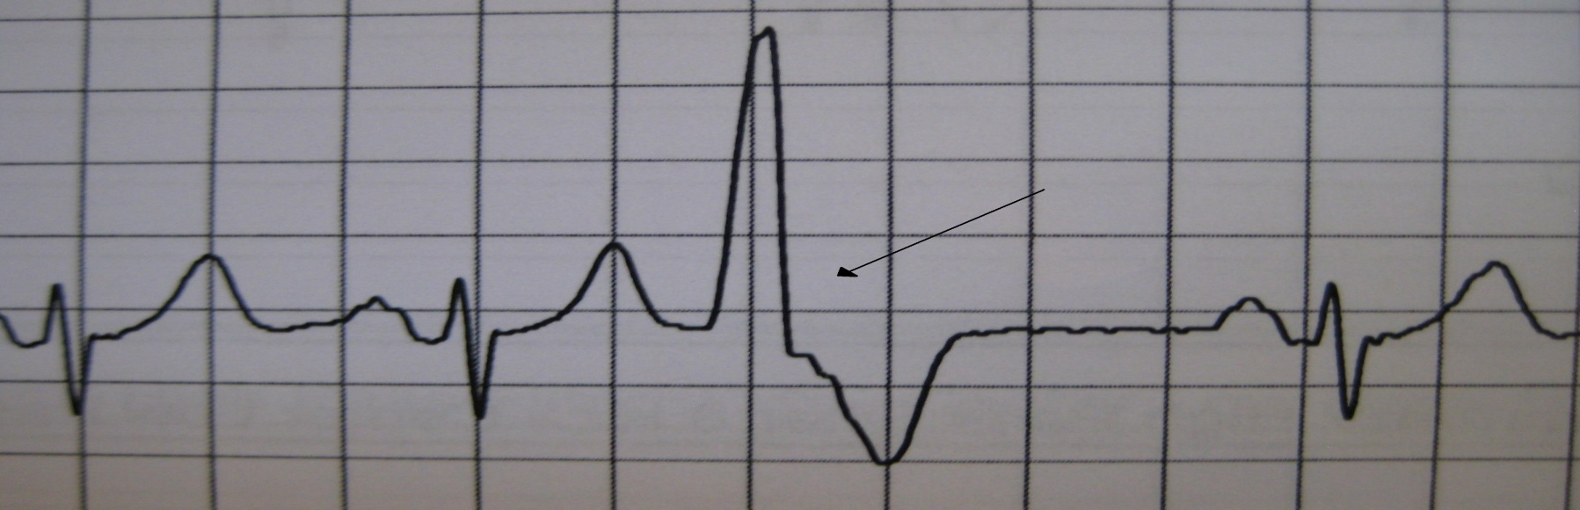
Premature ventricular contractions
(PVC’s)
Premature Ventricular Contractions (PVC’S) are an arrythmia and relatively common. Some people are very sensitive and feel every abnormal heart beat; others are blissfully unaware of them.

Slide 24
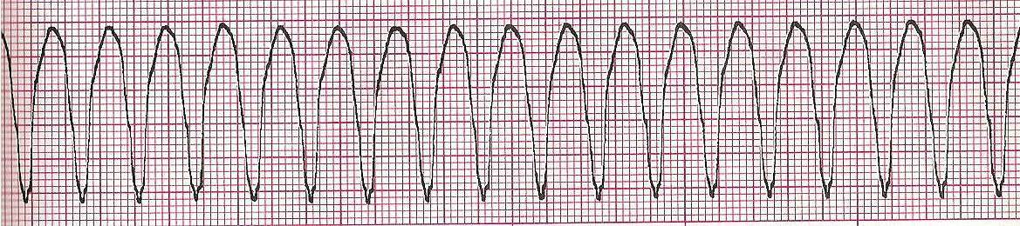
Ventricular Tachycardia
Rate – no atrial measurable rate, ventricular rate 100-250 bpm
Rhythm – Atrial rhythm undeterminable, ventricular rate regular
P waves may be present or absent
PRI – None
QRS – Greater than 0.12 sec.

Slide 25
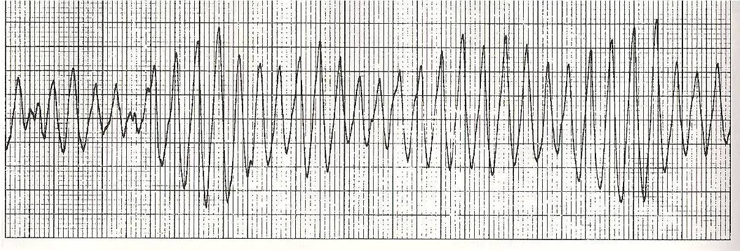
Torsades de Pointes
Rate – Atrial unmeasurable, ventricular 150-250 bpm
Rhythm – No atrial, ventricular may be regular or irregular
P waves – none
PRI – none
QRS – Greater than 0.12 second

Slide 26
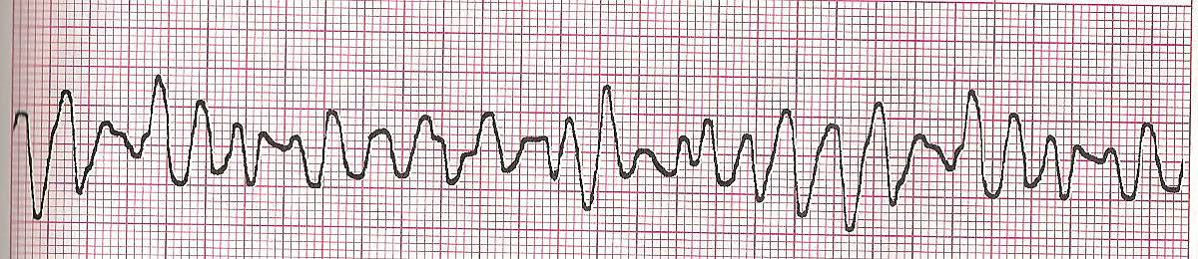
Course Ventricular fibrillation
Rate – undetermined
Rhythm – Rapid and chaotic with no pattern or regularity
P waves – not discernable
PRI – not discernable
QRS – not discernable

Slide 27
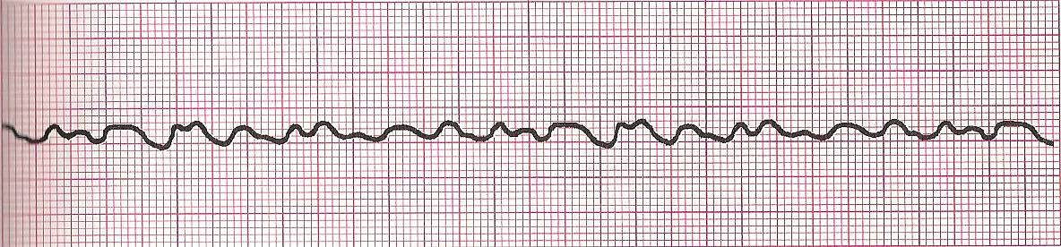
Fine ventricular fibrillation
Rate – Cannot be determined
Rhythm – rapid and chaotic, no regularity
P waves – not discernable
PRI – not discernable
QRS – not discernable

Slide 28
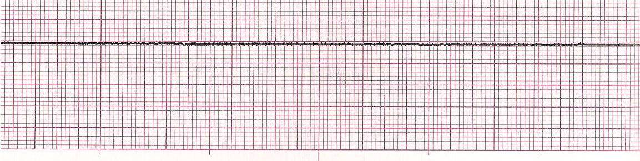
Asystole
Rate – ventricular usually indiscernable may see some atrial activity
Rhythm – Atrial may be detected, ventricular indiscernable
P waves – usually not discernable
PRI – not measurable
QRS - Absent

Slide 29
Atrioventricular Blocks
Degree of block
  Partial blocks
    First degree AV block
    Second degree AV block type I
    Second degree AV block type II
  Complete block
    Third degree AV block
Site of block
  AV node
    First degree AV block
    Second degree AV block type I
    Third degree AV block

Slide 30
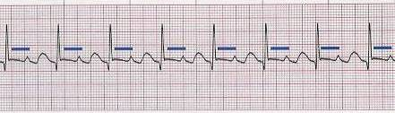
First Degree AV Block
Rate – Atrial and ventricular are the same
Rhythm – Atrial and ventricular regular
P waves – One p wave with every QRS, normal size and shape
PR interval – Prolonged, > 0.20 seconds but constant
QRS – Usually 0.10 sec or less

Slide 31
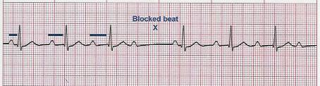
Second degree AV block, type I
(Wenckebach, mobitz type I)
Rate – Atrial rate > ventricular rate
Rhythm – Atrial regular, ventricular irregular
P waves – Some P waves not followed by QRS, more P’s than QRS’s
PR interval – lengthens with each cycle until P wave present without QRS
QRS – Usually 0.10 sec. or less, periodically absent

Slide 32
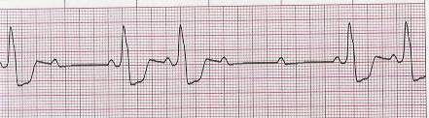
Second degree av block, type II
(Mobitz type ii)
Rate – Atrial rate > ventricular rate, ventricular rate slow
Rhythm – Atrial regular, ventricular irregular
P waves – Some P waves without QRS, more P’s than QRS’s
PR interval – WNL or prolonged but always constant for the conducted beats
QRS – Usually 0.10 sec or greater, absent periodically

Slide 33
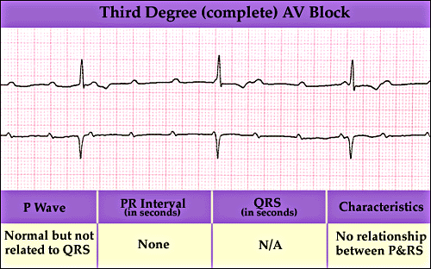
Third degree av block
(complete heart block)
Rate – Atrial rate > ventricular rate
Rhythm – Atrial and ventricular regular but no relationship between atrial and ventricular rhythm
P waves – normal in size and shape
PR interval - none
QRS – narrow if generated from junction, broad if generated from ventricular

Slide 34
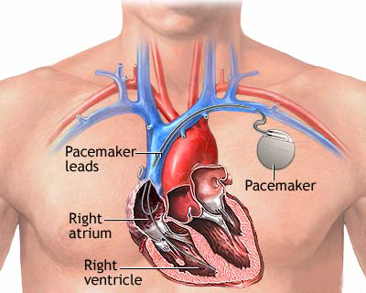
Pacemaker placement

Slide 35
Pacemakers
Definition – artificial pulse generator that delivers an electrical current to the heart to stimulate depolarization.
Key terms
  Pacemaker generator (pulse generator)- the power source that houses the battery
  Pacemaker spike – a vertical line on the ECG that indicates the pacemaker has discharged
  Asynchronous pacemaker (fixed-rate)
  AV sequential or dual chamber
  Synchronous (demand) pacemaker

Slide 36
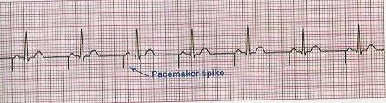
Atrial pacing
Pacemaker paces in atrium
Pacing electrode placed in right atrium
  Pacer spike appears before the P wave
    Ineffective if an AV block develops, cannot pace ventricles

Slide 37
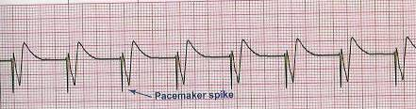
Ventricular pacing
Pacemaker paces in ventricular
Pacing electrode is located in right ventricle
  Pacer spike appears directly before a QRS which is wide in appearance

Slide 38
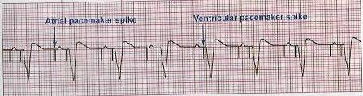
Dual chamber pacing
Pacemaker paces in both atrium and ventricle
Dual lead system, pacemaker electrodes placed in right atrium and right ventricle
  Two pacer spikes appear on ECG one before P wave and one before QRS

Slide 39
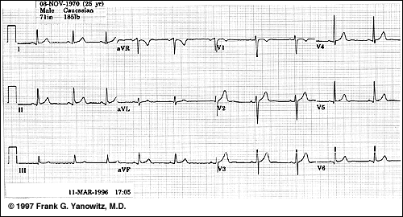
12 lead electrocardiogram

Slide 40
ECG Evaluation tool
Student Name : _________________________________________NCA III
Glue rhythm strip here
Rhythm Interpretation: HR___________________________________
PR interval ____________ QRS _______________ QT _________________
Rhythm identification ____________________________________________
____________________________________________________________________
Patient History:
Age – ___________
Admitting Diagnosis- _______________________________________________
Rhythm Evaluation: (state possible contributing factors associated with this rhythm and list medications with dosages that may be used to treat this rhythm)
_____________________________________________________________________________________________________________________________________________________________________________________________________________________________________________________________________________________________________________________________________________________________________________________________________________________________________________________________________________

