Slide 1
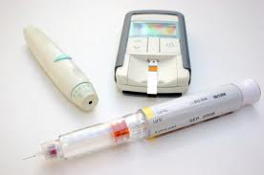
DIABETES
MELLITUS
In India
By: Angela Risaliti &
Molli Kochensparger

Slide 2
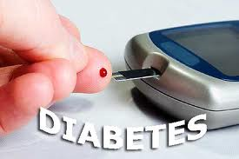

Slide 3
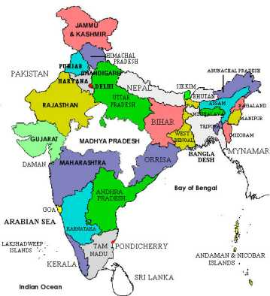

Slide 4
Demographics
2nd most populated
country
Life expectancy:
Total: 66.8
Females 67.95
Males: 65.77
Population: 1,210,193,422
Females: 5,086,469,174
Males: 6,023,724,248
Literacy:
Total: 74.04%
Females: 65.46%
Males: 82.14%
Birth Rate: 20.97 births/1,000 population
Diabetic capital
in U.S
Notes:
The World Health Organization (WHO) has predicted that India is likely to be the "diabetes capital" of the world by 2010. It has further been predicted that every fourth diabetic person will be an Indian, and that by 2025, there will be about 57 million Indians afflicted with the disease. With an estimated 40 million people suffering from the condition, the largest in any country in the world, diabetes has become a major health care problem in India. 10.8 % of people are unemployed.

Slide 5
Demographics cont.
Sex Ratio Total
1 female
1.08 males
>65 years and over
1 female
0.91 male
15-64 years
1 female
1.07 males
Below 15 years
1 female
1.13 males
At birth
1 female
1.12 males

Slide 6
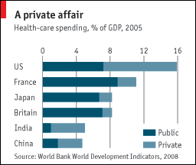
Health Care System
5% of Indians have healthcare
Less than 20% get care from doctors
More marketed than American model
66% of health expenditure paid out of pocket
Cheaper
Consumer friendly
Faster
Notes:
nearly four-fifths of all health services are supplied by private firms and charities—a higher share than in any other big country.
Technopak Healthcare, a consulting firm, expects spending on health care in India to grow from $40 billion in 2008 to $323 billion in 2023.

Slide 7
Incidence of Diabetes
20% of cases worldwide
Morality rate: > 5% of cases per year
80% deaths occur in low and middle income countries
By 2025 57 million will be affected

Slide 8
Prevention of Diabetes
Exercise
Weight loss
Fiber rich food
Low fat food
Low sugar food
Junk food= major cause of Type 2
Indians should have 6 small meals to enhance metabolism
Having meals at fixed times
Last meal at least 2 hours before bedtime
Regular checkups: blood pressure, cholesterol, sugar
Avoid food with high glycemic index
Spices: turmeric, fenugreek, and cinnamon
Bitter gourd juice
Indian blackberry
Avoid junk food
Patient teaching

Slide 9
Treatment of Diabetes
http://www.ndtv.com/video/player/news/romndtv/152068

