Slide 1
Coarctation of the Aorta
Jimmy, Sarah & Brian

Slide 2
Description
Localized narrowing near the insertion of the ductus arteriosus, which results in increased pressure proximal to the defect (head and upper extremities) and decreased pressure distal to the obstruction (body and lower extremities).

Slide 3
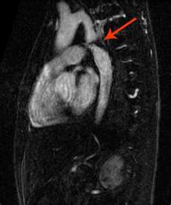
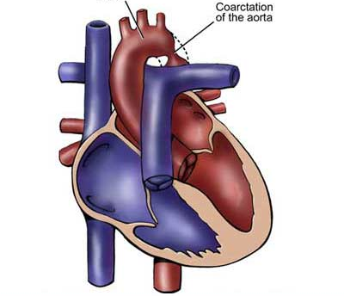
Pictures

Slide 4
Pathophysiology
The effect of a narrowing within the aorta is increased pressure proximal to the defect (upper extremities) and decreased pressure distal to it (lower extremities).

Slide 5
Clinical Manifistations
The patient may have high blood pressure and bounding pulses in the arms, weak or absent femoral pulses, and cool lower extremities with lower blood pressure.
There are signs of congestive heart failure in infants.
In infants with severe coarctation, the hemodynamic condition may deteriorate rapidly with severe acidosis and hypotension.
Mechanical ventilation and inotropic support are often necessary before surgery.

Slide 6
Clinical Manifistations
Older children may experience dizziness, headaches, fainting, and epistaxis resulting from hypertension. Patients are at risk for hypertension, ruptured aorta, aortic aneurysm, and stoke.

Slide 7
Surgical Treatment
Surgical repair is the treatment of choice for infants younger than 6 months of age, and for patients with long-segmented stenosis or complex anatomy; it may be performed for all patients with coarctation. Repair is by resection of the coarctated portion with an end-to-end anastomosis of the aorta or an enlargement of the constricted section using a graft of prosthetic material or portion of the left subclavian artery.

Slide 8
Surgical Treatment
Because this defect is outside the heart and pericardium, cardiopulmonary bypass is not required, and a thoracotomy incision is used. Postoperative hypertension is treated with IV sodium nitroprusside, esmolol, or milrinone followed by oral medications such as angiotensin-converting enzyme inhibitors or beta-blockers. Residual permanent hypertension after repair of COA seems to be related to the age and time of the repair.

Slide 9
Surgical Treatment
To prevent both hypertension at rest and exercise-provoked systemic hypertension after repair, elective surgery for COA is advised within the first 2 years of life.
There is a 15-30% risk of reoccurrence in patients who underwent surgical repair as infants.
Percutaneous balloon angioplasty techniques have proved to be effective in relieving residual postoperative coarctation gradients.

Slide 10
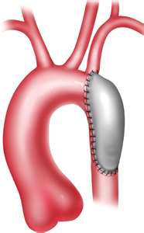
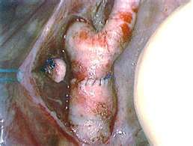
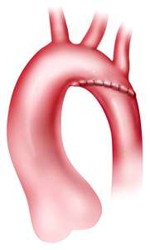
Pictures

Slide 11
Nonsurgical Treatments
Balloon angioplasty is being performed as a primary intervention for COA in older infants and children. In adolescents, stents may be placed in the aorta to maintain patency. Recent studies have demonstrated that balloon angioplasty is effective in children and aneurysm formation is rare. The high restenosis rate in young infants limits its application in this group.

Slide 12
Prognosis
Mortality is less than 5% in patients with isolated coarctation; risk is increased in infants with other complex heart defects.

Slide 13
Transposition of the Great Vessels

Slide 14
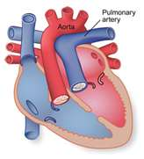
Description
The pulmonary artery leaves the left ventricle, the aorta exits from the right ventricle, with no communication between systemic and pulmonary circulations.

Slide 15
Pathophysiology
Associated defects such as septal defects or patent ductus arteriosis must be present to permit blood to enter the systemic circulation or the pulmonary circulation for mixing of saturated and desaturated blood.
Most common defects associated with TGA is a patent foramen ovale. At birth there is also a patent ductus arteriosis although it closes shortly after birth.

Slide 16
Pathophysiology
Another associated defect may be a ventricular septal defect (VSD). The presence of a VSD increases the risk of CHF because it permits blood flow from the right ventricle to the left ventricle into the pulmonary artery then into the lungs.
It produces high pulmonary blood flow under high pressure which can result in high pulmonary vascular resistance.

Slide 17
Clinical Manifestations
Depending on the type of defects and the size of the defects, newborns with minimum communication are severely cyanotic and have depressed function at birth.
Those with large septal defects or patent ductus arteriosis may be less cyanotic but have symptoms of CHF.
Heart sounds vary according to the type of defect present. Cardiomegaly is usually evident a few weeks after birth.

Slide 18
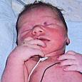
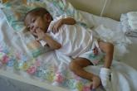
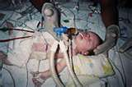
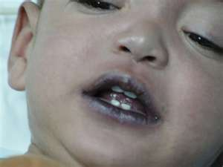
Pictures

Slide 19
Therapeutic Management
The administration of IV prostaglandin E₁ may be initiated to keep the ductus arteriosis open to temporarily increase blood mixing and provide an oxygen saturation of 75% or to maintain cardiac output. During cardiac catheterization or under echocardiographic guidance, a balloon arterial septostomy (Rashkind procedure) may also be performed to increase the mixing by opening the atrial septum.

Slide 20
Surgical Treatment
Aterial switch procedure is the treatment of choice within the first few weeks of life.
It involves transecting the great arteries, anastomosing the main pulmonary artery to the proximal aorta, just above the aortic valve, and anastomosing the ascending aorta to the proximal pulmonary artery.
The coronary arteries are switched from the proximal aorta to the proximal pulmonary artery to create a new aorta.

Slide 21
Surgical Treatment
Reimplantation of the coronary arteries is critical for the infants survival, and they must be reattached without kinking or torsion to supply the heart with its supply of oxygen.
The advantage of the procedure is reestablishment of normal circulation, with the left ventricle acting as the systemic pump.
Potential complications of the switch include narrowing of the great artery anastomoses and coronary artery insufficiency.

Slide 22
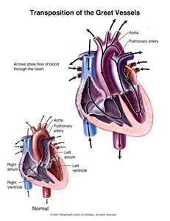
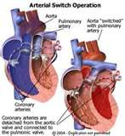
Pictures

Slide 23
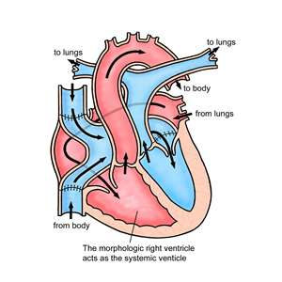
Surgical Treatment
Intraatrial Baffle Repairs
Rarely performed, although many adolescents and adults survive today with repairs that were done more than 15 years ago. An Intraatrial baffle repair is created to divert venous blood to the mitral valve and pulmonary blood to the tricuspid valve using the patients arterial septum. (Senning Procedure), or a prosthetic material (Mustard procedure).

Slide 24
Surgical Treatment
Disadvantages to this surgical repair is the continuing role of the right ventricle as a systemic pump and the late development of right ventricular failure and rhythm disturbances.
Other potential postoperative complications include loss of normal sinus rhythm, baffle leaks, ventricular dysfunction.

Slide 25
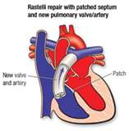
Surgical Treatment
Rastelli Procedure
This procedure is the operative choice for infants with TGA, VSD, and severe pulmoary stenosis.
It involves closure of the VSD with a baffle, so the left ventricular blood is directed through the VSD to into the aorta. The pulmonic valve is then closed, and a conduit is placed from the right ventricle to the pulmonary artery to create physiologically normal circulation. Unfortunately this requires multiple conduit replacements as the child grows.

Slide 26
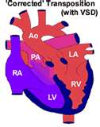

Slide 27
Prognosis
Operative mortality is less than 2%. Potential long term problems include suprapulmonic stenosis and neoaorta dilation and regurgitation.

