Slide 1
Coarctation of the Aorta
Jimmy, Sarah & Brian

Slide 2
Description
Localized narrowing near the insertion of the ductus arteriosus, which results in increased pressure proximal to the defect (head and upper extremities) and decreased pressure distal to the obstruction (body and lower extremities).

Slide 3
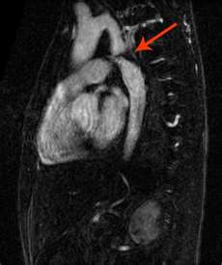
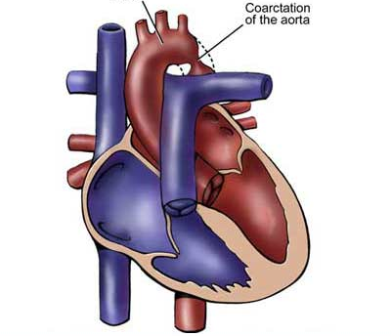
Pictures

Slide 4
Pathophysiology
The effect of a narrowing within the aorta is increased pressure proximal to the defect (upper extremities) and decreased pressure distal to it (lower extremities).

Slide 5
Clinical Manifistations
The patient may have high blood pressure and bounding pulses in the arms, weak or absent femoral pulses, and cool lower extremities with lower blood pressure.
There are signs of congestive heart failure in infants.
In infants with severe coarctation, the hemodynamic condition may deteriorate rapidly with severe acidosis and hypotension.
Mechanical ventilation and inotropic support are often necessary before surgery.

Slide 6
Clinical Manifistations
Older children may experience dizziness, headaches, fainting, and epistaxis resulting from hypertension. Patients are at risk for hypertension, ruptured aorta, aortic aneurysm, and stoke.

Slide 7
Surgical Treatment
Surgical repair is the treatment of choice for infants younger than 6 months of age, and for patients with long-segmented stenosis or complex anatomy; it may be performed for all patients with coarctation. Repair is by resection of the coarctated portion with an end-to-end anastomosis of the aorta or an enlargement of the constricted section using a graft of prosthetic material or portion of the left subclavian artery.

Slide 8
Surgical Treatment
Because this defect is outside the heart and pericardium, cardiopulmonary bypass is not required, and a thoracotomy incision is used. Postoperative hypertension is treated with IV sodium nitroprusside, esmolol, or milrinone followed by oral medications such as angiotensin-converting enzyme inhibitors or beta-blockers. Residual permanent hypertension after repair of COA seems to be related to the age and time of the repair.

Slide 9
Surgical Treatment
To prevent both hypertension at rest and exercise-provoked systemic hypertension after repair, elective surgery for COA is advised within the first 2 years of life.
There is a 15-30% risk of reoccurrence in patients who underwent surgical repair as infants.
Percutaneous balloon angioplasty techniques have proved to be effective in relieving residual postoperative coarctation gradients.

Slide 10
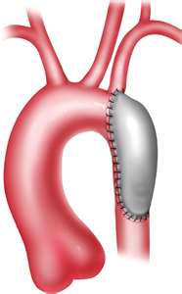
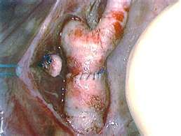
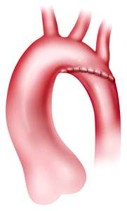
Pictures

Slide 11
Nonsurgical Treatments
Balloon angioplasty is being performed as a primary intervention for COA in older infants and children. In adolescents, stents may be placed in the aorta to maintain patency. Recent studies have demonstrated that balloon angioplasty is effective in children and aneurysm formation is rare. The high restenosis rate in young infants limits its application in this group.

Slide 12
Prognosis
Mortality is less than 5% in patients with isolated coarctation; risk is increased in infants with other complex heart defects.

