Slide 1
Organ Donation
June Baker
Heather Zeiter
Rachel Buie

Slide 2
Definitions
Brain Death: an irreversible, non-survivable brain injury, resulting in complete loss of functioning of the brain and brain stem.
Cardiopulmonary Death: irreversible cessation of circulatory and pulmonary functions
Imminent Death Referral: any patient with a severe acute brain injury who requires mechanical ventilation, and is in an intensive care unit, and whose clinical findings are consistent with a Glasgow Coma Scale (GCS) of 3-5, or for whom physicians are evaluation a diagnosis of brain death.

Slide 3
Definitions Con’t
First Person Consent: legally binding consent for donation completed by the individual prior death and accessed through the Ohio Donor Registry
Potential Organ Donor: Any person who has suffered a lethal, or potentially lethal, head injury or disease and is hemodynamically maintained with mechanical ventilation and is in the critical care setting.
Potential Tissue Donor: any person who has suffered cardiopulmonary death in any unit of the hospital

Slide 4
Criteria for Organ Donation
The patient has an irreversible neurological illness or injury with a hopeless prognosis requiring ventilator support.
The patient, family, or other authorized party has chosen to discontinue life support.
The patient is expected to expire soon after termination of life support.
Medical suitability for donation after cardiac death will be determined by LifeBanc.

Slide 5
FRMC Policies and Procedures
Registration for Charges and Billing
Routine Notification for Organ/Tissue Donor Identification
Organ/Tissue Donation after Cardiac Death
Notification of Death/Release of Body/Body Parts Documentation Guideline

Slide 6
Organ Donation After Circulatory Death
“A 2010 survey by Fugate and colleagues found great variety in hospital variability in hospital policies on DCD (organ donation after circulatory death); nearly half of hospitals that have such policies don’t define criteria for determining circulatory death” (Beach 36).

Slide 7
Organ Donation After Circulatory Death Con’t
OHIO
UNITED STATES
1,306 Kidney
235 Liver
26 Pancreas
106 Heart
115 Lung
6 Intestine
59 Kidney/Pancreas
2 Heart/Lung
87, 797 Kidney
16, 101 Liver
1, 404 Pancreas
3, 185 Heart
1, 795 Lung
260 Intestine
2, 249 Kidney/Pancreas
69 Heart/Lung

Slide 8
Speaking Up for Organ Donors
“Whether mechanically ventilated, brain-dead body still functions as a living person-a whole, integrated organism-is a matter of ongoing mystery and debate” (Linde 28).
The Uniform Determination of Death Act defines brain death as “irreversible cessation of all function of the brain, including the brain stem” (Linde 28).
“Three cardinal finding in brain death are coma or unresponsiveness, absence of brainstem reflexes, and apnea” (Linde 28).

Slide 9
Consent for Organ Donation
“Around 50% of those who would wish to donate after death have discussed this with family member” (Vincent and Logan 81).
Factors that influence consent for organ donation
Time and Setting
Emotional Support and Empathy

Slide 10
Organ and Tissue
DBD
DCD
Donation after brain death
“Donors have suffered a catastrophic brain injury, and brain death criteria have been met” (Phillips 32).
Donation after circulatory death
“Donors are unlikely to progress to brain death, but have poor prognosis” (Phillips 32).

Slide 11
Saving the Unseen Patient
“I never learned her name or anything about her. But I do know that our work was a success, because our patient gave five other people the chance she never had…the chance to live” (Cramer).

Slide 12
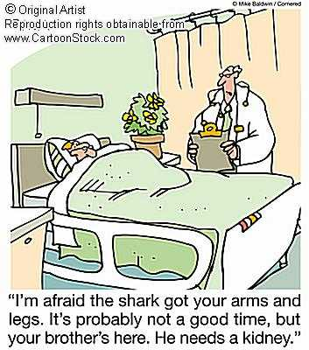

Slide 13
Works Cited
Beach, P. R., Hallett, A. M., & Zaruca, K. (2011). Organ Donation After Circulatory Death: Vital Partnerships. AJN The American Journal of Nursing, 111(5), 32.Cramer, C. (1996).
Linde, E. B. (2009). Consider the ethical issues raised by organ donation, such as how to define death. Then examine your own opinions. Nursing2012, 39(1), 28-31.
Phillips, D. M. (2013). Organ and tissue donation basics. Nursing made Incredibly Easy, 11(1), 30-36.
Saving the Unseen Patient. AJN The American Journal of Nursing, 96(9), 80.
Vincent, A., & Logan, L. (2012). Consent for organ donation. British journal of anesthesia, 108(suppl 1), i80-i87.

