Slide 1

DIABETES MELLITUS IN CHINA
MOLLI KOCHENSPARGER & BRIANNE DORITY
NCA1 2013

Slide 2
A BRIEF OVERVIEW OF CHINA
1,343,239,923 total population
35.5 avg. age (34.9M/36.2F)
12.31 births/1,000
7.17 deaths/1,000
1.415 physicians/1,000 population
4.06 hospital beds/1,000 population
adult obesity prevalence 2.9%
Notes:
China’s population is 23% of the world’s total population.
Health expenditures = 4.6% of the GDP, which is close to 5 trillion $

Slide 3
OVERVIEW CONTINUED…
>170M still <$1.25/day
Literacy rate = 92.2%
Communist
Capital = Beijing 14.9M
Various religions
Mountainous land
Country split
3 largest country in world
Notes:
-In 2011, more than 170 million Chinese were still living below the poverty level of <$1.25/day
-China is a communist government
-Religions = official atheist, Buddhist, Christian 3-4% and Muslim 1-2% of the population
-China split into Providences, Autonomous regions and municipalities
-3rd largest country in the world behind Russia & Canada

Slide 4
NUMBER OF PEOPLE IMPACTED YEARLY
China has become the world’s capital of diabetes
An estimated 92 million Chinese adults ages 20 and older have diabetes
“For every person in the world with HIV there are three people in China with diabetes,"
60 percent of those cases are still undiagnosed, the researchers found
Plus, over 148 million adults were estimated to have pre-diabetes
In China, 60.7% are undiagnosed, and this is likely to result from the combination of poor public awareness and limited opportunities for diagnosis

Slide 5
Number of people living with diabetes mellitus
more than 92 million adults in China have diabetes,
nearly 150 million more are well on their way to developing it.
An estimated 23.46 million people currently have diabetes
That number is predicted to increase to 42.30 million by 2030

Slide 6
ANNUAL COST OF DIABETES MELLITUS IN CHINA
An average of $194 a year is spent treating each diabetes patient in China, versus more than $5,000 in developed countries such as the U.S.
Even as China’s health spending is forecast to almost triple to $1 trillion over the next eight years.
China’s diabetes drugs market will expand 20 percent annually to reach 20 billion Yuan
($3.2 billion) by 2016

Slide 7
ANNUAL COST CONTINUED…
For the international drug makers for the international drug makers, diabetes offers riches, with global sales of diabetes medicines expected to reach $48-$53 billion by 2016, up from $39.2 billion in 2011, according to research firm IMS Health. rs, diabetes offers riches, with global sales of diabetes medicines expected to reach $48-$53 billion by 2016, up from $39.2 billion in 2011, according to research firm IMS Health.
CDS and IDF estimate that 13% of total medical expenditures in China are directly caused by diabetes: RMB 173.4 billion or US$25 billion. People with diabetes in China report 3 to 4 times more in-patient care, out-patient visits, and emergency room visits than people without diabetes of the same age and sex
According to IDF estimates, the latest prevalence figures emerging from China will mean healthcare expenditure on diabetes in the country this year will increase by at least US$1.9 billion, reaching a total of US$ 6.9 billion.

Slide 8
Preventing diabetes mellitus in china
intensive blood glucose and blood pressure control
use of lipid-lowering agents, screening for and treating diabetic retinopathy, active care of feet
are known to be cost-effective, and many of these interventions also are cost-saving,

Slide 9
PREVENTING DM CONTINUED…
IDF’s member association in China, the Chinese Diabetes Society, is working with Chinese health officials to promote education and self-management of the condition, which is vital in dealing with diabetes.
a three-year project to train 100,000 community-level doctors across China in diabetes prevention and treatment was launched. The project also features a web-based learning platform expected to deliver diabetes training to over 400,000 subscribers every year. Another project provided training in glucose management for 1,000 community-based healthcare providers.
intensive lifestyle interventions involving a combination of diet and physical activity can delay or prevent diabetes among persons at high risk.

Slide 10
Treating diabetes mellitus in china
Chinese medicine easier accessible
TCM
Ministry of Health Organization
Acupuncture
Mixing medicine therapies
New drugs for treatment
Anti-diabetic medications
Notes:
-Chinese medicine developers are searching for an agent that will offer lower-cost, effective treatment of DM patients.
-TCM = traditional Chinese medicine. This type of medicine is given to help to with the symptoms & clinical characteristics of DM.
-acupuncture is being prescribed to eliminate the progression of diabetes’s complications & help deal with any symptoms.
-a lot of patients are going to different providers and receiving both Eastern & Western treatments, though there have been no studies or proof to show that this way is safe and tolerable for patients
-The Ministry of Health Organization is piloting a program to cover certain chronic diseases, including those of kidney failure that can stem from dialysis treatments.
-In the next 3-6 years, many new oral & injectable medications are set to debut in clinical settings.
-There is a very limited number of anti-diabetic medications in China; they include: metformin, insulin & sulphonylureas.

Slide 11
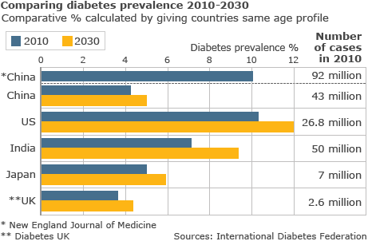

Slide 12


Slide 13
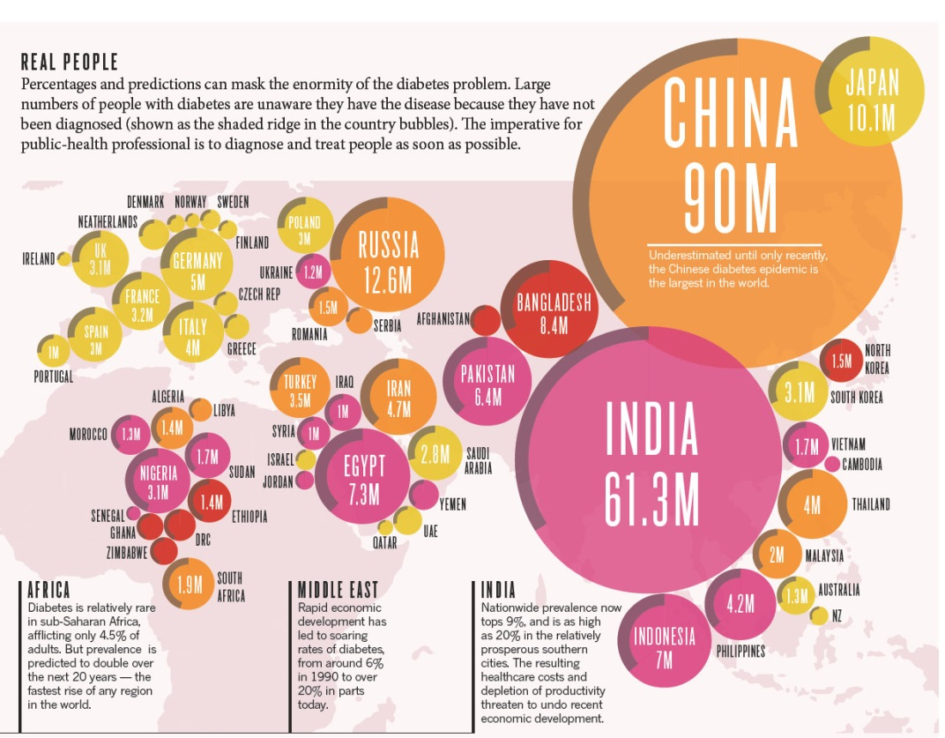

Slide 14
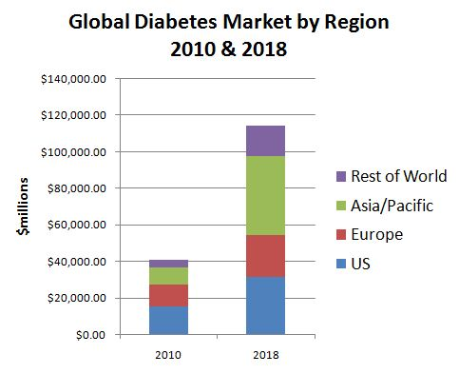

Slide 15
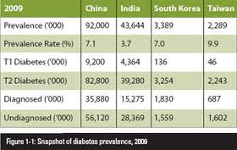

Slide 16
References
BloomBerg News (2012). China Diabetes Triples Creating $3.2 Billion Drug Market. [ONLINE] Available at: http://www.bloomberg.com/news/2012-11-04/china-diabetes-triples-creating-3-2-billion-drug-market.html. [Last Accessed 01 February 2013].
(2005). China Facts and Figures. [ONLINE]. Available at: http://www.infoplease.com/ipa/A0107411.html?pageno=19. [Last accessed 3 February 2013].
(2010). China spends RMB 173.4 billion (US$25 billion) a year on diabetes treatment. [ONLINE] Available at: http://www.idf.org/china-spends-rmb-1734-billion-us25-billion-year-diabetes-treatment. Last Accessed 01 February 2013].
Frederik Joelving (2010). China becomes world's new diabetes capital. [ONLINE] Available at: http://www.reuters.com/article/2010/03/24/us-china-diabetes-idUSTRE62N66220100324. [Last Accessed 01 February 2013].
(2013). General Information of the People's Republic of China (PRC). [ONLINE] Available at: http://www.chinatoday.com/general/a.htm. [Last accessed 3 February 2013].
Hornby, L. (2012). China diabetics raise stakes for healthcare reform. [ONLINE] Available at: http://www.reuters.com/article/2012/03/25/us-china-diabetes-idUSBRE82O04E20120325. [Last accessed 03 February 2013].
(2010). New diabetes figures in China: IDF press statement. [ONLINE] Available at: http://www.idf.org/press-releases/idf-press-statement-china-study. [Last Accessed 01 February 2013].
Pharmacol, J., (2006). Type 2 diabetes in China: partnerships in education and research to evaluate new antidiabetic treatments. [ONLINE] Available at: http://www.ncbi.nlm.nih.gov/pmc/articles/PMC1885117/. [Last accessed 3 February 2013].

