Slide 1
Chapter 28
Newborn at Risk

Slide 2
Acquired and Congenital Problems
Conditions or circumstances superimposed on the normal course of events associated with birth and adjustment to extrauterine existence.
  Birth Trauma
  Maternal Substance Abuse
  Infection
  Congenital anomalies

Slide 3
Birth Trauma
Birth injuries may be avoidable
  Ultrasonography allows antepartum diagnosis of macrasomia, hydrocephalus, and unusual presentation
  Elective cesarean birth chosen for some pregnancies to prevent significant birth injury
Small percentage of significant birth injuries are unavoidable despite skilled and competent obstetric care
  Especially with difficult or prolonged labor
  When infant is in an abnormal presentation

Slide 4
Birth Trauma: Care Management
Soft Tissue injuries:
  caput succedaneum, cephalhematoma, subconjunctival and retinal hemorrhages, erythema, ecchymoses, petechiae, abrasions, lacerations, edema
Skeletal Injuries:
  linear and depressed skull fractures, clavicle, humerus, and femur fractures
Peripheral Nervous System Injuries:
  Brachial palsy (
  Facial palsy (
  Phrenic nerve injury (
    Infants will usually require mechanical ventilation with this

Slide 5
Birth Trauma: Care Management
Central Nervous System Injuries
  Intracranial hemorrhage: can be related to birth trauma or hypoxia
    Subdural hematoma: life-threatening
    Subarachnoid hemorrhage: most common
  Spinal cord injuries:
    Almost always a result of breech births, rarely seen today because cesarean birth is used for breech presentation

Slide 6
Neonatal Infections
Sepsis: significant cause of neonatal morbidity and mortality due to immature immune system-increased risk of infection
  Increase risk of neonatal infection with prolonged rupture of membranes
  Bacteria infections:
    Early onset or congenital: usually manifests within 24 hours of birth and progresses more rapidly than later onset infections
      Caused by organisms in the maternal vaginal tract: group B-streptococci, Haemophilus influenzae, Listeria monocytogenes, Escherichia coli, Streptococcus pneumoniae
    Nosocomial infection- late onset: most commonly seen after two weeks of age and is slower in progression. Bacteria may be acquired from the birth canal or the external environment.
      Caused by Staphylococcus aureus, Staphylococcus epidermidis, Pseudomonas organism, and group B-streptococci.
Notes:
GBS can be tested at 37 weeks
Nosocomial: mainly caused by improper handwashing

Slide 7
Neonatal Infections
Viral infections: may cause miscarriage, stillbirth, intrauterine infection, congenital malformations, and acute disease.
Fungal infections: of greatest concern in immuno-compromised or premature infant.
    Thrush a fungal infection that may be found in a healthy term neonate
Septicemia: a generalized infection in the bloodstream.
  Pneumonia most common form of neonatal infection
  Bacterial meningitis another form of infection
  Gastroenteritis is sporadic, depends on epidemic outbreaks
Notes:
Viral: toxoplasmosis
Fungal: have to treat mom and baby to avoid passing back and forth; boil everything; very hard to get rid of
Septicemia
-GI example is rotavirus

Slide 8
Neonatal Infections
Perinatally acquired infections
  Toxoplasmosis
  Gonorrhea
  Syphillis
  Varicella-zoster
  Hepatitis B virus
Notes:
Toxoplasmosis: transmitted from cats (cleaning litter box without washing hands); can cause miscarriage
No pregnant woman should handle cat litter
Gonorrhea: contracted after ROM, and invade eye, mouth, and rectum of baby; can recover if treated correctly
Syphillis: pregnant woman must be treated immediately; baby is considered contagious and must be put on contact precautions
Varicella-zoster: transmission from mom to baby during 1st trimester often fatal
Hepatitis B virus: all moms tested at beginning of pregnancy; babies born to (+) mom can be chronic carrier, and have no symptoms at birth

Slide 9
Perinatally acquired infections
  HIV and AIDS: prenatal treatment reduces risk of transmission to fetus
    Important that expectant mothers be tested so that steps can be taken to prevent transmission
  Rubella infection: congenital abnormalities most severe when infection occurs during first trimester
    Immunization NEVER given to pregnant woman
  Cytolomegalovirus infection: most common cause of congenital viral infections in humans, but only occasionally are critically affected newborns seen
    Can be transmitted through breast milk while the mother is experiencing acute CMV syndrome
  Herpes simplex virus: neonate can acquire virus via transplacental infection, ascending infection by way of the birth canal, direct contamination during passage through infected birth canal, direct transmission from infected person
    Most infants infected during passage through birth canal
    Caregiver should wear gloves when handling infants
    Careful inspection of infants for lesions
Notes:
HIV/AIDS: not mandatory in Ohio; treated pregnancies prevent transmission in 98%
Rubella: immunization to mom can cause stillbirth
CMV
Herpes simplex virus: in moms with outbreak, can transmit to baby and baby can die
Any signs of outbreak will be delivered by c-section
Virus attacks babies’ brain
Nurse needs to wear gloves in caring for exposed infant to prevent transmission to nurse

Slide 10
Bacterial infections
  Group B streptococcus
    Most common cause of neonatal sepsis and meningitis
    Prophylactic ATB given to mothers with risk factors during labor decrease the incidence
  Tuberculosis
    Increasing cases in U.S., Untreated neonatal TB is almost always fatal
  Chlamydia infection
    Causes neonatal conjunctivitis and pneumonia
    Treated with oral antibiotics as prophylaxis as well as eye prophylaxis
Fungal Infections
  Candidiasis
    Acquired from maternal vaginal infection during birth, contaminated hands, bottles, nipples
    Treatment by eradicating causative organism
    Hand washing and cleanliness important for preventing re-infection
Notes:
GBS: found in normal flora of bowel; can be caused by improper wiping, frequent diarrhea, short perineum
Moms given antibiotics to prevent transmission
TB: increasing in this area d/t migrant farm workers
Chlamydia: eye med given prophalactic to prevent

Slide 11
Substance Abuse
Alcohol
  Fetal Alcohol syndrome: neonatal effects
Tobacco: associated with low birth weight for full term infants
Marijuana: crosses the placenta
    Higher incidence of shortened gestation, IUGR, and meconium staining
Cocaine: infant suffers from neurotoxic effect of drug
  Risk for multiple defects and abnormalities
PCP: infant may exhibit abnormal behaviors such as jitteriness, irritability, hypertonicity
Notes:
Increased incidence in lower socioeconomic status
Alcohol: SGA, smaller eyes, thin upper lip, hyperactive, ADHD, IQ deficit, diminished motor skills, speech issues
No alcohol is deemed safe
Tobacco: LBW d/t vasoconstriction, increased miscarriage and preterm birth, secreted in breastmilk; babies are often fussy d/t withdrawal
Marijuana:
Cocaine: SGA baby, moms at risk for abruptio placentae
PCP:

Slide 12
Heroin: crosses the placenta often resulting in IUGR
  Fetal withdrawal: jittery, hyperactive, shrill and persistent cry, frequent yawning or sneezing, poor feeding and sucking, tachypnea, vomiting, diarrhea, hypothermia, sweating, abnormal sleep cycle
  Withdrawal requires treatment
Methadone: crosses the placenta
  Withdrawal resembles heroin withdrawal but tends to be more severe and prolonged with higher incidence of seizures
  Treatment of withdrawal similar to that for heroin
Misc. Substances
  Meth
  Phenobarbitol
  Caffeine
Notes:
Heroin
Withdraw is quite prominent, and requires treatment
Methadone:
Misc. Substances
Meth: increased risk of cleft palates and cardiac defects
Phenobarbitol
Caffeine

Slide 13
Hemolytic Disorders
Occur when maternal antibodies are present naturally or form in response to antigen from fetal blood crossing placenta and entering maternal circulation
  Rh incompatibility
    Only Rh-positive offspring of Rh-negative mother is at risk
    If fetus is Rh positive and mother Rh negative, mother forms antibodies against fetal blood cells
    In subsequent pregnancies, fetus at risk for fetal hemolytic anemia unless mother received Rho(D) immune globulin
  ABO incompatibility: more common than Rh incompatibility
    Occurs if fetal blood type is A, B, or AB and maternal type is O
    Incompatibility arises because naturally occurring anti-A and anti-B antibodies are transferred across placenta to fetus
      Common cause of hyperbilirubinemia
Notes:
If mom is type A, type O, or negative, baby will have further testing of cord blood
These infants are at increased risk for developing jaundice d/t hemolytic reaction

Slide 14
Hemolytic Disorders
Other hemolytic disorders
  Other metabolic and inherited conditions that increase hemolysis and may cause jaundice in the infant
    Galactosemia
    Crigler-Najjar disease
    Hypothyroidism

Slide 15
Congenital Anomalies
Most common major congenital anomalies that cause serious problems in neonate are:
  Congenital heart disease
  Abdominal wall defects
  Imperforate anus
  Neural tube defects
  Cleft lip or palate
  Clubfoot
  Developmental dysplasia of the hip

Slide 16
Congenital Anomalies
Central nervous system anomalies: result from defects in the closure of the neural tube during fetal development
  Spina bifida: most common CNS defect
    Spina bifida occulta: posterior laminas fail to close, but the spinal cord and meninges do not herniate or protrude through the defect
    Spina bifida cystica: (sac that contain meninges and CSF and protrudes through the defect in the spinal column
      Exposed sac should be covered with sterile, moist, nonadherant saline dressing. Protect the sac from injury.
  Encephalocele and anencephaly
    Encephalocele is herniation of the brain and meninges through a skull defect
    Anencephaly is absence of both cerebral hemispheres and overlying skull (not compatible with life)
Notes:
Spina bifida: most common CNS defect

Slide 17
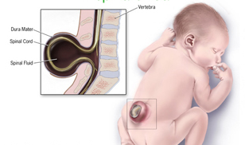
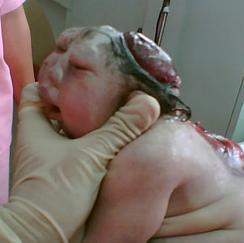
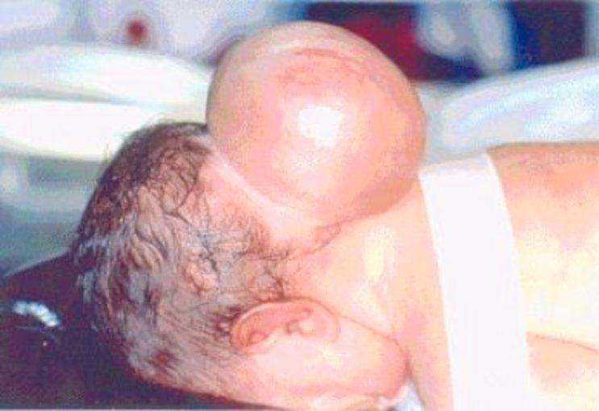

Slide 18
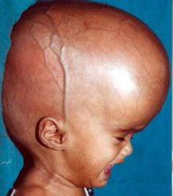
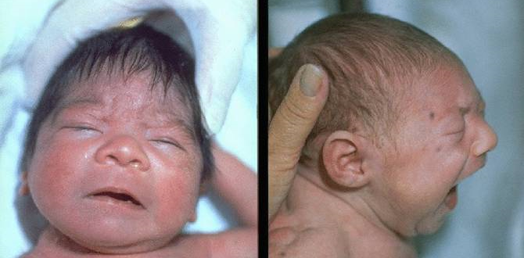
Congenital Anomalies
Central nervous system
  Hydrocephalus: ventricles of brain are enlarged due to imbalance of production and absorption of CSF
    Head circumference will increase at abnormal rate and will initially see a bulging anterior fontanel
    Surgical shunting required soon after birth to prevent brain damage
  Microcephaly: small brain in a normally formed head
    No treatment, will result in some type of cognitive impairment

Slide 19
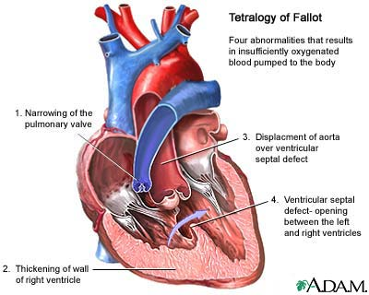
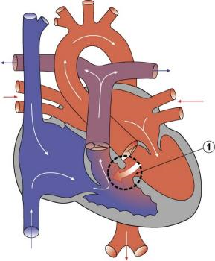
Congenital Anomalies
Cardiovascular system: congenital heart defects often evident immediately after birth
  Ventricular septal defects
  Tetralogy of Fallot (four defects)

Slide 20
Congenital Anomalies
Respiratory system
  Choanal atresia: most common congenital anomaly of the nose
    Is a bony or membranous septum located between the nose and the pharynx
    Infant requires emergency surgery to repair
  Laryngeal web: results from incomplete separation of the two sides of the larynx
  Congenital diaphragmatic hernia: displacement of abdominal organs into thoracic cavity
    Can cause severe respiratory distress
    Can be minimal to severe and requires surgical intervention
Notes:
Choanal atresia: checked for by plugging one side of nose, then the other
Requires emergency surgery d/t babies being nose breathers

Slide 21
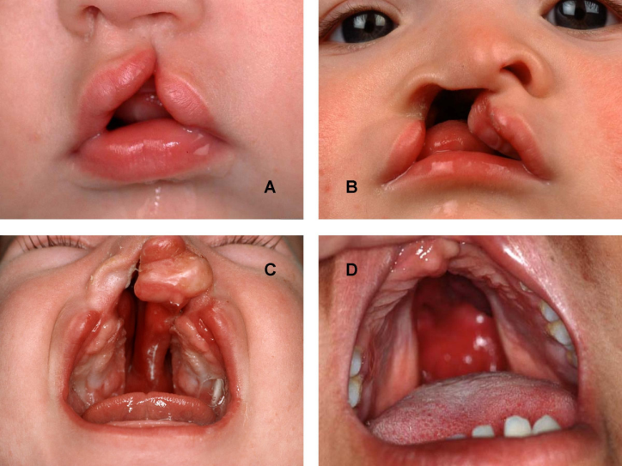
Congenital Anomalies
Gastrointestinal system
  Cleft lip and palate: special considerations with feeding
    Factors that may lead to the development of cleft lip and palate
  Esophageal atresia: esophagus ends in a pouch, is not connected to the stomach
    Results in excessive drooling and feeding intolerance
  Tracheoesophageal fistula: abnormal connection between the esophagus and trachea
    Results in respiratory distress
Notes:
Cleft lip/palate: period of time until treatment depends on severity of defect; often prefer to weight to have time for tissue expanders
Best method of feeding for these babies is breastfeeding
Formula fed babies need special nipples/bottles to be able to eat

Slide 22
Congenital Anomalies
  Omphalocele: herniation of ABD organs into umbilical ring- is covered by a peritoneal sac
  Gastroschisis: herniation of bowel through a defect in ABD wall- is not covered by a membrane
  Intestinal obstruction: can be caused by atresia (obliteration of the passage), partial obstruction, or malrotation (twisting) of intestine
  Anorectal malformations: no anal opening, may be a fistula from the rectum to the perineum or genitourinary system
Notes:
Meconium ileus caused by impacted meconium and I earliest symptom of CF

Slide 23
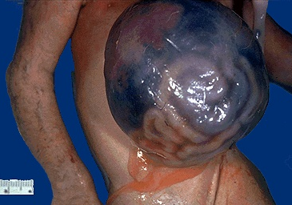
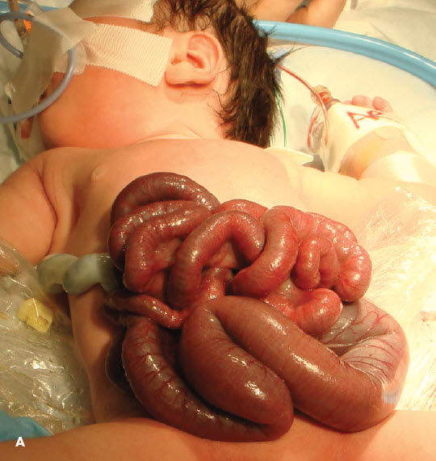

Slide 24
Congenital Anomalies
Musculoskeletal system anomalies
  Developmental dysplasia of hip: instability of hip
    Acetabular dysplasia or preluxation, subluxation, dislocation
  Clubfoot:
    Talipes varus-inversion or bending inward
    Talipes valgus-eversion or bending outward
  Polydactyly
    Hands or feet with extra digits
    Hereditary
Notes:
Dysplasia of hip: tested for with Ortilani’s maneuver
Clubfoot: often repaired by progressive casting; may need surgical repair depending on severity
Polydactyly: if no bone, they may tie it off and let it fall off; if bone is present, it may be left alone
Risk of leaving digit with no bone is choking hazard d/t sucking

Slide 25
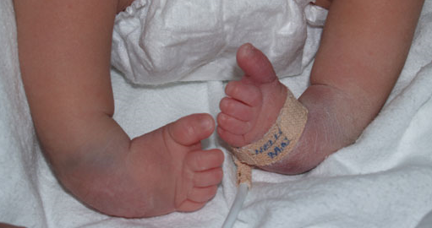
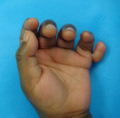

Slide 26
Congenital Anomalies
Genitourinary system
  Hypospadias: abnormally located urinary meatus
  Epispadias: failure of urethra canalization
  Exstrophy of bladder: abnormal development of bladder, ABD wall, and symphysis pubis that causes the bladder, urethra, and ureteral orifices to be exposed
  Ambiguous genitalia
  Teratoma:
  Treated with surgical resection as it likely hood of malignancy increases rapidly
Notes:
Hypospadias: on penis
Epispadias: bottom of penis remains open
Teratoma: embryonal tumor that may occur in the skull, mediastinum, abdomen, or sacral area
Likelihood of malignancy increases rapidly
Ambiguous genitalia: tested for by genetic testing; can also do ultrasounds to see what reproductive organs were present

Slide 27
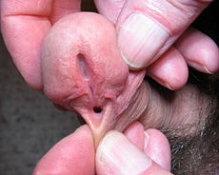
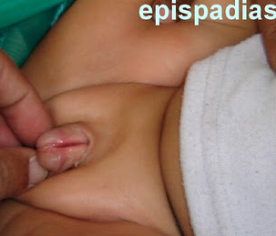
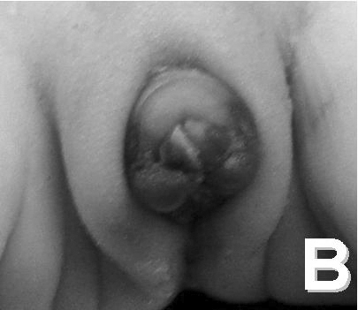
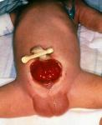

Slide 28
Key Points
Identification of maternal and fetal risk factors in antepartum and intrapartum periods is vital for planning adequate care of high risk infants
Infection in newborn may be acquired:
  In utero, at birth, in breast milk, within nursery
Preterm infants are at risk for problems related to immaturity of organ systems
Hyperbilirubinemia has variety of etiologic factors, including maternal-fetal Rh and ABO incompatibility
Injection of Rho(D) immune globulin in Rh-negative and Coomb’s test negative women minimizes possibility of isoimmunization

Slide 29
Key Points
Nurse often observes signs of newborn drug withdrawal and neonatal abstinence syndrome and obtains information from maternal history
Parents often need special instructions before they take home a high risk infant
  CPR
  Oxygen therapy
  Nutrition requirements
Supportive care given to parents of infants with an abnormal condition must begin at birth or at time of diagnosis and continue for years

