Slide 1
Chapter 27 Infants with Gestational Age Related Problems
Notes:
Pearls for Ch. 27
Complications of prematurity
Complications of oxygen therapy
Growth and development
Parental adaptation
Meconium aspiration syndrome
Persistent pulmonary hypertension

Slide 2
High Risk Newborn
High risk infant classification
Birth weight
Gestational Age
Predominate pathophysiologic problems
Necrotizing enterocolitis
Growth failure
Bronchopulmonary dysplasia
Intraventricular and periventricular hemorrhage
Retinopathy of prematurity

Slide 3
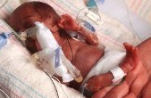
The Preterm Infant (Infants born before 37 weeks gestation)
Cause of preterm birth unknown
Organ systems are immature and lack adequate physiologic reserves for preterm infant to function in extrauterine environment
Potential problems and needs of preterm infant weighing 2000g differ from those of term, post-term, or post-mature infant of equal weight
Notes:
Preterm Infant: those born before 37 weeks gestation
Cause unknown, but incidence highest among low socioeconomic status population
Likely d/t lack of prenatal care
Gestational hypertension
Maternal infection
Multifetal pregnancy
HELLP syndrome
Premature dilation of cervix
Placental or cord conditions that affect the fetus’s reception of nutrients
Presence of physiologic disorders and anomalies affect response to treatment
The lower the birth weight and GA, the lower the chances of survival

Slide 4

Late Preterm Infant
Born between 34 and 36 6/7 weeks of gestation
An accurate assessment of the gestational age of high risk infants is critical for assisting the nurse in identifying potential problems the newborn may experience.
Notes:
Late Preterm Infant: born between 34 and 36 6/7 week gestation
Lower risk than early preterm infants but still at increased risk
Feeding problems
Neurodevelopment
Thermoregulation
Hypoglycemia
Hyperbilirubinemia
Sepsis
Respiratory function
LBW, VLBW, ELBW: based on weight at birth, regardless of GA
AGA, SGA, LGA: based on placement within or outside of 10-90% range
Preterm: born before 37 weeks
Late preterm: born 34 0/7 to 36 6/7 weeks
Full term: born between 38 and completion of 42 weeks
Postterm: born after 42 weeks

Slide 5
Nursing Care Management: Assessment
Respiratory function: the preterm infant is likely to have difficulty making the pulmonary transition from intrauterine to extrauterine life- numerous problems that can cause respiratory distress or apnea
Decreased # of functional alveoli
Deficient surfactant levels
Smaller airway lumen
Decreased tracheal cartilage
Obstruction of respiratory passages
Insufficient calcification of bony thorax
Circulating hormones (prostaglandins) that affect CV function
Immature and fragile pulmonary vasculature
Greater distance between functional alveoli and capillary bed

Slide 6
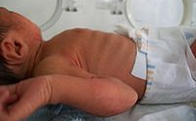
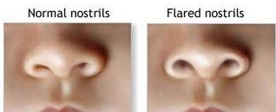
Nursing Care Management: Assessment
Early signs of respiratory distress:
Nasal flaring, grunting, retractions, increasing respiratory effort, decreased Pa02
Can progress quickly, nurse should be prepared to administer oxygen or assist with ventilation as necessary
Notes:
Respiratory distress
Tachypnea, nasal flaring, expiratory grunting
Retractions may begin as subcostal, intercostal, or suprasternal
Acrocyanosis is normal finding in neonate; central cyanosis indicates poor oxygenation
Must provide supplemental oxygen and artifical ventilation when signs show inability to initiate or maintain respiratory function
CV Distress
Symptoms of hypovolemia, shock or both require action
Prolonged capillary refill, pale color, poor muscle tone, lethargy, tachycardia initially, then bradycardia
Continued respiratory distress despite giving oxygen and supporting ventilation
Hypotension may be present or appear as late sign of shock

Slide 7
Nursing Care Management: Assessment
Body Temperature: issues due to
Large SA in relation to body weight
Minimal subq fat
Limited store of brown fat (heat source)
Decreased or absent reflex control of skin capillaries
Inadequate muscle mass activity
Poor muscle tone
Immature temperature regulation in brain
Increased insensible water loss
Decreased ability to increase oxygen consumption
Decreased caloric intake
Central Nervous System
Notes:
Goal of thermoregulation is a neutral thermal environment
Oxygen consumption and BMR are minimal but adequate
CNS Issues
Birth trauma with damage to immature intracranial structures
Bleeding d/t fragile capillaries
Impaired coagulation process, and prolonged bleeding times
Recurrent hypoxic and hyperoxic episodes
Predisposed to hypoglycemia
Fluctuating systemic BP with concommitant variation in cerebral blood flow and pressure
5 Categories of manifestations require careful evaluation
Seizure activity
Hyperirritability
CNS depression
Elevated ICP
Abnormal movement such as decorticate posturing
Reflexes should be present by 28 weeks and should be evaluated

Slide 8
Nursing Care Management: Assessment
Nutritional Status:
Weak/absent suck, swallow and gag reflexes
Small stomach capacity and weak abdominal muscles
Metabolic functions also compromised by limited store of nutrients, decreased ability to digest proteins and absorb nutrients, and immature enzyme systems
Some infants may require IV or gavage feeding instead of oral feeding
Renal Function: preterm infant renal system unable to:
Adequately excrete metabolites and drugs
Concentrate urine
Maintain acid-base, fluid, or electrolyte balances
Notes:
Initial goal for nutrition: prevent catabolism and excess fluid loss
After stabilization, goal is: promote optimal growth and development
Renal Function
I&O, specific gravity must be assessed
Labs for assessment of acid-base and electrolyte balance
Medication levels to ensure therapeutic range

Slide 9
Nursing Care Management: Assessment
Hematologic Status:
Increased tendency to bleed
Slowed production of RBC
Loss of blood (due to frequent laboratory testing)
Decreased RBC survival
Infection prevention:
Protection from infection integral to infant care
Strict hand washing
Person’s with infectious disorders not allowed on unit
Skin Care: increased sensitivity and fragility
Use skin products with caution
Avoid adhesives
Use of skin barriers to protect healthy skin
Notes:
Hematologic Monitoring
Assess for evidence of bleeding from punctures, GI tract, and pulmonary system
Monitor for s/s anemia
Monitor to prevent excess blood draws for labwork
Infection prevention
Strict handwashing
Infectious persons barred from unit
Standard precautions in all nursery areas

Slide 10
Nursing Care Management
Parental adaptation to preterm infant
Parental tasks: psychologic tasks must be accomplished before effective relationships and parenting patterns can evolve
Parental responses: Progress through stages as they interact with infant (eventually need to assume care of infant – bathing, feeding, etc)
Parenting maladaptation: incidence of physical and emotional abuse is greater in infants because of preterm birth/illness were separated from parents for a time after birth
Parents may have anxiety, financial burden, unresolved anticipatory grief, or impaired self- esteem
Notes:
Experiencing anticipatory grief
Mom accepts failure to give birth to healthy baby
Resuming relating to infant
Learning special needs
Adjusting home environment
Grandparents may show grief
Siblings may be angry with time spent with baby
Maladaptation
Resources should be made available for parent’s feeling
Proper guidance and counseling, including aftercare are available
Factors surrounding birth may predispose parents to rejecting infant
Parental anxiety, unmet personal expectations surrounding bith experience, financial burden of infant’s care, unresolved anticipatory grief, threat to self-esteem, infant being product of unwanted pregnancy, or discord in relationship with partner
Goal of healthcare professionals is early identification of inadequate coping skills and dysfunctional parenting to prevent further problems and enable early intervention

Slide 11
Implementation of Nursing Care
Goal to provide preterm infant with extrauterine environment that promotes normal growth and development
Physical Care: environmental support
Incubator/radient warmer to control body temp
Oxygen administration
Monitoring of respiratory and cardiac function
Assistive positioning devices
Clustering of care and minimal stimulation/handling
Maintaining body temp: gradual warming of hypothermic infant (rapid changes in temp may cause apnea or acidosis)
Gradual weaning from incubator as well
Pattern of steady weight gain and absence of poor feeding, respiratory distress, or temperature instability are appropriate measure of effectiveness of weaning to open bassinet

Slide 12
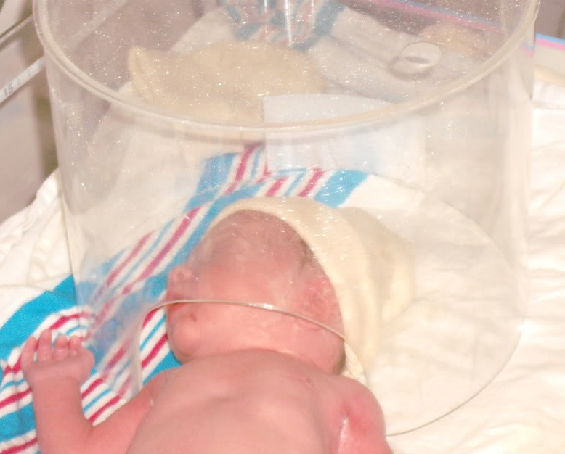
Implementation of Nursing Care
Oxygen therapy: oxygen should be warmed and humidified
Oxygen therapy administration:
Oxygen hood, nasal cannula, mechanical ventilation, surfactant administration
Weaning from oxygen therapy
Is done gradually with continued monitoring
Some infants may still require some type of oxygen therapy on discharge
Notes:
Oxygen hood
Nasal cannula: for infants who require low concentrations of supplemental oxygen
Continuous distending pressure:CPAP; may preclude need for vent
Preferred mode for those who require minor distending pressure
Mechanical Ventilation: used when other methods fail, and blood gasses indicate severe hypoxemia or severe hypercapnia
Surfactant Replacement Therapy
High Frequency Ventilation: provide more than 300 breaths per minute

Slide 13
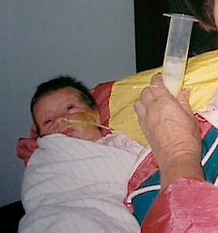
Implementation of Nursing Care
Nutritional care
Type and amount of formula for feeding will depend on:
Infant weight, weight gain/loss pattern
Presence/absence of suck and swallow reflex, behavioral readiness to feed
Physical condition (presence of bowel sounds, any respiratory distress)
If being gavage fed will monitor residuals
GI malformations
Renal function
Laboratory values
Notes:
Breastmilk is best nutrition for preterm
Hydration: may receive supplemental parenteral fluids
Elimination patterns: frequency of urination, amount, color, pH, and specific gravity of urine assessed; character and pattern of stools is monitored, and abdominal girth is monitored closely
Oral feeding: preferred route for infant with adequate strength and GI function
Gavage feeding: must monitor residuals, and implement aspiration precautions
Gastrostomy feeding
Nonnutritive sucking: benificial for infants receiving gavage or parenteral feedings; encourage sucking at breast during kangaroo care

Slide 14
Implementation of Nursing Care
Oral feedings: preferred route for infant with adequate strength and GI function, may breast feed or bottle feed
Gavage feeding: providing formula or breast milk through oro- or naso-gastric tube
Strict monitoring of amount, residuals
Position infants after feeding to prevent aspiration
Parenteral fluids: feeding may be supplemented with fluids or TPN
Nonnutritive sucking: may improve oxygenation to have infant suck on pacifier during gavage feeding and facilitate earlier transition to nipple feeding
Also may decrease restlessness
Should encourage mothers to let infant start sucking at breast during kangaroo care

Slide 15
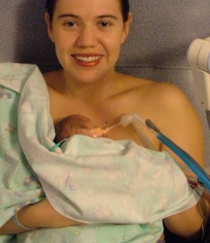
Implementation of Nursing Care
Environmental Concerns: life saving equipment in NICU is noisy- infants hearing can be damaged with continued high levels of auditory input from the environment
Infant stimulation: reduce inappropriate stimuli (noise, lights) implement appropriate stimuli (kangaroo care, interactions with parents, cuddling, rocking, singing, and talking)
Containment or facilitated tucking: keeps infants limbs close to body, blanket swaddling or nesting
Skin to skin (kangaroo care): helps infants to directly interact with parents

Slide 16
Growth & Development Potential
Nurturing parents: need encouragement when first seeing infant in NICU
May need assistance with focusing on the infant instead of the equipment
Should explain what is normal for preterm infants
Encourage parents to ask questions and express feelings
Providing accurate and consistent information: regarding care and how they can be involved in care
Help parents connect with other NICU parents: some hospitals have support groups for parents of infants in intensive care nurseries.
Parent education
Notes:
Parent education
CPR training

Slide 17
Complications of Prematurity
Respiratory Distress Syndrome (RDS)
Caused by a lack of pulmonary surfactant
Further compromised by weak respiratory muscles
Clinical symptoms include tachypnea, grunting, nasal flaring, intercostal, supraclavicular, or subcostal retractions, hypercapnia, respiratory acidosis, hypotension, and shock.
Symptoms will present immediately after birth or within 6 hours
Supportive treatment: adequate ventilation and oxygenation, administration of surfactant (surfactant improves respiratory compliance till infant can generate enough on own)
Patent ductus arteriosis (PDA)
Ductus arteriosis connects left pulmonary artery with the dorsal aorta
Should constrict after birth, but if it doesn’t is PDA
Clinical symptoms: systolic murmur, bounding peripheral pulses, tachycardia, crackles, and hepatomegaly, cardiac enlargement, pulmonary edema
Treatment surgically or medically with ventilatory support, fluid restriction and diuretics
Notes:
RDS
Symptoms usually appear within 6 hours of birth
Self-limiting and symptoms usually disappear within 72 hours
Treatment is supportive
PDA
Managed medically or surgically
Medical: vent support, fluid restriction, diuretics and indomethacin or ibuprofen
Nursing care focused on supportive care: NTE, oxygenation, meticulous fluid balance, and parenteral support

Slide 18
Complications of Prematurity
Periventricular-intraventricular hemorrhage (PV-IVH)
One of most common brain injuries occurring in neonates
Nursing care focuses on recognizing factors that increase risk of PV-IVH, interventions to decrease risk of bleeding, and supportive care to infants who have bleeding episodes
Necrotizing enterocolitis (NEC): acute inflammation of GI
Often fatal
Breast feeding lowers the incidence of NEC
Onset usually occurs between 4-10 days after birth
Signs of NEC: decreased activity, hypotonia, pallor, recurrent apnea, bradycardia, respiratory distress, temperature instability, ABD distention, vomiting (bile or blood), grossly bloody stools, ABD tenderness
Treatment is supportive: GI tract rest, gastric decompression, TPN, ATB therapy, surgical resection
Careful hand washing important as it is an infection process
Notes:
PV-IVH Nursing Care
focused on recognition of factors that increase risk, interventions to decrease risk of bleed, and supportive care for bleeding episodes
Positioned with head in midline
HOB elevated slightly
NTE maintained, as well as oxygenation
Rapid infusions of fluids avoided
BP monitored closely for fluctuations
Monitor for s/s of pneumothorax b/c it often precedes PV-IVH
Necrotizing Enterocolitis
3 factors play important role in development
Intestinal ischemia
Colonization by pathogenic bacteria
Substrate (formula feeding) in the intestinal lumen
Diagnosis of NEC confirmed by radiographic exam
Labs include CBC w/ differential, coagulation studies, ABG analysis, serum electrolyte levels, and blood culture

Slide 19
Complications of Prematurity
Retinopathy of prematurity
Management through prevention and early detection
Bronchopulmonary dysplasia (chronic lung disease)
Caused from barotrauma from pressure ventilation and oxygen toxicity
Clinical symptoms: tachypnea, retractions, nasal flaring, increased work of breathing, exercise intolerance (to handling and feeding), and tachycardia
Treatment includes oxygen therapy, nutrition, fluid restriction, medications (diuretics, corticosteroids)

Slide 20
The Postmature Infant
Meconium aspiration syndrome (MAS)
Suction infant before first breath
If not removed from airway can migrate into terminal airways causing obstruction or pneumonitis
Persistent pulmonary hypertension
Component of MAS, congenital diaphragmatic hernia, RDS, hyperviscosity syndrome, or neonatal pneumonia or sepsis.
Infant presents with tachycardia and cyanosis
Management depends on the cause
Notes:
Meconium aspiration syndrome: caused by migration of meconium down to terminal airways, causing mechanical obstruction, leading to MAS
Code pink required for infant with meconium in amniotic fluid
For infants with meconium staining who are not vigerous: endotracheal suctioning preformed immediately
Infants mouth and nares are no longer routinely suctioned on the perineum before first breath
Infant may aspirate meconium in utero, casing chemical pneumonitis
May develop PPHN
Infants with MAS who received surfactant had improved oxygenation and decreased severity of respiratory failure, need for ECMO, and air leaks
PPHN: combined findings of pulmonary hypertension, right-to-left shunting, and a structurally normal heart
May appear independently, or with MAS, congenital diaphragmatic hernia, RDS, hyperviscosity syndrome, or neonatal pneumonia or spesis
Any condition that interferes with fetal to neonatal circulation may precipitate PPHN; leads to exacerbating hypoxia and pulmonary vasoconstriction
Infant with PPHN typically born at term or postterm
Exhibits tachycardia and cyanosis that progresses to severe respiratory compromise with concomitant acidosis within minutes to hours
This compromises pulmonary perfusion and deteriorating oxygenation
Mgmt depends on cause; use of INO and ECMO has improved survival rates
High-frequency ventilation: delivers small volumes of gas at high frequencies, limits development of high airway pressure, and reduces barotrauma

Slide 21
Other Problems Related to Gestation
Small for gestational age (SGA) and Intrauterine growth restriction (IUGR)
Common problems:
Perinatal asphyxia
Hypoglycemia
Hyperglycemia
Heat Loss

Slide 22
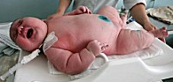
Other Problems Related to Gestation
Large for gestational age (LGA)
Common problems
greater risk for morbidity
higher incidence of birth injuries
asphyxia
congenital anomalies (heart defects)

Slide 23
Other Problems Related to Gestation
Infants of mothers with diabetes
Hyperglycemia of mother causes glucose to cross placenta which stimulates the fetal pancreas to produce insulin
Complications including congenital anomalies, macrasomia, birth trauma, perinatal asphyxia, RDS, hypoglycemia, hypocalcemia, hypomagnesemia, cardiomyopathy, hyperbilirubinemia, and polycythemia
Nursing considerations immediately after birth:

Slide 24

Discharge Planning
Assess the home care needs of the infant and infants parents (special equipment or education on equipment for parents)
Address knowledge deficits
Refer parents to appropriate resources
Set up home health assistance of follow-up appointments as needed

Slide 25
Key Points
Preterm infants at risk for problems related to immaturity of their organ systems
Respiratory distress syndrome, retinopathy of prematurity, and chronic lung disease are associated with prematurity
High risk infants must be observed for respiratory distress and other signs of physiologic distress
Adaptation of parents to preterm or high risk infants differs from that of parents of full term infants
Parents need special instruction before taking high risk infant home (CPR, suctioning, oxygen therapy, etc)
Infants born to diabetic mothers are at risk for hypoglycemia, RDS, birth asphyxia, and trauma
SGA infants are considered to be at risk because of fetal growth restriction
Nonreassuring fetal status among postmature infants is related to progressive placental insufficiency that can occur in post-term pregnancy
Specially trained nurses may transport high risk infants to and from special care units

