Slide 1
Chapter 27
Infants with Gestational Age Related Problems
Notes:
Pearls for Ch. 27
Complications of prematurity
Complications of oxygen therapy
Growth and development
Paternal adaptation
Meconium aspiration syndrome
Persistent pulmonary hypertension

Slide 2
High Risk Newborn
High risk infant classification
  Birth weight
  Gestational Age
  Predominate pathophysiologic problems
    Necrotizing enterocolitis
    Growth failure
    Bronchopulmonary dysplasia
    Intraventricular and periventricular hemorrhage
    Retinopathy of prematurity

Slide 3
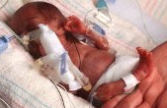
The Preterm Infant
(Infants born before 37 weeks gestation)
Cause of preterm birth unknown
Organ systems are immature and lack adequate physiologic reserves for preterm infant to function in extrauterine environment
Potential problems and needs of preterm infant weighing 2000g differ from those of term, post-term, or post-mature infant of equal weight
Notes:
Preterm Infant: those born before 37 weeks gestation
Cause unknown, but incidence highest among low socioeconomic status population
Likely d/t lack of prenatal care
Gestational hypertension
Maternal infection
Multifetal pregnancy
HELLP syndrome
Premature dilation of cervix
Placental or cord conditions that affect the fetus’s reception of nutrients
Presence of physiologic disorders and anomalies affect response to treatment
The lower the birth weight and GA, the lower the chances of survival

Slide 4

Late Preterm Infant
Born between 34 and 36 6/7 weeks of gestation
An accurate assessment of the gestational age of high risk infants is critical for assisting the nurse in identifying potential problems the newborn may experience.
Notes:
Late Preterm Infant: born between 34 and 36 6/7 week gestation
Lower risk than early preterm infants but still at increased risk
Feeding problems
Neurodevelopment
Thermoregulation
Hypoglycemia
Hyperbilirubinemia
Sepsis
Respiratory function
LBW, VLBW, ELBW: based on weight at birth, regardless of GA
AGA, SGA, LGA: based on placement within or outside of 10-90% range
Preterm: born before 37 weeks
Late preterm: born 34 0/7 to 36 6/7 weeks
Full term: born between 38 and completion of 42 weeks
Postterm: born after 42 weeks

Slide 5
Nursing Care Management: Assessment
  Respiratory function: the preterm infant is likely to have difficulty making the pulmonary transition from intrauterine to extrauterine life- numerous problems that can cause respiratory distress or apnea
    Decreased # of functional alveoli
    Deficient surfactant levels
    Smaller airway lumen
    Decreased tracheal cartilage
    Obstruction of respiratory passages
    Insufficient calcification of bony thorax
    Circulating hormones (prostaglandins) that affect CV function
    Immature and fragile pulmonary vasculature
    Greater distance between functional alveoli and capillary bed

Slide 6
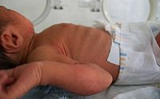
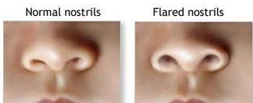
Nursing Care Management: Assessment
Early signs of respiratory distress:
  Nasal flaring, grunting, retractions, increasing respiratory effort, decreased Pa02
  Can progress quickly, nurse should be prepared to administer oxygen or assist with ventilation as necessary
Notes:
Respiratory distress
Tachypnea, nasal flaring, expiratory grunting
Retractions may begin as subcostal, intercostal, or suprasternal
Acrocyanosis is normal finding in neonate; central cyanosis indicates poor oxygenation
Must provide supplemental oxygen and artifical ventilation when signs show inability to initiate or maintain respiratory function
CV Distress
Symptoms of hypovolemia, shock or both require action
Prolonged capillary refill, pale color, poor muscle tone, lethargy, tachycardia initially, then bradycardia
Continued respiratory distress despite giving oxygen and supporting ventilation
Hypotension may be present or appear as late sign of shock

Slide 7
Nursing Care Management: Assessment
Body Temperature: issues due to
  Large SA in relation to body weight
  Minimal subq fat
  Limited store of brown fat (heat source)
  Decreased or absent reflex control of skin capillaries
  Inadequate muscle mass activity
  Poor muscle tone
  Immature temperature regulation in brain
  Increased insensible water loss
  Decreased ability to increase oxygen consumption
  Decreased caloric intake
Central Nervous System
Notes:
Goal of thermoregulation is a neutral thermal environment
Oxygen consumption and BMR are minimal but adequate
CNS Issues
Birth trauma with damage to immature intracranial structures
Bleeding d/t fragile capillaries
Impaired coagulation process, and prolonged bleeding times
Recurrent hypoxic and hyperoxic episodes
Predisposed to hypoglycemia
Fluctuating systemic BP with concommitant variation in cerebral blood flow and pressure
5 Categories of manifestations require careful evaluation
Seizure activity
Hyperirritability
CNS depression
Elevated ICP
Abnormal movement such as decorticate posturing
Reflexes should be present by 28 weeks and should be evaluated

Slide 8
Nursing Care Management: Assessment
Nutritional Status:
  Weak/absent suck, swallow and gag reflexes
  Small stomach capacity and weak abdominal muscles
  Metabolic functions also compromised by limited store of nutrients, decreased ability to digest proteins and absorb nutrients, and immature enzyme systems
  Some infants may require IV or gavage feeding instead of oral feeding
Renal Function: preterm infant renal system unable to:
  Adequately excrete metabolites and drugs
  Concentrate urine
  Maintain acid-base, fluid, or electrolyte balances
Notes:
Initial goal for nutrition: prevent catabolism and excess fluid loss
After stabilization, goal is: promote optimal growth and development
Renal Function
I&O, specific gravity must be assessed
Labs for assessment of acid-base and electrolyte balance
Medication levels to ensure therapeutic range

Slide 9
Nursing Care Management: Assessment
Hematologic Status:
  Increased tendency to bleed
  Slowed production of RBC
  Loss of blood (due to frequent laboratory testing)
  Decreased RBC survival
Infection prevention:
  Protection from infection integral to infant care
    Strict hand washing
    Person’s with infectious disorders not allowed on unit
Skin Care: increased sensitivity and fragility
  Use skin products with caution
  Avoid adhesives
  Use of skin barriers to protect healthy skin
Notes:
Hematologic Monitoring
Assess for evidence of bleeding from punctures, GI tract, and pulmonary system
Monitor for s/s anemia
Monitor to prevent excess blood draws for labwork
Infection prevention
Strict handwashing
Infectious persons barred from unit
Standard precautions in all nursery areas

Slide 10
Nursing Care Management
Parental adaptation to preterm infant
  Parental tasks: psychologic tasks must be accomplished before effective relationships and parenting patterns can evolve
  Parental responses: Progress through stages as they interact with infant (eventually need to assume care of infant – bathing, feeding, etc)
  Parenting maladaptation: incidence of physical and emotional abuse is greater in infants because of preterm birth/illness were separated from parents for a time after birth
    Parents may have anxiety, financial burden, unresolved anticipatory grief, or impaired self- esteem
Notes:
Experiencing anticipatory grief
Mom accepts failure to give birth to healthy baby
Resuming relating to infant
Learning special needs
Adjusting home environment
Grandparents may show grief
Siblings may be angry with time spent with baby
Maladaptation
Resources should be made available for parent’s feeling
Proper guidance and counseling, including aftercare are available
Goal of healthcare is early identification of inadequate coping skills and dysfunctional parenting

Slide 11
Implementation of Nursing Care
Goal to provide preterm infant with extrauterine environment that promotes normal growth and development
  Physical Care: environmental support
    Incubator/radient warmer to control body temp
    Oxygen administration
    Monitoring of respiratory and cardiac function
    Assistive positioning devices
    Clustering of care and minimal stimulation/handling
  Maintaining body temp: gradual warming of hypothermic infant (rapid changes in temp may cause apnea or acidosis)
    Gradual weaning from incubator as well
    Pattern of steady weight gain and absence of poor feeding, respiratory distress, or temperature instability are appropriate measure of effectiveness of weaning to open bassinet

Slide 12
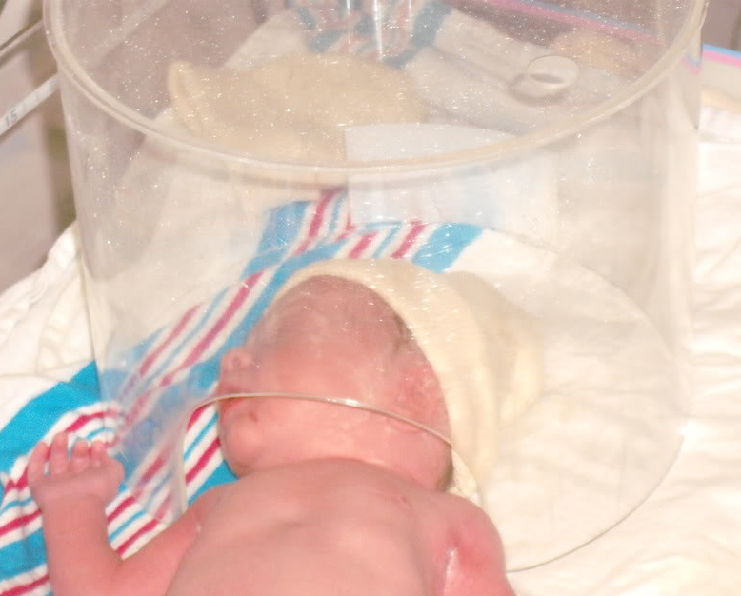
Implementation of Nursing Care
Oxygen therapy: oxygen should be warmed and humidified
  Oxygen therapy administration:
    Oxygen hood, nasal cannula, mechanical ventilation, surfactant administration
  Weaning from oxygen therapy
    Is done gradually with continued monitoring
    Some infants may still require some type of oxygen therapy on discharge
Notes:
Oxygen hood
Nasal cannula: for infants who require low concentrations of supplemental oxygen
Continuous distending pressure:CPAP; may preclude need for vent
Preferred mode for those who require minor distending pressure
Mechanical Ventilation: used when other methods fail, and blood gasses indicate severe hypoxemia or severe hypercapnia
Surfactant Replacement Therapy
High Frequency Ventilation: provide more than 300 breaths per minute

Slide 13
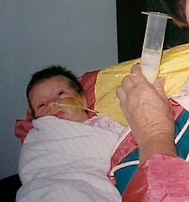
Implementation of Nursing Care
Nutritional care
  Type and amount of formula for feeding will depend on:
    Infant weight, weight gain/loss pattern
    Presence/absence of suck and swallow reflex, behavioral readiness to feed
    Physical condition (presence of bowel sounds, any respiratory distress)
    If being gavage fed will monitor residuals
    GI malformations
    Renal function
    Laboratory values
Notes:
Breastmilk is best nutrition for preterm
Hydration: may receive supplemental parenteral fluids
Elimination patterns: frequency of urination, amount, color, pH, and specific gravity of urine assessed; character and pattern of stools is monitored, and abdominal girth is monitored closely
Oral feeding: preferred route for infant with adequate strength and GI function
Gavage feeding: must monitor residuals, and implement aspiration precautions
Gastrostomy feeding
Nonnutritive sucking: benificial for infants receiving gavage or parenteral feedings; encourage sucking at breast during kangaroo care

Slide 14
Implementation of Nursing Care
Oral feedings: preferred route for infant with adequate strength and GI function, may breast feed or bottle feed
Gavage feeding: providing formula or breast milk through oro- or naso-gastric tube
  Strict monitoring of amount, residuals
  Position infants after feeding to prevent aspiration
Parenteral fluids: feeding may be supplemented with fluids or TPN
Nonnutritive sucking: may improve oxygenation to have infant suck on pacifier during gavage feeding and facilitate earlier transition to nipple feeding
  Also may decrease restlessness
  Should encourage mothers to let infant start sucking at breast during kangaroo care

Slide 15
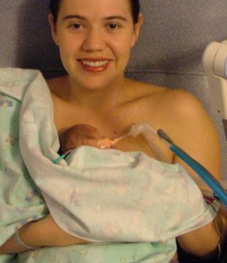
Implementation of Nursing Care
Environmental Concerns: life saving equipment in NICU is noisy- infants hearing can be damaged with continued high levels of auditory input from the environment
  Infant stimulation: reduce inappropriate stimuli (noise, lights) implement appropriate stimuli (kangaroo care, interactions with parents, cuddling, rocking, singing, and talking)
  Containment or facilitated tucking: keeps infants limbs close to body, blanket swaddling or nesting
  Skin to skin (kangaroo care): helps infants to directly interact with parents

Slide 16
Growth & Development Potential
  Nurturing parents: need encouragement when first seeing infant in NICU
    May need assistance with focusing on the infant instead of the equipment
    Should explain what is normal for preterm infants
    Encourage parents to ask questions and express feelings
  Providing accurate and consistent information: regarding care and how they can be involved in care
  Help parents connect with other NICU parents: some hospitals have support groups for parents of infants in intensive care nurseries.
Parent education
Notes:
Parent education
CPR training

Slide 17
Complications of Prematurity
Respiratory Distress Syndrome (RDS)
  Caused by a lack of pulmonary surfactant
  Further compromised by weak respiratory muscles
  Clinical symptoms include tachypnea, grunting, nasal flaring, intercostal, supraclavicular, or subcostal retractions, hypercapnia, respiratory acidosis, hypotension, and shock.
  Symptoms will present immediately after birth or within 6 hours
  Supportive treatment: adequate ventilation and oxygenation, administration of surfactant (surfactant improves respiratory compliance till infant can generate enough on own)
Patent ductus arteriosis (PDA)
  Ductus arteriosis connects left pulmonary artery with the dorsal aorta
  Should constrict after birth, but if it doesn’t is PDA
  Clinical symptoms: systolic murmur, bounding peripheral pulses, tachycardia, crackles, and hepatomegaly, cardiac enlargement, pulmonary edema
  Treatment surgically or medically with ventilatory support, fluid restriction and diuretics
Notes:
RDS
Symptoms usually appear within 6 hours of birth
Self-limiting and symptoms usually disappear within 72 hours
Treatment is supportive
PDA
Managed medically or surgically
Medical: vent support, fluid restriction, diuretics and indomethacin or ibuprofen
Nursing care focused on supportive care: NTE, oxygenation, meticulous fluid balance, and parenteral support

Slide 18
Complications of Prematurity
Periventricular-intraventricular hemorrhage (PV-IVH)
  One of most common brain injuries occurring in neonates
  Nursing care focuses on recognizing factors that increase risk of PV-IVH, interventions to decrease risk of bleeding, and supportive care to infants who have bleeding episodes
Necrotizing enterocolitis (NEC): acute inflammation of GI
  Often fatal
  Breast feeding lowers the incidence of NEC
  Onset usually occurs between 4-10 days after birth
  Signs of NEC: decreased activity, hypotonia, pallor, recurrent apnea, bradycardia, respiratory distress, temperature instability, ABD distention, vomiting (bile or blood), grossly bloody stools, ABD tenderness
  Treatment is supportive: GI tract rest, gastric decompression, TPN, ATB therapy, surgical resection
  Careful hand washing important as it is an infection process
Notes:
PV-IVH Nursing Care
focused on recognition of factors that increase risk, interventions to decrease risk of bleed, and supportive care for bleeding episodes
Positioned with head in midline
HOB elevated slightly
NTE maintained, as well as oxygenation
Rapid infusions of fluids avoided
BP monitored closely for fluctuations
Monitor for s/s of pneumothorax b/c it often precedes PV-IVH
Necrotizing Enterocolitis
3 factors play important role in development
Intestinal ischemia
Colonization by pathogenic bacteria
Substrate (formula feeding) in the intestinal lumen
Diagnosis of NEC confirmed by radiographic exam
Labs include CBC w/ differential, coagulation studies, ABG analysis, serum electrolyte levels, and blood culture

Slide 19
Complications of Prematurity
Retinopathy of prematurity
  Management through prevention and early detection
Bronchopulmonary dysplasia (chronic lung disease)
  Caused from barotrauma from pressure ventilation and oxygen toxicity
  Clinical symptoms: tachypnea, retractions, nasal flaring, increased work of breathing, exercise intolerance (to handling and feeding), and tachycardia
  Treatment includes oxygen therapy, nutrition, fluid restriction, medications (diuretics, corticosteroids)

Slide 20
The Postmature Infant
Meconium aspiration syndrome (MAS)
  Suction infant before first breath
  If not removed from airway can migrate into terminal airways causing obstruction or pneumonitis
Persistent pulmonary hypertension
  Component of MAS, congenital diaphragmatic hernia, RDS, hyperviscosity syndrome, or neonatal pneumonia or sepsis.
  Infant presents with tachycardia and cyanosis
  Management depends on the cause

Slide 21
Other Problems Related to Gestation
Small for gestational age (SGA) and Intrauterine growth restriction (IUGR)
Common problems:
  Perinatal asphyxia
  Hypoglycemia
  Hyperglycemia
  Heat Loss

Slide 22
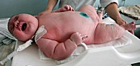
Other Problems Related to Gestation
Large for gestational age (LGA)
  Common problems
    greater risk for morbidity
    higher incidence of birth injuries
    asphyxia
    congenital anomalies (heart defects)

Slide 23
Other Problems Related to Gestation
Infants of mothers with diabetes
Hyperglycemia of mother causes glucose to cross placenta which stimulates the fetal pancreas to produce insulin
  Complications including congenital anomalies, macrasomia, birth trauma, perinatal asphyxia, RDS, hypoglycemia, hypocalcemia, hypomagnesemia, cardiomyopathy, hyperbilirubinemia, and polycythemia
  Nursing considerations immediately after birth:

Slide 24

Discharge Planning
Assess the home care needs of the infant and infants parents (special equipment or education on equipment for parents)
Address knowledge deficits
Refer parents to appropriate resources
Set up home health assistance of follow-up appointments as needed

Slide 25
Key Points
Preterm infants at risk for problems related to immaturity of their organ systems
Respiratory distress syndrome, retinopathy of prematurity, and chronic lung disease are associated with prematurity
High risk infants must be observed for respiratory distress and other signs of physiologic distress
Adaptation of parents to preterm or high risk infants differs from that of parents of full term infants
Parents need special instruction before taking high risk infant home (CPR, suctioning, oxygen therapy, etc)
Infants born to diabetic mothers are at risk for hypoglycemia, RDS, birth asphyxia, and trauma
SGA infants are considered to be at risk because of fetal growth restriction
Nonreassuring fetal status among postmature infants is related to progressive placental insufficiency that can occur in post-term pregnancy
Specially trained nurses may transport high risk infants to and from special care units

