Slide 1
Andrea K. Myers, SNFRMC
Brianne N. Dority, SNFRMC
Robinson J (2003) Deflation of a Foley catheter balloon. Nursing Standard. (17,27,33-38) Highbeam Research
Boston, K., Carrillo, J., Jentons, K., Schild, S., Utley, G., Zalocha, E. (2011) Preinflation of Foley Catheters: It’s up in the Air. Journal of Vascular Nursing. Volume 24 Issue 2
Perry, A.G., & Potter, P.A. (2011). Skill 33-1 Inserting a straight or an indwelling catheter. Clinical nursing skills and techniques, 7th edition, 864. St. Louis, MO: Elsevier Mosby.

Slide 2
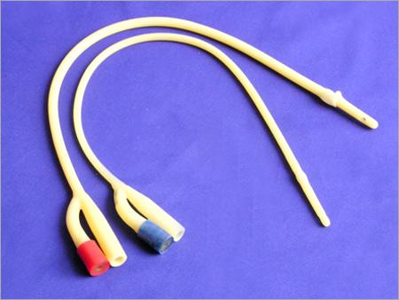
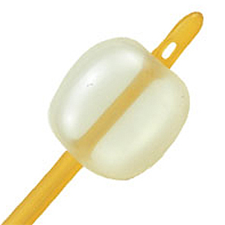
Evidence Based Practice:
To Inflate
or
Not To Inflate

Slide 3
Definition
Some of the possible negative outcomes of pretesting as mentioned are possible urethral trauma caused by creases, ridges, or cuffing that develop after inflation and deflation of the balloon.
-Crease: “the balloon membrane collapses in on itself, causing crease and ridge formation to occur”
-Ridges: “at deflation, the sides of the balloon membrane come together”
-Cuffing: “the balloon membrane is pushed back towards the catheter tip”
(Robinson 2003)

Slide 4
Levels of Evidence
Level I: Evidence from a systematic review or meta-analysis of all relevant randomized clinical trials (RCTs), or evidence based clinical practice guidelines based on systematic reviews of RCT’s or three or more RCT’s or good quality that has similar results.
Level II: Evidence obtained from at least one well designed RCT.
Level III: Evidence obtained from well-designed controlled trials without randomization.
Level IV: Evidence from well-designed case-controlled or cohort studies.
Level V: Evidence from systematic reviews of descriptive and qualitative studies. (Meta-synthesis)
Level VI: Evidence from a single descriptive or qualitative study.
Level VII: Evidence from the opinion of authorities and or reports of expert committees.

Slide 5
Introduction
Our topic of interest relates to pretesting foley catheter balloons prior to insertion. For years it has been standard practice to pretest the balloon before insertion. There are large discrepancies between healthcare facilities protocol, manufacture guidelines, and our nursing textbook. There is evidence that pretesting causes the catheter shaft to lose it’s smooth surface and develop creases and ridges upon deflation which could cause trauma to the urethra upon insertion.
Boston, K., Carrillo, J., Jentons, K., Schild, S., Utley, G., Zalocha, E. (2011) Preinflation of Foley Catheters: It’s up in the Air. Journal of Vascular Nursing. Volume 24 Issue 2

Slide 6
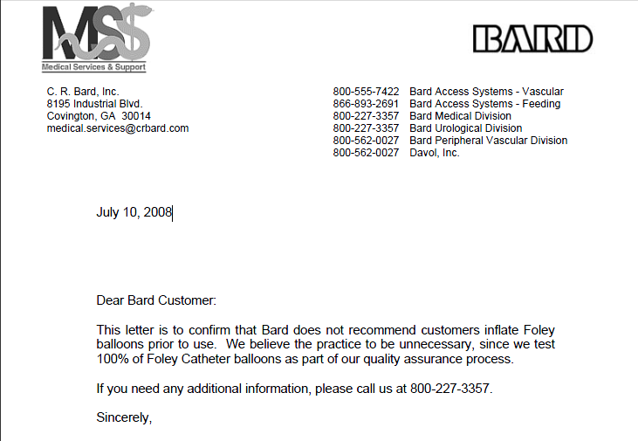
Effective
*Be aware of manufacture guideline variations
*Stay current with newly implemented EBP recommendations
Bard Clarification Letter
“Dear Bard Customer:
This letter is to confirm that Bard does not recommend customers inflate Foley balloons prior to use. We believe the practice to be unnecessary, since we test 100% of Foley Catheter balloons as part of our quality assurance process.”
Debra Griffith
Director, Medical Services and Support
C.R. Bard, Inc

Slide 7
Possibly Effective
If per protocol you are required to test balloon prior to insertion:
*Utilize the self-syringe aspiration technique to deflate the balloon prior to insertion. This is done by giving the plunger a gentle start and allowing gravity to drain the balloon.
*Instill 0.5 mL of sterile water reinserted into the catheter infill channel and balloon following deflation to smooth creases and ridges.
(Robinson 2003)

Slide 8
Possibly Harmful
Pretesting the Foley Balloon could result in:
* Creases
* Ridges
* Cuffing
* Increase in Diameter Size of Balloon
* Urethral Damage
* Balloon Membrane and Balloon Inflation Valve Area
Collapse and Deform
(Robinson 2003)

Slide 9
Summary
*A study was conducted to compare three different methods of deflating the foley catheter balloon and determine which methods produce creases and ridges and also show an increase in diameter size of the balloon area.
-The first method studied was Self-syringe aspiration
-The second method, the most commonly use method, referred to as
manual syringe aspiration.
-The third method by which the balloon was deflated was by cutting off
the inflation valve.
“Testing the balloon by injecting fluid from the prefilled sterile water syringe into the balloon port is no longer a common practice. Testing the balloon may lead to damage, causing increased trauma on insertion. (Check manufacturer’s instructions).” (Perry & Potter 2011)

Slide 10
Not Effective
Manual syringe aspiration:
Pulling back on the syringe plunger to remove the infilled water from the catheter balloon leads to creases and ridges.
Cutting off the inflation valve:
Posses the risk of causing the fine infill channel to seal which will make deflation difficult.
(Robinson 2003)

