Slide 1
Transposition of the Great Vessels
Emily Mosley
Amanda Koester
Melissa Wilhelm

Slide 2
Description
Transposition of the Great Vessels is a effects that falls in under the classification of mixed defect
A mixed defects cause volume overload on the ventricle, Pulmonary blood flow congestion, and systemic blood that is severely low in oxygen saturation
In this particular defect, the pulmonary artery leaves the left ventricle and the aorta leaves the right ventricle without any exchange between the systemic and pulmonary circulation.

Slide 3
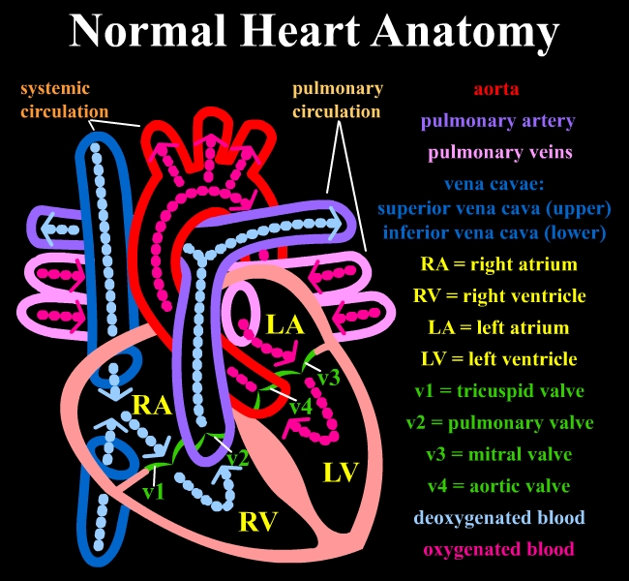
Notes:
Pulmonary veins bring oxygenated blood into the left atrium, then left ventricle, then out the aorta to the body.
Superior and inferior vena cava bring deoxygenated blood into the right atrium, then right ventricle, then out of the pulmonary arteries to the lungs.
In a normal heart, these two systems are completely separate and the deox blood never crosses the ox blood.

Slide 4
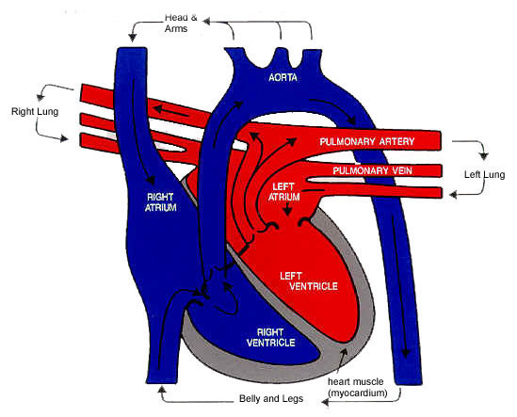
Transposition of the Great Vessels
PDA
RA
ASD
VSD
Notes:
ASD- Atrial Septal Defect
VSD- Ventricular Septal Defect
PDA- Patent Ductus Arteriosus
This patient has two separate systems with no blood cross, but the systems are transposed. Deox blood is being exited out the aorta to the body which causes cyanosis.
The blood coming in is correct, but the blood going out is incorrect.
This patient will die without one of the following septal defects to maintain life until surgery can correct the trasposition.

Slide 5
Transposition of the Great Vessels
Animation

Slide 6
Defects of the heart that are typically involved
Septal defects or patent ductus arteriosus are common because these defects allow for pulmonary and systemic blood to mix (desaturated and saturated)
Most common defect associated with the transposition of the great vessels is a patent foramen ovale
Patent ductus arteriosus is common but typically closes soon after birth
Ventricular septal defect
which increases the likelihood of a child with this defect to develop congestive heart failure, it allows for blood to go from the right ventricle to the left ventricle, into the pulmonary artery and then to the lungs

Slide 7
Pathophysiology
Severity of the defect and the presence of coexisting heart defects cause a large variation in this condition
Neonates with the most severe form of this defect will have little or no mix between saturated and unsaturated
Neonates that have large septal defects or a patent ductus arteriosus will be able to have more mix between oxygen saturated and desaturated blood, however these defects in conjuction with transposition of great vessels will lead to congestive heart failure due to pulmonary congestion and impaired myocardial functioning.
If the defect is not noticed and corrected or treated cardiomegaly will be significant a few weeks after birth.

Slide 8
Clinical Manifestations
In newborns that have minimum communication the symptoms are severe, involving cyanosis and depressed function at birth.
Infants that have large septal defects or a patent ductus arteriosus may not be as cyanotic but they will have similar symptoms to CHF. Some of those being tachypnea, respiratory distress (retractions), grunting, and difficulty with feeding including diaphoresis sometimes with the feeding.
Heart sounds may vary depending on the type of defect present.
Cardiomegaly is typically always evident within a few weeks after birth.

Slide 9
Treatment
Therapeutic management
IV prostaglandin E₁ may be initiated to keep the ductus arteriosus open to temporarily increase blood mixing and provide an oxygen saturation of 75% or to maintain cardiac output.
During cardiac catheterization or under echocardiographic guidance , a balloon atrial septostomy may be performed to increase mixing by opening the atrial septum.

Slide 10
Treatment
Surgical Treatment
The procedure of choice is an arterial switch procedure which is performed in the first weeks of life. This involves transecting the great arteries, anastomosing the main pulmonary artery to the proximal aorta, and anastomosing the ascending aorta to the proximal pulmonary artery. The coronary arteries are switched from the proximal aorta, to the proximal pulmonary artery to create a new aorta. For an infant to survive it is critical to reimplant the coronary arteries. They must be attached without torsion or kinking in order to supply the heart with its supply of oxygen.
Intraatrial baffle repairs is another option, but it is rarely performed. This procedure is done to divert venous blood to the mitral valve and pulmonary venous blood to the tricuspid valve using the patients atrial septum or a prosthetic material.

Slide 11
Treatment
Rastelli procedure is the operative choice for infants with TGA (transposition of great arteries), VSD (ventricular septal defect), and PS (severe pulmonic stenosis). This involves closure of the VSD with a baffle, so that the left ventricular blood is directed through the VSD into the aorta. The pulmonic valve is then closed and a conduit is placed from the right ventricle to the pulmonary artery to create a physiologically normal circulation.

Slide 12
Prognosis
The child's symptoms will improve after surgery to correct the defect.
Most infants who undergo arterial switch do not have symptoms after surgery and live normal lives.
If corrective surgery is not performed, the life expectancy is only months
ASD (Atrial Septal Defect), VSD (Ventricular Septal Defect), or PDA (Patent Ductus Arteriosus) necessary before surgery to maintain life

