Slide 1
Breastfeeding presentation
J. Baker
R. Buie
M. Quiggle
C. Johnson

Slide 2
Brands of Formula available at the Norwalk Wal-Mart
Similac
Enfamil
Parent’s Choice
Gerber Good Start
Earth’s Best Organic

Slide 3


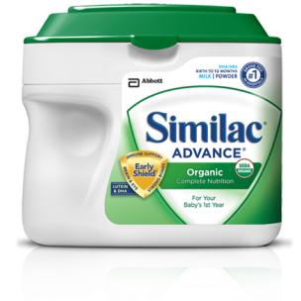
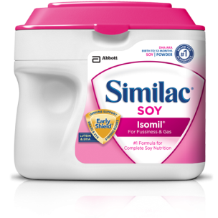
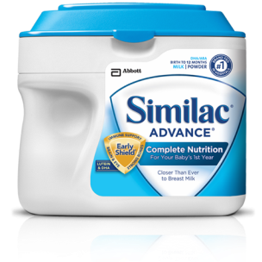
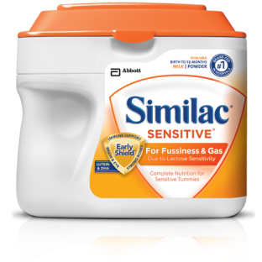
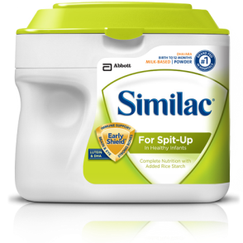
Similac
Similac® Advance®
Similac® Advance®
Organic Similac Sensitive®
Similac® Soy Isomil®
Similac® For Spit-Up
Similac Expert Care® Alimentum®
Similac Expert Care® NeoSure®

Slide 4
Ingredients
Nonfat Milk, Lactose, High Oleic Safflower Oil, Soy Oil, Coconut Oil, Galactooligosaccharides*, Whey Protein Concentrate. Less than 2% of the Following: C. Cohnii Oil?, M. Alpina Oil?, Beta-Carotene, Lutein, Lycopene, Potassium Citrate, Calcium Carbonate, Ascorbic Acid, Soy Lecithin, Potassium Chloride, Magnesium Chloride, Ferrous Sulfate, Choline Bitartrate, Choline Chloride, Ascorbyl Palmitate, Sodium Chloride, Taurine, m-Inositol, Zinc Sulfate, Mixed Tocopherols, d-Alpha-Tocopheryl Acetate, Niacinamide, Calcium Pantothenate, L-Carnitine, Vitamin A Palmitate, Cupric Sulfate, Thiamine Chloride Hydrochloride, Riboflavin, Pyridoxine Hydrochloride, Folic Acid, Manganese Sulfate, Phylloquinone, Biotin, Sodium Selenate, Vitamin D3, Cyanocobalamin, Calcium Phosphate, Potassium Phosphate, Potassium Hydroxide, and Nucleotides (Adenosine 5?-Monophosphate, Cytidine 5?-Monophosphate, Disodium Guanosine 5?-Monophosphate, Disodium Uridine 5?-Monophosphate). * Sourced from milk (GOS) ? A source of docosahexaenoic acid ( HA). ? A source of arachidonic acid (ARA). Contains milk and soy ingredients.

Slide 5
Costs of Similac Products
1.45 pound tub powdered formula $23.98
1 quart ready-to-feed bottles $6.78-$7.78
13 once can concentrated formula $5.18-$7.34

Slide 6









Enfamil
Enfamil PREMIUM® Infant
Enfamil® Gentlease®
Enfamil A.R.®
Enfamil® ProSobee®
Nutramigen® with Enflora™ LGG®
Nutramigen®
Enfamil® EnfaCare®
Pregestimil®

Slide 7
Ingredients
NONFAT MILK, LACTOSE, VEGETABLE OIL (PALM OLEIN, COCONUT, SOY, AND HIGH OLEIC SUNFLOWER OILS), WHEY PROTEIN CONCENTRATE, GALACTOOLIGOSACCHARIDES*, POLYDEXTROSE*, AND LESS THAN 1%: MORTIERELLA ALPINA OIL**, CRYPTHECODINIUM COHNII OIL+, CALCIUM CARBONATE, POTASSIUM CITRATE, FERROUS SULFATE, POTASSIUM CHLORIDE, MAGNESIUM OXIDE, SODIUM CHLORIDE, ZINC SULFATE, CUPRIC SULFATE, MANGANESE SULFATE, SODIUM SELENITE, SOY LECITHIN, CHOLINE CHLORIDE, ASCORBIC ACID, NIACINAMIDE, CALCIUM PANTOTHENATE, VITAMIN A PALMITATE

Slide 8
Costs of Enfamil Products
1.46 pound tub powdered formula $24.00-$32.57
Pack of 6 8-ounce ready-to feed bottles $9.97

Slide 9
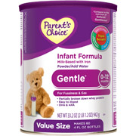
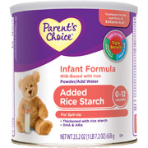
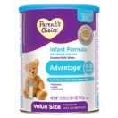
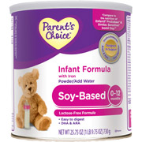
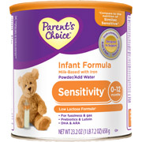
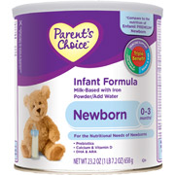
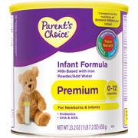
Parent’s Choice
Newborn
Gentle
Sensitivity
Soy-Based
Advantage
Premium
Added Rice Starch

Slide 10
Ingredients
Skim milk, water, reduced minerals whey, oleo oil, lactose, coconut, soybean and high oleic (safflower or sunflower) oils, soy lecithin, potassium bicarbonate, calcium chloride, ascorbic acid, sodium bicarbonate, sodium citrate, ferrous sulfate, taurine, calcium citrate, cytidine-5'-monophosphate, zinc sulfate, calcium carrageenan, alpha tocopheryl acetate, disodium uridine-5'-monophosphate, adenosne-5'-monophosphate, niacinamide, potassium chloride, disodium inosine-5'-monophosphate, disodium guanosine-5'-monophosphate, cupric sulfate, vitamin A palmitate, calcium pantomanganese, sulfate, beta carotene, folic acid, phytonadione, potassium iodide, biotin, cholecalciferol, cyanocobalamin.

Slide 11
Costs of Parent’s Choice Products
23.2 ounce can powdered formula $13.27-15.98
Pack of 4 8-ounce ready-to-feed bottles $4.67

Slide 12






Gerber good start
GERBER® GOOD START® Gentle Formula
GERBER® GOOD START® Nourish
GERBER® GOOD START® Premature 24
GERBER® GOOD START® Premature 24 High Protein
GERBER® GOOD START® Protect Formula
GERBER® GOOD START® Soothe Formula
GERBER® GOOD START® Soy Formula

Slide 13
Ingredients
Whey Protein Concentrate (from Cow's Milk, Enzymatically Hydrolyzed, Reduced In Minerals), Vegetable Oils (Palm Olein, Soy, Coconut, And High-Oleic Safflower Or High-Oleic Sunflower), Lactose, Corn Maltodextrin, And Less Than 2% of: Potassium Citrate, Potassium Phosphate, Calcium Chloride, Calcium Phosphate, Sodium Citrate, Magnesium Chloride, Ferrous Sulfate, Zinc Sulfate, Sodium Chloride, Copper Sulfate, Potassium Iodide, Manganese Sulfate, Sodium Selenate, M. Alpina Oil*, C. Cohnii Oil**, Sodium Ascorbate, Inositol, Choline Bitartrate, Alpha-Tocopheryl Acetate, Niacinamide, Calcium Pantothenate, Riboflavin, Vitamin A Palmitate, Pyridoxine Hydrochloride, Thiamine Mononitrate, Folic Acid, Phylloquinone, Biotin, Vitamin D3, Vitamin B12, Taurine, Nucleotides (Cytidine 5'-Monophosphate, Disodium Uridine 5'-Monophosphate, Adenosine 5'-Monophosphate, Disodium Guanosine 5'-Monophosphate), Ascorbyl Palmitate, Mixed Tocopherols, L-Carnitine, B. Lactis Cultures, Soy Lecithin. *A Source of Arachidonic Acid (Ara). **A Source of Docosahexaenoic Acid (DHA)

Slide 14
Costs of Gerber good start products
12 ounce can of powdered formula $12.97-14.77
22 ounce tub of powdered formula $19.00-$20.19
Pack of 8 3-ounce ready to feed bottles $8.99-$12.49

Slide 15
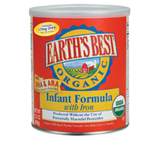
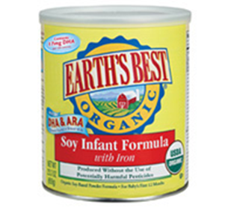
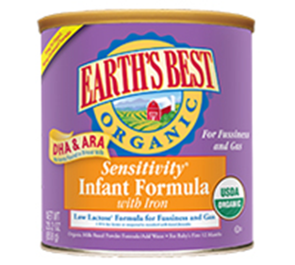
Earth’s Best Organic
Infant formula with Iron
Sensitivity Infant Formula with Iron
Soy Infant Formula with Iron

Slide 16
Ingredients
Organic Reduced Minerals Whey, Organic Non-Fat Milk, Organic Lactose, Organic Glucose Syrup Solids, Organic Palm Oil Or Organic Palm Olein, Organic Coconut Oil, Organic High Oleic (Safflower Or Sunflower Oil), Organic Soy Oil, Organic Whey Protein Concentrate And Less Than 1%: Crypthecodinium Cohnii Oil (Docosahexaenoic Acid), Mortierella Alpina Oil (Arachidonic Acid), Soy Lecithin, Minerals: (Calcium Chloride, Calcium Hydroxide, Cupric Sulfate, Ferrous Sulfate, Manganese Sulfate, Potassium Bicarbonate, Potassium Chloride, Potassium Hydroxide, Potassium Iodide, Sodium Citrate, Sodium Selenite, Zinc Sulfate), Taurine, Vitamins: Ascorbic Acid, Ascorbyl Palmitate, Beta-Carotene, Biotin, Calcium Pantothenate, Choline Chloride, Cyanocobalamin, Folic Acid, Inositol, Mixed Tocopherol Concentrate, Niacinamide, Pyridoxine Hydrochloride, Riboflavin, Thiamin Hydrochloride, Vitamin A Palmitate, Vitamin D (Cholecalciferol), Vitamin E (Dl-Alpha Tocopheryl Acetate), Vitamin K (Phytonadione), Nucleotides: Adenosine-5'-Monophosphate, Cytidine-5'-Monophosphate, Disodium Guanosine-5'-Monophosphate, Disodium Inosine-5'-Monophosphate, Disodium Uridine-5'-Monophosphate.

Slide 17
Cost of earth’s best organic products
23.20 ounce can powdered formula $28.15

Slide 18
Easiest directions to follow
All ready-to-feed formulas had the easiest directions to follow:
  Shake bottle well before opening, and then just twist off the cap and add nipple.
  Formula stored at room temperature does not need to be warmed. If you choose to feed warmed formula, do not microwave it. It can cause "hot spots" that could burn your baby. Instead, set the filled bottle in a bowl of warm (not boiling) water or hold the bottle under warm tap water. Sprinkle a few drops of formula on the inside of your wrist to make sure it’s not too hot.

Slide 19
Best choice for limited income
 | Ready –to-Feed | Powdered
Similac | 32 oz for $6.78-$7.98 | 23.2 oz for $23.98
Enfamil | 48 oz for $9.97 | 23.4 oz for $23.98-$32.57
Parent’s Choice | 32 oz for 4.67 | 23.2 oz for $13.27-$15.98
Gerber | 24 oz for $8.99-$12.99 | 22 oz for $19-$20.19
Earth’s Best | NA | 23.2 oz for 28.15

