Slide 1
Breastfeeding presentation
J. Baker
R. Buie
M. Quiggle
C. Johnson

Slide 2
Brands of Formula available at the Norwalk Wal-Mart
Similac
Enfamil
Parent’s Choice
Gerber
Earth’s Best Organic

Slide 3


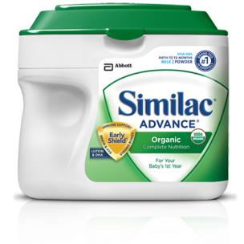
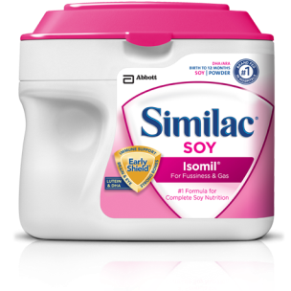
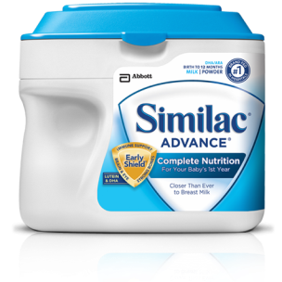
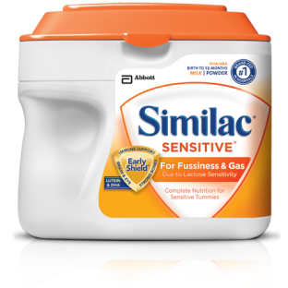
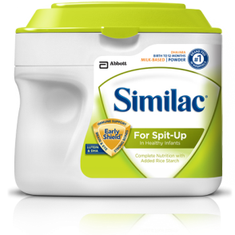
Similac
Similac® Advance®
Similac® Advance®
Organic Similac Sensitive®
Similac® Soy Isomil®
Similac® For Spit-Up
Similac Expert Care® Alimentum®
Similac Expert Care® NeoSure®

Slide 4
Costs of Similac Products
1.45 pound tubs $23.98
1 quart ready-to-feed $6.78-$7.78
13 once can concentrate $5.18-$7.34

Slide 5









Enfamil
Enfamil PREMIUM® Infant
Enfamil® Gentlease®
Enfamil A.R.®
Enfamil® ProSobee®
Nutramigen® with Enflora™ LGG®
Nutramigen®
Enfamil® EnfaCare®
Pregestimil®

Slide 6
Costs of Enfamil Products
1.46 pound tub $24.00-$38.57
Pack of 6 8-ounce ready-to feed bottles $39.88

Slide 7
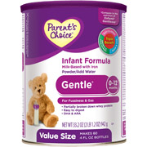
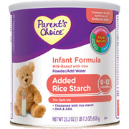
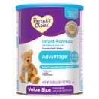
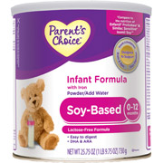
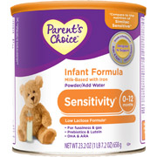
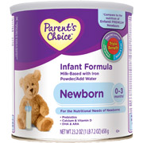
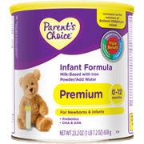
Parent’s Choice
Newborn
Gentle
Sensitivity
Soy-Based
Advantage
Premium
Added Rice Starch

Slide 8
Costs of Parent’s Choice Products
23.2 ounce can powdered formula $13.27-15.98
Pack of 4 8-ounce ready-to-feed bottles $4.67

Slide 9






Gerber good start
GERBER® GOOD START® Gentle Formula
GERBER® GOOD START® Nourish
GERBER® GOOD START® Premature 24
GERBER® GOOD START® Premature 24 High Protein
GERBER® GOOD START® Protect Formula
GERBER® GOOD START® Soothe Formula
GERBER® GOOD START® Soy Formula

Slide 10
Costs of Gerber good start products
12 ounce can of powdered formula $12.97-14.77
22 ounce tub of powdered formula $19.00-$20.19
Pack of 8 3-ounce ready to feed bottles $8.99-$12.49

Slide 11
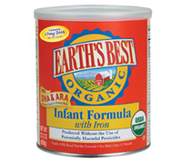
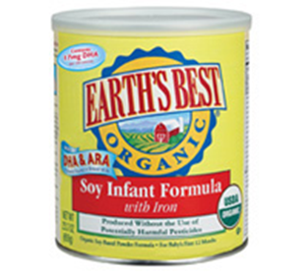
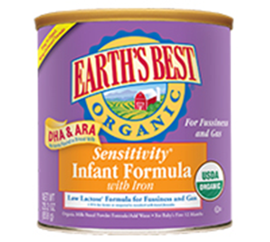
Earth’s Best Organic
Infant formula with Iron
Sensitivity Infant Formula with Iron
Soy Infant Formula with Iron

Slide 12
Cost of earth’s best organic products
23.20 ounce can powdered formula $28.15

Slide 13
Easiest directions to follow
All ready-to-feed formulas had the easiest directions to follow.

Slide 14
Best choice for limited income
 | Ready –to-Feed | Powdered
Similac | 32 oz for $6.78-$7.98 | 23.2 oz for $23.98
Enfamil | 48 oz for $9.97 | 23.4 oz for $23.98-$38.57
Parent’s Choice | 32 oz for 4.67 | 23.2 oz for $13.27-$15.98
Gerber | 24 oz for $8.99-$12.99 | 22 oz for $19-$20.19
Earth’s Best | NA | 23.2 oz for 28.15

