Slide 1


Breast Cancer and Prostate Cancer in France
By Megan Cuevas
and Demi Fox

Slide 2
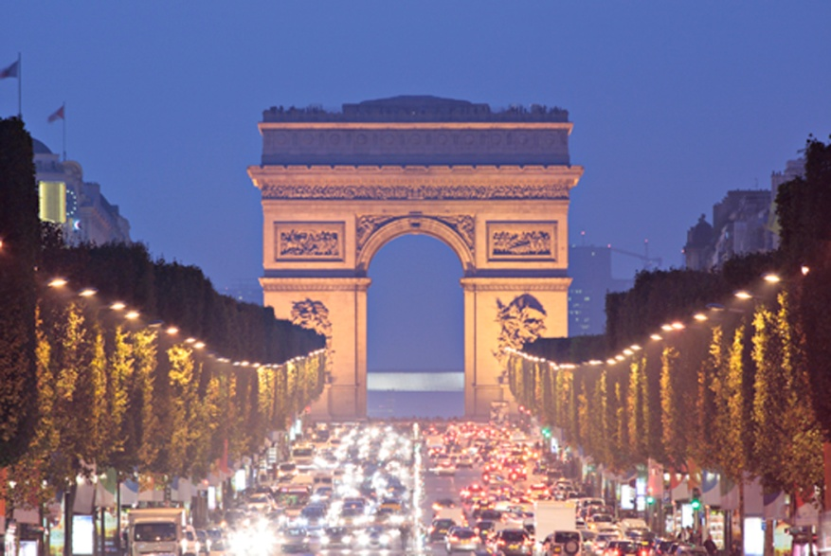

What’s it like?
Population : 65,312,249
0-14 years: 18.5% 15-64 years: 64.7% 65 years and over: 16.8%
Birth rate:12 births/1,000 population
Death rate:9deaths/1,000 population
Life expectancy at birth: total population: 81.19 years
*Index Mundi

Slide 3
Who are they?
Roman Catholic 83%-88%
Literacy: definition: age 15 and over can read and write total population: 99%
16.9% Obesity rate
*Index Mundi

Slide 4

Let’s get down to business…
#1 Universal Health Care, L’assurance maladie
3.4 physicians/1000 patients
Public versus private
75% of total health expenditures are covered government
10% of gross national income goes towards healthcare
336 linear accelerators compared to 279 in UK

Slide 5
Breast cancer
Breast cancers were previously classified either as ductal or lobular types, since it was believed that ductal carcinomas arose from ducts And lobular carcinomas from lobules. It is now known that both arise from the terminal duct lobular unit
Incidence has increased by 60% in past 20 years

Slide 6

Breast cancer in france
Rank 3rd for Breast cancer
Every year, 100 out of every 100,000 are affected
At least 52,000 new cases are estimated in 2010
Highest cancer among women

Slide 7

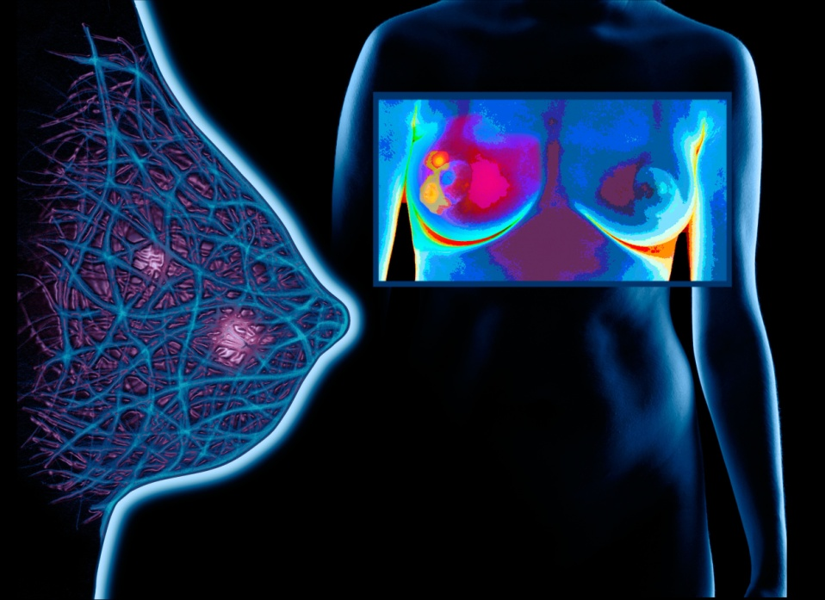
Prevention and Early detection
Mammograms
50- 74 y/o can get one every 2 years and is completely covered my insurance through local health authority
Under 50 with family history- free with GP referral
Clinical or self breast exams

Slide 8
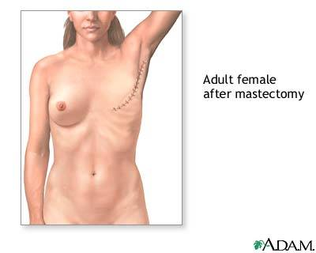
Treatment of BC
47,832 euros/year to treat breast cancer in 2004
http://www.doiserbia.nb.rs/img/doi/0354-7310/2011/0354-73101104059R.pdf
Radiation
Chemotherapy- Tamoxifen
Radical mastectomy/ lumpectomy
Hormone therapy
Targeted therapy- monoclonal antibodies and tyrosine kinase inhibitors

Slide 9
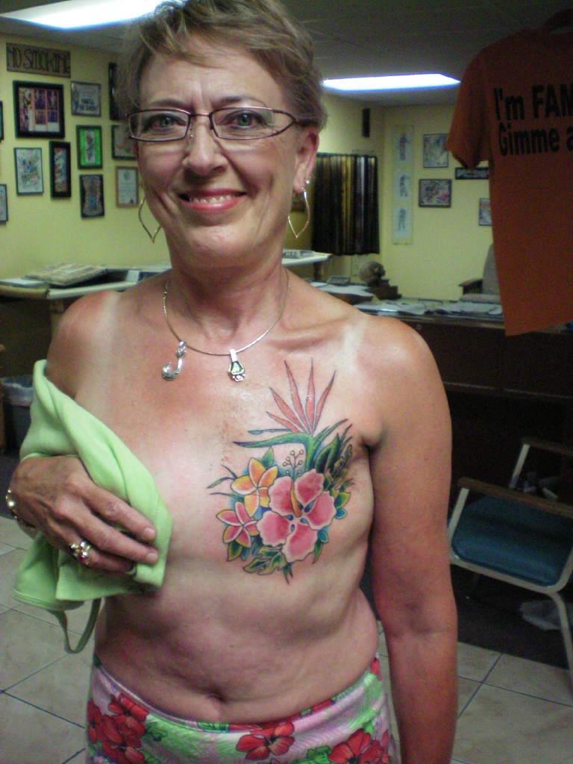
Survivors
Rate of 60.1-63.9% survival rate for breast cancer
News.bbc.co.uk

Slide 10
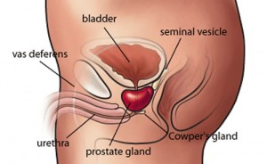
Prostate Cancer
Slow growing versus Aggressive
S&S: pain, difficulty with urination including frequency, hesitancy, intermittence, difficult or painful erections, hematuria, bloody semen, pain or stiffness in lower back, hips or upper thighs

Slide 11
Etiology
Age
Race- African Americans
Genetics
Infection
Exposure to chemicals
Hormones

Slide 12
Prostate cancer incidence
In 2005 prostate cancer was the most reported of all cancers in France, with 62,245 new cases and 9,202 deaths.
118 out of every 100,000 people are affected
Highest incidence >65 y/o
Metropolitan France ranked 4th
Martinique, France ranked #1

Slide 13
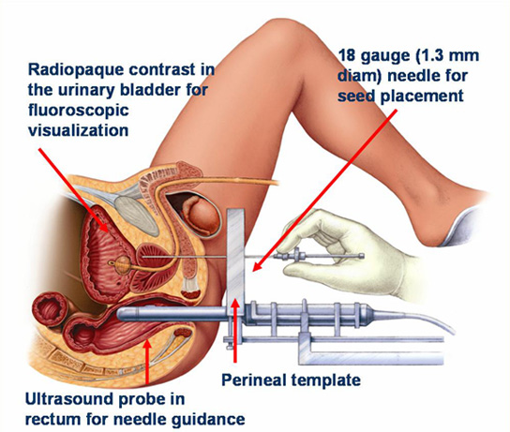
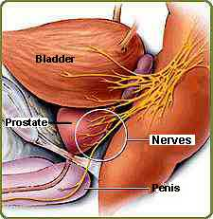
Treatment of PC
Surgery: radical prostatectomy (inguinal hernia), nerve-sparing, cryotherapy
Chemotherapy- Taxotere
Radiation (external/internal)
Immunotherapy- Sipuleucel-T(mets)
Hormone therapy
12,731 euro/ year

Slide 14

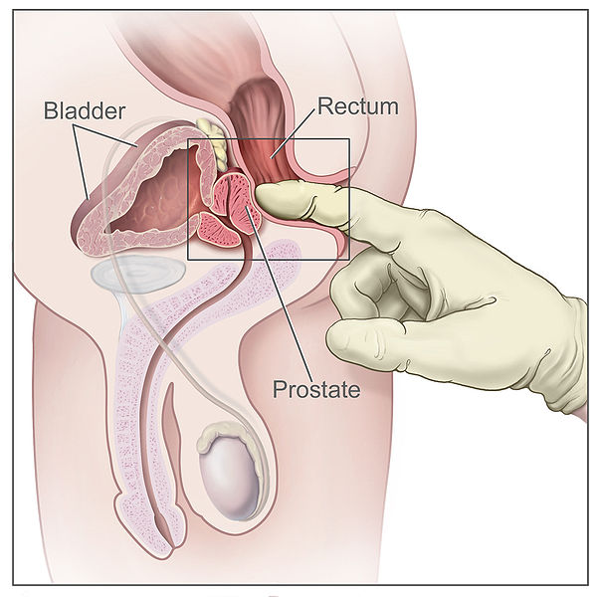

Fighting for the prostate
Digital Rectal exam
Prostate biopsy
Prostate specific antigen (PSA)- 4 or less
Chemoprevention with finasteride
www.PROACTIVE-cme.org

Slide 15

What’s new in France?
2010 study shows dogs can
sniff out prostate tumors,
according to French

Slide 16




In conclusion, get yourself checked!

Slide 17
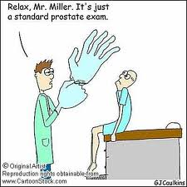

Slide 18
Citations
Index Mundi, (2011, July 12). France demographics profile 2011. Retrieved from http://www.indexmundi.com/france/demographics_profile.html
BrunNordqvistner, C. (2009, June 8). Medical news today. Retrieved from http://www.medicalnewstoday.com/articles/9994.php
http://www.urosource.com/fileadmin/user_upload/european_urology/PIIS1569905606001473.pdf
http://www.encr.com.fr/breast-factsheets.pdf
http://www.french-property.com/guides/france/public-services/health/system-overview/

