Slide 1
Breaks, Sprains and Wounds
Caitlin Morris
Lori Logan
John Muscetta
Tammy Duncil

Slide 2
Triage
Triage says you treat the most threatening injury first.
You help people who could be in a life threatening situation before those with a minor injury.
  Let’s imagine you, John, and Tammy were on a camping trip. While you are out walking, John and Tammy fall down a hill. John got a small cut on his leg. Tammy is unconscious. What do you do?
    In the above situation, you would assess Tammy and help her before you would wrap up John’s cut

Slide 3
Standard Precautions
Standard Precautions mean that we treat every victim as if they are infected with a disease that can be passed to us through their blood.
Standard Precautions also mean that we use personal protective equipment to prevent direct contact with a patient's blood or body fluids.
The consistent practice of Standard Precautions is the best method that we can use to protect ourselves from acquiring a bloodborne disease.
Treat all blood as if it were contaminated.
If possible, do not use bare hands to stop bleeding; always use a protective barrier; always was exposed skin areas with warm water and soap immediately after caring for the victim.
Should be included in all first-aid kits
  Disposable gloves
    Use when controlling bleeding or dressing wounds
  Plastic goggles or other eye protection
    To prevent victim’s blood from getting into your eyes in event of serious arterial bleeding.

Slide 4
How to Treat Severe Bleeding
Apply direct pressure over the wound with a clean cloth or sterile dressing.
Raise the injury above the level of the heart while pressing on the wound.
Apply pressure firmly without releasing until the bleeding stops.
If the bleeding does not stop, add additional dressings and put pressure to the pressure point on the victim’s groin or armpit.
Replace soaked dressing with fresh ones.
Secure the pad firmly when bleeding stops with wide bands of cloth tied snugly. Do not tie the cloths so snugly they cut off circulation.
Feel for a pulse further out on the limb. Loosen the bandage if there is no pulse.
Only use a tourniquet as a last resort if the bleeding cannot be stopped.

Slide 5
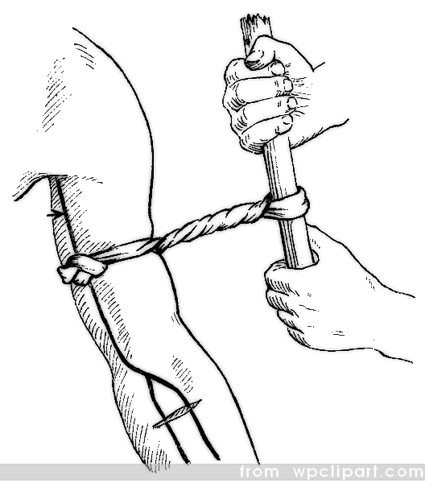
Tourniquets
Only use a tourniquet when a limb is severed or so badly mangled that you cannot stop heavy bleeding any other way, and there is a danger of the person bleeding to death.
Only use a tourniquet as a last resort, when a pressure dressing has failed to stop the bleeding or an arm or leg has been cut off.
Dangers of a tourniquet – As tourniquet cuts off blood supply, it can cause a limb to basically die from lack of blood. However, if someone gets a substantial wound, cutting off the blood supply can keep them from bleeding to death.

Slide 6
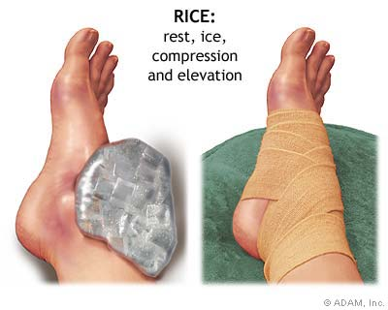

Slide 7
Broken Bones
Signs and Symptoms
  You heard a “snap” or a grinding noise during an injury
  There’s swelling, bruising, or tenderness
  The injured part is difficult to move or hurts when moving, being touched, or bearing weight
What to Do:
  Remove clothing from the injured area
  Apply an ice pack wrapped in cloth
  Keep the injured limb in the position you find it
  Place a simple splint, if you have one, on the broken area
  If broken skin, apply sterile bandage over the area
  If bone is visible protruding out of the skin, DO NOT TOUCH THE BONE OR TRY TO PUSH IT BACK INTO THE SKIN. APPLY STERILE BANDAGE TO COVER THE AREA.
  Get medical care, and don’t allow them to eat in case surgery is required

Slide 8
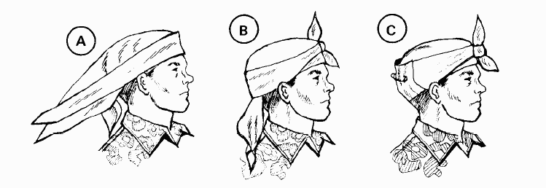
Applying a Bandage to the Head
Apply a Triangular Bandage to the Head.
To apply a triangular bandage to the head--
(1) Turn the base (longest side) of the bandage up and center its base on center of the forehead, letting the point (apex) fall on the back of the neck (Figure A).
(2) Take the ends behind the head and cross the ends over the apex.
(3) Take them over the forehead and tie them (Figure B).
(4) Tuck the apex behind the crossed part of the bandage and/or secure it with a safety pin, if available (Figure C). (Wilderness Survival, 2003)

Slide 9
Apply a cravat bandage to the shoulder or armpit
Make an extended cravat bandage by using two triangular bandages
Place the end of the first triangular bandage along the base of the second one
Fold the two bandages into a single extended bandage
Fold the extended bandage into a single cravat bandage.
After folding, secure the thicker part (overlap) with two or more safety pins
Place the middle of the cravat bandage under the armpit so that the front end is longer than the back end and safety pins are on the outside
Cross the ends on the top of the shoulder
Take one end across the back and under the arm on the opposite side and the other end across the chest. Tie the ends
Be sure to place sufficient wadding in the armpit. DO NOT tie the cravat bandage too tightly. Avoid compressing the major blood vessels in the armpit. (Wilderness Survival, 2003)

Slide 10
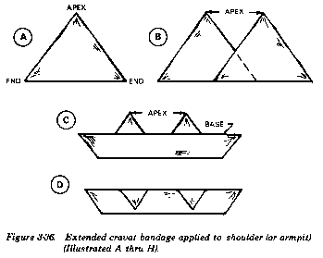
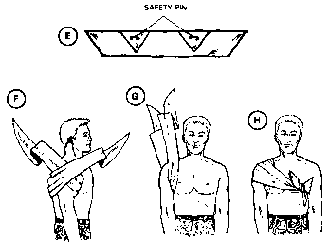
Apply a cravat bandage to the shoulder or armpit

Slide 11
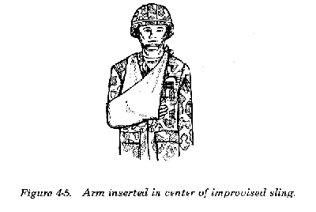
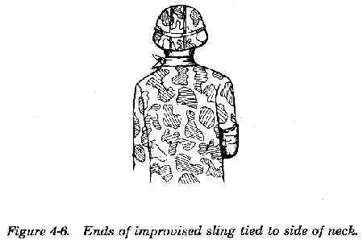
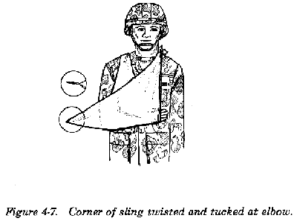
Broken Collarbone
Insert the splinted arm in the center of the sling
Bring the ends of the sling up and tie them at the side (or hollow) of the neck on the uninjured side
Twist and tuck the center of the sling at the elbow

Slide 12
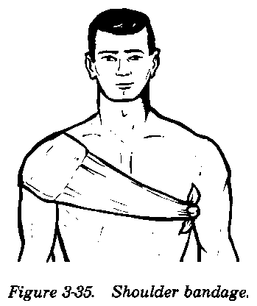
Upper Arm Injuries
    Try to immobilize the arm when you wrap it.
a. To apply bandages attached to the field first aid dressing--
(1) Take one bandage across the chest and the other across the back and under the arm opposite the injured shoulder.
(2) Tie the ends with a nonslip knot (Figure 3-35).

Slide 13
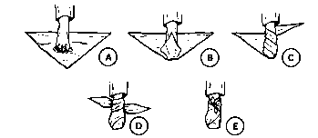
Apply a Triangular Bandage to the Foot
a. Place the foot in the middle of the triangular bandage with the heel well forward of the base. Ensure that the toes are separated with absorbent material to prevent chafing and irritation of the skin.
b. Place the apex over the top of the foot and tuck any excess material into the pleats on each side of the foot.
c. Cross the ends on top of the foot, take them around the ankle, and tie them at the front of the ankle.

