Slide 1
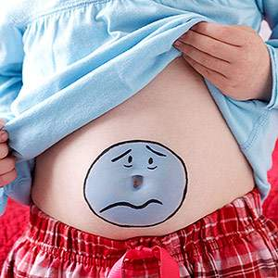
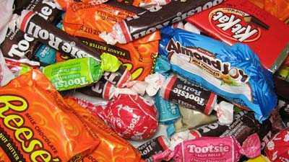
Abdominal Pain
What it feels like…
An ordinary belly ache, minor abdominal pain, bloating (indigestion), feeling gassy.
Possible causes…
Eating your food too quickly
Eating too much food at a time
Eating foods that did not mix well in your stomach
http://articles.petoskeynews.com/2011-10-26/halloween-candy_30326331
http://www.parents.com/health/stomach-ache/natural-tummy-ache-remedies/

Slide 2
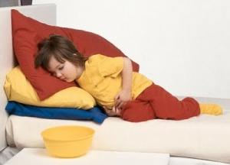
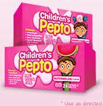
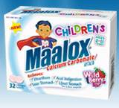
Abdominal Pain
Treatment…
Lay down and rest until your pain subsides
Try an over the counter medicine for indigestion such as Pepto-Bismol or Maalox. This can be found at your local drug store and should be kept in your first aid kit.
Avoid eating anymore solid food until the pain subsides
Do not use enemas or laxatives
Prevention
Eat several small meals a day rather than one large
meal and try to eat your meals slowly.
http://www.pepto-bismol.com/childrens-pepto-faq.php
http://www.maaloxus.com/index.shtml?kidsChildren
http://www.natural-homeremedies.com/blog/symptoms-and-natural-treatment-of-stomach-ache-in-kids/
Tip
1/3 t baking soda
½ glass water
Makes a perfect
substitute if no
Antacid is on
Hand!

Slide 3
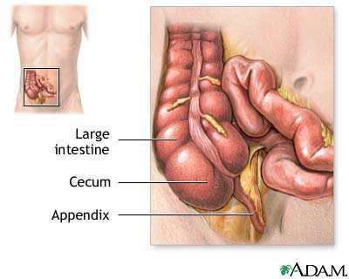
Severe Abdominal Pain
What it feels like…
Severe belly ache, a belly ache
lasting more than one hour,
abdominal pain with an unknown
cause
Possible causes…
Appendicitis
Gallbladder disease
Peptic ulcer disease
Strangulated hernia
Heart attack
http://www.umm.edu/patiented/articles/appendix_000170.htm
Appendicitis is the swelling of your appendix, a small
Pouch attached to your intestines. . If the pouch swells
too much it risks rupturing and causing serious infection.
Signs of appendicitis include severe pain in your abdomen
that moves to the lower right area of your belly. You may
also experience a fever, nausea, constipation, and loss of
appetite. You should not try to eat or drink and should
seek medical attention immediately.

Slide 4
Severe Abdominal Pain
Treatment…
The patient should lay down and a doctor should be called
It is important to get medical assistance immediately
The patient should not eat or drink anything
Prevention…
These types of health problems are generally not preventable, though a healthy diet can minimize risks of complications
FOOD

Slide 5
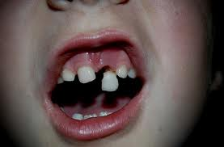
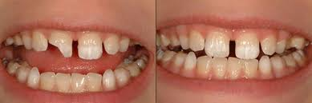
Broken, Chipped, or Loosened Tooth
What it is…
A broken, chipped, or loose tooth
Possible Causes…
Trauma to the mouth
http://www.thegentledentist.com/what-to-do-when-your-child-falls-and-breaks-their-front-teeth/
http://fromdortmund.com/wp-content/uploads/2011/10/

Slide 6
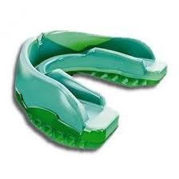
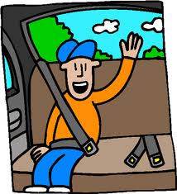
Broken, Chipped, or Loosened Tooth
Treatment…
Gently rinse your mouth with warm water to remove dirt or debris
Immediately go to the dentist, don’t forget to take any pieces of your tooth that may have been chipped off with you!
Prevention…
These types of injuries are generally prevented by wearing proper safety attire while playing sports, wearing your safety belt while in a vehicle, and avoiding chewing and biting on hard items.
http://mblind.hubpages.com/hub/Protect-Your-
Teeth-with-a-Mouth-Guard
http://www.westridge.provo.edu/Site_Home/home.htm

Slide 7
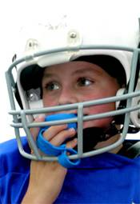
Knocked Out Tooth
What it is…
A knocked out tooth
Possible Causes…
Accident or Injury
Prevention…
These types of injuries are generally prevented by wearing proper safety attire while playing sports, wearing your safety belt while in a vehicle, and avoiding chewing and biting on hard items.
http://www.yourdentistryguide.com/mouth-guards/

Slide 8
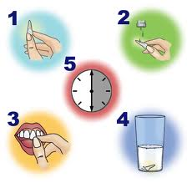
Knocked Out Tooth
Treatment…
Handle the tooth only by the crown, not the roots
Gently rinse the tooth with water or milk
Gently insert and hold the tooth into the socket with the roots completely embedded.
Have the patient bite on a piece of gauze to hold the tooth in place if possible.
If the tooth cannot be placed back in place, put it in a cup of milk or cool water.
The patient needs to seek immediate dental attention, within 30 minutes.
http://www.lacewoodendodontics.com/avulsed.html

