Slide 1


Breast Cancer and Prostate Cancer in France
By Megan Cuevas
and Demi Fox

Slide 2
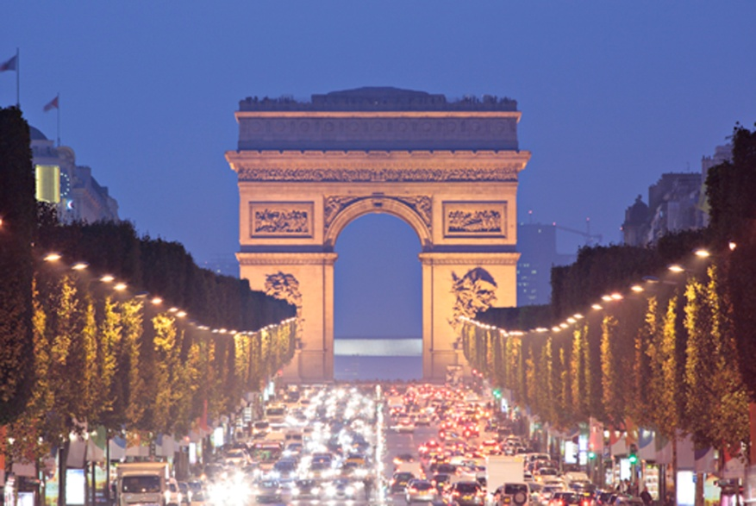

What’s it like?
Population : 65,312,249
0-14 years: 18.5% 15-64 years: 64.7% 65 years and over: 16.8%
Birth rate:12 births/1,000 population
Death rate:9deaths/1,000 population
Life expectancy at birth: total population: 81.19 years

Slide 3

Life in France
Roman Catholic 83%-88%
Literacy: definition: age 15 and over can read and write total population: 99%
16.9% Obesity rate

Slide 4

Let’s get down to business…
#1 Universal Health Care, L’assurance maladie
3.4 physicians/1000 patients
Public versus private
75% of total health expenditures are covered by government
10% of gross national income goes towards healthcare
336 linear accelerators compared to 279 in UK

Slide 5

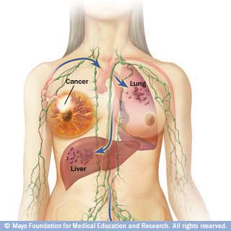
Breast cancer in France
Rank 3rd for Breast cancer
Every year, 100 out of every 100,000 are affected
At least 52,000 new cases are estimated in 2010
Highest cancer among women

Slide 6
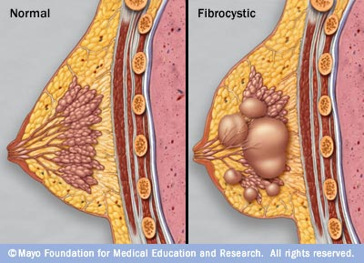
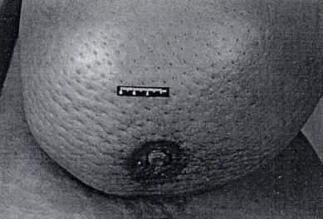
Breast cancer
Ductal versus Lobular
both arise from the terminal duct lobular unit
Incidence has increased by 60% in past 20 years
Clinical Manifestations: Lumps(especially in LOQ, hard, irregular), nipple discharge, nipple retraction, peau d’orange(skin of an orange)

Slide 7
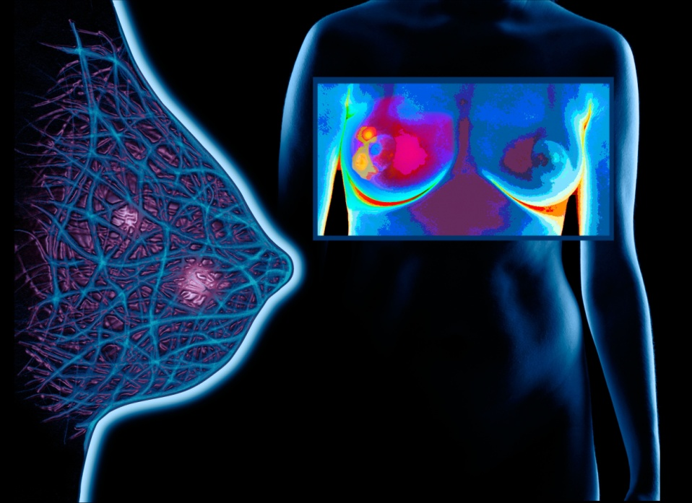
Prevention
Mammograms
50- 74 y/o can get one every 2 years and is completely covered my insurance through local health authority
Under 50 with family history- free with GP referral
Clinical or self breast exams

Slide 8
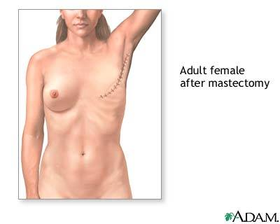
Treatment of BC
47,832 euros/year to treat
breast cancer in 2004
Radiation
Chemotherapy- Tamoxifen
Radical mastectomy/ lumpectomy
Hormone therapy
Targeted therapy- monoclonal antibodies and tyrosine kinase inhibitors
Notes:
http://www.doiserbia.nb.rs/img/doi/0354-7310/2011/0354-73101104059R.pdf

Slide 9



I’m a Survivor!
60.1-63.9% survival rate for
breast cancer
News.bbc.co.uk

Slide 10
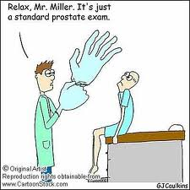
Now for the guys…

Slide 11
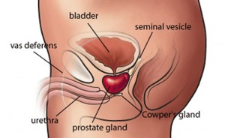
Prostate Cancer
Slow growing versus Aggressive
Clinical manifestations: pain, difficulty with urination including frequency, hesitancy, intermittence, difficult or painful erections, hematuria, bloody semen, pain or stiffness in lower back, hips or upper thighs

Slide 12
Prostate cancer incidence
In 2005, deemed the most reported of all cancers in France, with 62,245 new cases and 9,202 deaths.
118 out of every 100,000 people are affected
Highest incidence >65 y/o
Metropolitan France ranked 4th
Martinique, France ranked #1

Slide 13

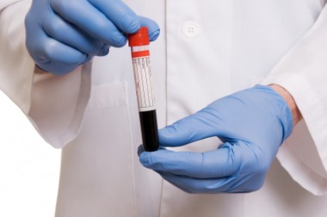
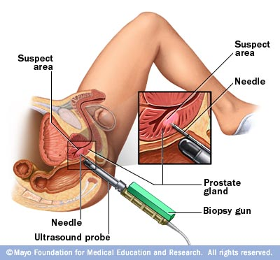
Fighting for the prostate
Prostate biopsy
Prostate specific antigen (PSA)- 4 or less
Chemoprevention with finasteride
www.PROACTIVE-cme.org
And the dreaded and highly feared…

Slide 14
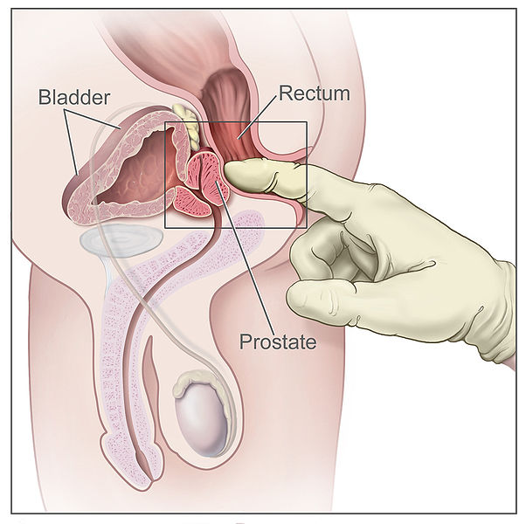


Digital Rectal Exam

Slide 15
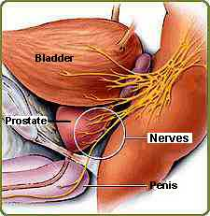
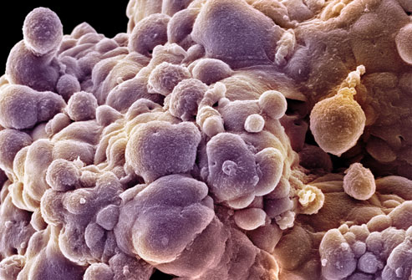
Treatment of PC
12,731 Euros annually
Surgery: radical prostatectomy (inguinal hernia), nerve-sparing, cryotherapy
Radiation (external/internal)

Slide 16
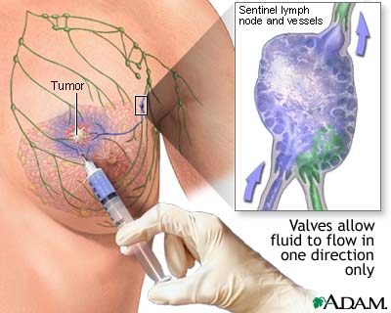
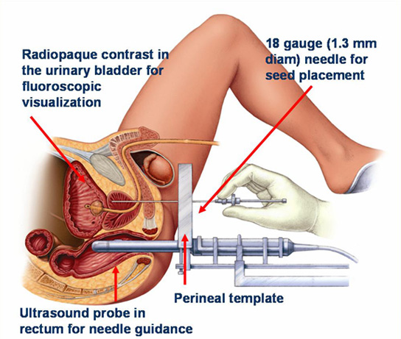
Other Treatments
Chemotherapy- Taxotere
Immunotherapy- Sipuleucel-T(mets)
Hormone therapy

Slide 17

What’s new in France?
2010 study shows dogs can
sniff out prostate tumors
2011 study shows that signs of male pattern baldness at the age of 20 may be a risk factor(2x more likely) for prostate cancer
Notes:
http://www.businessweek.com/lifestyle/content/healthday/649945.html

Slide 18



In conclusion…

Slide 19
Citations
Index Mundi, (2011, July 12). France demographics profile 2011. Retrieved from http://www.indexmundi.com/france/demographics_profile.html
BrunNordqvistner, C. (2009, June 8). Medical news today. Retrieved from http://www.medicalnewstoday.com/articles/9994.php
Teillac, Pierre, (2006, May). Prostate Cancer Prevention Trial and Its Implications for Clinical Practice: A European Consensus. Retrieved from http://www.urosource.com/fileadmin/user_upload/european_urology/PIIS1569905606001473.pdf.
Tyczynski, Jerzy, (2002, December). Breast Cancer in Europe. Retrieved from http://www.encr.com.fr/breast-factsheets.pdf .

