Slide 1
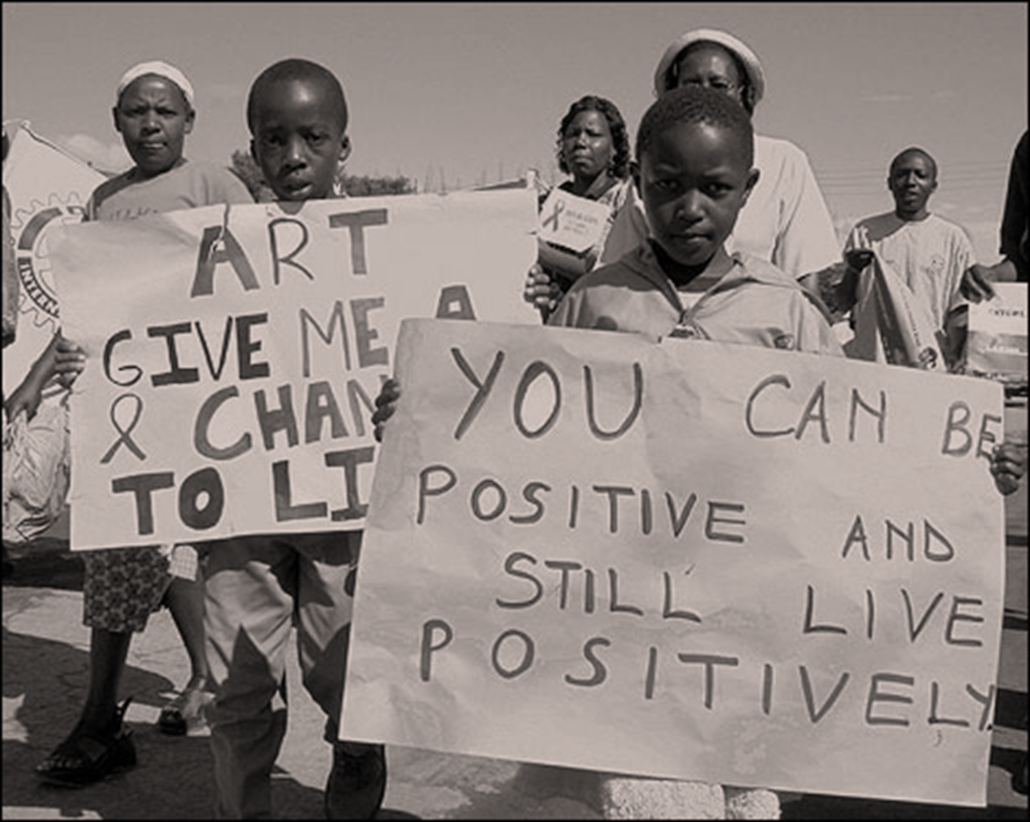
Battling HIV and AIDS
Country of Kenya

Slide 2
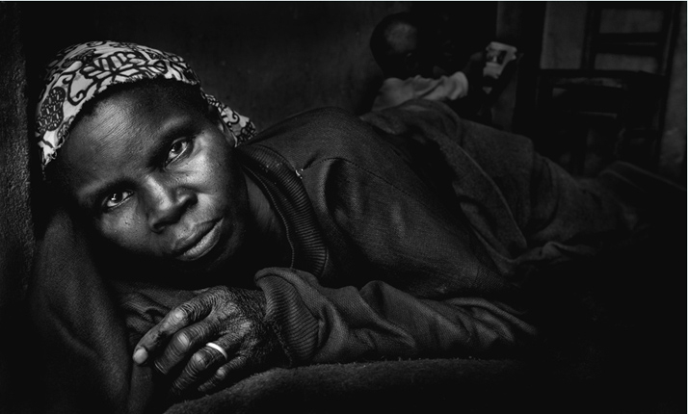
Harambee
“Let us all pull together.”
Population: 41,070,934
Age structure: 0-14 years: 42.2% (male 8,730,845/female 8,603,270)
15-64 years: 55.1% (male 11,373,997/female 11,260,402)
65 years and over: 2.7% (male 497,389/female 605,031) (2011 est.)
Birth rate: 33.54 births/1,000 population (2011 est.)
Death rate: 8.93 deaths/1,000 population (July 2011 est.)
Urbanization: urban population: 22% of total population (2010)
rate of urbanization: 4.2% annual rate of change (2010-15 est.)
Sex ratio: at birth: 1.02 male(s)/female
Major infectious diseases: degree of risk: high
food or waterborne diseases: bacterial and protozoal diarrhea, hepatitis A, and typhoid fever
vectorborne disease: malaria and Rift Valley fever
water contact disease: schistosomiasis
animal contact disease: rabies (2009)

Slide 3

Harambee
“Let us all pull together.”
Ethnic groups: Kikuyu 22%, Luhya 14%, Luo 13%, Kalenjin 12%, Kamba 11%, Kisii 6%, Meru 6%, other African 15%, non-African (Asian, European, and Arab) 1%
Religions: Protestant 45%, Roman Catholic 33%, Muslim 10%, indigenous beliefs 10%, other 2%
note: a large majority of Kenyans are Christian, but estimates for the percentage of the population that adheres to Islam or indigenous beliefs vary widely
Languages: English (official), Kiswahili (official), numerous indigenous languages
Literacy: definition: age 15 and over can read and write
total population: 85.1%
male: 90.6%
female: 79.7% (2003 est.)
Government type: republic
Legal system: mixed legal system of English common law, Islamic law, and customary law; judicial review in High Court

Slide 4
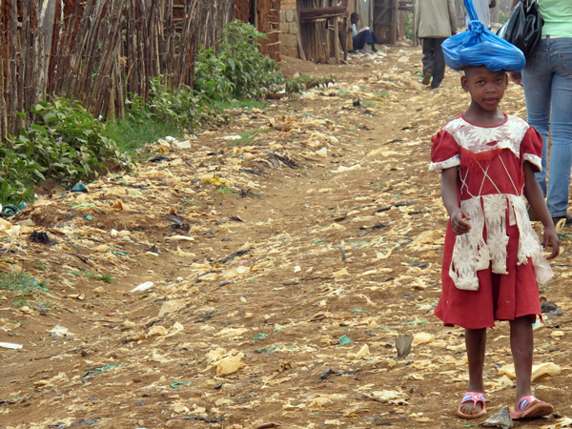
Kenya’s Economy
Economy - overview: Although the regional hub for trade and finance in East Africa, Kenya has been hampered by corruption and by reliance upon several primary goods whose prices have remained low. In 1997, the IMF suspended Kenya's Enhanced Structural Adjustment Program due to the government's failure to maintain reforms and curb corruption. The IMF, which had resumed loans in 2000 to help Kenya through a drought, again halted lending in 2001 when the government failed to institute several anticorruption measures. In the key December 2002 elections, Daniel Arap MOI's 24-year-old reign ended, and a new opposition government took on the formidable economic problems facing the nation. After some early progress in rooting out corruption and encouraging donor support, the KIBAKI government was rocked by high-level graft scandals in 2005 and 2006. In 2006, the World Bank and IMF delayed loans pending action by the government on corruption. The international financial institutions and donors have since resumed lending, despite little action on the government's part to deal with corruption. Post-election violence in early 2008, coupled with the effects of the global financial crisis on remittance and exports, reduced GDP growth to 1.7 in 2008, but the economy rebounded in 2009-10.
Population below poverty line: 50% (2000 est.)

Slide 5
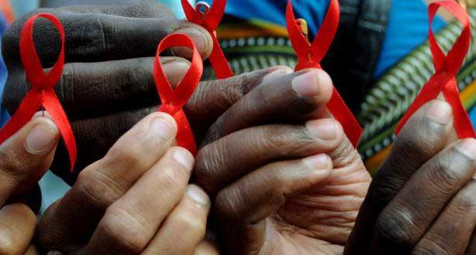
Battling HIV & AIDS
HIV/AIDS - adult prevalence rate: 6.3% (2009 est.)
HIV/AIDS - people living with HIV/AIDS: 1.5 million (2009 est.)
HIV/AIDS - deaths: 80,000 (2009 est.)
Hospital bed density: 1.4 beds/1,000 population (2006)
Health expenditures: 12.2% of GDP (2009)
Definition: This entry provides the total expenditure on health as a percentage of GDP. Health expenditures are broadly defined as activities performed either by institutions or individuals through the application of medical, paramedical, and/or nursing knowledge and technology, the primary purpose of which is to promote, restore, or maintain health.
Physicians density: 0.14 physicians/1,000 population (2002)
Definition: This entry gives the number of medical doctors (physicians), including generalist and specialist medical practitioners, per 1,000 of the population. Medical doctors are defined as doctors that study, diagnose, treat, and prevent illness, disease, injury, and other physical and mental impairments in humans through the application of modern medicine. They also plan, supervise, and evaluate care and treatment plans by other health care providers. WHO estimates that fewer than 23 health workers (physicians, nurses, and midwives only) per 10,000 would be insufficient to achieve coverage of primary healthcare needs.
Orphan: There are 1,200,000 children left as orphans because 1 or both parent(s) died of AIDs.

Slide 6
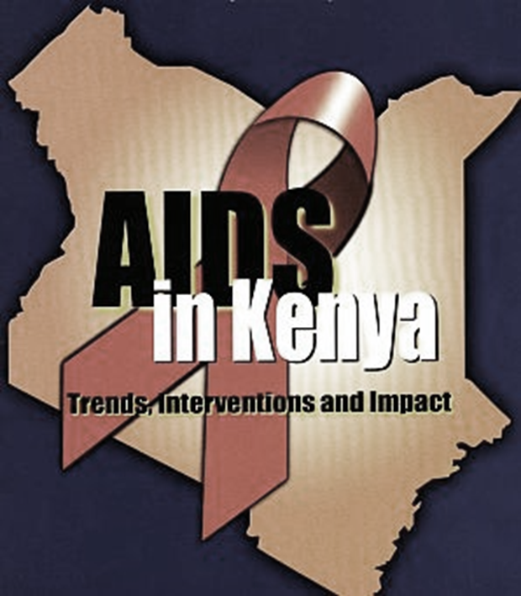

Slide 7
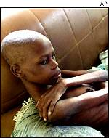
Cost of AIDS & HIV
In 2008/09 total funding for HIV/AIDS in Kenya amounted to $687 million.119 Funding comes from a range of donors, the most significant of which is the U.S. government. In FY 2009 funding from the U.S. President’s Emergency Plan for AIDS relief (PEPFAR) amounted to $541.5 million.120The Global Fund is the second largest contributor to HIV/AIDS funding in Kenya, having distributed $87,417,519 in total
The Kenyan government have pledged to address their HIV funding crisis by focusing on past and present shortfalls in financial management, tracking and transparency.129 In addition, Michel Sidibe, executive director of UNAIDS, has identified Kenya’s need to achieve financial sustainability for its AIDS programmes through domestic funding.130 The government of Kenya has pledged $34 million annually for five years to go towards HIV and AIDS programmes.131 However, external sources continue to account for 85 percent of all HIV funding.

Slide 8
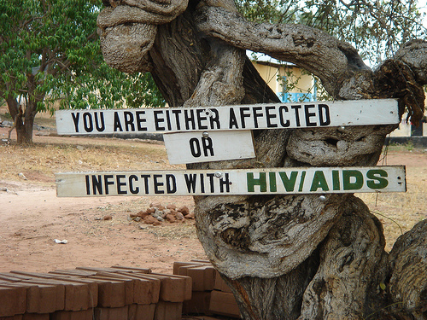
Prevalence of HIV
HIV prevalence rate, men 15-49 years old, in national based surveys
Year Value Footnotes
2003: 4.6
HIV prevalence rate, women 15-49 years old, in national based surveys
Year Value Footnotes
2003: 8.7

Slide 9
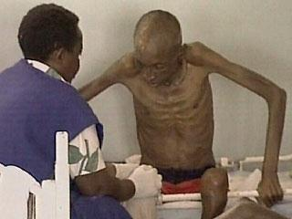
Death caused by AIDS
AIDS deaths
Year Value Footnotes
2008: 91000
2009: 80000
AIDS deaths (lower bound)
Year Value Footnotes
2008: 73000
2009: 61000
AIDS deaths (upper bound)
Year Value Footnotes
2008: 110000
2009: 99000

Slide 10
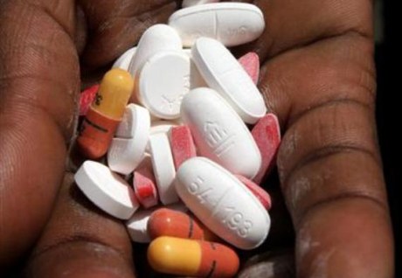
Treatment of HIV & AIDS
In 2003 only 5 percent of people needing ART were receiving antiretroviral therapy.98 In 2006 Kenya’s President announced that antiretroviral drugs would be provided for free in public hospitals and health centres.99 In 2007 treatment coverage was low at 42 percent with only 172,000 on treatment.100 Nevertheless, by 2009 the number of people receiving antiretroviral therapy had significantly increased to 336,980. However, due to a 2010 change in WHO treatment guidelines, which recommend starting treatment earlier, the proportion of people eligible to receive antiretroviral treatment remained at only 48 percent.101 Under the previous guidelines, treatment coverage would have been 65 percent. By 2010, access to treatment had increased further with 432,621 receiving treatment, around 61 percent of those in need.
Despite an increase in access to HIV treatment for children, the overall coverage for children remains extremely low. Of those receiving treatment, most are adults with 74 percent of adults in need of treatment receiving it. In contrast only 21 percent of children living with HIV in need of treatment are receiving it.109 A child’s access to treatment can sometimes be inhibited by reasons other than the reach of treatment services. According to Human Rights Watch reasons for this include: neglect on part of the children’s caregivers; a lack of accurate information about medical care for children; and the stigma and guilt associated with HIV and AIDS.
“Often, when other family members take in AIDS orphans, they really do not want to associate with that child. They are worried that they and their children could get infected.”- Manager of an orphanage for HIV-positive children in Kenya111
Adequate nutrition for people living with HIV is essential. Yet, as poverty levels are high in Kenya and food shortages frequent, people living with HIV are often unable to eat a healthy, balanced diet.112 Evidence shows that malnourished people are less likely to benefit from antiretroviral treatment and are at a higher risk of quicker progression to AIDS. In addition, taking treatment without food can be very painful.

Slide 11
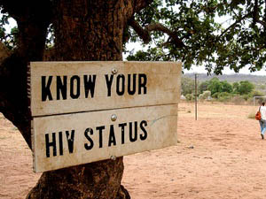
HIV Prevention
Men 15-24 years old with comprehensive correct knowledge of HIV/AIDS, percentage
Year Value Footnotes
2003: 47.2
2009: 54.9
Women 15-24 years old with comprehensive correct knowledge of HIV/AIDS, percentage
Year Value Footnotes
2000: 26.4
2003: 33.8
2009: 47.5

Slide 12
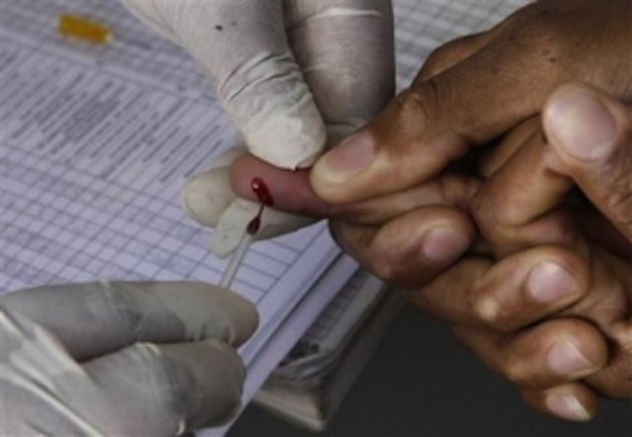
HIV Prevention
Prevention: A principle aim of the 2009/10-2013/14 Kenyan National HIV and AIDS Strategic Plan (KNASP III) is to reduce the number of new HIV infections by using evidence-based approaches to HIV prevention. Six main outcomes are outlined to be achieved in the latest Strategic Plan:
Reduced risky behaviour among the general, infected, most-at-risk and vulnerable populations.
Proportion of eligible PLHIV (people living with HIV) on care and treatment increased and sustained.
Health systems deliver comprehensive HIV services.
HIV mainstreamed in sector-specific policies and sector strategies.
Communities and PLHIV networks respond to HIV within their local context.
KNASP III stakeholders aligned and held accountable for results.
HIV testing
HIV testing has widely expanded across Kenya since the beginning of the millennium. In 2000 there were only three voluntary counseling and testing (VCT) sites nationwide; by 2007 there were almost 1000.39 HIV testing and counseling facilities increased to 4,438 in 2010.40 Alongside voluntary testing, provider initiated counseling and testing (PCT) has expanded and is now available in 73 percent of health facilities.41 PCT is when individuals are offered a HIV test whenever they go to a health facility, rather than patients having to ask for a test.

Slide 13
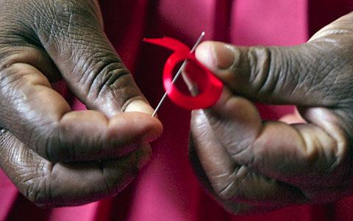
One step at a time..
Although Kenya has seen a dramatic reduction in HIV prevalence figures since 2000, the country is still facing a severe AIDS epidemic. In order to make progress in Kenya, the following areas need to be addressed:
The Kenyan government needs to increase the number of people who know their HIV status by promoting and expanding access to HIV testing.
Social, economic and legal gender inequalities in Kenya need to be addressed in order to reduce the disproportionately high HIV prevalence among women.
Among high-risk groups, Kenya needs to expand its HIV prevention work and increase access to HIV testing and treatment.
Stigma and discrimination towards those living with HIV must be eradicated.
As Kenya’s antiretroviral treatment program continues to expand, the country needs to find sustainable sources of money to finance the growing need for antiretroviral drugs.

Slide 14
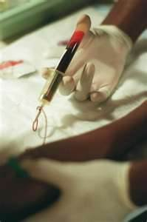
Bibliography
(n.d.). Retrieved from http://www.indexmundi.com/kenya/
(n.d.). Retrieved from http://www.avert.org/hiv-aids-kenya.htm

