Slide 1
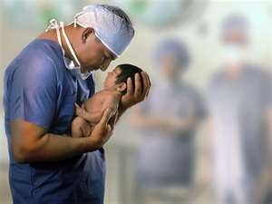
Appearance of Newborn

Slide 2
Appearance of Newborn
Newborns have many variations in normal appearance from color to the shape of the head. Some of these differences are just temporary a part of the physical adjustments a baby goes through. Others such as birthmarks may be permanent. Understanding the normal appearance of newborns can help you know that your baby is healthy. Some of the normal variations in newborns include the following.
Color: A baby’s skin color can vary depending on the baby’s age, race or ethnic group, temperature and whether or not the baby is crying. Skin color often changes with the environment and health. When the baby is first born, the skin is dark red to purple. As the baby begins to breath air the color changes to rd. This redness or dark pink begins to fade in the first day. The hands and feet may stay bluish in color for several days. This is a normal response to the baby’ immature blood circulation. Some develop a yellow coloring called jaundice. This may be a normal response as the baby rids excess red blood cells. Jaundice can often be seen by gently pressing on the baby’s forehead or chest and watch the color return. If this occurs consult with your physician.
Molding: This is the elongation of the shape of the baby’s head. This occurs when the movable bones of the baby’s head overlap to help the baby pass through the mother’s birth canal. Normal shape usually returns by the end of the first week.
Erythema Toxicum: This is a red rash on newborns that is often described as flea bites. It is commonly noted on the chest and back but may be found all over. Approximately one half of all babies develop this in the first few days. The cause is unknown but it is not dangerous. It disappears by itself in a few days.

Slide 3
Appearance of the Newborn
Vernix: This is the white greasy, cheese-like substance that covers the skin of a baby at birth. This substance protects the baby’s skin from the amniotic fluid during pregnancy. It does not need to be removed and is usually absorbed into the skin.
Lanugo: This is the soft, downy hair on the baby’s body esp. on the shoulders, back forehead and cheeks. This is a normal finding.
Milia: These are the tiny white hard spots that look like pimples on the baby’s nose, chin and forehead. They are formed from oil glands and disappear on their own. They may appear in the baby’s mouth and gums. These are called Epstein Pearls. Do not squeeze or scrape these as this may result in infection.
Stork Bites or Salmon Patches: These are small pink or red patches often found on the baby’s eyelids, upper lip and back of the baby’s neck. They are caused by a concentration of immature blood vessels and may be more visible when the baby is crying. Most often these fade and disappear completely.
Mongolia Spots: These are blue or purple colored splotches on the baby’s lower back and buttocks. Over 80% of African Americans, Asian and Indian babies have mongolia spots. They are caused by a concentration of pigmented cells and they usually disappear in the first 4 years.

Slide 4
Appearance of the newborn
Acne Neonatum: Approximately one fifth of newborns develop pimples in the first month. They usually appear on the cheeks and forehead. It is thought that they are caused by maternal hormones. They usually disappear with in a few months. Do not try to open or squeeze them as this can lead to infection.
Newborn breast swelling: Breast enlargement may occur around the third day of life. In the first week a milky substance (sometimes called witches milk) may leak from the nipples. This is related to the mother’s hormones and goes away with in a few days to weeks. Do not massage or squeeze the breasts or nipples as this may cause an infection in the breasts.
Swollen Genitals/Discharge: A newborns genitals may appear different depending on the gestational age (the number of weeks of pregnancy). Premature baby girls may have a prominent clitoris and inner labia. A baby born closer to full term has a large outer labia. Girls may have a small amount of whitish discharge or bloody tinged mucous from the vagina in the first few weeks. This is a normal occurrence and is related to the mother’s hormones. Premature boys may have a smooth, flat scrotum with undescended testicles. Boys born late in pregnancy have ridges in the scrotum with undescended testicles. The boy’s scrotum may appear swollen but this is normal as it relates to the mother’s hormones.

Slide 5
Appearance of the newborn
Swollen and Bruising of the Face: This may occur as the result of the labor and delivery process. The head may appear longer than normal as it must go through the birth canal. This is normal and the head will return to the round shape with in a couple of weeks. Occasionally the physician will use devices that aide in the delivery of the baby such as forceps or a vacuum device. These may leave some bruising on the face or head of the baby. These are temporary and will disappear with in a week or two. If a vacuum device was used there may be a lump on the head called a caput succedaneum. This will begin to disappear with in a few hours.
Eye Color: Eye color is determined by a substance called melanin (a dark pigment contained in the iris) and the genetic makeup of the parents. The baby’s eyes are not fully developed at birth. Permanent eye color is not set until the baby is at least 9 months old as he will have half of his/her adult melanin by this time. It may take up to 3 years before the eyes come to the final color. Usually somewhat darker than the eyes he/she was born with.
Usually the features that make a normal newborn strange are temporary. In the eyes of the adoring parent every infant looks like the perfect baby!!!!!

Slide 6
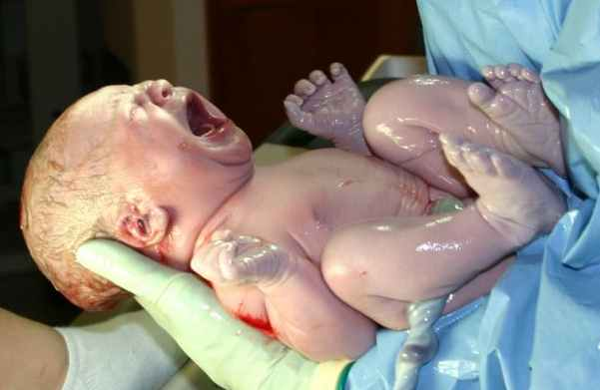
Reflexes of the Newborn

Slide 7
Reflexes of the Newborn
Rooting Reflex: To elicit this reflex you will touch the baby’s lip’ cheek or corner of mouth with nipple or finger. The normal response will be that the baby turns head toward the nipple or finger and opens its mouth. The reflex may not occur if the baby is in deep sleep or after he/she has been fed.
Sucking Reflex: To elicit the reflex touch the lip, cheek or corner of mouth with nipple or finger. The normal response is the baby will open mouth and begin to suck on nipple or finger. Reflex may not occur if baby is in deep sleep.
Swallowing Reflex: Swallowing will occur following sucking and obtaining fluids. It usually occurs without gagging, coughing, breathing or vomiting. Swallowing is coordinated with sucking and breathing.
Grasp Palmer Reflex: To elicit this reflex place your finger in the palm of baby’s hand. The baby’s fingers will curl around your finger. This reflex will lesson by the third or fourth month.
Planter Grasp Reflex: Place your finger at the base of the baby’s toes. The baby’s toes will curl downward. This reflex will lesson by 8 months.
Extrusion Reflex: Touch or depress the tip of the baby’s tongue. The baby will force the tongue outward. This reflex disappears about the forth or fifth month.

Slide 8
Reflexes of the newborn
Glabellar Reflex AKA Myerson Reflex: Gently tap over the baby’s forehead, bridge of nose or cheek when their eyes are open. The baby will blink for the first 4 or 5 taps.
Tonic Neck or Fencing Reflex: While the baby is on his/her back, turn his /her head toward to one side. The normal response when the baby’s face is turned to the left side the left arm and leg will extend (straighten) and the right arm and leg will flex. If the baby’s face is turned to the right side the right arm and leg will extend and the left arm and leg will flex.
Moro Reflex AKA Startle Reflex: To elicit this reflex hold the baby in a semi-sitting position and allow the head and trunk (body) of the baby to fall backward with support or place baby on back on a flat surface, make a loud abrupt noise. The response is that the baby’s arms move away and up from the body. The fingers fan out and the thumb and forefinger form a C and a slight tremor may be noted. The arms return toward the body as in an embracing motion and return to a relaxed movement. A cry may occur or follow the baby’s movements. The legs may follow a similar pattern of response. This reflex is present at birth and the complete response may be seen until 8 weeks old then a body jerk only is seen between 8 and 18 weeks old.
The Stepping or Walking Reflex: Hold the baby up under the arms of the trunk allowing one foot to touch the surface of the table. The normal response is that the baby will simulate walking. The baby will alternate lifting the leg up and putting it back down. The full term baby will walk on the soles of his/her feet and the preterm baby will walk on their toes. This response is present for 3 to 4 months after birth.

Slide 9
Reflexes of the newborn
Crawling Reflex: Place the baby on his/her stomach. The baby will make crawling movements with arms and legs. This response will disappear about 6 weeks of age.
Deep Tendon Reflex: Use your finger to tap on the knee cap. The knee should slightly jerk but an overall reaction may be seen as well.
Crossed Extension Reflex: Place the baby on his/her back. Gently pull to straighten one leg and press down on the knee then stimulate the sole of the foot. This will cause the other leg to flex upward toward the body and extend down as if attempting to push away the person stimulating the foot. This will be present during the newborn period.
Babinski or Planter Reflex: To elicit this response strike the outer portion of the foot upward beginning at the heel and continue up and across the ball of the foot to the great toe. The result will be that all toes will hyperextend or fan out and the great toe will flex back (dorsiflexion). This is a positive normal sign for the newborn.
Truncal Incurvation (Galant) Reflex: Lay the baby on his/her stomach on a flat surface. Run your finger down the back along the spine about 2 to 3 inches first on one side then on the other side. The response is that the baby flexes his/her trunk and swings his/her pelvis toward the stimulus.

Slide 10
Reflexes of the Newborn
Magnet Reflexes: To elicit this reflex place the baby on his/her back. Put your thumbs on both feet while holding the heels and partially push up on both soles of feet. The result should be both lower limbs extend (straighten) against the examiners (your) hands.
Other Reflexes: Yawn, stretch, burp, hiccup and sneezes are spontaneous behaviors. These may be slightly depressed temporarily because of maternal analgesic or anesthesia given to her in labor.

