Slide 1
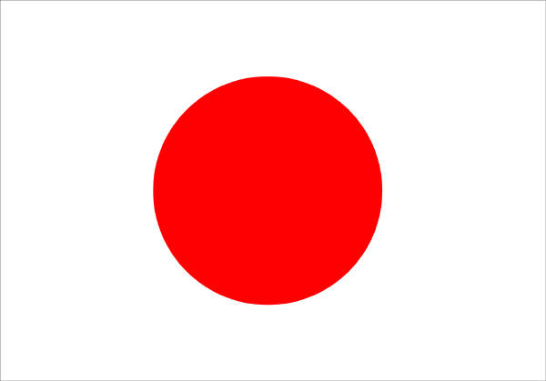
An Assessment of Breast and Prostate Cancer in
Japan
By: Tammy Duncil and Andrea Flewelling

Slide 2
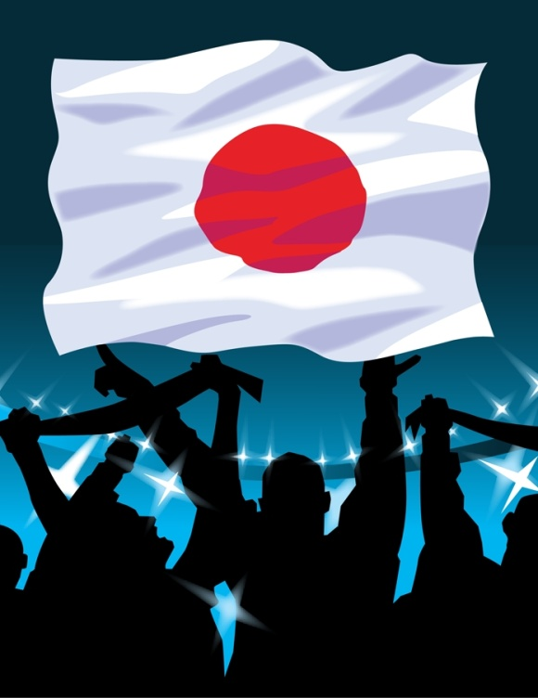
Japan
Island nation located off the east coast of Korea
Terrain: Rugged, Mountainous Islands
Climate: Subtropical to temperate
Area of Land and Water: 145,902 sq/miles (about 11% smaller than California)
Capital City: Tokyo
Government: Constitutional Monarchy with a Parliamentary Government
U.S. Department of State: www.state.gov

Slide 3
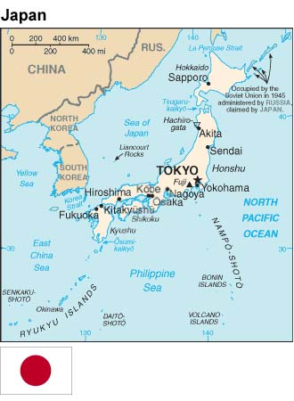
Snapshot of the Japanese Population
Population: 128,056,000¹
Female: 62,360,000¹
Males: 65,697,000¹
Age 65+: 23.1%¹
Median Age: 44.8²
  Median Age Male: 43.2
  Median Age Females: 46.7
¹Country Health Information Profiles 2009 and 2011 on World Health Organization: Western Pacific Region at www.wpro.who.int
²CIA World Fact Book: www.cia.gov

Slide 4
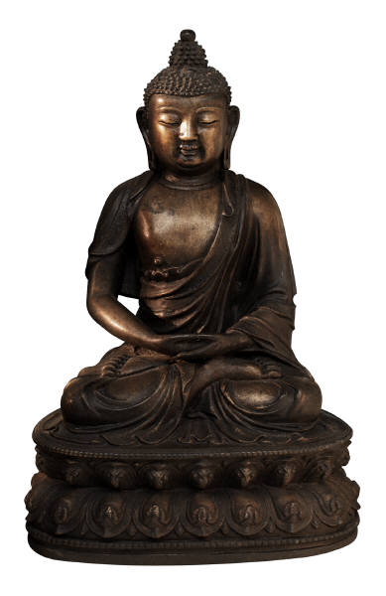
Demographics of Japan
Life Expectancy in Japan is among highest in the world
Life Expectancy (male): 79.59¹
Life Expectancy (female): 86.44¹
Religions: Shinto and Buddhist, Christian and other
¹Country Health Information Profiles 2009 and 2011 on World Health Organization: Western Pacific Region at www.wpro.who.int

Slide 5
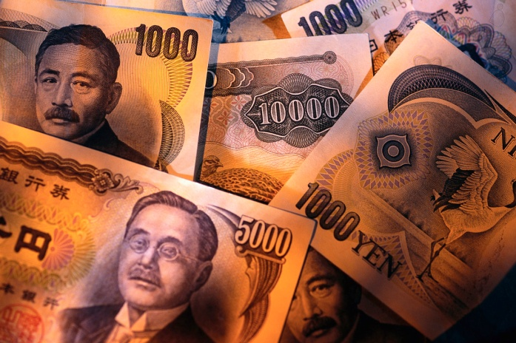
Japanese Economic Status
Gross Domestic Product Per Capita: $35,200
  Japan’s economy is the 3rd largest in the world
Unemployment Rate: 4.6%
Population Below Poverty Level: 16%
CIA World Fact Book: www.cia.gov

Slide 6
Japan’s Health Care System Overview
Universal Health Care structure
Monthly premiums are based on salaries
There is no family doctor system in Japan – they may go to any physician or specialist they chose
Focus is on preventative medicine with emphasis on early detection
  Improving and maintaining healthy dietary habits
  Promoting exercise
  Promotion of rest and sleep
  Enforcing smoke-free policies for public areas, and encouraging education on smoking
Allianz: www.allianzworldwide care.com

Slide 7
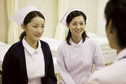
Japan’s Health Care System Statistics
Number of Physicians per 1000 = 2.25¹
Number of Nurses per 1000 = 10.15¹
Health Expenditure: 9.3% of GDP²
Japanese have consultations with a doctor on average 14.4 per person per year (U.S. average is 8.9!)
Japan has the highest average length of hospital stays at 34.7 days
¹Country Health Information Profiles 2009 and 2011 on World Health Organization: Western Pacific Region at www.wpro.who.int
²CIA World Fact Book: www.cia.gov

Slide 8

Breast Cancer in Japan
Breast cancer is on the rise in Japan, some blame birth control pills and a Western diet for the increase
Number of Incidence of Breast Cancer in Japan in 2005: 50,695
Japanese Mortality Rate from all Cancers: 344,105¹
  Cancer is the leading cause of death in Japan since 1981
Mortality Rate due to Breast Cancer: 12,008¹
  Male: 90
  Female: 11,918
Pre-menopausal Breast Cancer is more common in Japan, in western countries Post-menopausal occurs more often
¹Country Health Information Profiles 2009 and 2011 on World Health Organization: Western Pacific Region at www.wpro.who.int

Slide 9

Prostate Cancer in Japan
Number of Incidence of Prostate Cancer in Japan in 2005: 42,997
Japan has some of the lowest rates of Prostate Cancer worldwide
Mortality Rate due to Prostate Cancer: 9,264
  Accounting for 4.7% of all Cancer related deaths in Japan
The Japanese Guideline for Prostate Cancer at www.medicalnewstoday.com
http://ganjoho.jp/data/public/statistics/backnumber/2010/files/data04.pdf

Slide 10
Treatment for Breast Cancer in Japan
Breast cancer is treated as in the U.S. with the same surgical and sentinel lymph node biopsy procedures
Some of the radiotherapy may be a bit different
Hormonal therapy may also be used
Some of the chemo therapy that is approved in the U.S. is still not approved in Japan
Breast conserving surgery has been the preferred treatment over radical mastectomies
US National Library of Medicine: www.ncbi.nlm.nih.gov

Slide 11
Treatment for Prostate Cancer in Japan
Four therapies widely used
  Surgery – Total Prostatectomy
  Radiation Therapy
  Pharmacotherapy (Endocrine Therapy)
  Expectant Management – watching the prostate cancer patient without treatment, until treatment is deemed necessary
Evidence-based clinical practice guidelines for prostate cancer: http://online library.wiley.com

Slide 12
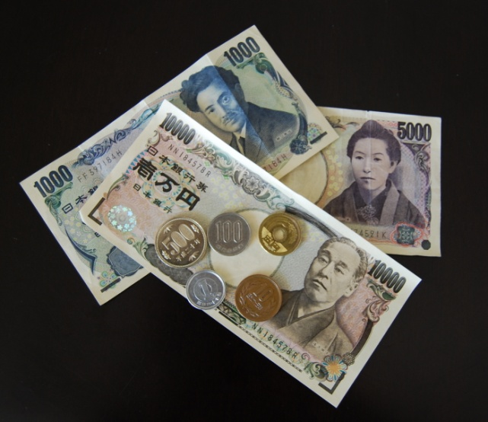
Cost of Breast and Prostate Cancer in Japan
“The direct cost of cancer treatment in Japan amounts to” $36 billion
“The indirect costs (of cancer) of morbidity and mortality amount to…” $6 billion and $81.6 billion “…respectively.”
Economics of Cancer: http://eche2012.abstractsubmit.org/presentations/3286/

Slide 13
What Does Japan do for cancer prevention overall
Japan Cancer Society
  Relay for Life
  Free Cancer Consultations
    Doctors give advise to patients
    Free telephone hotline
  Promotion of Cancer Screening
  Assistance to Medical Staff
  Pink Ribbon Festival
  Cancer Education Campaign

Slide 14

Breast Cancer Prevention in Japan
Suggested initial Mammography screening was changed from age 50 (suggested in 2000) to age 40 in 2004
Using palpation alone as a screening method was abolished
Pink Ribbon Festival
US National Library of Medicine: www.ncbi.nlm.nih.gov

Slide 15

Prevention for Prostate Cancer in Japan
In 2001 only 14.7% municipalities used PSA testing
Japanese Association of Urology recommends screening for men over the age of 50
If there is a family history of prostate cancer it is recommended to start screening at age 50

Slide 16

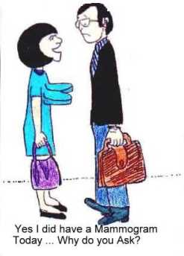

Slide 17
