Slide 1
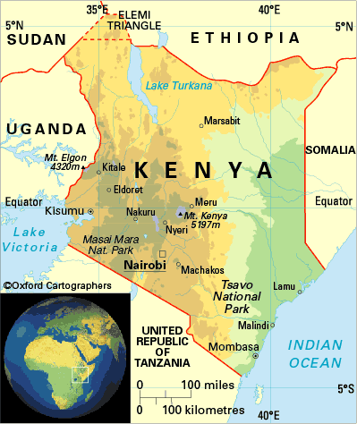
HIV & AIDS in Kenya
Globalization in Health Care
Andrea Myers

Slide 2
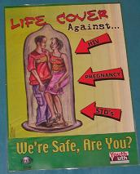
Facts about HIV
HIV is a disease with many stages. People with HIV may have no symptoms, a few symptoms, or many serious symptoms.
People can have HIV for many years without feeling or looking sick. They may no even know they have HIV. However they can still pass on the virus.
You are at risk if you:
Have had sex with a man or woman who has had other partners.
Have shared needles to inject drugs, or have had sex with someone who has.
Come in blood to blood contact of infected person.

Slide 3
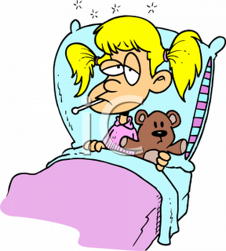
Symptoms Associated with HIV/AIDs
Seroconversion (when HIV-specific antibodies develop) is often mistaken for the FLU:
Weakness/Fatigue
Headache
Night sweats
Low-grade fever

Slide 4
Demographics in 2011
Population- 41,070,934 - people
Average Age- 18.9 years
Life Expectancy for Females- 60 years
Life Expectancy for Males- 58 years
Population Growth Rate- 2.462%

Slide 5
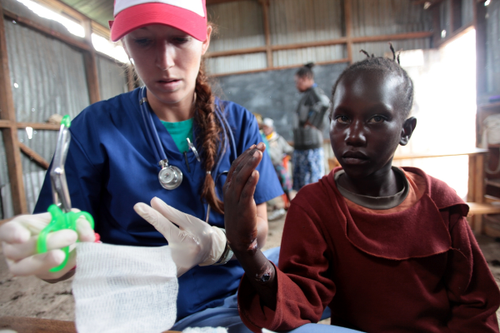
Health Care in Kenya
Government is the main provider of health services, but the private for profit, and the private-not-for-profit providers also serve a significant proportion of the population.
Hospital Bed Density: 1.4 beds/ 1,000 population (2002)
Physician Density: 0.14 physicians to 1,000 population (2002)

Slide 6
Incidence of HIV/AIDS
KENYA
Adult Prevalence Rate:
6.3 % in 2009
Number of people living with HIV/AIDS:
1.5 Million in 2009
Number of people on ART
(Anti-retroviral Therapy):
222,000 people in 2009
-% of eligible people living with HIV/AIDS on ART:
50 in 2009
HIV/AIDS Deaths:
80,000 people in 2009

Slide 7
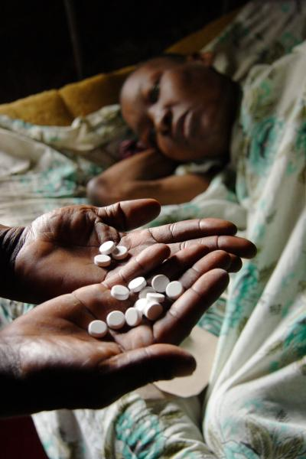
Treatment
Anti-retroviral therapy
Highly Active Antiretroviral Therapy (HAART) is used to describe a combination of three or more anti-HIV drugs.
The Treatment of Opportunistic Infections-usually provided when anti-retrovirals are not available, or when the anti-retrovirals drugs are no longer effective as the person is resistant to them.

Slide 8
Cost of the Disease
The average cost per patient per year on ART, which are all supported by the U.S. President’s Emergency Plan for AIDS Relief (PEPFAR) through the Walter Reed Projects, is around $250. This excludes inpatient care but includes ARVs, non-ARV drugs, laboratory tests, outpatient visits, clinic infrastructure, and other fixed costs.

Slide 9
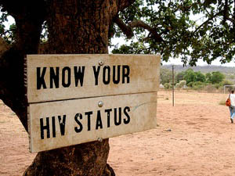
Prevention
HIV testing- 3 testing sites in 2000; 4,438 testing sites in 2010
Condom Use
Kenya Faces Condom Shortage- a shipment of 19 million condoms last 6 weeks. Total of 124.5 million condoms shipped in 2008
Male Circumcision- significantly reduces a man’s risk of acquiring HIV during heterosexual intercourse.
Education & Awareness Organizations
Campaign to End Pediatric HIV/AIDS (CEPA)
President’s Emergency Plan for AIDS Relief (PEPFAR)
HIV/AIDS Testing and Counseling (HTC)- over 1,000 HTC sites targeting the general public, and most at risk populations.
Many prevention programs focus on increasing people’s knowledge about sexual transmission, hoping to overcome the misconceptions, and change them toward safer behaviors.
Percentage of young people aged 15-24 who both correctly identify two ways of preventing the sexual transmission of HIV and who reject two misconceptions about HIV transmission: 0% for both sexes.

Slide 10
Sources
http://www.bu.edu/cghd/projects/costs-and-outcomes-of-hivaids-treatment-in-kenya/
http://hivinsite.ucsf.edu/global?page=cr09-ke-00
http://www.who.int/hiv/HIVCP_KEN.pdf
http://www.kenyaaidsinstitute.org/hivtreatment.html
http://www.avert.org/hiv-aids-kenya.htm

Slide 11
☺ The End ☺

