Slide 1
Acute Coronary Syndromes
Beta Blockers:
  Selective
  Nonselective
  Start within 24 hours after MI (or sooner)
Notes:
3] Beta blockers:
Research has demonstrated that persons who take beta-blockers after an AMI have a reduced incidence of reinfarction. The standard of treatment is to start this therapy within 24 hours after AMI.
a] Nonselective:
Nonselective beta-blockers block sympathetic impulses to both beta one and beta two branches. The overall effect is to decrease BP and heart rate and reduce contractility. All of these effects reduce oxygen demand and increase oxygen supply to the heart. Nonselective beta-blockers also affect the respiratory system to reduce airway size; this class in contraindicated in asthmatics.
b] Selective:
Selective beta-blockers stop only the beta one impulses. This makes them heart specific. Heart rate and contractility and BP are reduced and thus O2 demand is reduced. There is no effect on the respiratory system.

Slide 2
Acute Coronary Syndromes
Beta Blockers:
  Must be weaned off – no cold turkey-stress this during teaching
  If also taking digitalis, cut off point for holding a dose of digitalis is a pulse rate of 50, not 60.
Notes:
Patients must be weaned off of beta-blockers to prevent rebound affect. Persons who take digitalis preparations and beta-blockers are expected to have slow pulse rates. Digitalis is not held unless the pulse drops below 50, rather than 60.

Slide 3
Acute Coronary Syndromes
Metabolic modulator:
  Ranolazine (Ranexa):
    Mechanism of action unknown.
    Used when other methods of anginal control ineffective.
    Used in combination with Ntg & B blockers
    Check liver function.
    Will prolong QT interval.
    One extended release tablet twice a day.

Slide 4
Acute Coronary Syndromes
ACE inhibitors:
  Drugs that end in “pril”
  Prevents remodeling after AMI
  Prevents heart failure
  Reduces the workload of the heart
Notes:
4] ACE inhibitors:
These drugs treat hypertension by blocking the enzyme that converts angiotensin I to angiotensin II. Because afterload is reduced, the workload of the heart is reduced. These drugs are ordered after AMI as they have been proven to prevent the remodeling that occurs after MI. Remodeling reduces the efficiency of contraction and promotes heart failure. The generic names for this class of drugs usually end in “ pril.” (e.g.. lisinopril)

Slide 5
Acute Coronary Syndromes
ARB’s:
  Angiotensin II receptor blockers
  Names end in “sartan”
  Used if patient cannot tolerate ACE-inhibitor
  Some patients are on both ACE-I and ARB

Slide 6
Acute Coronary Syndromes
Calcium channel blockers:
  Not normally ordered after AMI
  Higher death rates among post MI patients who took this class of drug
  Used to treat Vasospastic angina
  Frequently taken along with a beta blocker
Notes:
5] Calcium channel blockers:
This class of antihypertensive drug is not normally ordered after AMI. Research has shown a higher death rate post MI for persons who were ordered this medication. It is the class of choice for persons who have vasospastic angina; it may be ordered concurrently with beta-blockers (because both are negative inotropics, watch for signs of heart failure)

Slide 7
Acute Coronary Syndromes
Antilipemics:
  Statins (HMG co A reductase inhibitors)
  Ezetimbe (Zetia)
  Combinations (Vytorin)
  Fibric Acid derivatives
  Niacin
  Omega 3 fatty acids
Notes:
a] Statins:
HMG co A reductase inhibitors are used to lower total and LDL cholesterol levels. Since elevated cholesterol levels are a risk factor for ACS, reduction of cholesterol is thought to reduce the incidence of AMI. Research has demonstrated that this class of drugs does prevent second events and may prevent primary events in persons at risk for AMI.
Ezetimbe or Zetia: prevents the absorption of cholesterol from the small intestine; lowers total cholesterol and LDL. Frequently prescribed along with a Statin.-Vytorin is one of these combinations. Most recent research questions the effectiveness of this class of drug.
b] Fibric Acid derivatives:
Gemfibrozil (Lopid) reduces triglyceride , LDL and VLDL in addition to lowering cholesterol. It decreases the uptake of free fatty acids in the liver. This class of drug may increase the effects of coumadin. It may alter liver function tests. There is a high incidence of GI side effects; compliance is a problem.
c] Niacin:
Larger than the normal vitamin doses of this drug help to lower cholesterol, triglycerides, LDL and VLDL. The drug is available as a time-release capsule. The drug has GI side effects and also causing flushing that may last an hour after each dose; liver function tests may be altered.
d] Vitamin E:
Some patients may still be prescribed this class of drug to reduce the oxidation of LDL. The latest research shows that vitamin E and beta-carotene are not helpful in the treatment of atherosclerosis and ACS.

Slide 8
Acute Coronary Syndromes
Low Molecular Weight Heparin:
  Lovenox and similar preparations may be used to treat unstable angina and non-Q wave AMI’s. The dosage is weight-based and it is administered SQ. (previously discussed in PVD)

Slide 9
Acute Coronary Syndromes
Reduce Anxiety:
  Why is patient anxiety bad with ACS?
  Interventions:
    Communicate
    Family/friends
    Prn medications
    Investigate the source
Notes:
1] Effects of anxiety on MVO2:
Anxiety is interpreted by the body as a stressor; the stress response is initiated. As long as anxiety persists, there are elevated levels of epinephrine and norepinephrine; these in turn elevate the HR, BP and increase contractility. These effects cause an increase in O2 demand and a further decrease in supply with the overall effect of increasing the ischemic or injured areas.
2] Interventions:
a] Communicate/inform the patient about anything and everything that is done related to his/her care.
b] Encourage/discourage family or significant other visitation. Family members can allay anxiety and provide support.
Example: girlfriend in waiting room/wife in patient room
c] PRN medications may be ordered to help with anxiety during hospitalization, e.g.. Valium
d] Investigate the source of the client’s concerns; many times there are financial worries; a social services consult can help to reduce these problems.

Slide 10
Acute Coronary Syndromes
Promote Activity:
  What if the patient has chest pain?
  What about activity after MI?
  When should cardiac rehabilitation start?
Notes:
1] During episodes of pain:
Patients with CAD are taught to stop activity during episodes of chest pain. Resting may improve the O2 supply and demand imbalance and relieve the pain. Persons experiencing ACS and are receiving nitroglycerine are ordered on bedrest. Cardiac rehab exercises include range of motion only. Individual physicians may allow use of the commode if this is less stressful than using a bedpan.
2] After AMI:
Patients are discharged after AMI with written instructions as to the activity permitted. This is normally limited for two weeks. After a period of two to four weeks, cardiac rehabilitation can begin on an outpatient basis.
3] Cardiac rehabilitation:
Cardiac rehabilitation has been proven to be an effective method of returning post MI patients back to health. Persons who have been through the rehab experience feel better than before the MI in many instances.

Slide 11
Acute Coronary Syndromes
Cardiac rehabilitation:
  Phase I
  Phase II
  Phase III
  Education
Notes:
Phase I is the hospital phase; it includes gentle exercises, diet teaching, home instructions on medications, signs & symptoms to report to the doctor and self care measures.
Phase II is the outpatient phase; patients are monitored during exercise. Further teaching on lifestyle modification is done.
Phase III is an extended time of continued exercise, mostly independently, many hospitals provide exercise facilities or associate with a YMCA for continued support
b] Education:
Materials that are taught after the acute phase of an illness are better retained. Patients benefit from peer support and learn from one another in addition to formal teaching.

Slide 12
Acute Coronary Syndromes
Sexuality and ACS:
  Misconceptions
  Safety measures
  Concurrent medications
Notes:
1] Misconceptions:
Patients and their partners may believe that having sex can precipitate another MI; this rarely occurs when persons with CAD have sex with their “regular” partner.
Patients are reluctant to discuss these matters with their physician; physicians many times do not include sexual matters in their discharge instructions.
Healthcare providers may assume that older clients are celibate when this is not the case. The elderly participate in sexual activity with their partners; sexual matters should not be omitted from their discharge instructions.
2] Safety measures:
Physicians may order a limited exercise tolerance test prior to discharge; this provides a guide for the resumption of all activities, including sexual relations.
Nitroglycerine may be taken prior to sexual relations if this activity initiates angina.
Concurrent medications should be cleared with a doctor. The combination of Viagra and nitroglycerine has caused death from episodes of severe hypotension and resultant MI or stroke. Do not encourage this combination of drugs unless your spouse is well insured.
Anal sex may stimulate the parasympathetic nervous system and contribute to bradycardias; this practice should not be done unless the doctor is aware and clears the patient
3] Psychological issues:
Worries about sexual matters may lead to abnormal behaviors if these concerns are not expressed. Inappropriate sexual remarks and attempts to touch staff members should be investigated as to cause. Some individuals may require counseling if the fear of causing an MI interferes with their ability to have a satisfactory sex life.

Slide 13
Acute Coronary Syndromes
Read the Sensuous Heart

Slide 14
Acute Coronary Syndromes
Optimal Nutrition:
  Low saturated fats, low cholesterol
  Limit sodium intake
  Calorie reduction if indicated
  Add diabetic restrictions if indicated

Slide 15
Acute Coronary Syndromes
Treatment options:
  PTCA
  Percutaneous transluminal coronary angioplasty

Slide 16
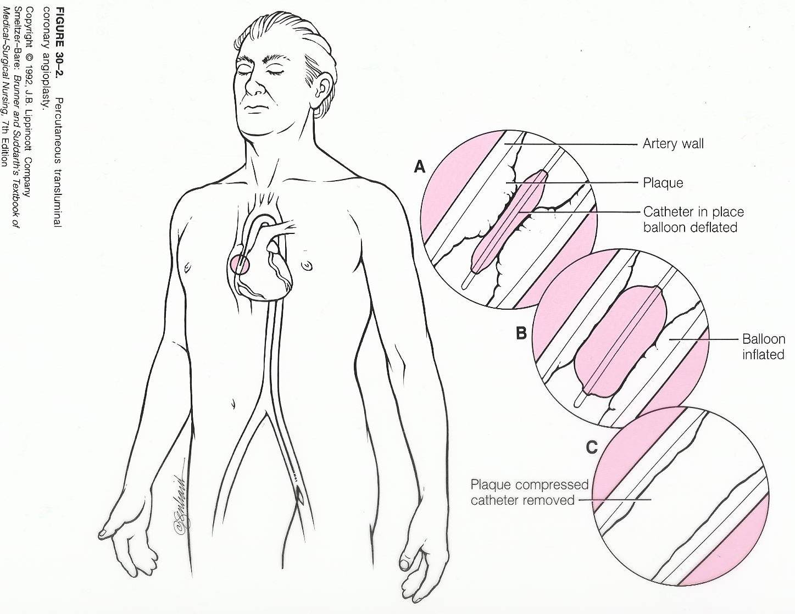
Acute Coronary Syndromes

Slide 17
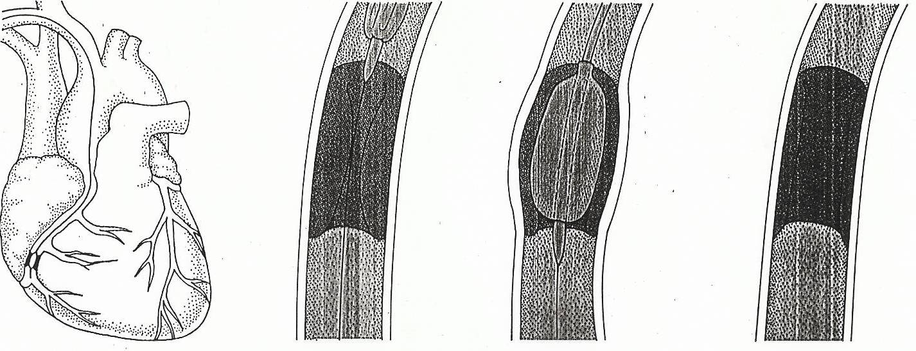
Acute Coronary Syndromes

Slide 18
Acute Coronary Syndromes
PTCA
  Who gets this procedure?
    Lesions more than 70% of artery lumen
    Poor control with medications
    Meet the criteria for CABG surgery
    Persons with occluded CABG grafts

Slide 19
Acute Coronary Syndromes
PTCA
  Complications
    Dissection of coronary artery
    Closure of artery
    Severe coronary artery vasospasm

Slide 20
Acute Coronary Syndromes
PTCA with stent:
  Better long term patency rates
  Best results with drug eluding stents
  Cannot stent everything, coronary arteries twist and turn, are very tortuous.

Slide 21
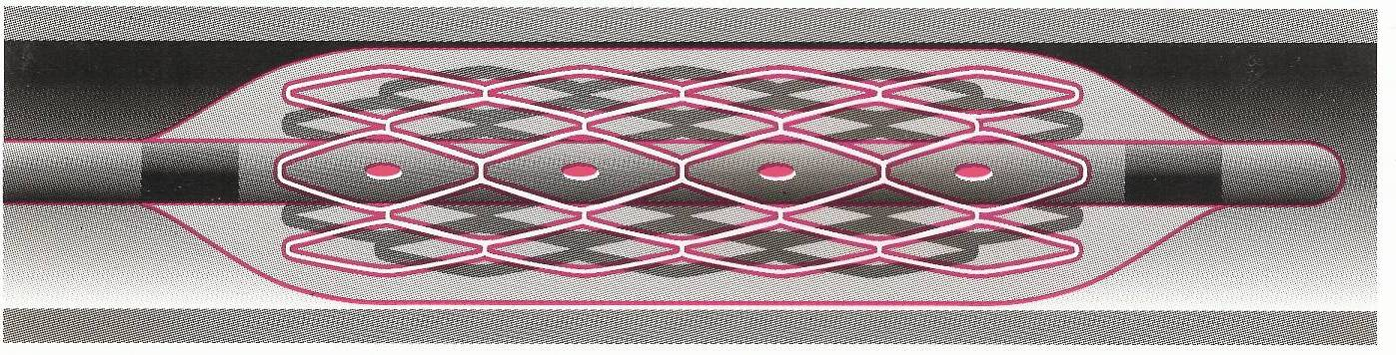
Acute Coronary Syndromes

Slide 22
Acute Coronary Syndromes
Atherectomy:
  Can be done with a balloon device
  Other cutting tools also utilized
  May be done in combination with stenting

Slide 23
Acute Coronary Syndromes
Laser Atherectomy:
  Same problems as with peripheral use of laser to dissolve plaque
  Easy to perforate artery wall
  Does make a nice, smooth lumen

Slide 24
Acute Coronary Syndromes
CABG:
Coronary artery bypass grafting

Slide 25
Acute Coronary Syndromes
CABG:
  Terms:
    CPB-cardiopulmonary bypass, aka: the heart-lung machine
    Cardioplegia
    Hypothermia
    Anticoagulation
Notes:
CPB:
Maintains circulation when the heart is stopped
Oxygenates the blood
Warms and filters the blood
Cardioplegia uses high concentrations of potassium to paralyze the heart and stop it for surgery
Hypothermia: the patient’s body is cooled to reduce O2 demand; the heart is cooled too to reduce its’ demand for O2-it may be done with a small cooling blanket or with sterile icy slush.
Anticoagulation is necessary for the blood to enter the CPB machine and not develop clots; high doses of heparin are used.

Slide 26
Acute Coronary Syndromes
CABG:
  Procedure:
    Veins are harvested; or arteries freed
    Patient is placed on bypass
    Occlusions are bypassed by area arteries or by reversed vein grafts (end to end; side to side)
    Patient is rewarmed; protamine sulfate is given
    Heart is restarted

Slide 27
Acute Coronary Syndromes
CABG:
  If vein grafts are used, the coronary arteries perfuse in diastole; just like normal.
  If arteries are used to bypass the occlusion, that area of the heart is perfused in systole.

Slide 28
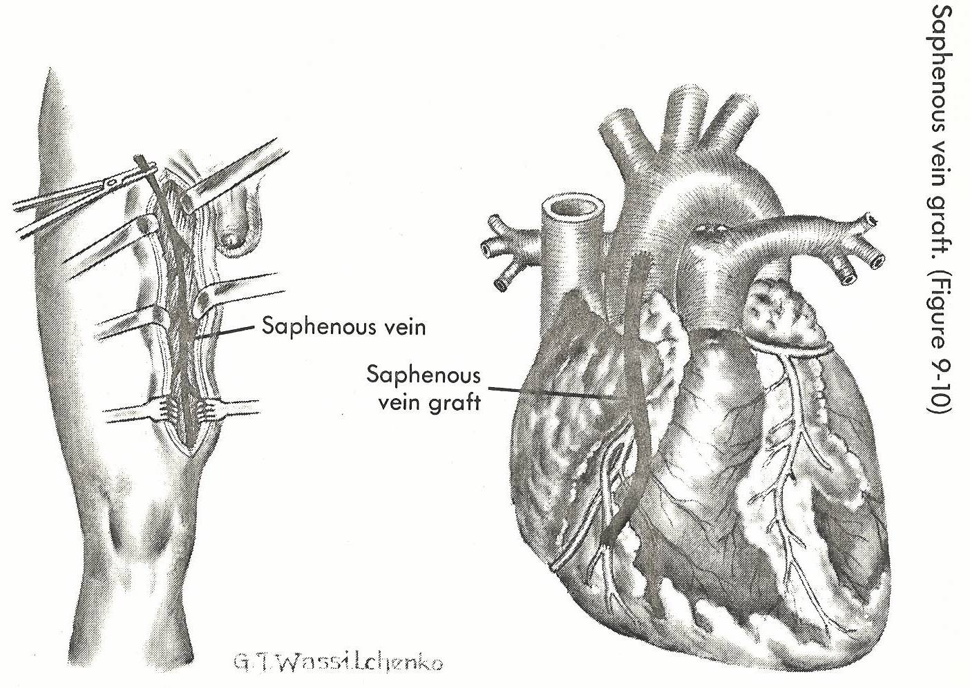
Acute Coronary Syndromes

Slide 29
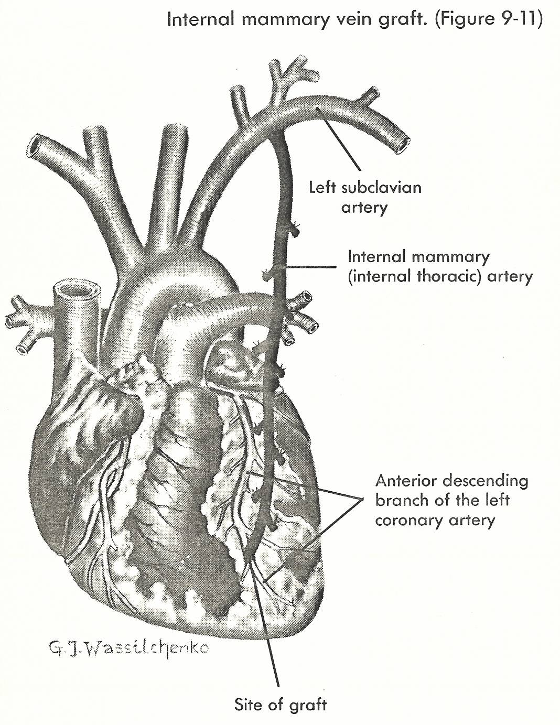
Acute Coronary Syndromes

Slide 30
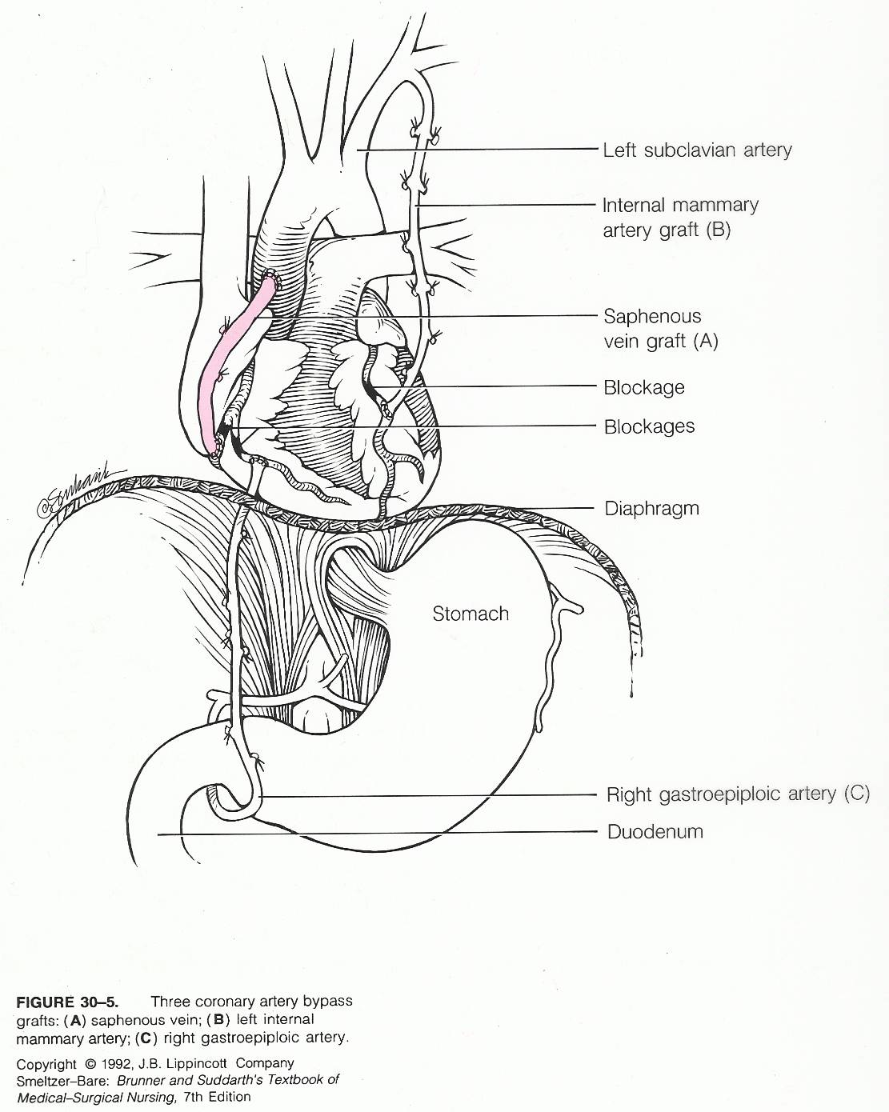
Acute Coronary Syndromes

Slide 31
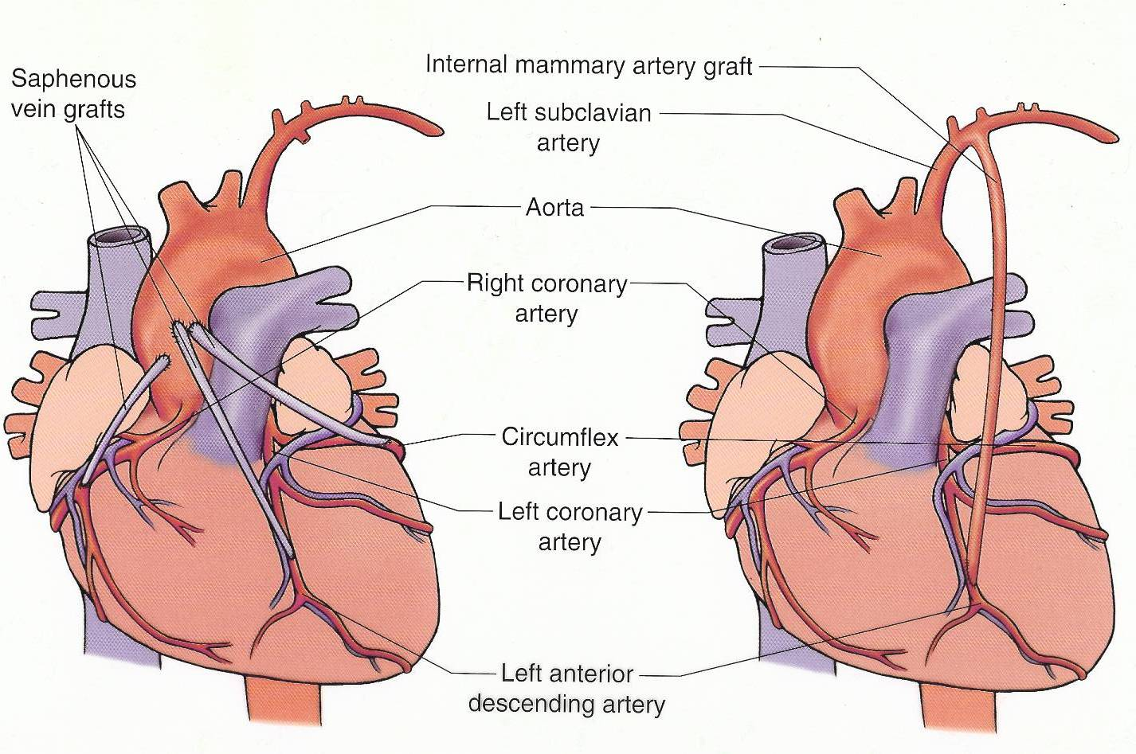
Acute Coronary Syndromes

Slide 32
Acute Coronary Syndromes
CABG:
  Complications of CABG (and other open heart surgery procedures)
    Dysrhythmias
    Bleeding
    Pulmonary
Notes:
Most common dysrhythmia is atrial fibrillation; rhythm problems can occur because of ischemia, heart failure.
Bleeding is the most common problem after heart surgery; when heparin is stored in fat, it is slowly released; protamine is no longer available; Watch the chest tubes closely for sudden increases in drainage.
Pulmonary complications occur because the lungs are collapsed during CPB. Atelectasis and pnuemonia can occur unless vigorous pulmonary hygiene is performed.

Slide 33
Acute Coronary Syndromes
CABG:
  Complications of CABG (and other open heart surgery procedures)
    Stunning
    Heart failure
    Cardiogenic shock
    Stroke
Notes:
Stunning means that the heart is not working mechanically up to par. This happens because of the assault of surgery. The heart is being perfused OK, just “sick in bed.” Treated with IV drugs or machines.
Stunning if prolonged may lead to heart failure; Decreased cardiac output, decreased cardiac index, reduced ejection fraction.
Cardiogenic shock is the dysfunction of the cells due to low cardiac output; body systems start to shut down.
Stroke happens because emboli can form during CPB or in the heart chambers; these can dislodge and cause CVA

Slide 34
Acute Coronary Syndromes
CABG:
  Complications of CABG (and other open heart surgery procedures)
    Aortic dissection
    Post pericardotomy syndrome
    Sternal wound infections
Notes:
Aortic dissection happens because the CPB tubes are inserted into a friable aorta
Post pericardotomy syndrome happens after the initial recovery. Patients develop fever, malaise and sometimes a pericardial friction rub
Sternal wound infections can be treated with wound vacs, packing or muscle flap procedures

Slide 35
Acute Coronary Syndromes
CABG:
  Type of incision
    Median sternotomy
  Graft materials
    RIMA
    LIMA
    Radial artery
    Saphenous veins

Slide 36
Acute Coronary Syndromes
CABG:
  Pre operative
    CBC
    Type and screen
    Electrolytes
    Clotting studies
    ABG’s
    BUN/creatinine
    ECG
    CXR
    Heart catherization

Slide 37
Acute Coronary Syndromes
CABG:
  Other medical problems:
    Diabetes-poor wound healing on sternal and leg incisions
    Renal disease-electrolyte imbalances and hypertension
    PVD, CVD, Aneurysms-which to treat first?

Slide 38
Acute Coronary Syndromes
CABG:
  Stop antiplatelets, anticoagulants prior to surgery; may be on a heparin drip

Slide 39
Acute Coronary Syndromes
CABG:
  Patient and family teaching:
    Coughing and deep breathing
    Splinting chest
    Ventilator
    Pain control
    Equipment in the room
    Ambulation
Notes:
Ideally a tour of the unit and room is good for a patient who will have elective surgery.

Slide 40
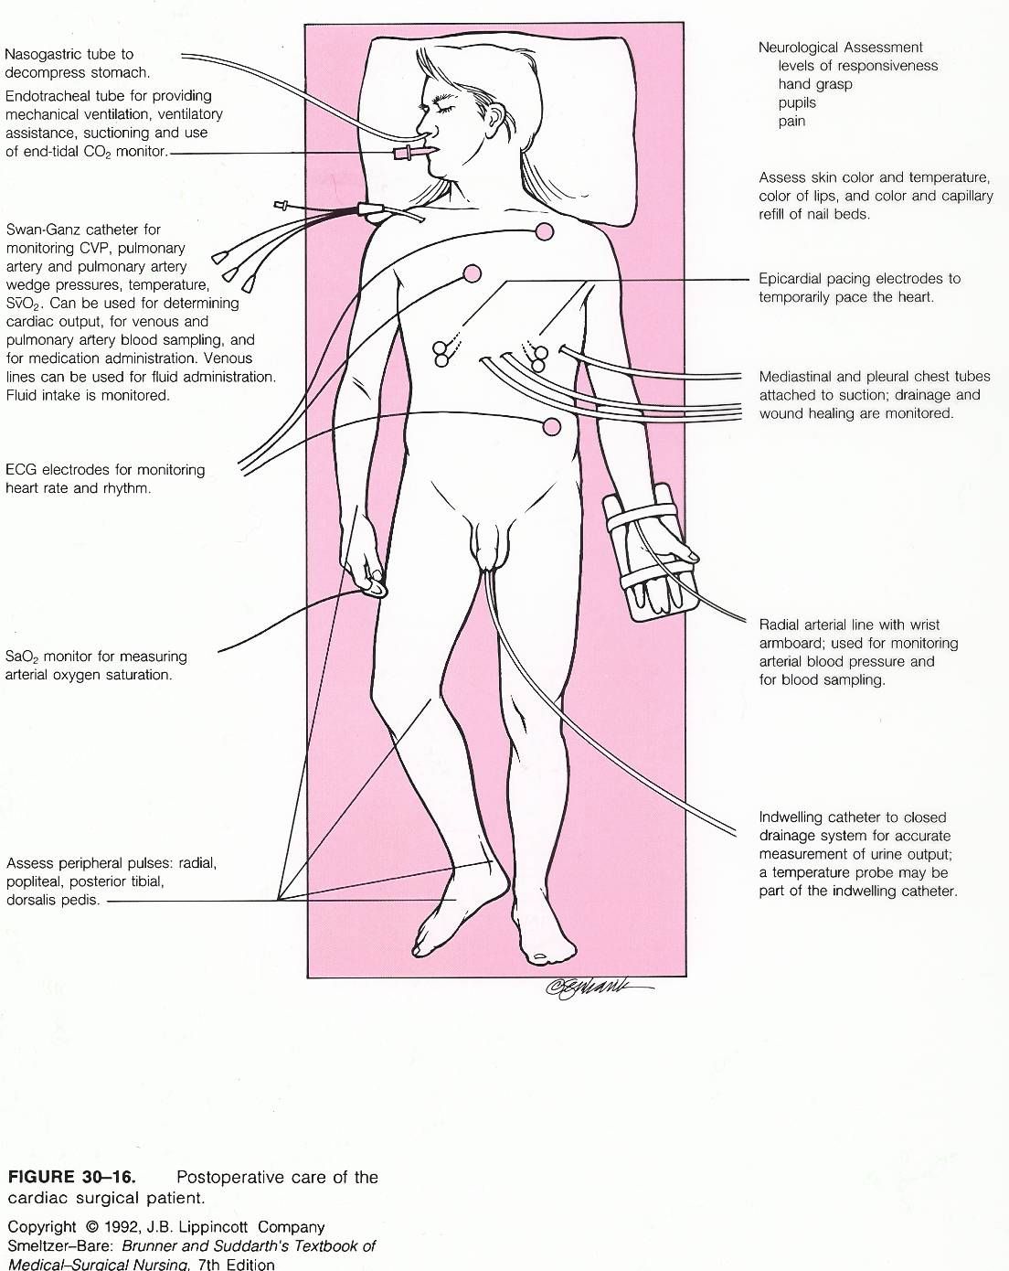
Acute Coronary Syndromes

Slide 41
Acute Coronary Syndromes
CABG:
  Off pump bypass: newer technique that makes it possible to do bypasses on a beating heart-fewer complications; no CPB
  MID CABG: mini heart surgery; only good for certain lesions; small incisions; quick recovery
Notes:
6] Off pump bypass:
Newer techniques have made certain bypass procedures possible on the beating heart. This eliminates the need for CPB and the complications that this can cause. A regular median sternotomy incision is made for this operation.
7] MID CABG:
Certain lesions may be accessible to the “mini CABG” procedure. In this operation the surgeon uses small incisions and fiber optics to perform the bypass on the beating heart without the large sternotomy incision. Postoperative stay is one to two days compared to four or five for a regular CABG. Only 12% of cases are eligible for this procedure.

Slide 42
Acute Coronary Syndromes
Complications of ACS/AMI:
  Ventricular aneurysm
Notes:
a. Ventricular aneurysm:
After scar formation has taken place in the post MI heart, an aneurysm may form. The tissue is thin and stretched and a section balloons outward in systole. Aneurysms can be a source of arrhythmias (because of the stretched fibers) and emboli may form in the pocket. The surgical procedure to correct this is an aneurysmectomy. This involves the use of CPB and open-heart surgery. Persons who are not surgical candidates may have internal cardioverter/defibrillators implanted.

Slide 43
Acute Coronary Syndromes
Complications of ACS/AMI:
  Myocardial rupture
Notes:
b. Myocardial rupture:
This blowout of the ventricle is possible after a transmural wall MI. The tissue undergoes a change process from infarction to scar tissue; between 10 and 21 days after infarction the tissue is at its weakest point. Death is instant unless immediate surgery is available. Blood collects in the pericardial sac and cardiac Tamponade occurs.

Slide 44
Acute Coronary Syndromes
Complications of ACS/AMI:
  Dressler’s syndrome
Notes:
c. Pericarditis/Dressler’s syndrome:
After transmural wall MI and inflammatory process can occur on the outer surface of the muscle causing an inflammation between the visceral and parietal layers of the pericardial sac. Patients complain of a toothache-like chest pain that is aggravated by movement. A friction rub may be audible. ECG changes of pericarditis mimic those of injury.
If a pericardial effusion or pleural effusion occurs this is termed Dressler’s syndrome. It is treated symptomatically. NSAIDS are administered

Slide 45
Acute Coronary Syndromes
Complications of ACS/AMI:
  Dysrhythmias:
Notes:
d. Dysrhythmias:
It is estimated that 90% of MI patients experience electrical rhythm disturbances. Dysrhythmias can cause sudden cardiac death in the post MI patient. It is important to use continuous ECG monitoring on AMI patients, treat warning arrhythmias and intervene quickly in lethal arrhythmias. Signal averaged ECG’s may be performed post MI to determine if antiarrhythmic medications or an implantable cardioverter defibrillator are necessary

Slide 46
Acute Coronary Syndromes
Complications of ACS/AMI:
  Heart failure or cardiogenic shock
Notes:
e. Heart failure/cardiogenic shock:
Depending on the extent of muscle damage after MI, heart failure may result. Cardiac output falls and circulating volume backs up in the system. Cardiogenic shock is the most severe form of heart failure. Because cardiac output does not meet the demands of the body, organs and tissues are deprived of O2 and glucose and begin to malfunction. BP falls, HR increases and other symptoms of shock are evident. Circulatory volume is normal or higher than normal.

Slide 47
Acute Coronary Syndromes
What’s new?
  Combination therapy: PCI and GP IIb/IIIa inhibitors
  Combination therapy: Thrombolytics and GP IIb/IIIa inhibitors
  Third generation thrombolytics: TNK tPA

Slide 48

Acute Coronary Syndromes

