Slide 1
ABC’s
Morgan, Tara, Angela, & Heather
Firelands Regional Medical Center

Slide 2
5 most common signals of a heart attack
Pain and heavy pressure in the center of chest
Pain that extends to jaw, neck, left shoulder, left arm
May feel burning in the chest (indigestion)
Sweating, nausea, vomiting, unnatural paleness, SOB, difficulty breathing
Pain that lasts more than 3-5 minutes and goes away and comes back

Slide 3
CPR
Early recognition and Access “Are you ok?”
Have someone call 911
“Open airway”
Person needs to be back, lift chin, one hand pushing on forehead
Watch for chest movement, listen for breathing, lower cheek to feel breath
If person is breathing place victim on their side
If NOT breathing check mouth for foreign objects then 2 slow breaths
Allow lung to deflate between breaths
Check circulation
Cough, movement, normal breathing, and a pulse
Pulse: 2-3 fingers on Adam’s apple to feel carotid (10 seconds or less)
No signs of circulation must begin compression
15 compression to every 2 breaths
(One and two, and three, and..)
If no sign of circulation resume CPR with compressions
Check pulse, give 1 rescue breath, Q5 seconds

Slide 4
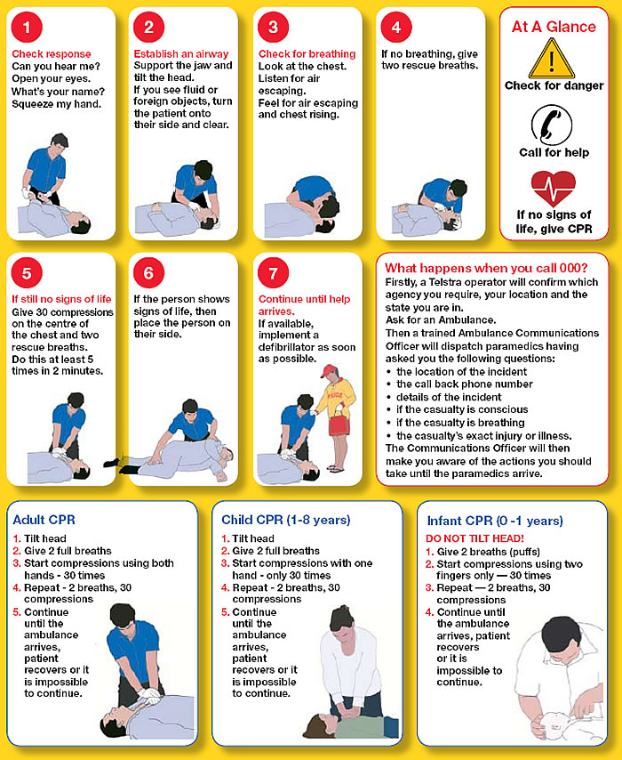

Slide 5
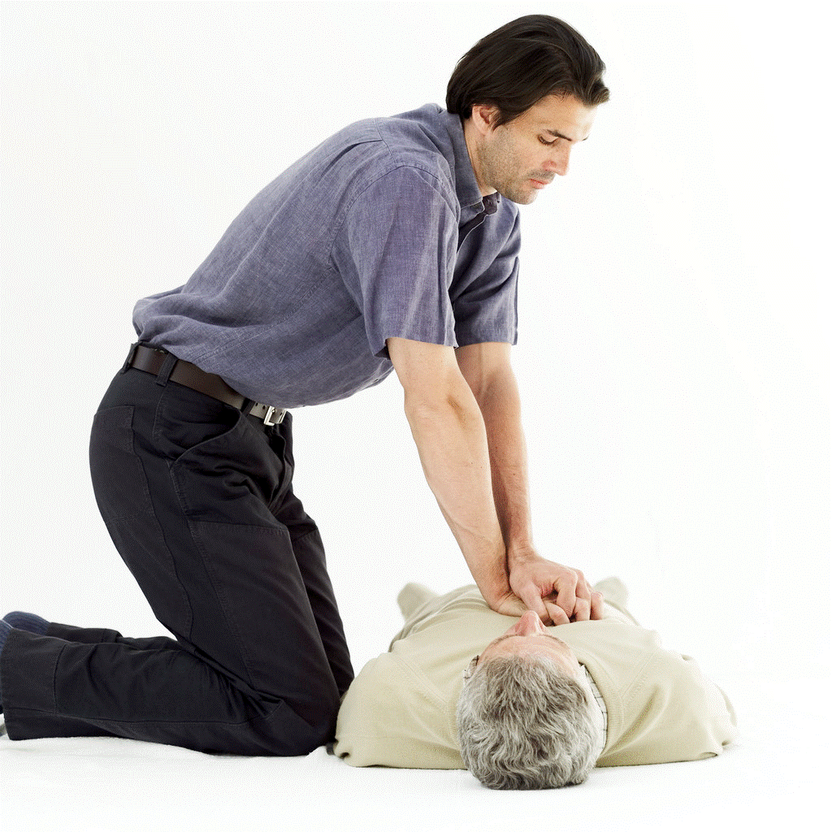

Slide 6
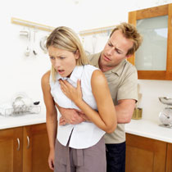
Care for someone who is choking
Determine if victim is able to cough, speak, breathe
“Can I help you?”
Stand behind victim and wrap arms around waist
Press fist into abdomen with quick inward and upward thrust
Pregnant victim or very large:
Chest thrust- stand behind victim and place arms under victims armpit, encircles chest
Press quick backward thrust

Slide 7
Action you should take for SHOCK
Have victim lay down with feet raised slightly
Eliminate cause of shock- control the bleeding, restore breathing, relieve severe pain, treat wound
Place blanket or coats under and over victim for warmth; cover enough to prevent loss of body heat
Make sure airway is open for breathing, be prepared to give lifesaving aid such as rescue breathing
If patient is conscious then give a sip of water, send for emergency medical care

Slide 8
Action you should take for HEART ATTACK
Place victim in a partly reclining or siting position
Do not wait to see if the pain goes away and call 911
Loosen all tight clothing at neck, chest and waist
Keep person calm and comfortable, warm but not hot
Do not allow the victim to move around
Do not give stimulants
If the victim is not breathing, give CPR

Slide 9
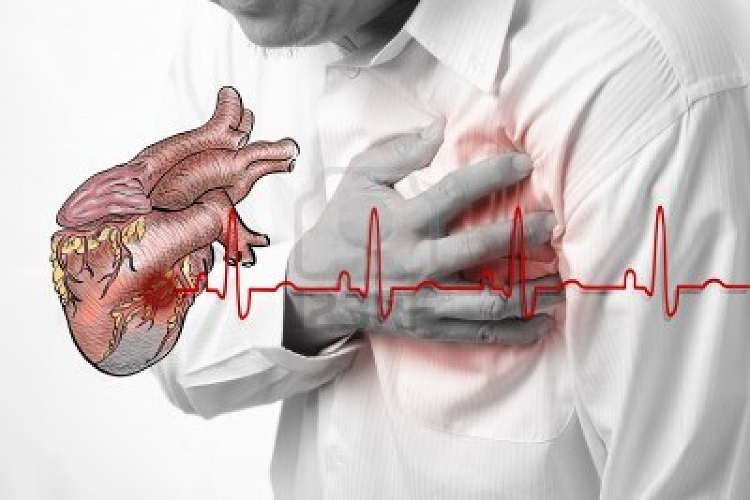

Slide 10
Action you should take for STROKE
Place patient on their side on the flow in the recovery position so saliva drains out of mouth
Loosen any tight clothing
Protect them from trauma is convulsing (sharp objects)
Clear airway so they can breathing and make sure their tongue had not blocked their airway
DO NOT PLACE anything in their mouth
Call ambulance

Slide 11
Automated External Defibrillator (AED)
An AED is a portable device that checks the heart rhythm. If needed, it can send an electric shock to the heart to try to restore a normal rhythm.
AEDs are used to treat sudden cardiac arrest (SCA)

Slide 12
What is SCA?
SCA is a condition in which the heart suddenly and unexpectedly stops beating. When this happens, blood stops flowing to the brain and other vital organs.

Slide 13
Signs of SCA
a person suddenly collapse and pass out. Or, you may find the person unconscious and unable to respond when you call or shake him or her, the person may not be breathing, or he or she may have an abnormal breathing pattern. Person may have no pulse and skin color might be blue from lack of oxygen.

Slide 14
What are AED’s?
lightweight, battery-operated, portable devices that are easy to use. Each unit comes with instructions, and the device will even give you voice prompts to let you know if and when you should send a shock to the heart.

Slide 15
How does it work?
Sticky pads with sensors (called electrodes) are attached to the chest of the person
The electrodes send information about the person's heart rhythm to a computer in the AED.
The computer analyzes the heart rhythm to find out whether an electric shock is needed. If a shock is needed, the AED uses voice prompts to tell you when to give the shock, and the electrodes deliver it.

Slide 16
How do you use it?
If you see a person suddenly collapse and pass out, or if you find a person already unconscious, confirm that the person can't respond. Shout at and shake the person
Never shake an infant or young child. Instead, you can pinch the child to try to wake him or her up.
Call 9–1–1 or have someone else call 9–1–1. If two rescuers are present, one can provide CPR (cardiopulmonary resuscitation) while the other calls 9–1–1 and gets the AED.
Check the person's breathing and pulse. If breathing and pulse are absent or irregular, prepare to use the AED as soon as possible.
If no one knows how long the person has been unconscious, or if an AED isn't readily available, do 2 minutes of CPR. Then use the AED
Give CPR until emergency medical help arrives or until the person begins to move in between the use of the AED
If by water remove from wet area and remove wet clothes, dry person best as possible
Remove all jewelry and clothes with mental to not cause burns
If chest is hairy try to remove hair best as possible so electrodes can attach better
Check the person for implanted medical devices, such as a pacemaker
If one is implanted move pad at least 1 in from devices
Place one pad on the right center of the person's chest above the nipple. Place the other pad slightly below the other nipple and to the left of the ribcage
Check that the wires from the electrodes are connected to the AED. Make sure no one is touching the person, and then press the AED's "analyze" button. Stay clear while the machine checks the person's heart rhythm
If a shock is needed, the AED will let you know when to deliver it. Stand clear of the person and make sure others are clear before you push the AED's "shock" button
After shock was given resume CPR
Supplies needed

Slide 17
