Slide 1

Facebook Inquiries
Course Overview

Slide 2


Facebook Inquiries or “FI” refers to a lead generated through the studios Facebook page.
A prospective client may reach out in the following ways:
A private Facebook message
Responds to a post on the studios Facebook page
What is a FI

Slide 3
Respond Immediately
Be Polite, Professional & Enthusiastic
Be Confident! They Called For Your Help
Only Give “Either or Choices”
Get Their Phone Number
Confirm the Studio Address
FI Booking Steps

Slide 4
To book the appointment as soon as possible.
To be in control of the conversation.
To have consistency in all studios
To be and sound confident with our responses.
To create a desire to come in and join.
FI Goals

Slide 5
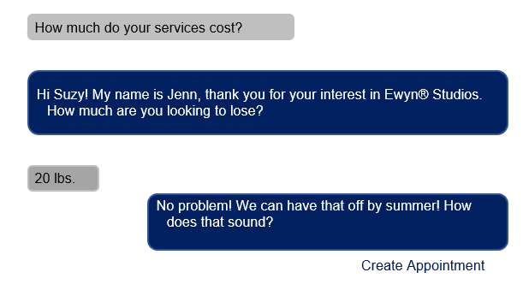
Let’s Review
Facebook Messenger will provide prompts to help with booking an appointment.
Click the Create Appointment button when you are ready to book an appointment.

Slide 6
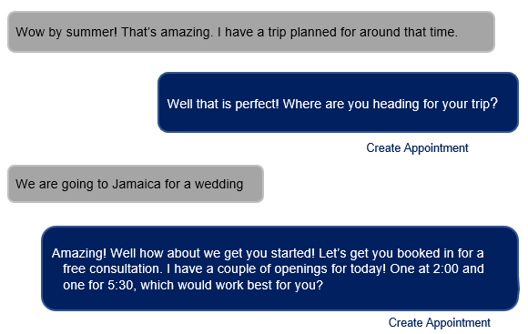
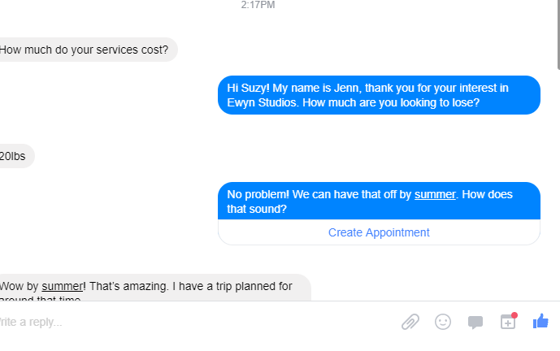
Let’s Review
Another way to create an appointment is to click the red dot at the bottom of your responses.
Prompts will continue to be visible until an appointment is created.
Create Appointment

Slide 7
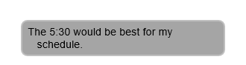
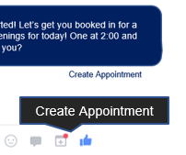
Let’s Review
Once the potential client confirms an appointment time, you can click one of the two buttons to create a calendar Appointment.
Select the date and time in the Create Appointment pop-up.

Slide 8
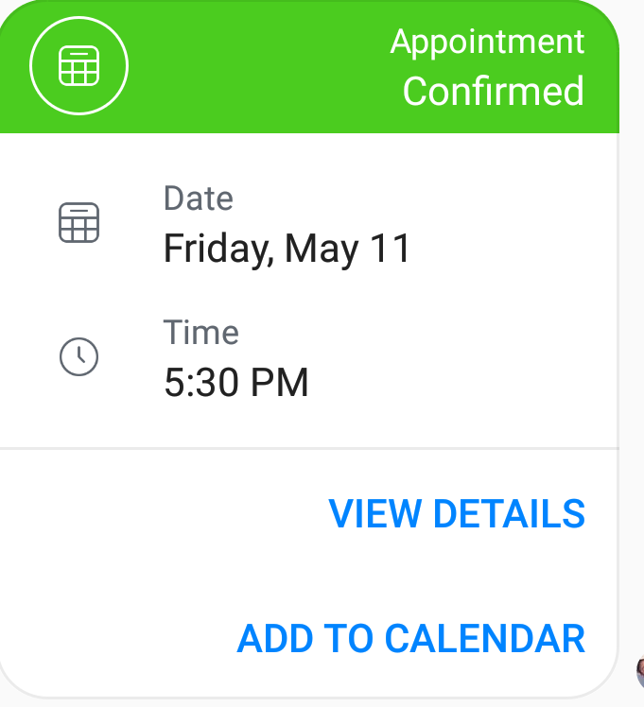
Let’s Review
An Appointment Confirmed pop-up message will display on the screen.
The appointment is confirmed in Facebook and the client receives subtle reminders in Messenger.
The 5:30 would be best for my schedule.

Slide 9
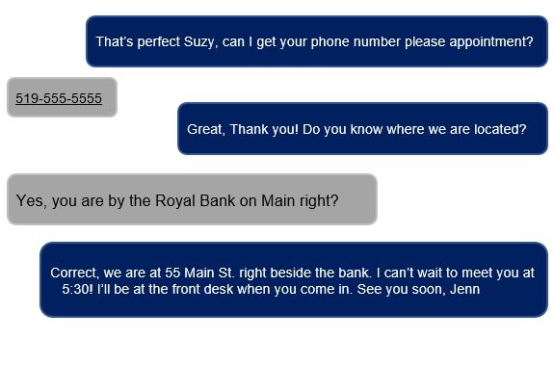
Let’s Review

Slide 10
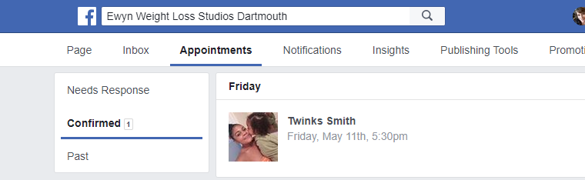
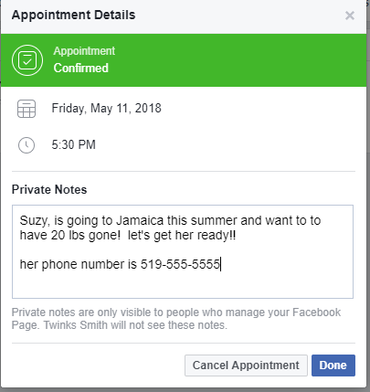
Let’s Review
Managing Appointments
All confirmed appointments
can be easily found under the Appointments tab at the top of your studio Facebook page.
Studio Tip: Click on the Appointment
tab to create private notes for staff.

Slide 11
Module
Complete

