Slide 1

Telephone Information
Studio Basics

Slide 2


The telephone information call, or “TI” refers to an incoming inquiry regarding our weight loss programs.
A prospective client calls the studio because they want to start losing weight with the Ewyn® program.
What is a TI?

Slide 3
Memorize and never vary from the TI script
Always use your RING! RING!! prompt pad
Ensure you sound confident and enthusiastic
Always use an assumptive approach
Only give controlled choices
Be capable of handling several questions
“Close” after answering each question
TI Booking Steps

Slide 4
To book the appointment as soon as possible.
To be in control of the call.
To have consistency in all studios
To be and sound confident.
To sound enthusiastic, create a desire to come in and join.
TI Goals

Slide 5
Most T.I’s begin with the client controlling the conversation. This is because they are the one asking questions
Common Questions
“can I get some information”
“what does it cost to join?”
Gain control of the conversation by responding with a question.
“I’d be happy to share some information, can I get your name please?”
Controlling
the Call

Slide 6
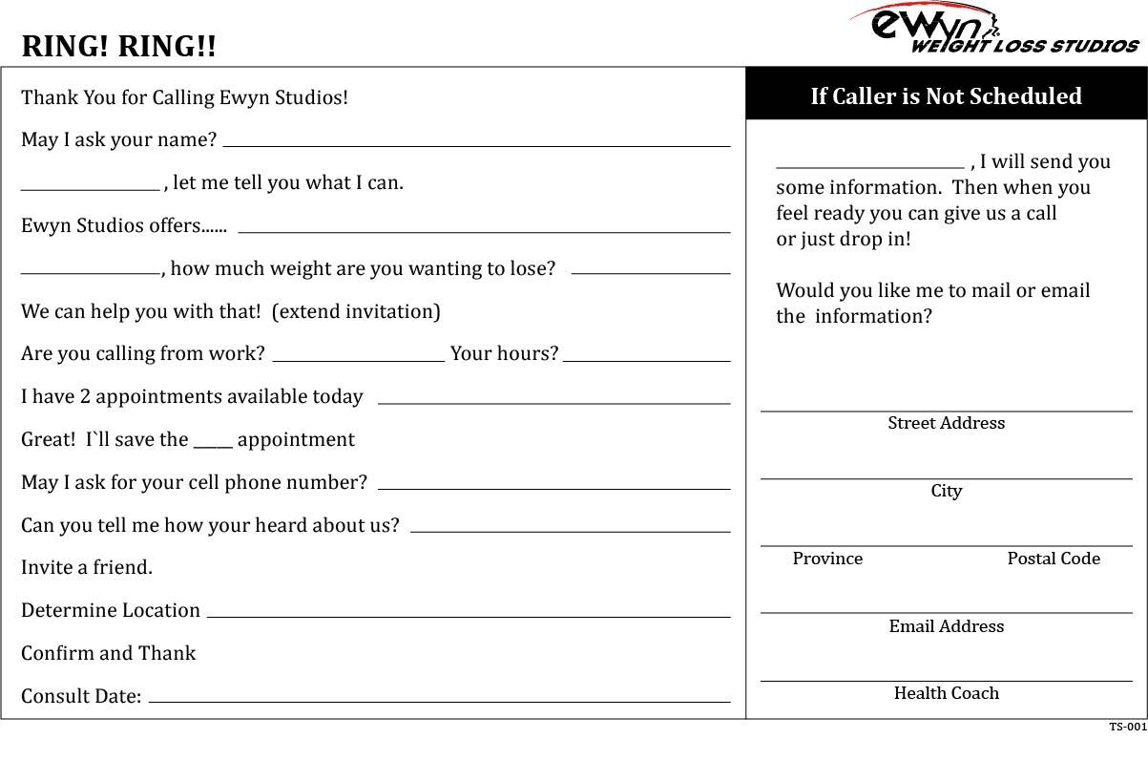
TI Script Review
YOU: Thank you for calling Ewyn® Studios. This is Jenn speaking
  how may I help you?
CLIENT: Yes, what does it cost to join there?
YOU: I would be happy to share some information.
May I ask your name please?
CLIENT: Suzy.
Gain Control

Slide 7
TI Script Review
You: Hi Suzy! Let me tell you what I can. Ewyn® Studios offers our very effective weight management programs, customized to meet your needs. Suzy, how much weight do you need to lose?
CLIENT: Oh probably 15 or 20 lbs.
YOU: We can help you with that! Suzy, I’m going to invite you into our studio. You’ll be able to meet our health coaches, more importantly we will be able to determine the approach that will give you the best results. Suzy, are you calling from work?
CLIENT: Yes, I am.

Slide 8
TI Script Review
YOU: Your hours are?
CLIENT: I finish at 2 pm.
YOU: OK, let me see......I have 2 spots available today, one at 2:45 and one at 5:00. Suzy, which would suit you best?
CLIENT: I think I could make it by 2:45.

Slide 9
TI Script Review
YOU: Great!! I’ll save the 2:45 for you! Can I get your cell number?
CLIENT: 519-123-4567
YOU: Can you tell me how your heard about us
CLIENT: I always hear your radio ads and I know a bunch of people from your Sarnia Studio!

Slide 10
TI Script Review
YOU: Suzy, many of our most successful clients like to diet with a friend. Is there anyone you would like to invite to come in with you?
CLIENT: My Mom has been thinking about this too. I’ll call her and see if she can come in with me.
YOU: I would love to meet you both! Do you know where we are located?
CLIENT: Yes.
YOU: Great, we are right next to Hollywood Tan. I’m looking forward to meeting you 2:45. Thanks for calling Ewyn® Studios!

Slide 11
Module
Complete

