Slide 1
Week 5 Assignment A
Lauren Solis
San Diego Christian College
BI 392
October 22, 2017
Professor Devereaux Lloyd

Slide 2
David green
CEO & FOUNDER OF HOBBY LOBBY

Slide 3

The Servant Billionaire

Slide 4
Humble Beginnings
David Green grew up in rural Oklahoma with very humble beginnings. His family was not necessarily financial rich, but spiritually wealthy in that they gleaned the meaning of life through the advancement of God’s kingdom. It has been noted that David was constantly encouraged by his parent’s faith and that remained a part of his life as his business grew. David’s mother often mentioned in light of David’s success, “…but what are you doing for the Lord?” Within his home one could find the words, “Only one life; ’twill soon be past. Only what’s done for Christ will last.” The company was started by David and Barbara with a humble six-hundred-dollar loan to make picture frames in 1970. The company now estimates two billion dollars in retail annually and exceeds up to 434 stores (David Green, n.d.).

Slide 5
His Heart, His Vision, His Legacy…
“I believe that God has placed us on this earth to work, to earn, and to care for those he has entrusted to us. Yet I also believe that we are put on this earth to give, to devote ourselves to a radical brand of generosity that changes lives and leaves a legacy. To paraphrase God’s words to patriarch Abraham, we are blessed so that we can be a blessing”
(High, 2017)

Slide 6
David Green
encompasses the characteristics of a servant leader through:
Leading with integrity
Holding to his values, vision and legacy
Serves initially, gives exceedingly
Upholds the value and well being of his employees
The health and structure of family comes before profit
Strives to cultivate a better society and the next generation
Challenges ordinary concepts

Slide 7
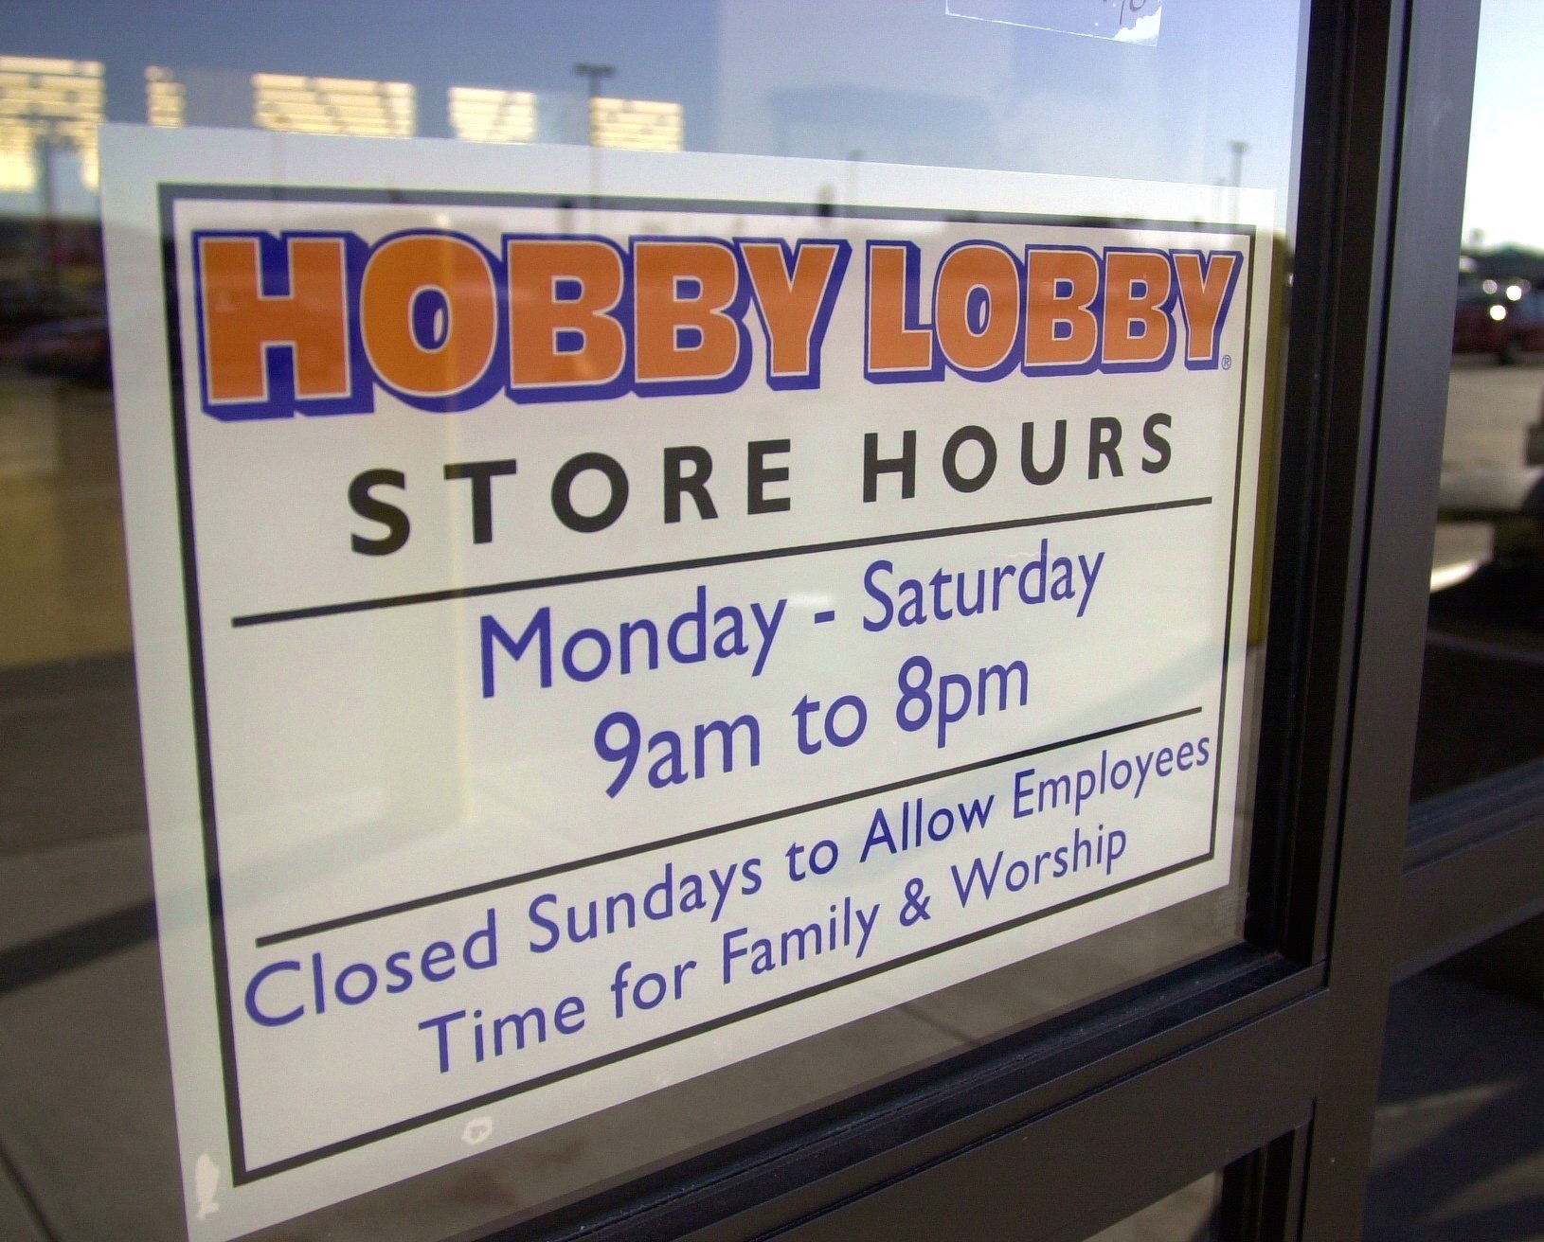
“We're Christians, and we run our business on Christian principles. I've always said that the first two goals of our business are (1) to run our business in harmony with God's laws, and (2) to focus on people more than money. And that's what we've tried to do. We close early so our employees can see their families at night. We keep our stores closed on Sundays, one of the week's biggest shopping days, so that our workers and their families can enjoy a day of rest. We believe that it is by God's grace that Hobby Lobby has endured, and he has blessed us and our employees. We've not only added jobs in a weak economy, we've raised wages for the past four years in a row. Our full-time employees start at 80% above minimum wage.”
-David Green
(McKay, 2012)

Slide 8
Burwell v. Hobby Lobby Stores, Inc.
A fight against the health mandate created by Obamacare to force organizations to offer contraceptive pills to their employees, including the “morning-after pill”.
“If we refuse to comply, we could face $1.3 million PER DAY in government fines. Our government threatens to fine job creators in a bad economy. Our government threatens to fine a company that's raised wages four years running. Our government threatens to fine a family for running its business according to its beliefs. It's not right.”
–David Green
(McKay, 2012)

Slide 9
References
Figure 1. David Green. Retrieved from http://smartandrelentless.com/wp-content/uploads/2016/07/David-Green-Fortune-500.jpg
Figure 2. Hands holding. Retrieved from http://epmgaa.media.clients.ellingtoncms.com/img/photos/2017/06/29/Touch.jpg
Figure 3. Hobby Lobby Store Hours. Retrieved from http://media.mlive.com/mid-michigan-business_impact/photo/hobbylobbyclosedsundayjpg-1032bb82e8798c88.jpg
David Green – Hobby Lobby. (n.d.). Retrieved from http://www.giantsforgod.com/david-green/
High, B. (2017). What Will Your Legacy Be? Retrieved from http://www.thinke.org/blog/what-will-your-legacy-be
McKay, S. (2012, December 1). The Hobby Lobby CEO Letter Everybody’s Talking About. Retrieved from http://www.familysecuritymatters.org/publications/detail/the-hobby-lobby-ceo-letter-everybodys-talking-about

