Slide 2
Genetic Fun-de-Mendels
Principles of Agricultural Science – Animal
Unit 7 – Lesson 7.1 A New Pair of Genes

Slide 3
Gregor Mendel: The Man, the Monk, the Master of Genetics
Austrian monk in the mid-1800s who conducted experiments with pea plants to discover the principles of heredity.

Slide 4
Gregor Mendel’s Studies
His work provided the basis for four laws of inheritance:
The law of dominance
The law of segregation
The law of independent assortment
The law of unit characters

Slide 5
What are genes?
A gene is the simplest unit of inheritance.
A gene influences certain genetic traits in living things.
Notes:
Definition of terminology.

Slide 6
What do genes do?
Genes are carried in the chromosomes in the gametes.
Genes are passed from parent to offspring through the process of meiosis and mitosis during sexual reproduction.
The genetic transfer of traits from parent to offspring is called heredity or inheritance.

Slide 7
Defining Traits of Living Things
Genotype
Genotype is the genetic make-up of living things.
Individual organisms of the same genotype breed alike.
Notes:
It will be important in Activity 7.1.2 Drosophila Genetics Simulation for you to be able to distinguish between genotype and phenotype.

Slide 8
Defining Traits of Living Things
Phenotype
Phenotype is the observed characteristics of an individual organism without reference to its genetic make-up.
Individuals of the same phenotype look alike but may not breed alike.
Notes:
Visual appearance, such as color, presence of horns in cattle, and height.

Slide 9
How Heredity is Affected by Genes
Each characteristic or trait has two genes – one derived from each parent
If both genes for a characteristic are the same, the animal is homozygous for that characteristic.
If the two genes differ for a given characteristic, the animals are heterozygous.
Notes:
The introduction of terms homozygous and heterozygous. These terms will be illustrated in following examples.

Slide 10
Which Trait Wins in Heterozygous Pairings?
The law of dominance offered by Mendel states that one gene of the pair may exert its influence over the other.
D
d
Notes:
If there are two different traits trying to be expressed, what are the mechanisms for the decision? Chance may be a logical assumption by students, but Mendel provides evidence of genetic dominance among gene pairs. Therefore, prediction of traits can be better than left to chance.

Slide 11
Dominance
A dominant gene overrides the other gene and is visible in the organism’s physical characteristics (i.e., phenotypic characteristics).
This is referred to as a dominant trait.
Notes:
Definition of dominance.

Slide 12
Recessive
The other gene partner of heterozygous traits will not be seen in the phenotype.
It does still remain in the genotype however
When crossed with another animal containing the same recessive trait, some offspring may show the recessive characteristic.
Notes:
The explanation for recessive genes – the other gene in the pair of a heterozygous pairing.

Slide 13
Predicting Offspring
Each gene is signified by a letter
Each gene is paired with another – one gene from each parent
If the letter is capitalized it is a dominant gene
If the letter is not capitalized it is a recessive gene
Notes:
As mentioned in a previous slide, knowledge of dominant and recessive traits may help in predicting offspring.
Here are some rules for you to remember as the Punnett Square method is introduced. The Punnett Square will be the tool used to help you predict offspring from breeding pairs of genes.

Slide 14
Polled Trait in Herefords
If polled is a dominant trait, it is represented by the letter “P.”
If a parent is homozygous for the genetic traits of polled, the gene pair would be “PP.”
If it is heterozygous for polled traits, the gene pair would be “Pp.”
Notes:
This slide provides you a specific example for the rules for using a Punnett Square.

Slide 15
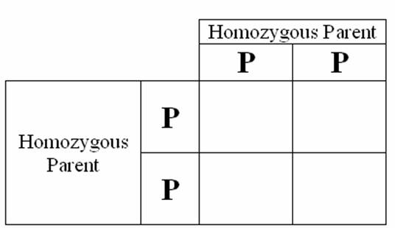
Punnett Square
Use a Punnett Square to determine the offspring for two homozygous parents:
Notes:
Try a practice Punnett Square.
This will build foundation knowledge related to dominance.
Modeling of how to use the square may be needed.

Slide 16
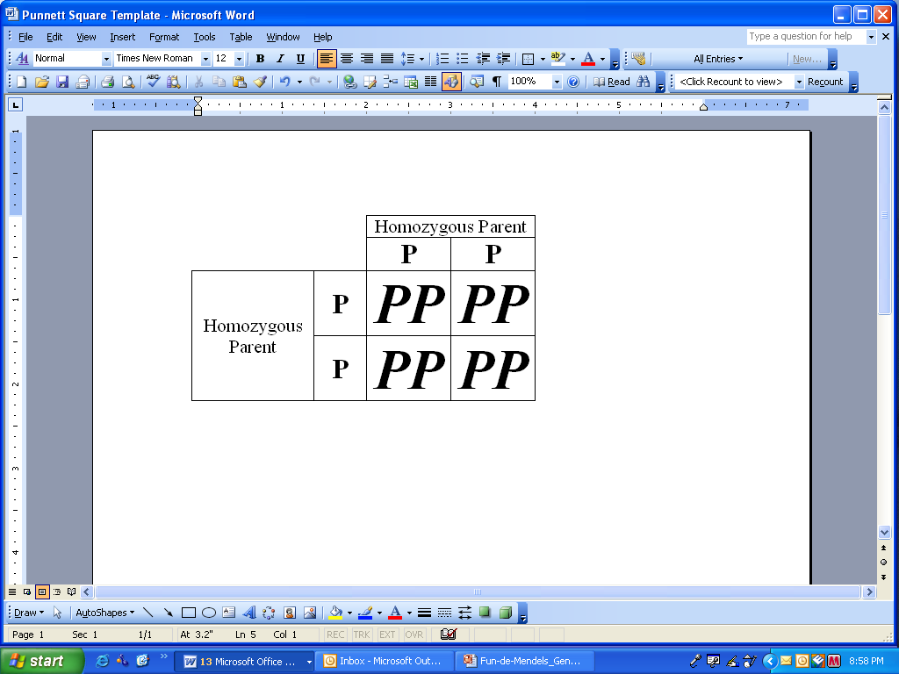
Results of Homozygous Pairing
What is the percent chance of offspring that will be polled?
Notes:
Of course the predicted percentage of polled offspring is 100%. If the parent crossing produced 100 new offspring all would have the phenotypic traits of no horns.

Slide 17
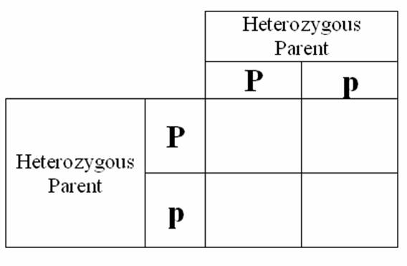
Let’s see how recessive genes reappear…
Use a Punnett Square to determine the offspring for two heterozygous parents:
Notes:
This simple example will illustrate how recessive genes are still part of the genetic make up even though the parents do not show different phenotypic characteristics. In this example, the small “p” represents a Hereford with horns.

Slide 18
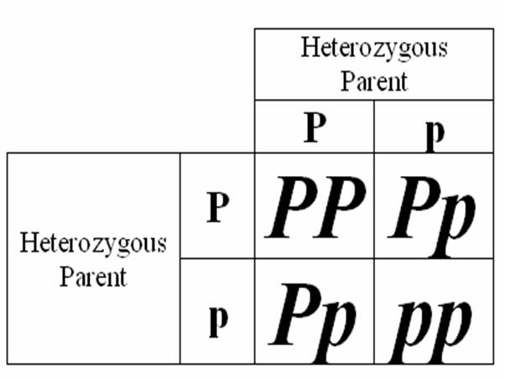
The Results…
What is the percent chance of offspring that will be polled?
Notes:
Once the Punnett Square is completed, you should be able to determine that the recessive gene emerges in 75% of the crosses, however when paired with a dominant gene it will only be expressed in the phenotype 25% of the time. Therefore, you can predict that 75% of the offspring will be polled and only a 25% chance will exist for the expression of horns.

Slide 19
References
Herren, R. V., & Donahue, R. L. (2000). Delmar’s agriscience dictionary with searchable CD-ROM. Albany, NY: Delmar.
Gillespie, J.R., & Flanders, F.B. (2015). Modern livestock and poultry production (9th ed.). Clifton Park, NY: Delmar.

