Slide 2
Feedstuffs
Principles of Agricultural Science – Animal
Unit 5 – Lesson 5.3 Feedstuffs

Slide 3
Feedstuff
An ingredient or material fed to animals for the purpose of sustenance.
  Provide one or more nutrients
Feedstuff vs. feed
  A feedstuff is not normally fed by itself, but is mixed with other feedstuffs to formulate a feed.
Notes:
Feedstuffs are the ingredients in the diet of an animal. If you were to read the label on a bag of dog food, you may see corn, wheat flour, rice flour, chicken by-products, beef, and a wide assortment of vitamins and minerals. Any of these feedstuffs alone would not provide the nutrition your dog needs, but together form a healthy meal or feed for your dog.
A feedstuff is considered to be one piece of a complete ration. A feed may be fed by itself or may be a combination of feedstuffs. The word feed is often substituted for feedstuff.

Slide 4
Feedstuff
Roughages
Concentrates
Supplements
Feed Additives
Notes:
Feedstuffs can be broken into four categories.
Roughages are used in large quantities in ruminant diets.
Concentrates have a greater nutrient density per volume of weight.
Supplements and feed additives are used in small quantities to provide missing nutrients or to modify a ration.

Slide 5
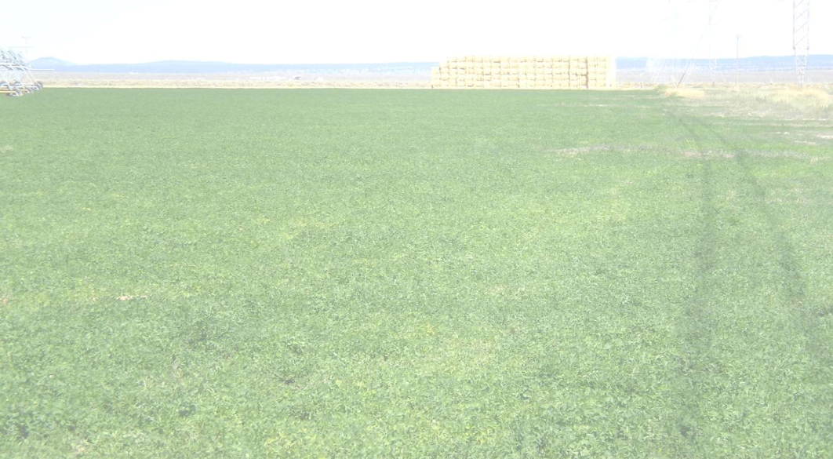
Roughage
Feedstuffs that are high in fiber and low in nutrient density.
Bulky
Utilized primarily by ruminants and pseudo-ruminants
Common sources:
  Hay
  Silage
  Pasture
Notes:
Roughages are most commonly used in ruminant diets. Monogastric animals, such as pigs and dogs, do not have the ability to break down the tough cellular walls of roughage during digestion.
Characteristics of roughages include:
Bulk – low weight per unit of volume – Serve as a good filler.
Fiber – contain more than 18% crude fiber
Digestibility – low digestibility due to lignin content – May be indigestible in simple stomachs.
Minerals and vitamins – Tend to be a good source for calcium, potassium, trace minerals, and fat soluble vitamins.
Protein – Varies greatly upon type of roughage. Grasses tend to be low in protein. Legumes, such as alfalfa are a good source of protein.
The nutritional quality of a roughage ranges from very good in young lush growth to very poor in some straw and browse.

Slide 6
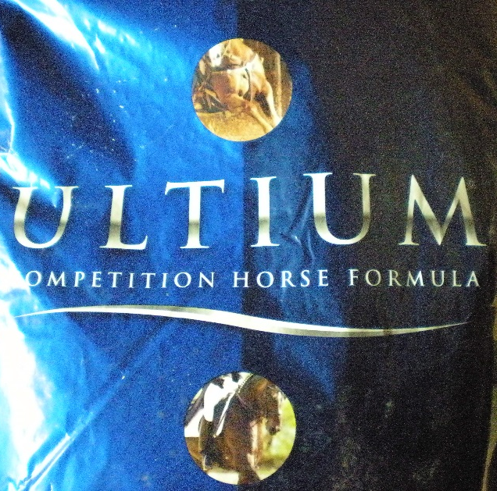
Concentrate
Feedstuffs that are low in fiber and high in nutrient density.
Energy sources
  Cereal grains: corn, oats, barley
Protein sources
  Oil seed by-products: soybean meal
Notes:
Concentrates have less than 18% fiber and have high levels of energy, protein, or both. Concentrates are broken into energy sources and protein sources.
Energy sources of concentrates are the cereal grains. Corn is the most common grain in livestock feeds. It is high in energy and palatable.
Protein sources contain more than 20% protein and may come from plants or animals. Vegetable proteins come from many oilseed crops. Animal proteins are higher in crude protein, most over 47%, and have a balance of amino acids.
Many concentrates are utilized in human diets, increasing the demand and cost. The cost and availability are primary considerations when selecting a concentrate to feed.

Slide 7
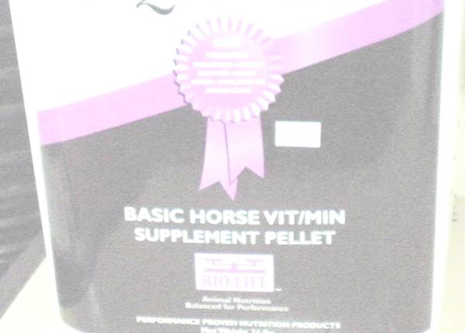
Supplements
Supplements are commonly used to provide small amounts of nutrients that are deficient in a ration.
  Vitamins
  Minerals
  Fats and oils
Notes:
A diet consisting of two to three feedstuffs may still be deficient in one or more nutrients, particularly vitamins and minerals.
Rather than adding another feedstuff, the producer may choose to use supplements to prevent a deficiency. Supplements can be mixed in a feed or be offered free choice. Salt and mineral blocks are common forms of free choice mineral supplements.

Slide 8
Feed Additive
Feed additives are used to modify one or more properties of a feed. A feed additive does not add nutritional value.
Additives:
  Increase stability
  Enhance growth or performance
  Promote animal health
  Improve consumer acceptance
Notes:
Feed additives are used to modify one or more properties of a feed. A feed additive does not add nutritional value.
Additives that increase stability are used to:
Reduce the growth of molds during storage.
Prevent breakdown of nutrients.
Bind feedstuffs in pellet form.
Reduce dust and fine particles.
Additives that enhance growth or performance help:
Increase palatability through flavor enhancement, commonly sweeteners.
Improve digestibility of feeds.
Buffer pH levels.
Additives that promote animal health and protect against disease and parasites.
Additives that improve consumer acceptance are most common in poultry. Xanthophyll, a plant pigment, produces the yellow color in egg yolks.

Slide 9
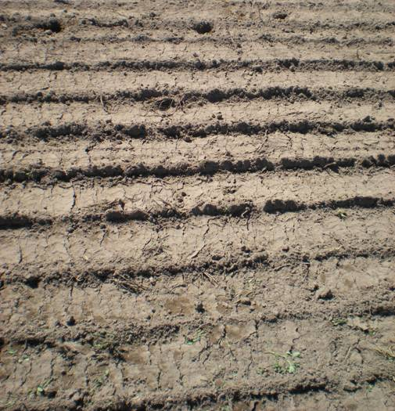
Variability
The same feedstuff may have differing nutrient contents based on
  Time of harvest
  Growing conditions
  Soil conditions
  Water availability
  Geography
Notes:
Due to seasonal differences in rate of growth, water, and nutrient availability, feedstuffs can vary in nutritional value depending on the time of year harvested. This is particularly true of forage crops.
The nutrients in the soil and geography also play important roles in the nutritional value of feedstuffs. Some soils and regions of the country are deficient in specific minerals.

Slide 10
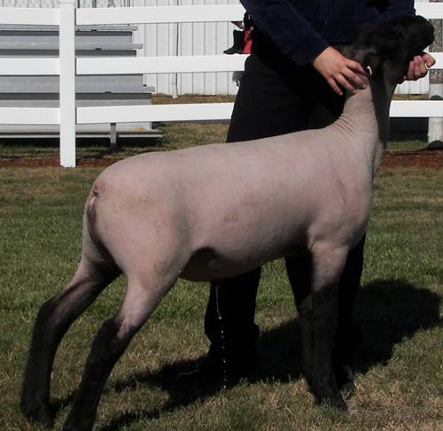
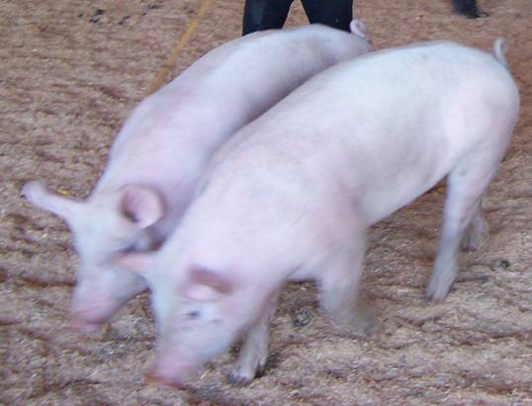
Variability
The amount of nutrition derived from a feed varies from species to species due to digestive differences.
Notes:
Each species of animal digests and utilizes feed in slightly different ways. Due to this, feedstuffs provide different quantities of nutrients to different animals. The greatest differences often occur between ruminant and monogastric animals.

Slide 11
NRC Feed Tables
The National Research Council has published feed tables containing the nutritional value of common feeds.
Use the feed tables as a guide.
Feed analysis is still recommended due to variability in feeds.
http://books.nap.edu/catalog.php?record_id=1713
Notes:
The National Research Center has published feed composition tables as guidelines for the nutritional value of common feeds.
The tables provide average values and can be helpful in selecting a feedstuff and balancing rations.
If precise values are needed, individual feed analysis should be performed.

Slide 12
References
Cheeke, P.R. (1991). Applied animal nutrition: Feeds and feeding. Englewood Cliffs, NJ: Prentice Hall.
Ensminger, M.E. (1991). Animal science. Danville, IL: Interstate Publishers, Inc.
National Research Council. (1982). United States-Canadian tables of feed composition: Nutritional data for United States and Canadian feeds, third revision. Washington D.C.: National Academies Press.

