Slide 2
Animals in Our Lives
Principles of Agricultural Science – Animal
Unit 1– Lesson 1.1 Animal Planet

Slide 3
From Industry to Products
Career opportunities in animal production are seemingly endless.
Will you produce if you pursue one of these careers?
Notes:
As students have been exploring the world of animal agriculture and the career opportunities within, they need to recognize the diversity of uses and products derived from animals. This presentation starts the process of discovering the many uses of animals and breaks those uses and products into narrower categories.
Realizing all components of animal production are necessary to become an efficient producer.

Slide 4
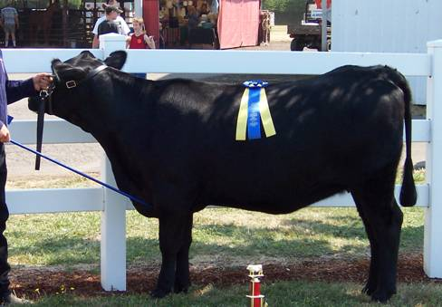
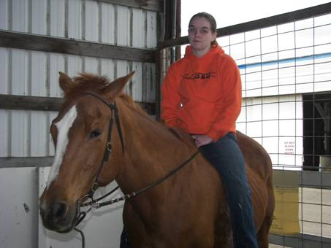
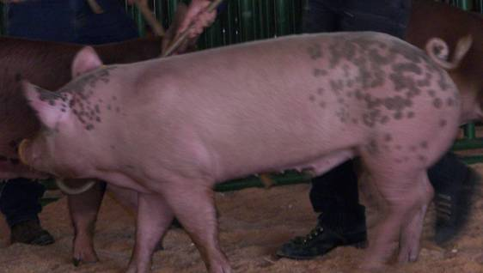
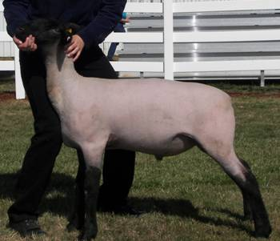
Animal Uses
Notes:
You may commonly think of animal agriculture as the production of meat animals and horses. What other uses of these common animals can you think of?

Slide 5
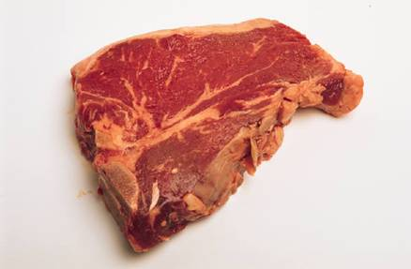
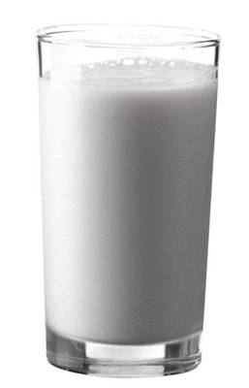
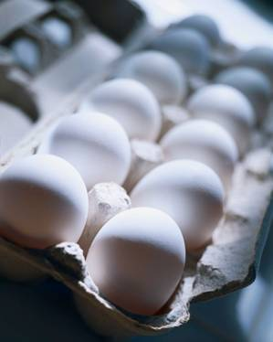
Animal Uses
Food
Meat
Milk
Eggs
Notes:
In the United States, the most common use of agricultural animals is as a source of food. The main types of food are meat, milk, and eggs, although you will see other food products in different groups.

Slide 6
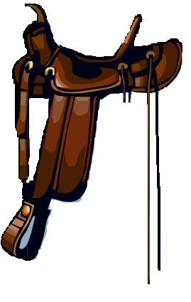
Animal Uses
Fiber/Hide
Wool
Leather
Hair
By-products
Edible
Non-edible
Notes:
Technically, all products that are not a major use, such as meat, are by-products. Since there are so many types of by-products, they are broken into smaller categories.
Edible by-products include such things as marshmallows, gelatin, and lard.
Non-edible by-products include a multitude of medicines, cosmetics, soap, and fertilizers.
One by-product group is fiber and hides. This is one of the most economically important by-products as the hide of a beef animal may be worth 5% of the total carcass value. People depend on wool and hair for many everyday uses, such as carpet and paintbrushes.

Slide 7
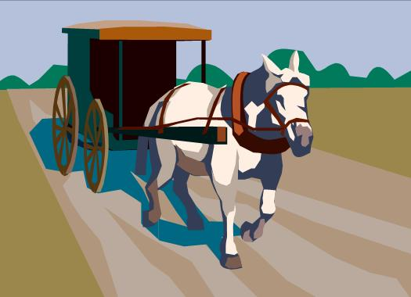
Animal Uses
Work
Draft
Service
Herding
Pulling
Companionship
Pets
Friends
Notes:
Historically, animals have been used for many work purposes.
Currently, the use of animals for work is not economical in terms of time and labor. However, draft animals are still used on historic farms, in parades and shows, and by some cultures. Additionally, animals, such as dogs and miniature horses are used as service animals for disabled and handicapped people.

Slide 8
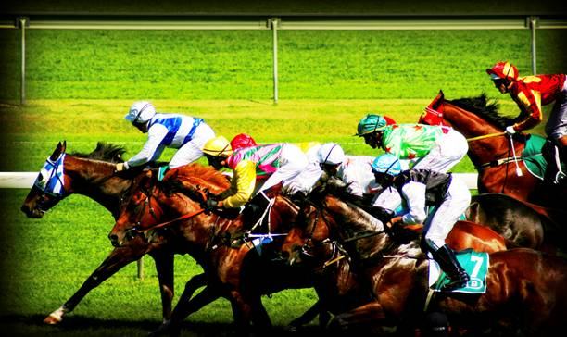
Animal Uses
Research
Pharmaceuticals
Cosmetics
Entertainment and Recreation
Racing
Rodeo
Riding
Fishing
Notes:
Research utilizes animals in many ways, from live animal testing to developing and processing new pharmaceuticals and cosmetics. Numerous drugs are derived from livestock, such as insulin, heparin, and epinephrine that people rely on everyday.
Many national past-times rely on animals from rodeo and racing sporting events to recreational activities, such as horseback riding, fishing, and hunting.

Slide 9
References
Gillespie, J.R., & Flanders, F.B. (2015). Modern livestock and poultry production (9th ed.). Clifton Park, NY: Delmar.

