Slide 2
Respiratory and Circulatory Anatomy
Principles of Agricultural Science – Animal
Unit 4 – Lesson 4.3 Breathing, Beating, and Body Controls

Slide 3
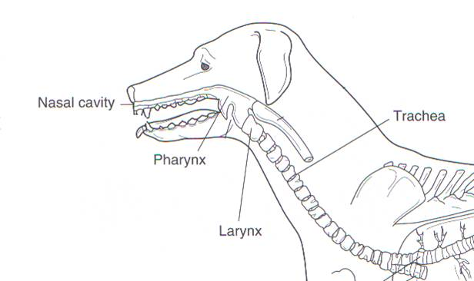
Upper Respiratory Tract
1. Nose/mouth – entry and exit of air
2. Nasal cavity –
warms and moistens air
Pharynx – nose and mouth passages join
Romich, J.A. (2006). An illustrated guide to veterinary medical terminology (2nd ed.). Clifton Park, NY: Thompson Delmar Learning.
4. Larynx – vocal cords
5. Trachea – windpipe, attaches larynx to lung
Notes:
The respiratory tract is commonly divided into the upper and lower portions. The upper portion consists of the nose, nasal cavity, pharynx, and larynx. The trachea can be considered an upper or lower part.
The nose, or mouth, is the point where air enters and exits the body.
The nasal cavity warms and moistens the air before it passes to the lungs. The nasal cavity also filters particulates from the air and contains the olfactory, or smell, receptors.
The pharynx is the joint passage of the respiratory and digestive tracts commonly referred to as the throat. It is also where the nasal and mouth passages join. In the pharynx, the epiglottis is a small flap that closes the passageway to the lungs, forcing food down the esophagus to the stomach. The epiglottis opens to allow air into the lungs.
The larynx connects the pharynx to the trachea. It is also the site of the vocal cords, which produce sound.
The trachea connects the larynx to the lungs. It is commonly referred to as the windpipe and is composed of dense cartilage rings. These rings keep the trachea from collapsing and closing off air flow.
Source:
Romich, J.A. (2006). An illustrated guide to veterinary medical terminology (2nd ed.). Clifton Park, NY: Thompson Delmar Learning.

Slide 4
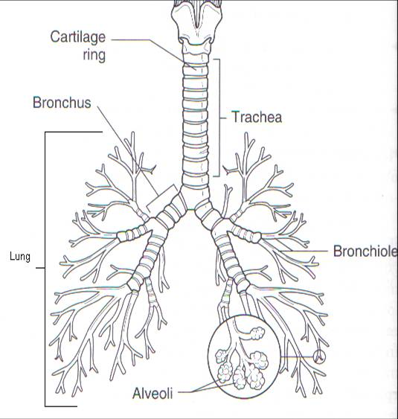
Lower Respiratory Tract
Bronchiole – small branches of the bronchi
Alveoli – air sacs where gas exchange occurs
Lung – main organ of respiration
Bronchi – two main branches of the trachea that lead to each lung
Romich, J.A. (2006). An illustrated guide to veterinary medical terminology (2nd ed.). Clifton Park, NY: Thompson Delmar Learning.
Notes:
The lower respiratory tract consists of the bronchi, bronchiole, alveoli, and lungs.
The lungs are the main organ of respiration and contain the smaller portions within. The base of the trachea branches into two main bronchi (NOTE: singular is bronchus). Each bronchus leads to a lung where they further divide into smaller bronchioles.
At the base of the bronchioles are alveoli. Alveoli are small air sacs that contract and expand with each breath. The alveoli are connected to capillaries and allow the diffusion of oxygen and carbon dioxide. The alveoli look like small grape clusters when viewed.
Source:
Romich, J.A. (2006). An illustrated guide to veterinary medical terminology (2nd ed.). Clifton Park, NY: Thompson Delmar Learning.

Slide 5
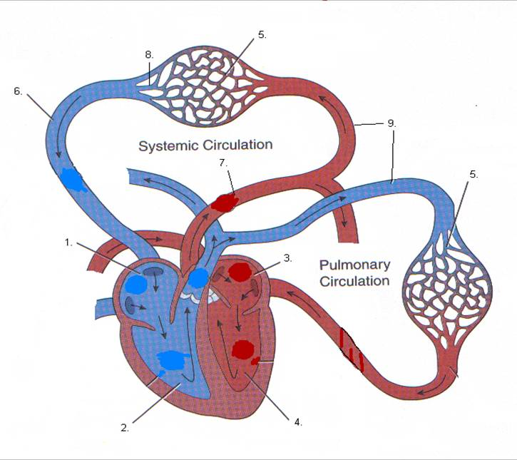
Circulatory Parts and Their Function
Heart Parts:
Right atrium – blood enters from vena cava, ↓ O₂, ↑CO₂
Right ventricle – sends blood to lungs via pulmonary artery
Left atrium – blood returns from lung oxygenated via the pulmonary vein
Left ventricle – sends oxygen rich blood to the body via aorta.
Lawhead, J., & Baker, M. (2005). Introduction to veterinary science. Clifton Park, NY: Delmar.
Notes:
There are two components of the circulatory system controlled by the heart, systemic circulation and pulmonary circulation. The heart connects the two systems. The four main parts of the heart channel the flow of blood from the organs to the lungs. The parts are numbered in order of the blood flowing through the heart.
Source:
Lawhead, J., & Baker, M. (2005). Introduction to veterinary science. Clifton Park, NY: Delmar.

Slide 6
Circulatory Parts and Their Function
Capillaries – smallest vessel carrying blood, site of nutrient and gas transfer
Vena cava – large vein entering the heart
Aorta – main vessel that carries blood to all organs except lungs
Lawhead, J., & Baker, M. (2005). Introduction to veterinary science. Clifton Park, NY: Delmar.
Notes:
Capillaries are the smallest vessels within the body and the site of nutrient and gas exchange between cells, organs, blood, and the lungs.
Conversely, the vena cava and aorta are the largest vessels in the body. The vena cava brings blood to the heart from the organs and the aorta returns blood to the body.
Source:
Lawhead, J., & Baker, M. (2005). Introduction to veterinary science. Clifton Park, NY: Delmar.

Slide 7
Circulatory Parts and Their Function
Vein – carry blood toward the heart
Artery – carry blood away from the heart
Lawhead, J., & Baker, M. (2005). Introduction to veterinary science. Clifton Park, NY: Delmar.
Notes:
The final two components of the circulatory systems are arteries and veins. Arteries carry blood away from the heart, while veins bring blood to the heart. An easy way to remember the direction of flow is A=away.
Typically arteries carry oxygen-rich blood to the organs and veins carry oxygen-poor blood to the heart. The exception is blood flow between the heart and lungs. Oxygen-poor blood flows through the pulmonary arteries to the lungs and returns oxygen-rich through the pulmonary veins.
Source:
Lawhead, J., & Baker, M. (2005). Introduction to veterinary science. Clifton Park, NY: Delmar.

Slide 8
Finalize Activity 4.3.1 Show What I Know and answer Conclusion questions
Notes:
Have students complete Activity 4.3.1 Show What I Know.
Answer any questions and ask students to share any areas where their previous knowledge was incorrect.

Slide 9
References
Gillespie, J.R., & Flanders, F.B. (2015). Modern livestock and poultry production (9th ed.). Clifton Park, NY: Delmar.
HowStuffWorks.com. (2005). How your lungs work. Retrieved from http://health.howstuffworks.com/human-body/systems/respiratory/lung2.htm
HowStuffWorks.com. (2005). How your heart works. Retrieved from http://health.howstuffworks.com/human-body/systems/circulatory/heart.htm
Lawhead, J., & Baker, M. (2005). Introduction to veterinary science. Clifton Park, NY: Delmar.
Romich, J.A. (2006). An illustrated guide to veterinary medical terminology (2nd ed.). Clifton Park, NY: Thompson Delmar Learning.

