Slide 2
Reading Labels
Principles of Agricultural Science – Animal
Unit 5 – Lesson 5.3 Feedstuffs

Slide 3
Terminology
Crude Fiber (CF)
The part of feeds containing the cellulose, lignin, and other structural carbohydrates as determined by the proximate analysis.
Crude Protein (CP)
A measure or estimate of the total protein in a feed determined by multiplying the total nitrogen content by 6.25.

Slide 4
Terminology
Dry Matter (DM)
The total amount of matter, as in a feed, less the moisture it contains.
Metabolizable Energy (ME)
The total amount of energy in feed less the losses in feces, combustible gases, and urine. Also called available energy.

Slide 5
Terminology
Total Digestible Nutrients (TDN)
A standard evaluation of the usefulness of a particular feed for livestock, which includes all the digestible organic nutrients; protein, fiber, nitrogen-free extract, and fat.

Slide 6
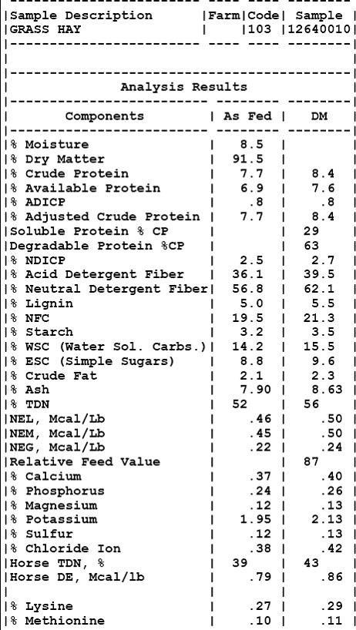
Feed Analysis
The chemical or material analysis of a feedstuff that is determined at a laboratory.
Notes:
The most accurate method of determining the nutritional value of a feed or feedstuff is through feed analysis. To analyze a feed, samples are sent to a chemical laboratory. At the lab, the feed sample undergoes a series of tests to determine the dry matter, protein, fiber, fat, energy, and mineral contents.
Due to costs and time, many people use the NRC Feed Composition Tables discussed in the Feedstuffs presentation for a base feed analysis to compute rations.

Slide 7
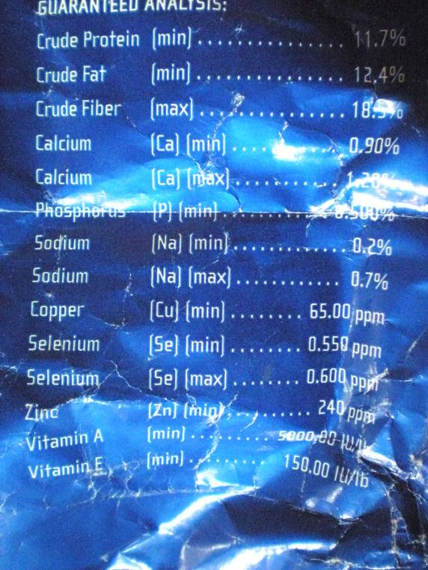
Feed Labels
Contains less information than an analysis report.
May use estimates rather than exact percentages of nutrients.
Notes:
Commercially prepared feeds are required to have a feed label with guaranteed levels of nutrients.
Always read the ingredients as well as the guaranteed analysis as some feeds use unpalatable or indigestible items to increase the nutrient content of the feed.

Slide 8
Guarantees
Guarantees allow for some flexibility in mixing a feed.
Usually expressed as a percentage (%).
Minimum – the least amount of a nutrient included in the feed (i.e., protein & fat).
Maximum – the greatest amount of a nutrient included in the feed (i.e., fiber).
Notes:
To protect the consumer, commercial feed labels have a guaranteed analysis. In the guaranteed analysis, the buyer is assured the feed will have a minimum or maximum amount of a nutrient in that feed. The feed is allowed to have less than the maximum or more than the minimum. This is to allow for the variability in nutritional value of feedstuffs.
Nutrients, such as protein and fat are typically guaranteed as minimum levels. Fiber is guaranteed as a maximum percentage.

Slide 9
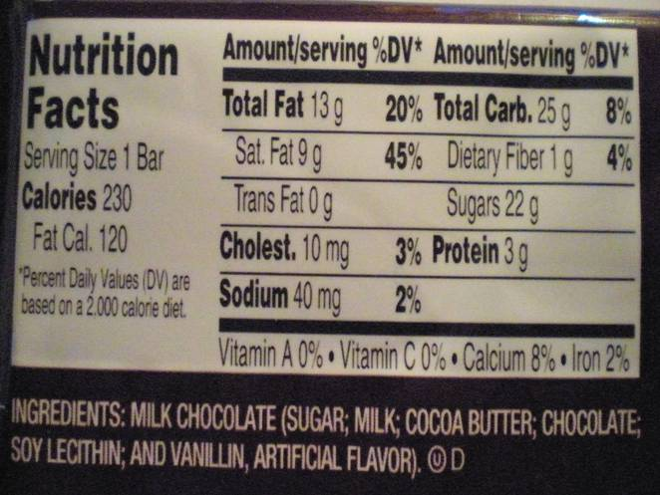
Nutrition vs. Feed Label - Energy
Candy Bar
Nutrition labels
Calories on a label are expressed in “food” calories.
A food calorie is equal to one kilocalorie.
One food calorie equals 1000 calories.
Notes:
Products for human consumption use calories as a measure of energy in the food. The food calorie is actually 1000 calories. The amount of calories is based on the serving size of the food.

Slide 10
Nutrition vs. Feed Label – Energy
Feed labels
Energy expressed in megacalories per kilogram or Mcal/kg.
One megacalorie equals 1,000,000 calories.
Dog Food Label
Ingredients & Nutrition Information
GUARANTEED ANALYSIS
Crude Protein (Min) | 25.0% | Calcium (Ca) (Min) | 1.1%
Crude Fat (Min) | 10.0% | Iron (Fe) (Min) | 200 mg/kg
Crude Fiber (Max) | 4.0% | Selenium (Se) (Min) | 0.2 mg/kg
Moisture (Max) | 14.0% | Vitamin A (Min) | 10,000 IU/kg
Linoleic Acid (Min) | 1.5% | Vitamin E (Min) | 100 IU/kg
CALORIE CONTENT
Metabolizable Energy (ME)
3.69 Mcal/kg
16.74 Mcal/lb
.36 Mcal/cup
Notes:
Animal feeds use megacalories per kilogram as the unit of measurement for energy.

Slide 11
Nutrition vs. Feed Label
Feed labels express energy content in megacalories per kilogram.
Nutrition labels express energy content in food calories based on a serving size.
How do these relate?
Notes:
Let’s convert a food calorie to Mcal/kg.

Slide 12
Energy Content of a Candy Bar
First change food calories (230 calories) to calories. Since there are 1000 calories per food calorie, multiply the calories by 1000.
There are 230,000 calories in a candy bar.
The candy bar is 43g, the next step is to determine the calories per gram.
Divide the total calories by 43.
The result is 5348.8 calories per gram.

Slide 13
Energy Content of a Candy Bar
Feed composition tables are expressed in Mcal/kg. The next step is to determine the calories per kilogram.
To do this, multiply by 1000.
There are 5,348,800 calories per kilogram of candy bar.
Finally, convert calories to megacalories. There are 1,000,000 calories per megacalorie.
Divide 5,348,800 by 1,000,000.
The result is 5.35 Mcal/kg.

Slide 14
Energy Comparison in a Candy Bar
Digestible energy for beef cattle in common feeds
Corn ~3.66 Mcal/kg
Alfalfa ~2.56 Mcal/kg
Oats ~ 3.40 Mcal/kg
Candy Bar ~ 43g
230 food calories/ 43g
230000 calories/ 43g
5348.8 cal/ 1g
5348800 cal/ 1kg
5.35 Mcal/kg
Notes:
This is not a perfect comparison as the candy bar may have a different value for digestible energy in cattle, but does show the comparison of a nutrition label versus a feed label. This analysis demonstrates that this particular candy bar is a high energy food.

Slide 15
References
Cheeke, P.R. (1991). Applied animal nutrition: Feeds and feeding. Englewood Cliffs, NJ: Prentice Hall.
Ensminger, M.E. (1991). Animal science. Danville, IL: Interstate Publishers, Inc.

