Slide 2
In the Beginning
Principles of Agricultural Science – Animal
Unit 7 – Lesson 7.1 A New Pair of Genes

Slide 3
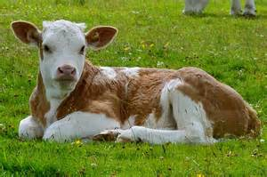
Before the calf….
Was the
Egg
and the
Sperm
Notes:
In the previous unit, Unit 6 Animal Reproduction, you learned about the reproductive process, but may have wondered how a foal or child looks like it’s parent. In this lesson, you will learn the science of genetics and how traits are inherited.

Slide 4
What is Inheritance?
4
The transfer of genetic material (genes) from one generation to the next.
Half of an individual’s genes come from the sire via sperm.
Half of an individual’s genes come from the dam via the egg.
Offspring contain genes from both parents.
Notes:
Inheritance is founded on the principle that genetic material moves from one generation to the next via genes. Half the dam’s genes are transferred to the offspring in the egg. At conception, those genes combine with half the sire’s genes contained in the sperm. Therefore, a fertilized embryo has a full compliment of genetic material, with half coming from each parent.
4

Slide 5
Fertilization
Fertilization is the union of sperm with the ovum to produce a fertilized egg called a zygote.
When sperm reaches the ovum:
One sperm cell unites with one ovum.
The resulting cell contains all genetic material and undergoes rapid cell division (i.e., mitosis) as the embryo develops.

Slide 6
Why does fertilization not increase the number of chromosomes in each generation of offspring?
Point to Ponder
Meiosis
Notes:
If offspring inherited all chromosomes from each parent, the number of chromosomes in each generation would double.
How might that affect the appearance and viability of offspring?

Slide 7
A Microscopic View – Formation of Sperm and Egg Cells
Sperm and egg cells must undergo the process of meiosis to become haploid.
Meiosis is a type of cell division that reduces the number of chromosomes in new cells by half.
Notes:
Meiosis happens when a pair chromosomes in a sex cell divide and separate to form two new cells containing one member of the original pair of chromosomes in each new cell.
In Lesson 4.1 Units of Life, you learned about the parts of a cell and that the nucleus contains DNA and genetic material. In this presentation, you will be taking a closer look at the transmission of DNA from parent to offspring.

Slide 8
Start With a Sex Cell
Male and female reproductive organs produce sex cells.
The nucleus of cells contains chromosomes, which carry genes.
Chromosome
Nucleus
Chromatid
Notes:
The nucleus of cells contains all the genetic material necessary to replicate an individual. The number of chromosomes varies by species of animal. Humans have 46 chromosomes, cows have 60, horses 64, dogs 78, and fruit flies 8. Chromosomes occur in pairs, one from each parent. These pairs are called homologous chromosomes and they work together in meiosis. So, humans have 23 pairs of chromosomes.
Notice the nucleus in this slide has two pairs of chromosomes. In the next slides, the nucleus will have one pair of chromosomes. Realize in most animals there would be more than one chromosome.

Slide 9
Meiosis I
Diploid cells are cells with two sets of each chromosome.
Diploid Sex Cell
Haploid Cells
Matching chromosomes separate
Notes:
Meiosis is the process of chromosome reduction. Meiosis has two phases – the first is to produce haploid cells containing “half” of the chromosomes of the original diploid cell. In meiosis I, the homologous chromosomes are separated, resulting in cells that have one half as many chromosomes in the new cells.

Slide 10
Meiosis II
Cells divide again to produce haploid gametes.
This process happens for both sperm and egg cells.
Four gametes are produced
Notes:
Haploid cells reduce again splitting the chromosomes and each producing two new gametes containing chromatid material. Sperm and egg cells go through this process to reduce to chromatid material for fertilization.

Slide 11
From Haploid Gametes
Back to a Diploid
Sperm Gametes
Egg Gametes
Fertilization
One gamete from the male joins one gamete from the female during fertilization.
This new cell is called a zygote.
Notes:
Fertilization happens when the sperm cell containing a male gamete is joined with the egg cell containing the female gamete. The union of the two gametes create a new cell containing chromatid material from both parents. A fertilized egg is called a zygote.

Slide 12
The Next Step
Following fertilization, division of the zygote will continue the cell replication process.
This process is called mitosis.
Notes:
The zygote essentially brings the process back to the beginning of the cell development process. Mitosis will begin the cell multiplication process. The following slides provide an overview. However, Activity 7.1.1 Focus in on Mitosis will be critical to help you understand mitosis.

Slide 13
The Development of a Zygote
Cells undergo rapid mitosis
as the zygote grows.
Parent Cell
Replication
Cell Division
Daughter Cells
You will learn more about mitosis in a later activity.
Notes:
Mitosis and meiosis can easily be confused. Mitosis results in new cells with genetic material that is identical to the parent cell. If an organism has 46 chromosomes, there will be 46 chromosomes in each replicated cell.

Slide 14
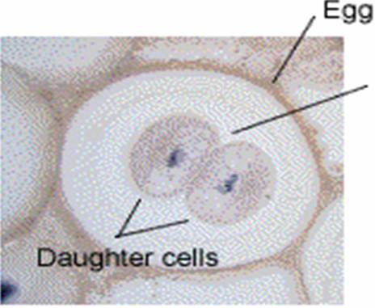
Mitosis
Mitosis is the division of cells to produce daughter cells that contain a full set of chromosomes.
Parent cell
Notes:
Mitosis defined. Mitosis occurs in all cells and occurs throughout life as cells are replaced in the body.

Slide 15
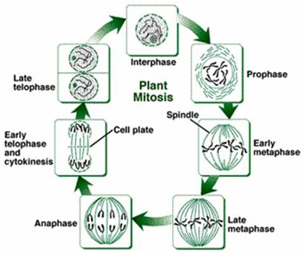
Phases to Mitosis
Interphase
Prophase
Metaphase
Anaphase
Telophase
Mitosis phases will be explored further in Activity 7.1.1 Focus in on Mitosis.
Notes:
This is an overview of the phases for mitosis. Refer to pages 191-194 in Modern Livestock and Poultry Production (8th ed.) textbook (Gillespie & Flanders, 2010) for further reading related to phases of mitosis.

Slide 16
References
Feldkamp, S. (Ed.). (2002). Modern biology. Austin, TX: Holt, Rinehart, and Winston.
Gillespie, J.R., & Flanders, F.B. (2015). Modern livestock and poultry production (9th ed.). Clifton Park, NY: Delmar.
Herren, R. V. (2004). The science of agriculture: A biological approach (2nd ed.). Albany, NY: Delmar.
Herren, R. V., & Donahue, R. L. (2000). Delmar’s agriscience dictionary with searchable CD-ROM. Albany, NY: Delmar.

