Slide 2
Domestication
Principles of Agricultural Science – Animal
Unit 2 – Lesson 2.1 Taming Animals
Notes:
This presentation introduces the benefits of domestication and the six characteristics of domesticated animals.
It will help you to recognize the differences between wild, tame, and domesticated species.

Slide 3
What is domestication?
Think of a domestic animal
What makes an animal domesticated in your mind?
Notes:
Responses may include:
Depends on humans for food, shelter, and care.
Serves a purpose to humans – food, fiber, work, companionship.
Has been developed to better fulfill purposes – variety of breeds.

Slide 4
What is domestication?
Defined:
To bring wild animals under the control of humans over a long period of time for the purpose of providing useful products and services; the process involves careful handling, breeding, and care.

Slide 5
Why domesticate?
More stable food and clothing supply
Allows for specialization
Leads to less nomadic cultures and greater population density
Allows for selective breeding
Early genetic modifications
Greater production capabilities lead to surpluses and storage
Notes:
Why did our ancestors begin to domesticate animals? The early domestication of wolves may have been partially out of convenience. Wolves protected tribes of people and assisted in hunting. They in turn received some protection, a steady food supply, and companionship.
Agricultural production, of both plants and animals, allowed a small group of people to produce food for many thus giving the others the opportunity to develop new technology, such as tools, weapons, and written language.
As groups could produce more food and shelter, the need to follow herds of animals diminished. This more sedentary lifestyle gave rise to larger families and better nutrition in turn contributing to a growth in population.
As the ability and knowledge of farmers increased, they began selecting plants and animals for desirable traits. This lead to early genetic modifications, breed development, and eventually food surpluses and stores.

Slide 6
Six Characteristics of Domesticated Animals
Diet
Growth Rate
Ability to Breed in Captivity
Disposition
Temperament
Social Hierarchy
Notes:
These are the six characteristics of domestication. During this presentation, you will learn more about each one. Remember to take notes on these six topics.

Slide 7
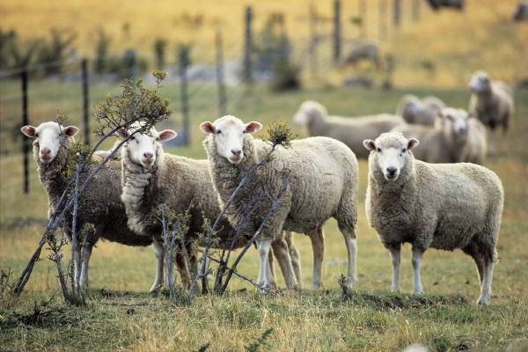
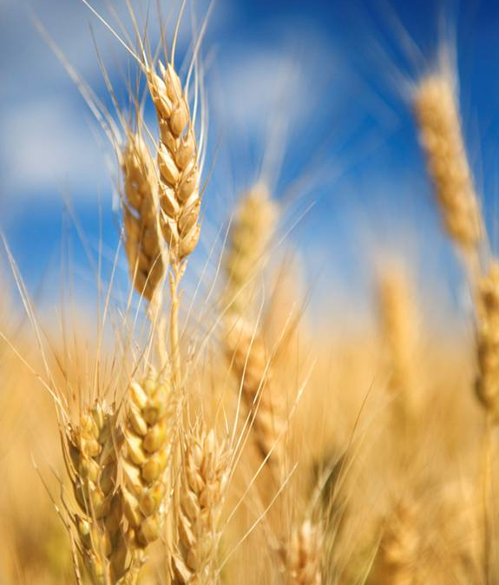
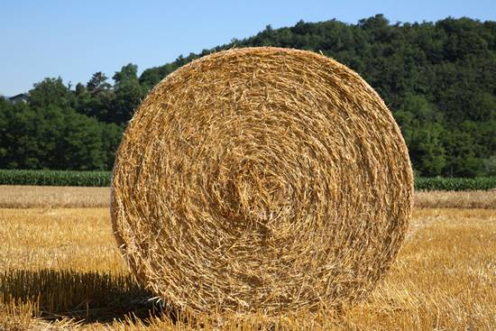
Characteristics Leading to Domestication
Diet
Must be flexible
Herbivore or omnivore are more sustainable
Notes:
Animals must have a flexible, plant-based diet for domestication. Reasons include:
Cost – carnivores are much more expensive to care for.
Efficiency – herbivores consume less overall biomass. Plant eaters are at a lower trophic level than carnivores.
Dogs may seem like carnivores, but most commercial dog foods are grain based.

Slide 8
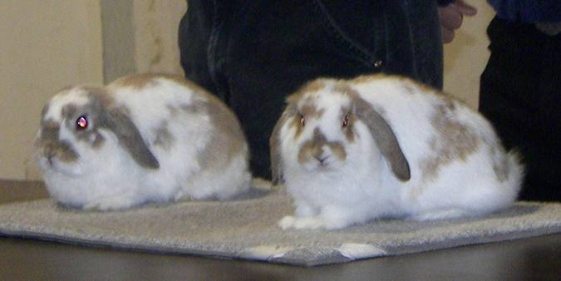
Characteristics Leading to Domestication
Growth rate
Reach maturity relatively fast
Lifespan and reproductive cycle short enough for humans to control breeding.
Notes:
For practical purposes, the reproductive cycle of animals must be short enough for selective breeding to allow change.
Slow maturing animals, such as the elephant, mature so slowly that it is nearly impossible to make significant genetic progress in a lifetime.
Small animals, particularly rabbits and mice, mature fast enough and can reproduce with such speed that they are excellent candidates for laboratory and genetic research.

Slide 9
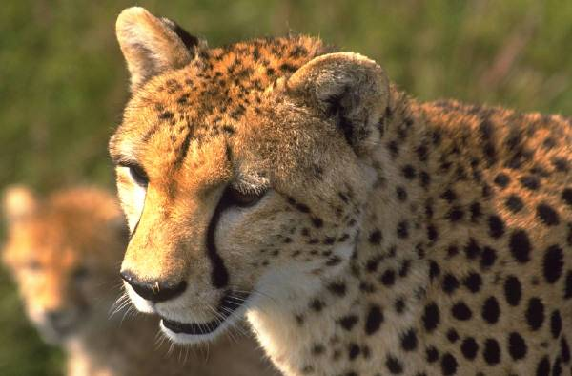
Characteristics Leading to Domestication
Ability to breed in captivity
Some animals will not breed in captivity
Notes:
Some species of animals have long, complex courtship processes and captivity may inhibit that process.
These species will not mate without courting and in some cases the female may not ovulate or become sexually receptive to the male.

Slide 10
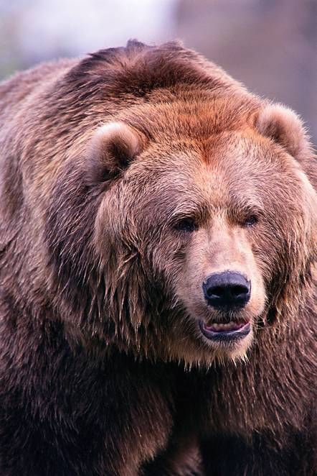
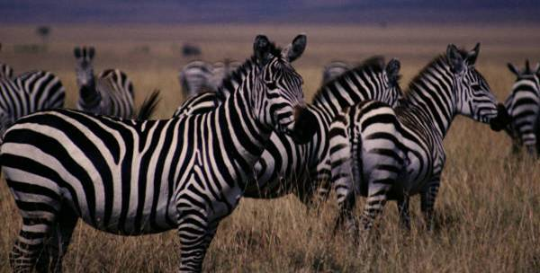
Characteristics Leading to Domestication
Disposition
Calm and moderately predictable
Not overly aggressive
Notes:
Carnivores are among the least likely animals to domesticate because humans and all other animals can be a food source for them. Combine that with an aggressive disposition, and human safety becomes a limiting factor of domesticating certain kinds of animals.
The ability to predict behavior is essential and some species seemingly capable of being domesticated are excluded due to their unpredictable nature. Grizzly bears and zebras are excellent examples.

Slide 11
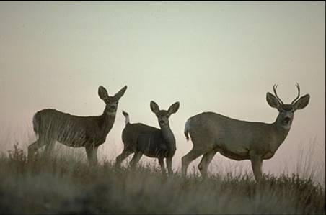
Characteristics Leading to Domestication
Temperament
Does not panic easily
Humans can manage flight zone
Notes:
Most animals have a flight zone, which is an area that causes an animal to move away from an apparent threat. Domestic animals can overcome the flight response.
While some species can be trained to overcome the flight response, others, such as the gazelle, cannot. Many wild animals can be tamed and will be less flighty, but it is not or cannot be bred into them.

Slide 12
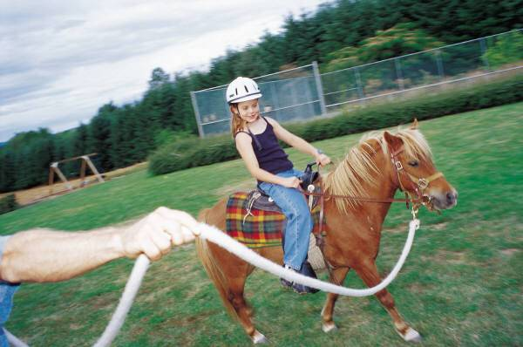
Characteristics Leading to Domestication
Social hierarchy
Can be modified
Will accept humans as leader
Notes:
A species must be willing to submit to a human leader. This is seen often with imprinting, particularly with geese. Dependency on people for food and care often necessitates this modification of social structure.
Some people question whether cats are truly domesticated due to their apparent lack of submission to humans.

Slide 13
Domestication Facts
Some animals can be partially domesticated or raised in captivity.
If humans cannot control and modify an animal’s appearance or behavior, the animal is not fully domesticated.

Slide 14
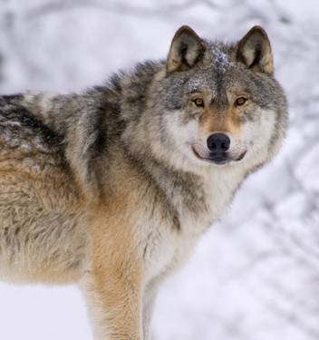
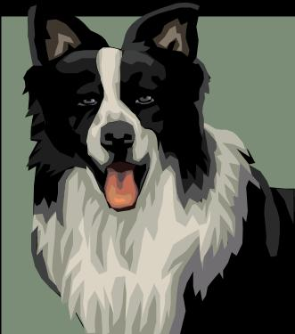
Domestic or Tame?
Domestic:
Entire species
Meets all six domestic characteristics
Tame:
One or a few individuals
Offspring still possess traits of wild counterparts
Notes:
Many “wild” animals can fit into one or more of the six characteristics of domestication. However, the combination of all six characteristics is essential for full domestication.
To be truly domesticated, the entire species must meet the requirements. Whereas, there may be examples of tame individuals within a species, but the species as a whole remains wild.
Example: Dog vs. Wolf
There are numerous breeds of dogs and they consistently rely on humans. Wolves can be bred and raised in captivity, but special care must be taken in the upbringing of the pups to tame them. The wolf pups retain the overall characteristics of those in the wild.

Slide 15
References
Diamond, J. (1999). Guns, germs, and steel. New York, NY: Norton.
University of Vermont, Department of Animal Science. (2008). Historical perspectives of animal domestication. Retrieved from http://asci.uvm.edu/course/asci001/domestic.html
Wikipedia. (2008). Domestication. Retrieved from http://en.wikipedia.org/wiki/Domestication

