Slide 2
Biosecurity
Principles of Agricultural Science – Animal
Unit 3 – Lesson 3.3 Home Sweet Home

Slide 3
What is Biosecurity?
The practices that protect herd health by preventing the spread of pathogens.
Reducing the potential for diseases to reach the farm
Controlling the spread of diseases on the farm
Notes:
The purpose of biosecurity is two-fold. The first purpose is to limit and reduce the introduction of pathogens to the farm. This can be achieved through limiting access to the farm.
The second purpose is to control the spread of diseases, if they do occur. Good biosecurity plans are used to implement strategies for isolating, removing, and properly caring for infected animals.
Biosecurity is extremely important to many confinement operations as the high concentrations of animals is conducive to the rapid spread of disease. Large poultry and swine facilities may have very detailed risk management plans, whereas large cattle ranches may have very little planned.

Slide 4
Risk Management
Balancing the likelihood of an uncertain event happening with the cost of protection
Preventative maintenance
Watch this video for an introduction to cleanliness of a backyard poultry farm….
https://www.youtube.com/watch?v=S9fCDU2pn5I
Notes:
Risk management is the technique of assessing, minimizing, and preventing accidental loss to a business, as through the use of insurance, preventive maintenance, safety measures, and so forth.

Slide 5
Control Points
Area where risk can be influenced
Reduce the risk that something bad will happen
Monitor the control points
Notes:
Producers cannot manage every factor, such as weather, that influences the health of their animals. However, practices, such as shelter and additional feed, can be used to limit the impact weather might have on a herd. Managing these control points reduces the risk to livestock.
Biosecurity must be a daily habit, not an afterthought or a once-in-a-while activity. Having standard operating procedures in place for daily management routines is necessary for an effective plan.

Slide 6
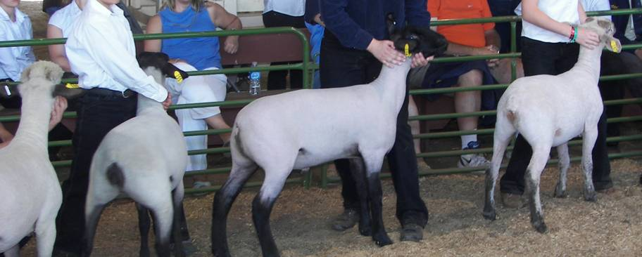
Risk Factors
New Animals on the Farm
Comingling new animals
Returning animals from fairs
Strategies to Overcome:
Quarantine for 2-4 weeks
Wear different clothing and shoes
Use parasite controls and vaccinate
Notes:
The greatest risk for bringing pathogens to the farm is the introduction of new animals. Comingling groups of animals from various sources exposes animals to greater numbers of pathogens.
Teacher Note: Example: When students go back to school in the fall, colds and viruses are common. This is due to the fact that students are suddenly exposed to a greater variety of viruses than they had been while at home over the summer.
There are completely closed herds in the United States where all animals are born on the farm and may not return if they are transported to other facilities. This is not possible in all operations and the safest way to handle new or returning livestock is to isolate them for two to four weeks. The incubation period for most illnesses is two weeks and animals not exhibiting signs of illness after isolation are generally safe to integrate into the original stock. While in isolation, it is a good practice to update vaccinations and parasite control.
During isolation, animals should not be penned close to other animals or share feed or water. Different clothing and shoes should be worn around animals in isolation.

Slide 7
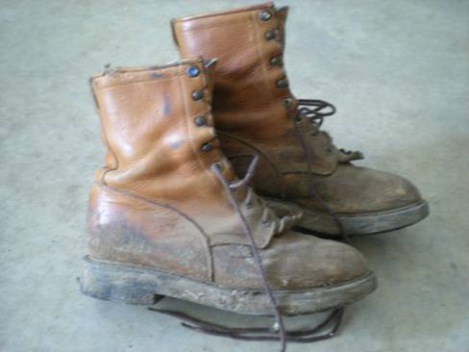
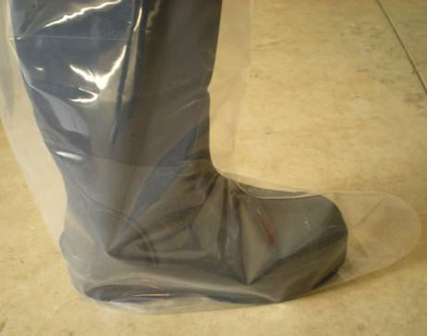
Risk Factors
Visitors to the Farm
Carry pathogens from farm to farm
Strategies to Manage
Provide clean coveralls and disposable boots
Minimize contact with animals
Notes:
Unfortunately, the highest risk visitors are often the most necessary – veterinarians and other livestock producers. Due to their frequent contact with animals, they are the most likely carriers of pathogens transmissible to livestock. These people should take extra caution when visiting farms, such as clean clothing or coveralls, shoes or disposable boots, and vehicles. They should also wash hands and forearms with an antibacterial soap before and after handling animals.
Lower risk visitors include salesmen who may travel from farm to farm, but not come into contact with animals. The lowest risk visitors are those from urban areas where they have little contact with other animals. However, care should still be taken and these visitors should be cautioned to wash thoroughly after visiting a farm.

Slide 8
Risk Factors
Equipment and Trucks
Tires moving manure from group to group
Using the same loader for manure and feed
Strategies to Reduce Harm
Limit traffic on and through farm
Clean and sanitize equipment regularly
Notes:
Just as animals and humans can transport pathogens, so can farm equipment and vehicles. Remove manure and debris regularly and sanitize shared equipment carefully. If at all possible, do not use the same equipment to clean pens and haul manure that is used in feeding or the transport of feed.

Slide 9
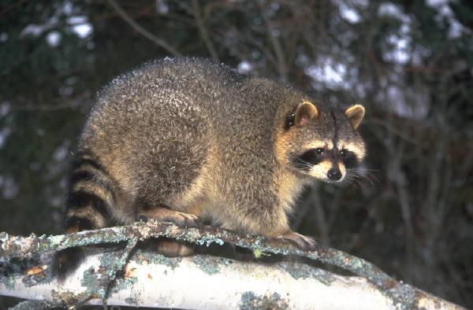
Risk Factors
Wildlife
Less common carrier due to species specific diseases
Strategies to Prevent Problems
Keep feed areas clean and materials put away
Property perimeter maintained
Fences
Notes:
Wildlife are not common carriers of illness to farms. However, poorly maintained and cleaned facilities can lead to large rodent populations, which can cause health and further sanitation challenges.

Slide 10
Limiting Exposure
Isolation
Keep new and returning animals separate
Limit contact with outside people
Resistance
Vaccination and parasite control programs
Sanitation
Clean and disinfect facilities regularly
Provide clean clothing and boots
Notes:
The old adage “an ounce of prevention is worth a pound of cure” is the key to biosecurity. The cost of implementing and maintaining an effective biosecurity plan is easily returned in the prevention of a disease outbreak resulting in lower performance and death loss.

Slide 11
Disinfectants
Should be used as part of a biosecurity plan; not the only measure
Boots and shoes must be clean and manure free before disinfecting
Must be used properly to achieve disinfecting properties
Notes:
There are many disinfectants for farm level biosecurity on the market. They are not intended to be the only biosecurity measure used in the prevention plan, but as a component of an overall plan. Disinfectants should be mixed properly (stronger is not always better) and changed regularly.

Slide 12
References
Lawhead, J., & M. Baker. (2005). Introduction to veterinary science. Clifton Park, NY: Delmar.
Snively, D. (2008). Biosecurity on the farm. Retrieved from http://www.wvu.edu/~agexten/Biosecure/Farm.pdf.

