Slide 2
What Is a Disease?
Principles of Agricultural Science – Animal
Unit 8 – Lesson 8.1 Popular Pathogens

Slide 3
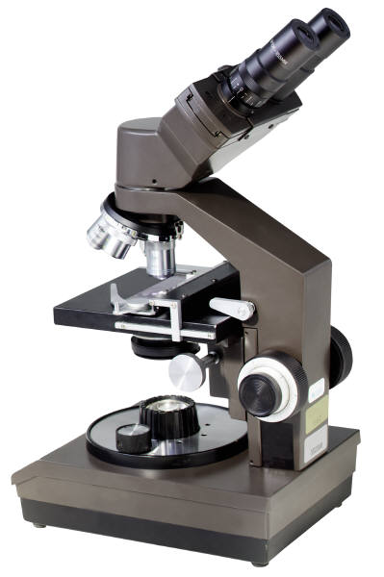
Pathogens
Anything capable of causing disease.
A living, microscopic, disease-producing agent, such as a bacteria or virus.
Notes:
Pathogens are anything that causes disease. You studied some prevention of pathogens in Lesson 3.3 Home Sweet Home when you discussed biosecurity. In this lesson, you will take a closer look at pathogens and the types of pathogens that cause livestock producers significant concern.

Slide 4
Disease
Any deviation from a normal state of health in plants, animals, or people, which temporarily impairs vital functions.
Disease Categories
Infectious
Contagious
Non-infectious
Notes:
Diseases have many causes and come in many forms. Some are very mild and animals recover easily on their own. Others are far more serious and may lead to death. Producers strive to limit diseases and exposure to disease-causing agents to maintain the health of their animals and to maximize profits.
Diseases are commonly classified into the following three categories: infectious, contagious, and non-infectious. Contagious diseases are infectious, but not all infectious diseases are contagious.

Slide 5
Infectious Disease
A disease caused by bacteria, protozoa, viruses, prions, or fungi entering the body.
Not necessarily contagious or spread by contact.
Can be ingested, inhaled, or absorbed
Notes:
Infectious diseases occur when microorganisms enter and attack the body of animals. Infectious diseases are not always spread from animal to animal, but can be ingested in food and water, acquired through the air, and absorbed through the skin and mucous membranes.

Slide 6
Infectious Disease
Example: “Mad Cow Disease”
Bovine Spongiform Encephalopathy
Degenerative disease of brain and spinal cord
Caused by feeding meat and bone meal to cattle
Notes:
Incorrectly called Mad Cow Disease, Bovine Spongiform Encephalopathy (BSE) is an example of an infectious disease. In cattle, it is most commonly caused by feeding meat and bone meal containing infected prions. BSE causes degeneration of the brain and spinal cord. It has a 3-5 year incubation period and is typically only seen in older cattle.
BSE is a transmissible spongiform encephalopathy (TSE). Other TSE’s include scrapie in sheep and variant Creutzfeldt-Jakob Disease (vCJD) in humans.
Cattle slaughtered under 36 months of age should not be infected with BSE.

Slide 7
Contagious Disease
A disease transmitted or spread from animal to animal by direct or indirect contact with a diseased animal.
Common colds and the flu are contagious diseases.
Notes:
If an animal or a human has a contagious disease, that means it can be spread and caught by another animal or human. For example, in humans, the common cold or flu is contagious and easily spreads. In animals, many diseases are contagious and can be spread from animal to animal or from one herd of animals to another herd of animals.

Slide 8
Contagious Disease
Example: Foot-and-Mouth Disease
Virus found in cloven-hoofed animals
Spreads easily from cattle to sheep to pigs to goats to deer
Destruction, decontamination, and quarantine only methods to control
Notes:
Foot-and-Mouth Disease (FMD) is a highly contagious, viral disease that affects cloven-hoofed animals. It can be spread by humans, birds, and other animals that are not affected by the disease. The disease is identified by a high fever, blisters in the mouth, and on the feet and legs.
FMD is not typically fatal, but recovery is a very slow process and the disease is so contagious that destruction of infected animals is used to prevent spread of the disease.

Slide 9
Non-Infectious Disease
A disease that is not caused by microorganisms or transmitted from one animal to another.
Examples:
Nutritional disorders
Poisoning
Genetic disorders
Notes:
Some diseases are caused by genetic or nutritional problems. Genetic disorders are caused by mutations and may be passed on to offspring. Some mutations are beneficial, while others are harmful and even lethal.
Nutritional disorders were discussed in Unit 5 Animal Nutrition and are caused by improper feeding practices.

Slide 10
Non-Infectious Disease
Example: Spider Lamb Syndrome
Genetic disorder
Causes skeletal deformities, such as bent legs, crooked spine, long neck and flattened ribs
Notes:
Spider lamb syndrome is a genetic disorder thought to be originally caused by a genetic mutation. It occurs infrequently, mostly in black-faced sheep. It is recessive. The frequency has increased in recent years, possibly due to intensive selection practices.

Slide 11

How Diseases Spread
Direct contact
Animal to animal or person to person contact
Shaking hands
Indirect contact
Vectors
Fomites
Notes:
Diseases can be spread through both direct contact and indirect contact.
The next two slides define Vectors and Fomites.

Slide 12
How Diseases Spread
Vector
Any agent, such as an insect or animal that transmits, carries, or spreads a disease from one plant or animal to another.
Example:
Mosquito carrying malaria
Notes:
Some diseases can be carried on an insect or animal without infecting that animal. When an animal or insect is a carrier of a pathogen without becoming infected itself, it is considered a vector.

Slide 13
How Diseases Spread
Fomites
Contaminated inanimate objects
Substance other than food that may harbor or transmit a disease
Example:
Sharing straws or water troughs
Notes:
Diseases can be spread through indirect contact. The object that transfers the contagion is called a fomite. Examples of some objects that can be a fomite are door handles, desk tops, and feed and water troughs. These objects may be infected with saliva, tears, nasal discharge, urine, and feces.
The ability of contagious diseases to spread without direct contact is one reason for the recommendation of frequent hand-washing during cold and flu season.

Slide 14
References
Feldkamp, S. (Ed.). (2002). Modern biology. Austin, TX: Holt, Rinehart, and Winston.
Herren, R.V. (2007). The science of animal agriculture (3rd ed.). Clifton Park, NY: Delmar.
Herren, R. V., & Donahue, R. L. (2000). Delmar’s agriscience dictionary with searchable CD-ROM. Albany, NY: Delmar.
Lawhead, J., & Baker, M. (2005). Introduction to veterinary science. Clifton Park, NY: Delmar.

