Slide 2
Tissues
Principles of Agricultural Science – Animal
Unit 4 – Lesson 4.2 Putting the Puzzle Together

Slide 3
Animal Tissues
Tissue is comprised of a mass of organized cells to provide specific structure or function to a living organism.
Types of tissue:
Connective
Epithelial
Fluid
Muscle
Nerve
Notes:
Tissues are a collection of cells that are similar in structure and that work together to perform specific functions.

Slide 4
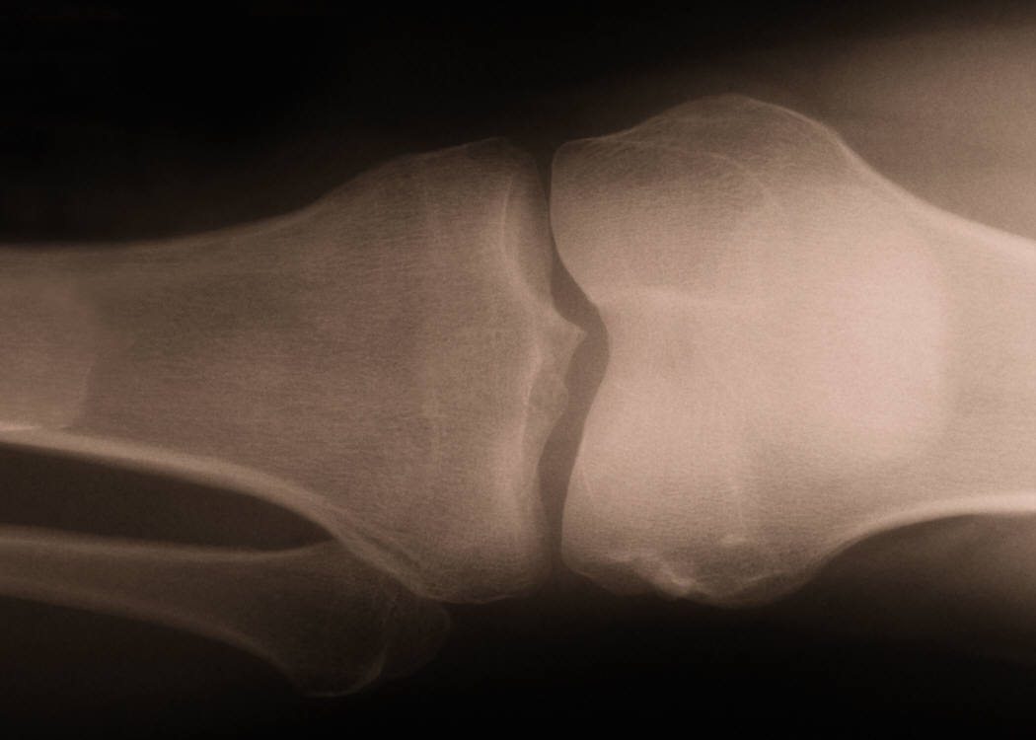
Connective Tissues
Connective tissues provide structure to hold other tissues together and include:
Bone
Cartilage
Ligaments
Tendons
Notes:
Connective tissue is the most abundant tissue in the body. It binds, supports, and protects structures within the body. The four types of connective tissue include bone, cartilage, ligaments, and tendons.
These connective tissues will be discussed in the next slides and are examined in Activity 4.2.2 Just Winging It.

Slide 5
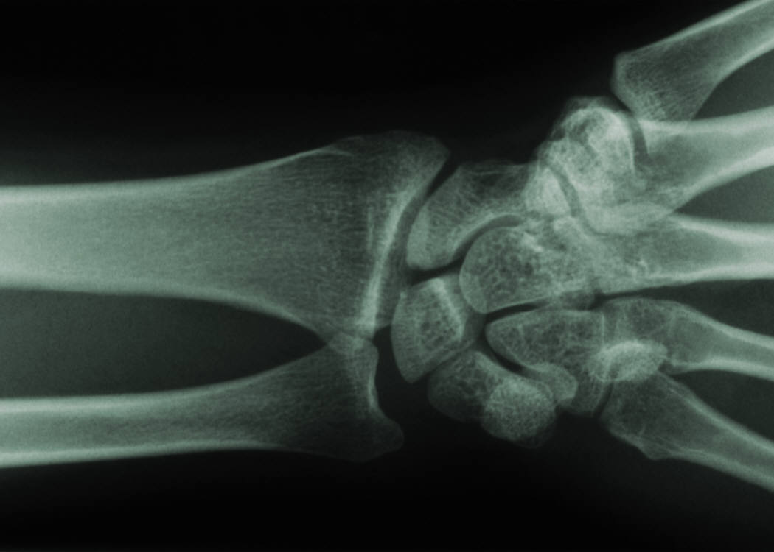
Connective Tissue
Bone is calcified material that replaces cartilage as animals age
Provides structure of animals
Four classifications of bones
  Long
  Short
  Flat
  Irregular
Notes:
Bones store important body minerals and compounds. They make up the structure of the body and provide a framework for muscles and other tissues. They support and protect the internal organs.
Bones have blood vessels that provide nourishment for bone cells.

Slide 6
Connective Tissue
Cartilage is flexible and elastic
Found between bones and in some structures, such as the ears and nose
Normally white in color
Notes:
Cartilage, like bone, is a type of supporting connective tissue. However, it lacks blood vessels and instead receives nourishment from surrounding fluid.
Cartilage is found between bones in joints and to provide shape for certain organs, such as the larynx.

Slide 7
Connective Tissue
Ligaments help to hold two bones together at a joint.
Tendons connect the muscle to bone.
Both are white flexible tissues
Notes:
Ligaments connect bone to bone, typically at a joint. Ligaments are composed of bundles of protein fibers called collagen and elastin. Collagen provides strength in holding the two structures together. Elastin is more flexible and provides ligaments the ability to stretch and return.
Tendons connect muscle to bone and contain only collagen.

Slide 8
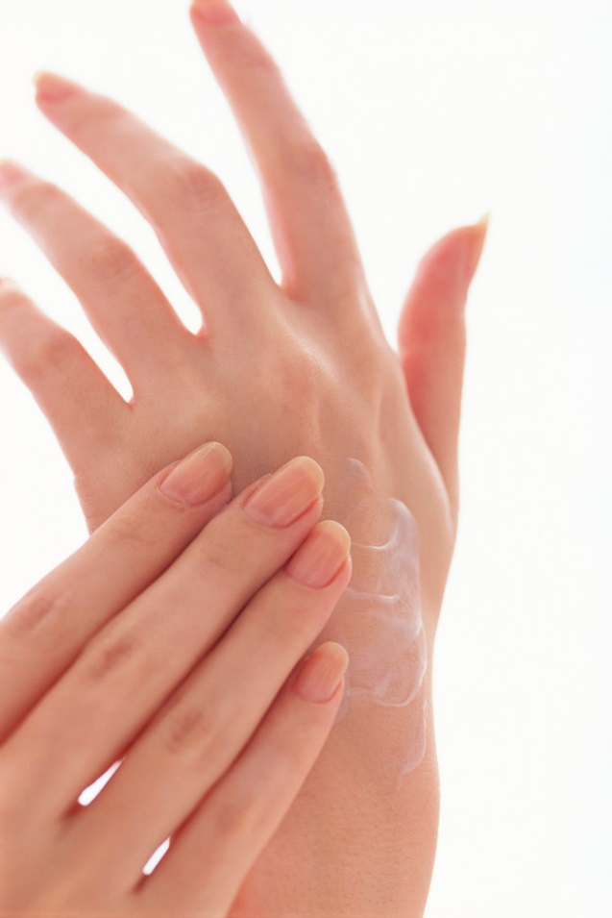
Epithelial Tissues
Epithelial tissues form the outer covering of internal organs and external parts of an animal, such as skin.
Notes:
Epithelial tissues are layers or sheets of tissue that line the body’s surface and openings. They also line tubes in the body, such as blood vessels. They provide protection to muscle and nerve tissue.

Slide 9
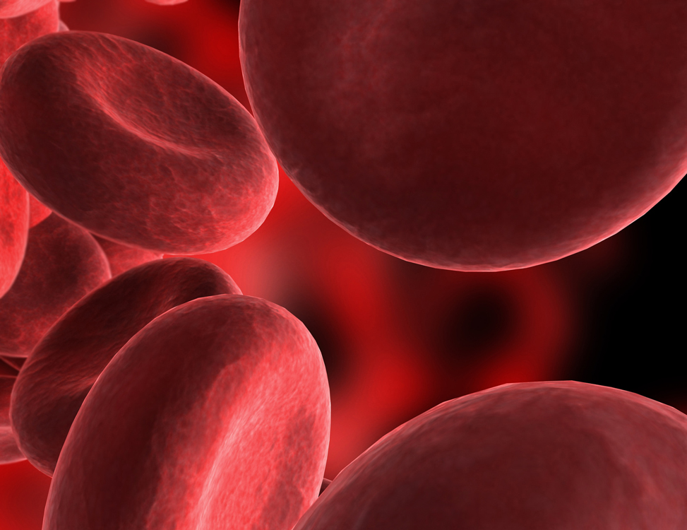
Fluid Tissues
Fluid tissues are specialized cells contained inside an organ or the circulatory system, such as blood.

Slide 10
Muscle Tissues
Muscle tissues aid in the movement and function of animal internal organs and external parts.
Three types of muscles are essential:
  Cardiac – involuntary, the heart
  Skeletal – voluntary, e.g., bicep
  Smooth – involuntary, surrounds hollow internal organs, such as the blood vessels or stomach
Notes:
Muscle is the tissue that allows animals to move. Skeletal muscles are voluntary, meaning that the animal controls movement of these muscles with impulses from the nervous system.
Cardiac and smooth muscles are involuntary, and conscious thought is not necessary for these muscle to function. In fact, they continue to function at all times, including when the animal sleeps.
For more information related to the muscle types refer to pages 109-112 in Modern Livestock and Poultry Production (Gillespie & Flanders, 2010).
Activity 4.2.2 Just Winging It will further examine differences in muscle types.

Slide 11
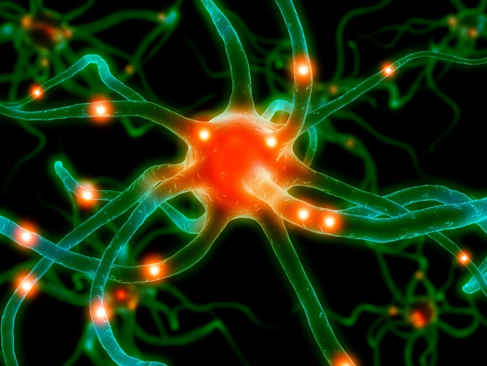
Nerve Tissues
Nerves are specialized cells to transmit electrical pulses from the brain to muscles throughout the body.
Nerves control muscle function in the body.
Notes:
The nervous system includes the brain, spinal cord, and nerve tissue bundles. It is the communication system of the body.

Slide 12
References
Gillespie, J.R., & Flanders, F.B. (2015). Modern livestock and poultry production (9th ed.). Clifton Park, NY: Delmar.
Romich, J. (2006). An illustrated guide to veterinary medical terminology (2nd ed.). Clifton Park, NY: Delmar.

