Slide 2
Signs of Health
Principles of Agricultural Science – Animal
Unit 8 – Lesson 8.2 Diseased!

Slide 3
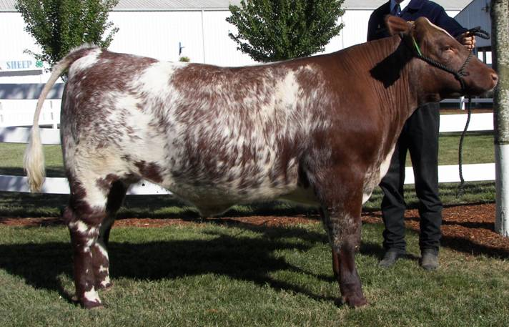
What is Health?
The state where all body parts are functioning normally.
Notes:
Health is the state of a plant or animal where all parts are functioning normally.
The animal will possess no symptoms of disease and have normal vital signs.

Slide 4
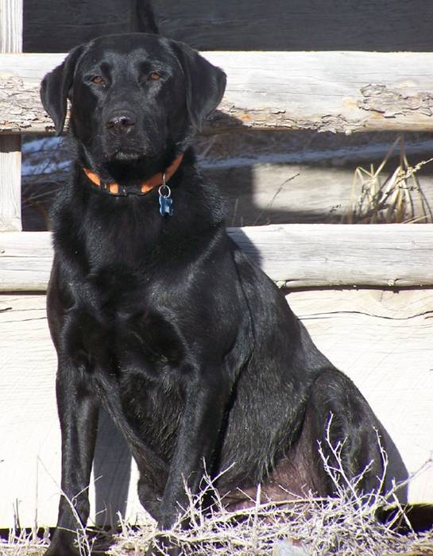
Recognizing Good Health
Contentment
Alertness
Good appetite
Sleek coat and
pliable skin
Notes:
Knowing how a healthy animal appears assists in diagnosing unhealthy animals.
Signs of good health include:
Contentment: Animal appears content. Signs of contentment in animals include stretching upon rising, standing or lying quietly, and relaxed when resting.
Alertness: Animals are alert, bright-eyed, and ears pricking with slight noises.
Good appetite: Animals are eager for feed. Also includes cud-chewing in ruminants.
Sleek coat and pliable skin: Healthy animals have a sleek hair coat and the skin is elastic.

Slide 5
Recognizing Good Health
Bright eyes and pink eye membranes
Normal feces and urine
Normal temperature, pulse rate, and respiration rate
Notes:
More signs of good health include:
Bright eyes and pink eye membranes. Gum tissue should also be pink.
Feces and urine should remain fairly constant. Changes in feed, especially fresh grass, may cause loose feces, but there should not be undigested feed, blood, mucus, or pus in the feces.
The temperature, heart rate, and respiration rate of animals are good indicators of health, but require a more thorough physical examination.

Slide 6
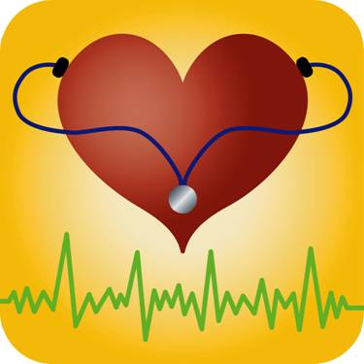
Recognizing Poor Health
Loss of appetite
Listless or depressed
Droopy ears
Humped back and head down
Separated from other animals
Coughing, wheezing, or labored breathing
Notes:
The absence of indicators of good health may be hard to recognize at first and without frequent observations. Indicators of poor health are sometimes more easily observed and include:
Loss of appetite
Listless or depressed
Droopy ears
Humped back and head down
Separated from other animals
Coughing, wheezing, or labored breathing
There are other animal and disease specific indicators. Indicators discussed here are the most common signs of poor health.

Slide 7
Diagnosis
The process of identifying a disease by examination and study of symptoms
May include:
Observing signs of good versus poor health
Physical examination
Veterinary diagnosis
Notes:
Diagnosing a disease is a complex process that involves recognizing the animal is ill, recognizing the symptoms of an illness, and determining possible treatments for a disease.
Becoming a good diagnostician requires practice, knowledge of animals, knowledge of diseases, the ability to apply and use scientific inquiry, and a little luck.
Early detection of an illness can significantly reduce its duration and severity.
For complicated or uncommon diseases, a trained professional, such as a veterinarian should be consulted.

Slide 8
Symptoms
Observable differences an animal exhibits from its normal function
Signs of poor health
Fever
Weight loss
Listlessness
Notes:
Diagnosticians, both veterinarians and animal producers, look for symptoms that indicate a specific disease. This helps speed up determining an appropriate treatment.

Slide 9
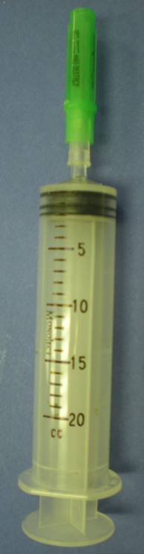
Treatment
Not effective or efficient for all diseases
Some can be administered by producer
Veterinary care
Notes:
Disease treatment is dependent on the animal, the disease, and the effectiveness of available medications.
Some diseases, such as viruses, are not easily treated with medications and may require separation and individual care until the animal has recovered. Other diseases, such as many bacterial infections, are easily combated with medication and the animal recovers quickly.
Most medical treatments require the assistance of a veterinarian.

Slide 10
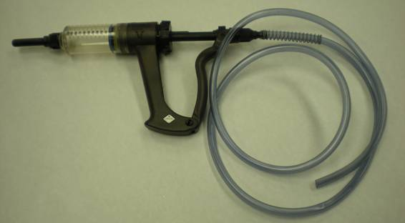
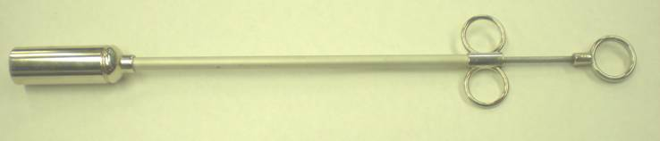
Methods of Treatment
Topical – applied to the skin
Oral – through the mouth
In or on feed
Drenching
Balling gun
Injection – shot using a needle and syringe
Intramuscular
Subcutaneous
Intravenous
Drenching tool
Balling gun
Notes:
Treatment of animal disease can be administered topically, orally, or through injection.
Topical treatments are applied to the skin and can be a liquid or powder, such as Advantage® or ivermectin.
Oral treatments can be administered through feeding, drenching, or with a balling gun. Drenching gives animals fluid medications through the mouth. Balling guns hold a capsule or bolus much like a pill you swallow. The balling gun allows producers to place the bolus at the back of the throat of an animal to ensure the medication will be swallowed.
Injections are commonly used and will be discussed in greater detail in Lesson 8.4 Preventing Pathogens. Intramuscular injections are given in the muscle and subcutaneous injections are given just under the skin.

Slide 11
References
Damron, W.E. (2000). Introduction to animal science: Global, biological, social, and industry perspectives. Upper Saddle River, NJ: Prentice Hall, Inc.
Ensminger, M.E. (1991). Animal science. Danville, IL: Interstate Publishers, Inc.
Herren, R. V., & Donahue, R. L. (2000). Delmar’s agriscience dictionary with searchable CD-ROM. Albany, NY: Delmar.

