Slide 2
Livestock Breeding Systems
Principles of Agricultural Science – Animal
Unit 6 – Lesson 6.2 Generating Generations

Slide 3
Breeding Systems
Straight breeding
  Mating animals of the same breed
Crossbreeding
  Mating animals of different breeds
Notes:
Animal producers commonly use two types of mating systems. Those whose goal is the production of purebred breeding stock use straight breeding. With straight breeding animals of the same breed are mated and the genetics of that breed persist.
The other mating system is crossbreeding where animals of different breeds are mated. These offspring tend to perform well due to hybrid vigor. One common crossbreed in the cattle industry is the Hereford-Angus cross, which produces commercial black-baldy cattle.

Slide 4
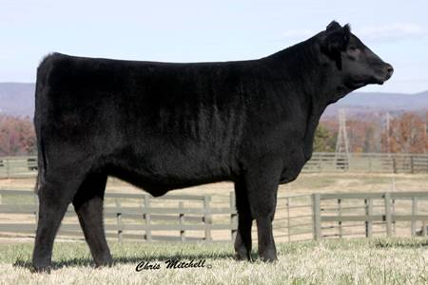
Straight Breeding
Animals maintain qualities of ancestors.
Used mostly in the production of breeding stock.
Purebreds are eligible for registration.
Notes:
Straight breeding is mostly used by purebred producers. Animals maintain the qualities and characteristics of their ancestors and those that are purebred are eligible for registration.

Slide 5
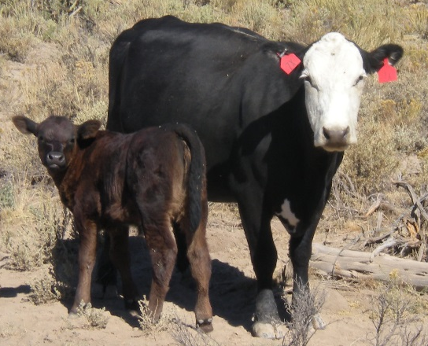
Crossbreeding
Combine qualities of two or more breeds.
Tends to result in offspring that are superior to the contribution of each parent.
  Heterosis, or hybrid vigor
Used mostly in the production of market animals.
Notes:
Crossbreeding is used to increase the performance of offspring. The qualities of two or more breeds are combined, generating animals with hybrid vigor, offspring are above the average of the parents. While the first generation of crossbred animals tend to be very high performing, subsequent crossings of crossbred animals may not exhibit the increased performance. This system is used mainly in the production of market animals.

Slide 6
Livestock Breeding Methods
Natural Breeding (a.k.a. Live Cover)
  In natural breeding the male physically breeds the female.
    Pasture Breeding
    Hand Breeding
  Artificial Insemination
  Embryo Transfer
  Cloning
Notes:
The four basic livestock breeding methods that will be discussed are natural breeding (also known as live cover), which we divide into pasture breeding and hand breeding. Hand breeding is further divided into artificial insemination, embryo transfer, and cloning.
This PowerPoint will spend more time on artificial insemination and embryo transfer.
Cloning will only be touched upon, as it is possible, but at this point in the industry, not practical.

Slide 7
Natural Breeding
Pasture Breeding
  The male physically mounts female on his own while animals are in the pasture.
Advantages
  Is easiest for producer
Disadvantages
  Lower conception rates
Hand Breeding
  The males are brought to females in heat and allowed to mount by the breeder.
Advantages
  Higher conception rate
Disadvantages
  Intensive for producer

Slide 8
Artificial Insemination (A. I.)
Advantages
Use superior male genetics
Faster genetic improvement
Frozen semen may be stored and transported around the world
Can be less expensive – no need to own a sire
Safety – aggressive males
Disadvantages
Labor intensive – have to monitor heat cycles of females carefully
Requires training
Decreases genetic diversity
Conception rates
Notes:
There are many advantages and disadvantages with artificial insemination. The issues vary among species as well. Currently, the use of artificial insemination is very widespread in dairy cattle, common in beef cattle, swine, and horses.

Slide 9
Embryo Transfer
Advantages
Takes advantage of superior female and male genetics
Females can have more offspring per year
Disadvantages
Requires skill – vet may be required
Expensive and may only yield a few viable embryos
Notes:
Used primarily in cattle and horses.
The process of embryo transfer:
Superovulation of superior female
Artificial insemination using sperm of superior male
Embryos flushed from uterus of donor
Embryos implanted in uterus of recipient

Slide 10
Cloning
First vertebrate cloned – Dolly the sheep 1996
Cattle successfully cloned in 1998
May be done using cells that haven’t yet specialized or adult cells
Very costly process
Many potential benefits
Notes:
Dolly the sheep was our first successful vertebrate clone.
Since this is such new technology, it is very costly, making it less than economically feasible for most livestock producers. However, there is great potential for cloning of livestock in the research arena, in areas such as disease treatment testing, organ production for organ transplant, pharmaceutical production, or cloning endangered species to prevent extinction.

Slide 11
References
Gillespie, J.R., & Flanders, F.B. (2015). Modern livestock and poultry production (9th ed.). Clifton Park, NY: Delmar.
Herren, R. V., & Donahue, R. L. (2000). Delmar’s agriscience dictionary with searchable CD-ROM. Albany, NY: Delmar.
Selk, G. Artificial insemination for beef cattle. Oklahoma cooperative extension service fact sheet. Retrieved from http://www.thecattlesite.com/articles/721/artificial-insemination-for-beef-cattle/
Taylor, R.E. (1992). Scientific farm animal production: An introduction to animal science. New York, NY: Macmillan Publishing Company.

