Slide 2
Infectious Disease Causing Agents
Principles of Agricultural Science – Animal
Unit 8 – Lesson 8.1 Popular Pathogens

Slide 3
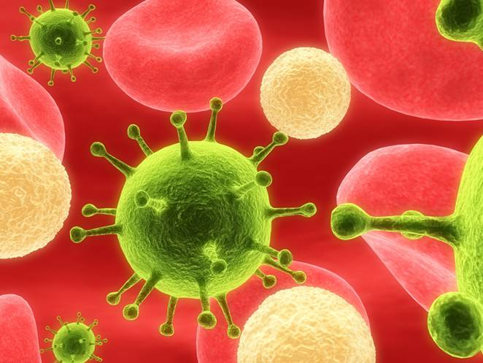
Agents That Infect Animals
Bacteria
Virus
Fungi
Protozoa
Prions
Notes:
The five infectious disease-causing agents include bacteria, viruses, fungi, protozoa, and prions.
All of these are infectious and some forms are contagious. It is important to remember there are many bacteria, fungi, and protozoa that are beneficial and necessary to life processes.

Slide 4
Bacteria
Prokaryotes – single-celled organisms
Organelles are not membrane-bound
Three basic shapes:
  Cocci
  Bacilli
  Spirilla
Notes:
Bacteria are classified as prokaryotes, meaning they do not have membrane bound organelles. Harmful bacteria cause disease by producing toxins or by destroying body tissues.
There are three basic shapes of bacteria, which will be discussed in upcoming slides.
Bacteria have historically been treated very effectively with antibiotics. In recent years, concern has developed about antibiotic-resistant bacteria. Bacteria with mutations can survive antibiotic treatments and continue to grow and reproduce. This causes concern in the health industry as research for new medications struggles to keep pace with the mutated bacteria.

Slide 5
Bacteria Shapes
Cocci:
  Spherical or egg-shaped
  Chains are streptococci
  Clusters are staphylococci
  Examples: strep and pneumonia infections
Notes:
Bacteria that are round or spherical in shape are called cocci. They can be singular, paired, in groups of three or four, clustered, or in chains.

Slide 6
Bacteria Shapes
Bacilli:
  Rod shaped
  Examples: anthrax and salmonella
Spirilla:
  Spiral or corkscrew shaped
  Examples: leptospirosis
Notes:
Bacilli or rod-shaped bacteria can form chains and are referred to as streptobacilli.

Slide 7
Virus
Very tiny
Have a core of nucleic acid with a protein covering
Characteristics of both living and nonliving material
Only grow and reproduce inside a living cell
Notes:
Viruses are made of cell components, but do not have all characteristics of cells. They do not have a nucleus, cytoplasm, organelles, or a cell membrane and cannot carry out cellular functions. Yet they do have nucleic acid and a protein coat. The nucleic acid is either DNA or RNA, but not both. Viruses can only replicate inside another cell while using the organelles of that cell.
Viruses are so small they can attack and infect bacteria. Viruses that infect bacteria are called bacteriophages.
Treatment of viruses is fairly limited as they do not respond well to most antibiotics. Prevention in the form of vaccinations is the most successful approach to controlling viruses.

Slide 8
Virus Size
To see a virus, go to
  http://www.cellsalive.com/howbig.htm
What is a nm?
  Nanometer = .00000004 inches
Example: influenza
Notes:
Go to the Cells Alive website and view the demonstration of “How big is…” to show students the size of a virus. While at the site, ask students why you would not be able to see a virus on a slide at school. You may need to give a hint, such as the magnification power of microscopes. You may want to revisit this after students have completed Activity 8.1.2 Rounds, Rods, and Spirals.

Slide 9
Fungus
Eukaryotes – have membrane-bound organelles
Common forms include molds and yeasts
Example: Ringworm
Notes:
Fungi are commonly multicellular organisms with membrane bound organelles, thus classifying them as eukaryotes. There are many types of fungi including molds, yeasts, and mushrooms.
Diseases caused by fungi range from skin infections, such as ringworm and athletes foot to fungal poisons, such as alfatoxin, which can be found in moldy grains. Most fungal infections can be treated with drugs.

Slide 10
Protozoa
Eukaryotes – single-celled organisms
Often parasitic
Examples: Coccidiosis in animals, malaria and giardia in humans
Notes:
Protozoa are single-celled organisms that have membrane bound organelles, which classifies them as eukaryotes. Protozoa can live in many environments, some are free-living while others are parasitic.
Diseases caused by protozoa are effectively controlled with drugs.

Slide 11
Prions
Abnormal form of protein that clumps together inside a cell
Causes brain-wasting diseases, such as scrapie and Bovine Spongiform Encephalopathy (BSE)
Notes:
Prions are even simpler than a virus and are abnormal clumps of protein that form in a cell. They are made of amino acids and have no nucleic acids. Prions eventually kill the cell and lead to a slow degeneration of the nervous system.
Prions are not very well understood and there are no known treatments for the diseases caused by prions. Prions have received much attention in recent years with the increased media surrounding BSE (aka Mad Cow disease).

Slide 12
References
Feldkamp, S. (Ed.). (2002). Modern biology. Austin, TX: Holt, Rinehart, and Winston.
Herren, R.V. (2007). The science of animal agriculture (3rd ed.). Clifton Park, NY: Delmar.
Herren, R. V., & Donahue, R. L. (2000). Delmar’s agriscience dictionary with searchable CD-ROM. Albany, NY: Delmar.
Lawhead, J., & Baker, M. (2005). Introduction to veterinary science. Clifton Park, NY: Delmar.
Notes:
Infectious Disease Causing Agents

