Slide 2
Disease Prevention
Principles of Agricultural Science – Animal
Unit 8 – Lesson 8.4 Pathogens Prevented

Slide 3
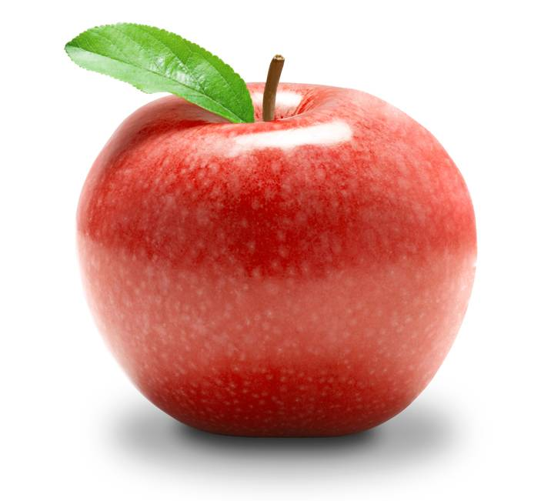
Prevention Practices
Keeping the
Doctor Away
Reduce stress
Sanitary conditions
Adequate ventilation
Proper nutrition
Vaccinations
Notes:
Many of these practices have been discussed in earlier lessons and this presentation will focus on vaccinations.
Review:
Causes of stress include weather extremes, rough handling, overcrowding, and transporting animals. Stress can be reduced by using safe and proper methods when handling animals and by providing adequate space and shelter for animals.
Sanitary conditions can be maintained by providing clean dry bedding, clean fresh water, and implementing good biosecurity practices. Biosecurity includes reducing the occurrence of disease by limiting access to animals, quarantining new or returning animals, and minimizing the spread of diseases when they do occur.
Adequate ventilation is extremely important in confinement operations. It allows release of humidity, heat, and airborne pathogens, helps control temperature, and helps remove ammonia from the air.
Proper nutrition includes providing animals with adequate quantities of needed nutrients from feeds free of molds and fungi.

Slide 4
Providing Immunity
Vaccinations increase immunity.
Types of immunity:
Passive: transfer of antibodies
Active: animal produces antibodies
Notes:
Vaccinations inject small amounts of antigens, which are substances that stimulate the formation of antibodies when introduced into the body.
After the antibodies develop, the animal is better prepared to fight off the disease.
There are two types of immunity.
Passive immunity occurs when antibodies are transferred directly to the animal. This occurs in newborn animals when they receive colostrum from their mother. Colostrum is the first milk produced by the mother and passes antibodies from the mother to the offspring. Antibodies can also be given to animals in the form of vaccines. Passive immunity is fairly short lived and does not stimulate the production of antibodies.
Active immunity occurs when a animal produces antibodies for a disease. This can occur naturally after an animal has had the disease. Natural immunity is often the strongest immunity. Active immunity can also be developed by giving animals modified antigens that cannot replicate, but stimulate the production of antibodies.

Slide 5
Types of vaccines:
Killed – organism within the vaccine is completely inactivated
First vaccination initiates immune response
Second dose to produce effective levels of antibodies
Periodic boosters are needed
Modified live – small amount of antigen in vaccine
Longer lasting and more complete immunity
Fewer doses needed throughout life of animal
Notes:
There two categories of vaccines: killed and modified live.
In killed vaccines, any antigens are inactivated to prevent the transmission of the disease. They provide mostly passive immunity and typically require an initial series of shots and frequent boosters.
Modified live vaccines have organisms that have been altered to prevent replication, but are still living. They cause the body to develop antibodies to fight the antigens. Modified live vaccines provide longer lasting immunity and require less frequent boosters.

Slide 6

Scheduling Vaccinations
Work with a veterinarian to determine necessary vaccinations.
Plan vaccinations and boosters according to age and use of the animal.
Notes:
Timing vaccinations and boosters is critical to proper disease management.
Vaccinate too early and it wastes money on unnecessary vaccinations.
Vaccinate too late and the animal may become ill because their immunity has diminished.

Slide 7
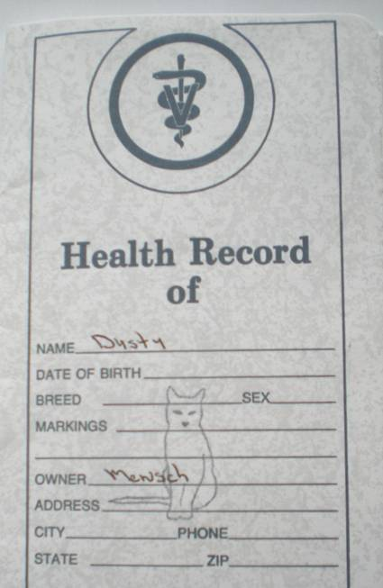
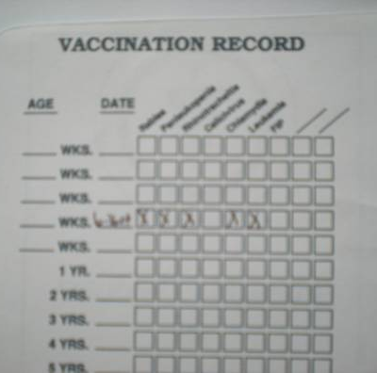
Vaccination Records
Assist in scheduling vaccinations and boosters
Notes:
Keeping good records is important in any vaccination program.

Slide 8
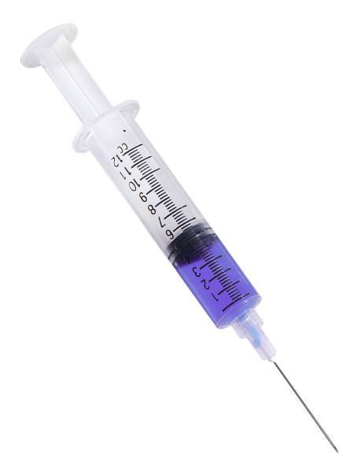
Administering Shots
Common methods of giving vaccinations:
Intramuscular
Subcutaneous
Intravenous
Intranasal
Notes:
Vaccinations are commonly administered in the form of a shot. The types of shots commonly used in the animal industry are intramuscular, subcutaneous, intravenous, and intranasal.
Intravenous shots are most commonly administered by a veterinarian and should not be attempted by an untrained individual.
Intranasal shots are administered in the nasal cavity.
In Activity 8.4.1 Give Me One More Shot, you will be learning more about intramuscular and subcutaneous shots.

Slide 9
Balanced Approach
One practice will not prevent disease.
Animal environments should be low stress, clean, and well-ventilated.
Vaccinations should be used in combination with a healthy environment.
Notes:
While vaccinations are critically important to disease prevention, it is also important to continue using good biosecurity, animal handling, and sanitation practices.

Slide 10
References
Lawhead, J., & Baker, M. (2005). Introduction to veterinary science. Clifton Park, NY: Delmar.
Parker, R. (2003). Equine science (2nd ed.). Clifton Park, NY: Delmar.

