Slide 2
Creature Comforts
Principles of Agricultural Science – Animal
Unit 3 – Lesson 3.3 Home Sweet Home

Slide 3
What are your basic needs?
How are they different from the basic needs of animals?
Notes:
Teacher Notes: Capture student responses for questions on the whiteboard or chalkboard.
Primary responses to the first question may include shelter, food, water, and clothing. Additional responses may be vaccinations, medication, preventative care, and so forth.
Teacher Note: After showing the second question, students responses may be very similar.
Animals do not typically need clothing, but require shelter, food, and water. However, animal needs can be provided using different methods as their bodies have different digestive and insulating systems. Temperatures that are uncomfortable for humans may be within the comfort zone of animals.

Slide 4
Shelter
Provides protection from environmental extremes.
  Sun
  Wind
  Rain
  Snow
Notes:
Providing shelter for animals has become increasingly important in the animal industry. Production efficiency may be greatly improved by providing the ideal growing environment. The type of animal and the location in which you are raising the animal are significant considerations when providing shelter. For example, simply providing shade for poultry in northern states during winter months would not be very effective.

Slide 5
Parts of a House
Think of your house, what is the use of each room?
How does the use relate to your needs?
Bath room
Bedroom
Kitchen
Bedroom
Living
Notes:
When contractors design and build a house, they take the needs and wants of the home owner into consideration.
Designing and building animal facilities should be done in the same manner. Think of the needs of animals and how a well-planned facility can meet those needs.

Slide 6
Housing and Handling Facilities
Design with production goals in mind.
Considerations
  Basic animal needs
  Space requirements
  Life stages
  Handling
  Providing health care
  Transporting
Notes:
Animal facilities vary greatly throughout the United States. While there are recommendations for certain features and components of facilities, the actual design must be functional and practical for the producer. Variations in local environments, investments, and production goals make developing a single, perfect facility for all locations impossible.
When planning facilities, producers should take into consideration the following:
Basic animal needs
Space requirements
Life stages
Handling
Providing health care
Transportation

Slide 7
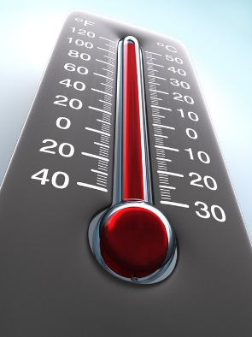
Temperature
Primary consideration when providing shelter.
Warm-blooded animals rely on thermoregulation to maintain a constant body temperature.
Outside of the optimal temperature range, animals must expend additional energy on maintaining homeostasis.
Notes:
The main reason for providing shelter to animals is to provide relief from extreme temperature conditions. A shed may provide cooling shade for cattle in the summer and serve as a wind and snow break in the winter. Animals then use less energy on maintaining temperature.
Thermoregulation is the control of body temperature.
Homeostasis is the maintenance of a constant internal environment by a combination of body mechanisms.

Slide 8
Comfort Zone
Also called thermoneutral zone.
A range of temperatures in which an animal is the most comfortable.
This often correlates with production efficiency.
  If an animal does not expend surplus energy maintaining body temperature that energy can be used for growth and production.
Notes:
The thermoneutral zone of animals is the range of temperatures that maximizes efficiency and rate of gain. This temperature range requires the lowest energy expenditure on maintenance and allows energy to be used on growth and production, such as milk and gestation. The thermoneutral zone is variable based primarily on the age of the animal and moisture on their body covering, but also wind, body condition, hair coat, and length of exposure to extreme temperatures.

Slide 9
Heat Stress vs. Cold Stress
Heat
  Reduced feed intake ~ decreases heat from digestion
  Panting
  Sweating
  Blood vessels dilate
  Decreased growth rate
Cold
  Higher energy requirement to maintain body temp
  Bunching
  Hair provides air insulation
  Blood vessels constrict
  Reduces feed efficiency
Notes:
Extreme heat and cold cause different responses in an animal, but the overall result is a decrease in production efficiency.
What happens to your body when you are hot?
Sweat
Listless
What happens when you are cold?
Goose bumps
Shiver

Slide 10
Wet Conditions
Evaporative cooling
  Air evaporates water and in the process the air loses heat to the water.
Beneficial in the summer
  Misters and wallows can help moderate high temperatures.
Harmful in the winter
  Uses body heat for drying, magnifies cold temperatures and wind chill.
Notes:
Air moisture and moisture on the body of an animal can significantly impact the effects of temperature. When it is hot out, water and mist can help cool animals through evaporative cooling. This is commonly used in production systems with misters and fan and pad coolers.
On the other hand, moisture can cause cool temperatures to feel much colder. One study shows that cattle with a dry coat are within their comfort zone down to 32°F. When wet, the low range of the comfort zone increases to 60°F.

Slide 11
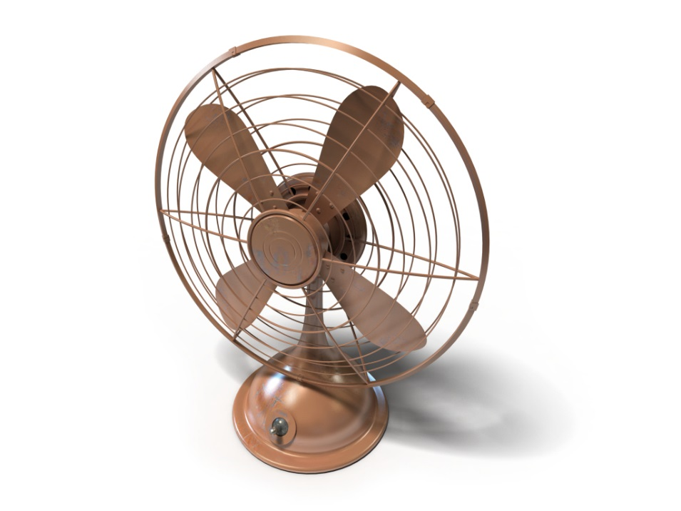
Ventilation
Varies on style of shelter
Provides:
  Temperature control
  Fresh air
  Odor removal
Notes:
Ventilation in animal housing allows fresh air to cycle through the building. Some ventilation systems are highly mechanized and control the amount of airflow while filtering the air to help reduce disease risks. Other systems simply promote the movement of air through the facility through vents and openings.

Slide 12
Sanitation
Manure management
  How will stalls and barns be cleaned?
  In confinement, how will manure be disposed of?
Disease control
  Cleaning pens between groups of animals.
  Minimizing dust and airborne contagions.
Notes:
Including considerations for sanitation is necessary in facility design to allow for cleaning and maintaining the health of your animals. Provisions may need to be made for equipment, such as tractors, or special flooring to allow the manure to fall away. Facilities should always be cleaned between groups of animals.

Slide 13
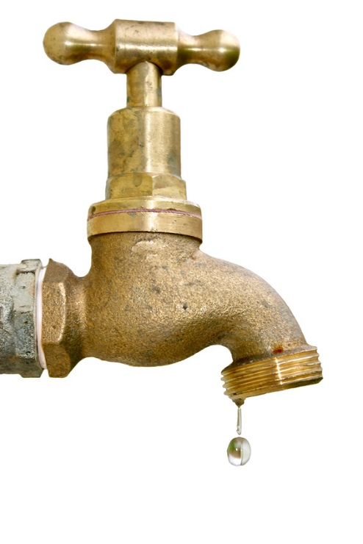
Water
Major considerations
Clean and fresh
Constant and adequate supply
  Automatic waterers
Accessibility
Notes:
Supplying water to animals should not be overlooked in facility design. Consider the volume of water provided in comparison to the number of animals and their average daily consumption of water.

Slide 14
Feed
Major Considerations
Designating a feeding area
Planning for feed equipment
Bunk space requirements per head in group feeding arrangements
Feeding on the ground is not efficient or sanitary.
Notes:
Provide for both a defined area for feeding and consider the delivery method of the feed – feed truck, tractor, 4-wheeler, pitchfork, etc. Also realize that age and breed can impact the area required for feeding. For example, Texas Longhorn cattle require more bunk space than Angus.

Slide 15
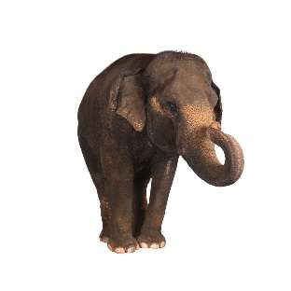
Elephant Needs
Example Considerations | Animal Requirements
Indoor Area | 400 ft²
Outdoor Area | 1800 ft²
Optimal Temperature Range | 55-80° F
Water Needs | 18.5-52.8 gallons/day
Notes:
In the upcoming activity you will be asked to determine the needs of the animal you are researching for your Producer’s Management Guide. There are many industry publications that provide space and water requirements for livestock at various stages of production. Just as this elephant has space and temperature needs, so will your animals.
Facility design is much more than just providing a shelter from the elements, it is providing animals with a home that meets their water, feed, growth and production needs. Well designed facilities may have multiple areas to fulfill these functions.
For example, a swine confinement operation may have facilities for gestating sows, farrowing sows, weaner pigs, and feeder pigs. A dairy may have such areas as a dry cow barn, a milking parlor, a free stall barn for the milking herd, calf hutches, pens for replacement females, and pasture.

Slide 16
References
Association of Zoos and Aquariums. (2003, May 5). Standards for elephant management and care. Retrieved from https://www.aza.org/uploadedFiles/Conservation/Commitments_and_Impacts/Elephant_Conservation/ElephantStandards.pdf
Brownson, R., & D. Ames. (2000). Winter stress in beef cattle. Cow-Calf Management Guide: Cattle Producer’s Library. Moscow, ID: Ag Communications University of Idaho.
Feldkamp, S. (Ed.). (2002). Modern biology. Austin, TX: Holt, Rinehart, and Winston.
Gillespie, J.R., & Flanders, F.B. (2015). Modern livestock and poultry production (9th ed.). Clifton Park, NY: Delmar.
Herren, R.V., & Donahue, R.L. (2000). Delmar’s agriscience dictionary with searchable CD-ROM. Albany, NY: Delmar.

