Slide 2
Animal Conformation
Principles of Agricultural Science – Animal
Unit 9 – Lesson 9.2 In Search of the Ideal Animal

Slide 3
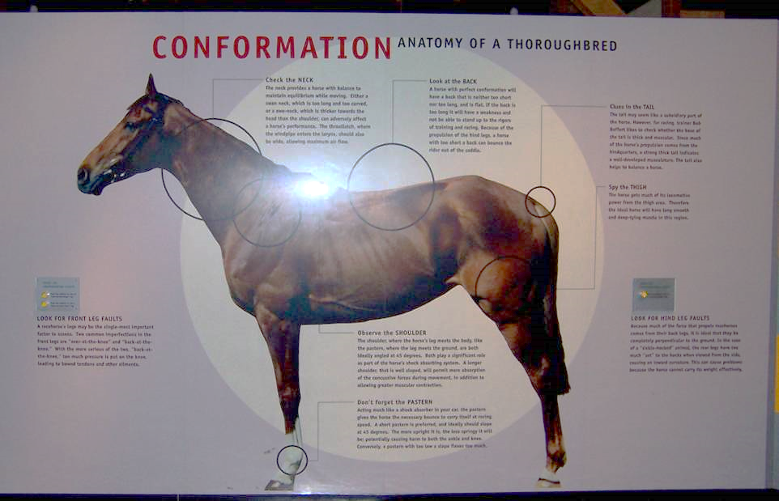
What Is Conformation?
The appearance or type, form, and shape of a live animal.
Notes:
When evaluating an animal, you are looking at the appearance or conformation of the animal. Conformation is how an animal is put together.

Slide 4

Conformation Priorities in Animal Selection
Muscularity
Capacity
Frame Size
Condition
Structure
Balance
Udder
Sex Character
Breed Character
Notes:
Conformation is evaluated based on several priorities. Not every priority fits each type of animal nor the purpose of the animal. These are the most common priorities and have application in several species and uses of animals.

Slide 5
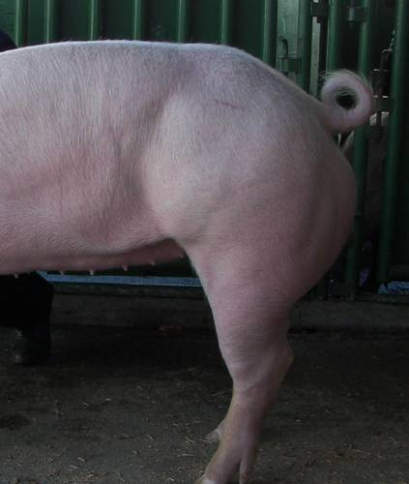
Muscularity
The natural fleshing of an animal
Inheritable trait
Evaluate at the
Hip and rump
Back
Shoulder
Notes:
Muscling is an important trait in nearly all species and for nearly all uses. For most producers, the purpose of raising livestock is the production of meat, which comes from muscle. The muscularity of breeding animals is passed on to their offspring.
Other performance animals, such as horses, require muscling to compete or perform work.

Slide 6
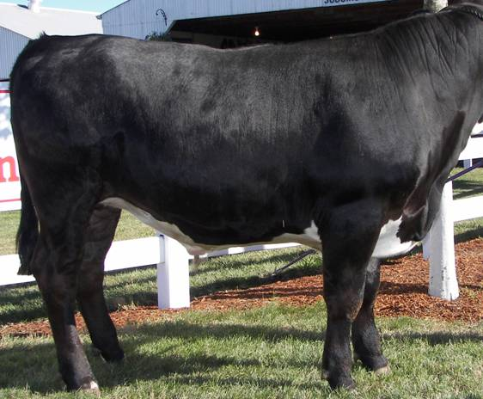
Capacity
Also referred to as volume
Considerations:
Spring and shape of rib
Depth of body
Length of body
Width of body
Notes:
Capacity refers to the amount of body volume an animal possesses. This volume is necessary to allow animals to perform at high levels while maintaining body condition. Capacity is typically associated with production and performance traits.

Slide 7
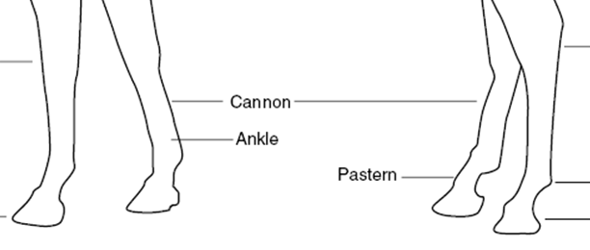
Frame Size
Skeletal size
Used in moderation in beef cattle
Indicators:
Length of body
Length of cannon bone
Height
Length of face and neck
Notes:
Frame or skeletal size determines the overall size of an animal. While bigger is not always better, larger framed animals tend to produce more meat and have greater capacity.
In young animals, frame can be used to evaluate growth potential, particularly by looking at the length of the cannon bone. Young animals with a long cannon bone in relation to their body have a greater potential for growth than those with a short cannon bone.

Slide 8
Condition
The degree of fatness
Also referred to as finish or leanness in market animals
Market animals need adequate quantity for meat quality
Breeding animals need adequate quantity for health and reproductive soundness
Notes:
The degree of fatness of an animal is referred to as condition, finish, or leanness. The term is dependent on the production goal. Condition is used for breeding animals, while finish and leanness are typically used in market animals.
The amount of fat a market animal has is economically important in both meat quality and cost of production. Meat animals with too little fat tend to produce meat that is dry and low in flavor. On the other hand, animals with too much fat require more trim during processing and have wasted feed resources and increased costs.
Breeding animals need to carry enough condition to maintain health, produce offspring and milk, and to maintain reproductive soundness. An excess of condition can decrease fertility and costs producers money.

Slide 9
Structural Soundness
The physical condition of the skeletal structure, especially the feet and legs, of an animal.
Considerations
Levelness of top and hip
Angle to shoulder, pastern, hock
Ease of movement
Notes:
Structural soundness is one of the most important traits in every species. The structural soundness of an animal determines how efficiently it can move, longevity, and the quality of offspring produced.
Structure is extremely important in breeding animals.

Slide 10
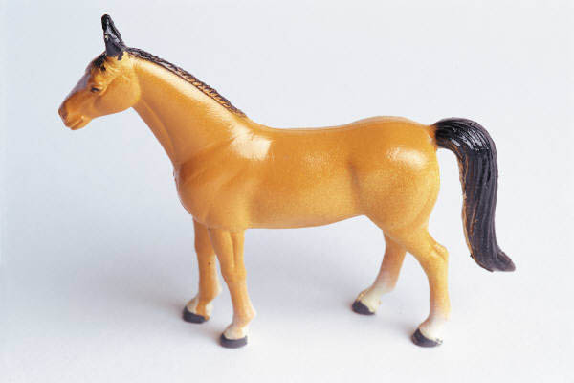
Balance
The way an animal puts other traits together in proportion
Combination of desirable qualities
Notes:
Balance can be the most challenging trait to describe and evaluate. It is how well an animal combines other traits into the ideal package.

Slide 11
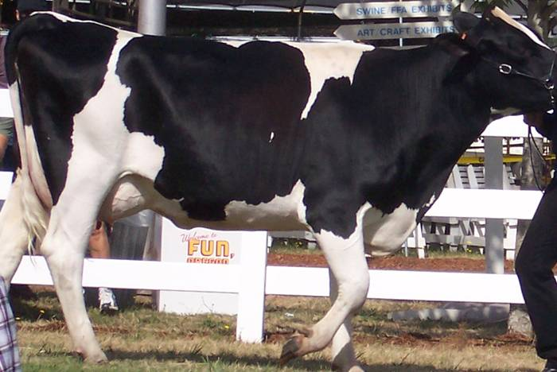
Udder or Underline
Important in producing females, particularly dairy animals
Inheritable trait - sires can pass desirable and undesirable traits to female offspring
Notes:
The quality of an udder or underline is important in breeding females for efficiently producing offspring or fluid milk.
Udder quality is not important in market animal selection.

Slide 12
Sex Character
Masculinity
More rugged appearing
i.e., broad shoulders, thick neck, wide head, thick musculature
Femininity
Daintier appearance
i.e., refined head, neck, and shoulders, lighter muscling
Notes:
Breeding animals should look their sex.
Sex character is not an important priority in market animals.

Slide 13
Breed Character
Animals should exhibit the traits that make their breed desirable and identifiable.
Examples:
Arabian horse – dished face; long, arched neck; high tail set
Holstein dairy cattle – black and white spots, large frame size
Notes:
Breeds have been established and developed over a long period of time. Purebred animals should exhibit the traits of that breed to continue passing those traits to future generations. Breed character is not a key priority in market animal selection.

Slide 14
References
Wood, C.H., & Jackson, S.G. (2004). Horse judging manual. Retrieved from http://www.ca.uky.edu/agc/pubs/asc/asc118/asc118.pdf

