Slide 2
Animal Behavior and Handling
Principles of Agricultural Science – Animal
Unit 3 – Lesson 3.2 Manipulating Manners

Slide 3
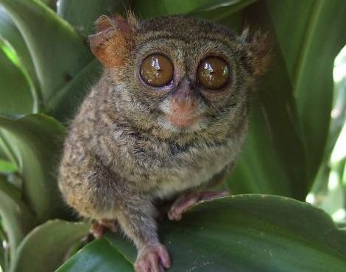
Animal Behavior
Reaction of organism to stimuli or the environment
Ethology – The study of animal behavior in their natural habitat
Behaviors:
Instinctive
Learned
Notes:
The study of animal behavior allows producers to predict and modify the reactions of animals to their environment. An understanding of basic animal behaviors is necessary before working with, handling, or training animals.

Slide 4
Types of Behaviors
Social
Interactions with each other – herding/flocking
Reproductive
Courtship and mating
Ingestive
Eating and drinking
Maternal
Caring for young
Protective of newly born offspring
Combative
Positioning for dominance within group
Defensive
Notes:
There are many types of behaviors of animals that have been studied. Common behaviors include the ones listed on this slide.
Other behaviors include eliminative – patterns of urination and defecation, and investigative – curiosity about new and different surroundings.

Slide 5
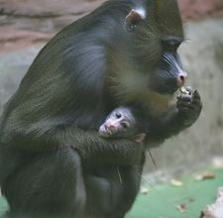
Instinct
Behavior that occurs automatically to a stimulus
Genetic
Examples: eating, drinking, and breeding
Notes:
Instinct is the most basic animal behavior. When an animal is exposed to a stimulus they do not recognize, they will react automatically whether it is to fight the stimulus or to turn and run. This is the flight or fight response. These reactions are genetic and animals do not need to learn them. Training can overcome some instinctive behaviors as animals are tamed.

Slide 6
Communication
Animals communicate with sight, sound, and smell.
Visual signs:
Position of ears and tail
Posture
Sounds:
Grunts
Squeal
Whinny
Smell:
Marking
Estrus
Notes:
Animals communicate in many ways. They often use their body positions to relay messages. The ears laid back on an animal typically communicates anger or aggression whereas ears upright and forward indicates interest and curiosity. Body posture and stance may also be used to determine signs of aggression, fear, dominance, and social order.
While animals may not use words to communicate, many species talk in a variety of ways. A mother pig will grunt to tell her litter that it is time to eat. Horses whinny and neigh to express fear or concern. A dog may bark to warn of danger or growl aggressively.
Animals will also use smell to mark their territory and rely heavily on smell for many reproductive behaviors.

Slide 7
Learned Behaviors
Imprinting
Animals attaching themselves (socializing) to an individual early on
Conditioning
Training an animal to respond to a stimulus
Habituation
Getting used to or ignoring a stimulus
Notes:
Animals can be trained and can learn many behaviors.
Imprinting can often be done on young animals. One of the most famous cases of imprinting is of the goslings in Austria. Many breeds of ducks and geese will adopt a human or other animal as its companion if it is introduced shortly after hatching. Imprinting also occurs in bottle-raised animals. These animals may become a nuisance as they tend to rely on people throughout life and socialize poorly with other animals. Imprinting is often used to socialize puppies and foals early to interact with people.
Conditioning teaches animals to react to certain conditions. Animals minding an electric fence or cows entering a milking parlor and letting their milk down are examples of conditioning. Operant conditioning trains animals to use certain objects or tools. The automatic waterers or feeders in hog facilities use operant conditioning to train animals to use the devices.
Habituation occurs when animals get used to a stimulus and choose to ignore it. A good example is training horses not to spook when objects flutter by. This is often done by waving a plastic bag around them progressing to touching them with the bag.

Slide 8
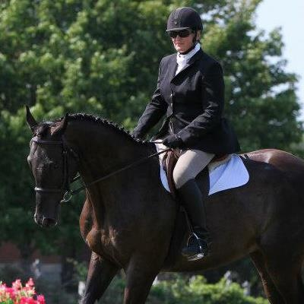
Working with Animals
Understanding the behavior of animals aids in safe handling
Major considerations:
Temperament
Degree of tameness
Perceptions of animals
Notes:
Animal producers must understand animal behavior in order to safely and effectively work with them. Three considerations to be aware of before handling an animal are its temperament, how tame it is, and how animals perceive things.
The temperament of an animal is highly influenced by its genetics. Several breeds of animals have flightier tendencies than other breeds. Temperament is influenced by the level of fear of an animal and the way in which animals are handled. The level of fear may be lessened through good management practices, such as low-stress handling techniques, training of animals, and positive reinforcement.
The tameness of an animal also affects the handling strategies. Very tame animals can be challenging to work because they may seek human affection. On the other hand, wild animals are challenging to handle as they are very fearful of humans and seek to be as far away from humans as possible.
Animals “see” things very differently than people do. They also lack logic and the ability to reason when presented with new or different situations. The next slides discuss animal perceptions in greater detail.

Slide 9
Novelty
New or different things in the environment of an animal causes it stress.
The effect of novel items on animals is dependent on training and temperament.
Flighty animals will spook more easily.
Flighty animals are also more curious about new objects when left alone.
Notes:
New items or noises are referred to as novelty. Novel items both intrigue animals and frighten them.

Slide 10
Vision
Livestock can see a wider range than humans
Blind spot is directly behind them
Depth perception tends to be poor
Changes in flooring surface, lighting, color, and movement cause distraction and possible fright and balking
Notes:
Teacher Note - Illusions: Give each student two pennies and ask them to hold the pennies stacked between their thumb and forefinger. Instruct students to rub the pennies back and forth quickly. Ask students what they see. Many will respond that they see three pennies. Ask why that is. As students discuss the illusion, ask them how they can rationalize the appearance of a third penny. If an animal sees something they do not immediately recognize and understand, how do they react?
Animals will typically react with fear to visual objects they do not understand. This triggers a fight or flight response. Some very tame animals can overcome the fear and remain calm.
Their range of vision is much wider than that of a person causing them to be easily distracted. The blind spot of animals is directly behind them and a person in that area will cause the animal to turn around and face the person.
When designing livestock facilities, solid-siding is ideal as it allows fewer distractions. Any changes in lighting, flooring, and color may cause an animal to balk. Trash, clothing, or other items left laying or hanging around animal handling areas may frighten animals.

Slide 11
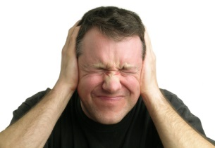
Noise
Animals have a different sensitivity to noise than people
Unexpected and loud noises increase the likelihood of stress
Continuous sound, such as music, can condition animals to be less stressed around noise
Notes:
Animals do not possess logic that allows them to reason and rationalize sound or visual distractions. They react instinctively and tend to move away from distractions. Unexpected and loud noises in areas may cause stress and fright in animals and they may associate those handling facilities with that stress and fear in the future.
Think about when you were young and had to get shots to go to school. The next time you were supposed to visit the doctor, did you want to go? Probably not, because you associated the doctor’s office with the pain of shots. That is why they typically give children stickers and suckers at the end of a visit – to leave kids with a positive association.

Slide 12
Flight Zones
Personal space of an animal
Size is based on familiarity with people
Tame animals have no flight zone
In the flight zone
Animals turn and move away
Outside the flight zone
Animals face and look at person
Notes:
The flight zone of an animal is its personal space or bubble. The size of a flight zone is dependent on the tameness of the animal. Very tame animals will have little to no flight zone and allow people to approach and touch them. Wild animals may have a very large flight zone and spook at the appearance or smell of other animals and people.
When a person enters the flight zone of an animal, the animal turns and moves away. When a person is outside the flight zone, animals will face and look at the person.

Slide 13
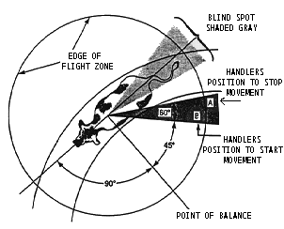
Flight Zones continued
Point of balance
Shoulder
Stand in front of it and animals will move backward
Stand behind and they will move forward
Grandin, T. (2008). Understanding flight zone and point of balance. Retrieved from http://www.grandin.com/behaviour/principles/flight.zone.html.
Notes:
When studying a flight zone, the point of balance or area where an animal will change direction of movement, is the shoulder. Within the flight zone, a handler standing in front of the shoulder will cause the animal to move backward whereas a handler standing behind the shoulder will cause the animal to move forward.
Reference:
Grandin, T. (2008). Understanding flight zone and point of balance. Retrieved December 31, 2008, from http://www.grandin.com/behaviour/principles/flight.zone.html.

Slide 14
Safe Handling
Calm and orderly movements and mannerisms
Avoid yelling, running, or entering the blind spot of an animal
Move into the flight zone behind the point of balance to start animals moving forward
Notes:
Safe and calm handling of animals lowers stress of both the handler and the animal.

Slide 15
References
Damron, W.E. (2000). Introduction to animal science: Global, biological, social, and industry perspectives. Upper Saddle River, NJ: Prentice Hall, Inc.
Ensminger, M.E. (1991). Animal science. Danville, IL: Interstate Publishers, Inc.
Grandin, T. (2008). Livestock behavior, design of facilities and humane slaughter. Retrieved from http://www.grandin.com/index.html.
Herren, R.V. (2007). The science of animal agriculture (3rd ed.). Clifton Park, NY: Delmar.

