Slide 1

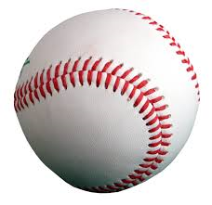
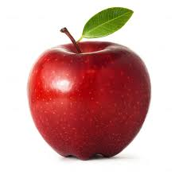
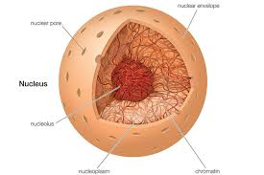
My Cell part functions similar to a boss because the boss tells the workers what to do.
My cell part looks like a baseball because it is round.
My cell part looks like an apple.
An apple has lots of parts and so does the nucleus.
Nucleus- tells the cell what to do.

