Slide 1
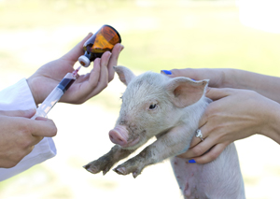
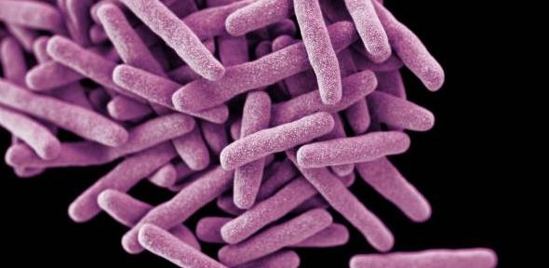
Antibiotics & Growth Hormones
Pros
Cons
Animals receiving antibiotics in their feed gain 4% to 5% more body weight than animals that do not receive antibiotics.
The livestock that are treated live longer.
It leads to resistant Salmonella strains found in both meat and eggs.
Antibiotics can lead to multi-drug resistant pathogens.

