Slide 1

Chapter 6
Introducing and Focusing the Study

Slide 2
Questions for Discussion
What does evidence of interrelationship across the research problem, purpose, and questions look like?
How can the problem statement be best written to reflect one of the approaches to qualitative research?
How can the purpose statement be best written to convey the orientation of an approach to research?
How can a central question be written so that it encodes and foreshadows an approach to qualitative research?
How can subquestions be presented so that they subdivide the central question into several parts?

Slide 3
Methodological Congruence
Problem statement
Purpose statement
Research question
Subquestions

Slide 4
The Research Problem Statement
Need for study
Create a rationale
Opening passage

Slide 5
Reasons for Qualitative Studies
Add to deficiencies in the literature
Give voice to under-represented groups
Probe understanding of central phenomenon
Lead to outcomes such as
Stories
Essence of a phenomenon
Generate theory
Cultural life of group
In-depth analysis of a case

Slide 6
Introduction: Elements
Topic
Research problem
Scholarly literature
Deficiencies
Audiences or stakeholders
Create reader interest
Need for study
Directly, generally, relatively related to study
Gaps that exist
Relate to one of the approaches
How each will benefit
Narrative hook
Real life issues or literature gaps

Slide 7
Sample Introduction: McVea, Harter, McEntarffer, & Creswell, 1999
Topic | Conceptions & Misconceptions of Teen Smoking
Advance topic | Exploring the conceptions and misconceptions of teen smoking in high schools
Research problem | Tobacco is leading cause of cancer
Evidence from literature | Previous research focused on 4 topics Fewer studies examined smoking cessation
Deficiencies in evidence | Minimal research on social context Existing studies quantitative, transtheoretical Qualitative investigations provide detailed views Allow high school students as co-researchers
Importance for audiences | Understand tobacco use in high schools Researchers isolate variables Administrators and teachers plan interventions

Slide 8
Purpose Statement
Major objective or “road map”
Most important statement in qualitative study
Clear & concise

Slide 9
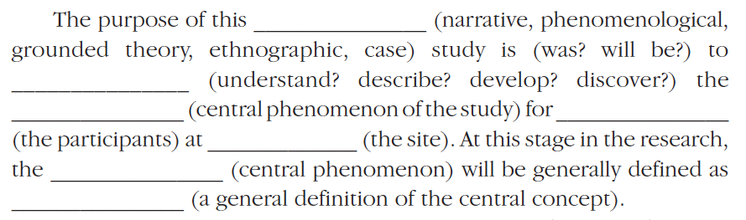
Purpose Statement: Script

Slide 10
Purpose Statement: Script Components
Identify qualitative approach
Encode with words to indicate action and approach
Identify central phenomenon
Foreshadow participants and site
General definition of central phenomenon

Slide 11
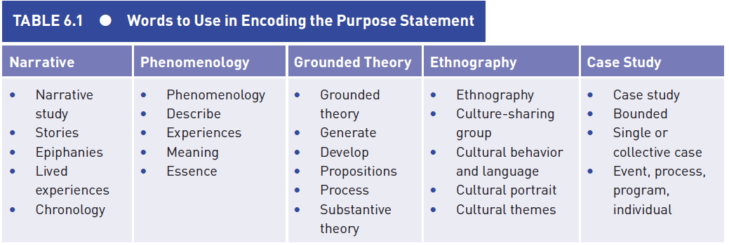
Purpose Statement: Encoding Words

Slide 12
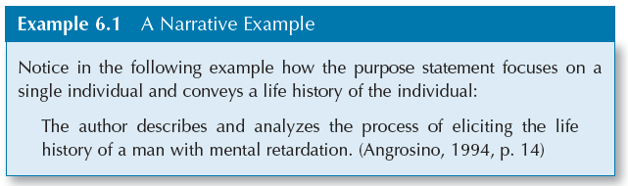
Purpose Statement: Narrative Example

Slide 13
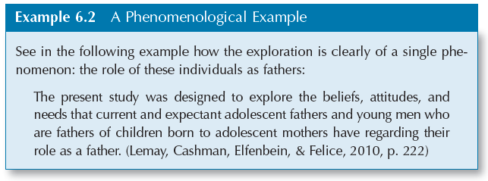
Purpose Statement: Phenomenological Example

Slide 14
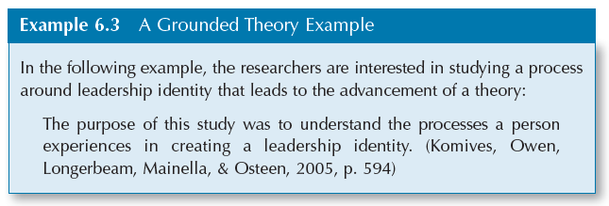
Purpose Statement: Grounded Theory Example

Slide 15
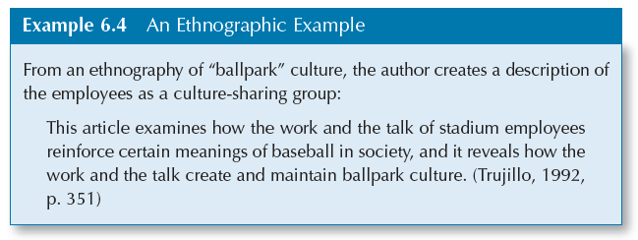
Purpose Statement: Ethnographic Example

Slide 16
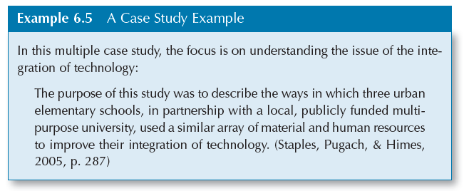
Purpose Statement: Case Study Example

Slide 17
The Research Questions
Open-ended, evolving, and nondirectional
Restate purpose in specific terms
Start with what or how
‘Grand tour’ (Spradley, 1979, 1980)
‘Tell me about yourself’
Overarching central question
Several subquestions

Slide 18
Research Questions: Central Question
Write broadest question to address research problem
Encode language of 5 approaches
Begin with how or what

Slide 19
Research Questions: Subquestions
State small number of subquestions
Subdivide central question
Begin with ‘how’ or ‘what’
Keep subquestions open-ended
Form core collection questions from subquestions
5-7 subquestions

Slide 20
Subquestions by Qualitative Approach
Approach | Subquestion Focus
Narrative study | Probe meaning of stories
Phenomenology | Establish components of ‘essence’
Grounded Theory | Detail emerging theory
Ethnography | Detail aspects of culture-sharing group Members’ rituals Communication Economic way of life
Case study | Address elements of case or issue

