Slide 1
Water
Genesis 1: 6

Slide 2

Theological Background
This page contains a video element and is optimized to work with PowerPoint 2010 and PowerPoint 2007.
PowerPoint 2003 and older versions have an image in place of the video element.

Slide 3
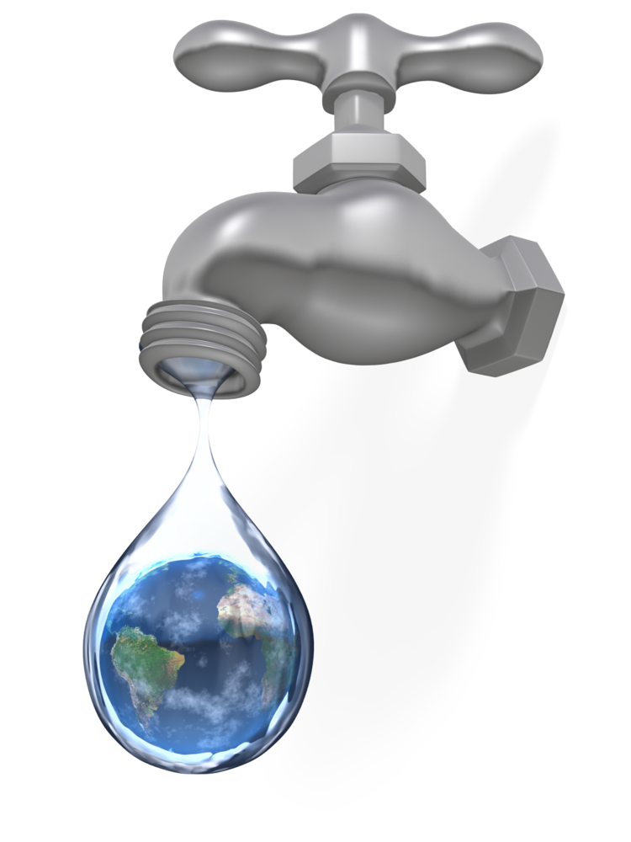
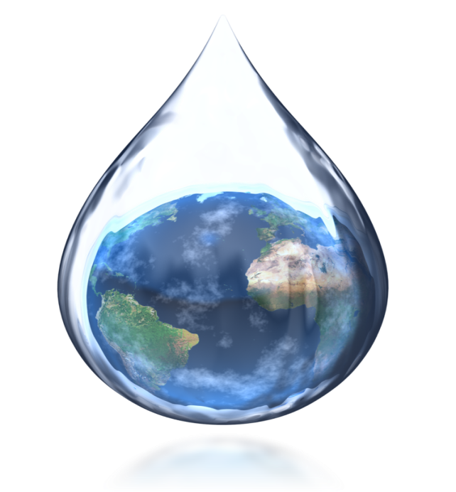
Water
Water is one of our natural resources.
The other two are soil and air.

Slide 4

Water Cycle
Phase 1
Discussion Item One – Phase 1
A Placeholder for text
Phase 2
Discussion Item Two – Phase 2
A Placeholder for text
Phase 3
Discussion Item Three – Phase 3
A Placeholder for text
Phase 4
Discussion Item Four – Phase 4
A Placeholder for text

Slide 5
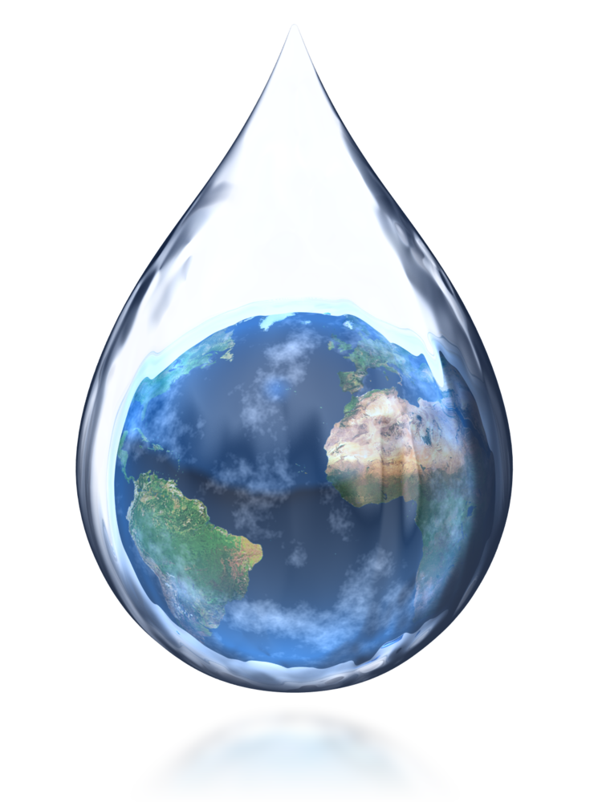
Water
Needs on the Earth
People use water in three resourceful areas:
Household: Wash dirty clothes; Car; Extinguish a Fire
Personal: Quench thirst; Hygiene-bath
Recreational: Beach, Pool, Fishing,

Slide 6
Water Comparison
Comparison of Fresh Water
Comparison of Salt Water
      Freshwater:
      Renewable Resource
      3%
Salt Water:
Oceans
97%

Slide 7
A Two Column
Page Layout
A content placeholder. Use for text, graphics, tables and graphs. You can change this text or delete it.
  Here is a placeholder for more text. You may delete this text
  Here is a placeholder for more text. You may delete this text

Slide 8


Water from Creation
A placeholder for text for the first picture
    More information can be added here by changing this text.
A placeholder for the second picture
    More information can be added here by changing this text.
    Make changes to this text.

Slide 9
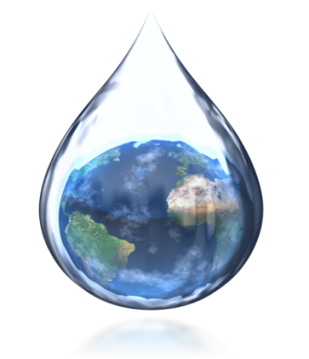
Water Cycle
Evaporation
Condensation
Precipitation
Rain

Slide 10
Questions? Need More Information?
PresenterMedia.com
support@presentermedia.com
4416 S. Technology Dr
Sioux Falls, SD 57106

