Slide 1
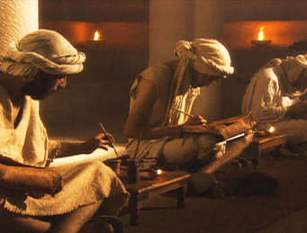
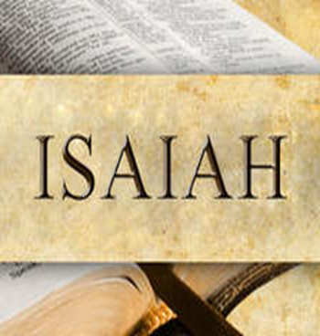
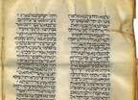

Slide 2
Hebrew words for Prophets
Nabi- Navi- The Hebrew word for “prophet” a spokesperson for YHWH who delivered God’s judgment on contemporary society and expressed God’s intention on the world (Deuteronomy 13:1-5:18:9-22; Amos 3:7).
Ro’eh-“Diviner”. Associated Primarily with the figure Samuel. Someone who is able to communicate with the world of the sacred to discover information that will be useful to those who consult him (I Samuel 9:6).

Slide 3
Hozeh -“Seer” or Visionary. A person who receives and reports visions (Amos 7:12). A seer transmitted to the audience a vision, dream, or the proceedings from the divine council.
Divine Council is “the assembly of gods, over which the high G-D presides. In the Hebrew and Christian Bibles, YHWH is described as the head of the divine council and prophets have claimed to have witnessed or participated in its meetings (Coogan, 2014, 553).

Slide 4
Is ha elohim- Man of God. Prominent in the stories about Elijah and Elisha, particularly the latter. The literary character of these stories corroborates a judgment that the “Man of God” can best be understood as a “Holy Man”, a type of individual attested in numerous religious traditions. Such persons possess the power of the holy and hence are dangerous, powerful, and due appropriate respect. Unlike visionaries, who occasionally engage in trance or possession behavior, the “holy man” personifies the deity in the midst of the profane world (II Kings 6:1-7).

Slide 5
Monotheism as presented in classical Western Christian theology, is an intellectual claim that only one G-D presides over all existence. Yet the Bible articulates YHWH as a fully functioning deity marked by immense complexity and interiority that are characteristically excluded in conventional rational understandings of the one G-D (Brueggemann, Reverberations of Faith: A Theological Handbook of Old Testament Themes, 137).

Slide 6
Brueggemann argued that “the biblical question is not the number of gods [one!], but the practice and character of YHWH in an assumed world of contested polytheism, the ways in which this G-D (among others) is known, and the ways in which Israel is related to this G-D).
This claim of “one G-D” is also to be distinguished from henotheism, a common assumption in the ancient world that each god presides over his or her own territory, but is limited to that territory (1 Samuel 26:19) Brueggemann, Reverberations of Faith, 137).

Slide 7
The Old Testament, in its final form, certainly ends up with an affirmation, that YHWH alone is G-D. This affirmation is clearest in exilic Isaiah (43:11; 48:12). That confession made in doxological form is not an intellectual or rational confession; rather the assertion is a faith confession with the quite practical intent of permitting displaced Israel in exile to continue to “trust and obey” in terms of its most elemental faith commitments (Brueggemann, 137).

Slide 8
Eighth and Seventh Century Prophets:
Context, Content, and the usage of literature to shape, inform and influence the mind of a people and nation.

Slide 9
The Eighth Century Prophets, (Amos, Hosea, Isaiah and Micah) all conveyed messages that dealt with land as it pertained to the promise of G-D to Israel.
Latifundialization, which is derived from the term latifundia-large estates, can be generally defined as the process of land accumulation in the hands of a few wealthy elite to the deprivation of the peasantry.

Slide 10
Central to the process of latifundialization is the accumulation of land. However, there are multiple dimensions and causative factors.
1. Systems of Production- Nature and Factors
2. Distribution-Consumption and Systems of exchange and distribution

Slide 11
The Process of Latifundialization
1. Land Accumulation
2. Growth of Urban Centers
3. Militarization
4. Extraction of Surplus
5. Lifestyle of the Upper Class
6. Trade and Commerce
7. Market Condition
8. Indebtedness of the Peasants
9. Role of Creditors
10. Role of Judicial Courts

Slide 12

Overview of Isaiah
Isaiah of Jerusalem lives and proclaims his message in Jerusalem, the capital of Judah during the Assyrian Crisis.
Isaiah connects his message to the reigns of Uzziah, Jotham, Ahaz and Hezekiah, all kings of Judah (792-687 B.C.E).

Slide 13
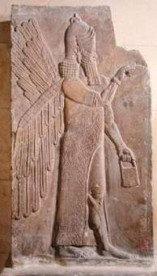
Assyrian – Kingdom in northern Mesopotamia that ruled much of the Near East during the first millennium B.C.E.
The Assyrians captured the northern kingdom of Israel in 722 B.C.E. and laid siege to Jerusalem 701 B.C.E. (Coogan, Michael. The Old Testament: A Historical and Literary Introduction to the Hebrew Scriptures. 3rd Edition. 552).

Slide 14
During the first half of the eighth century (i.e. the 700’s B.C.E), the Assyrians were experiencing a period of weakness.
Under Jeroboam II (786-746 B.C.E) Israel was expanding and enjoying a time of material prosperity (Amos will critique this). (Hays, J. Daniel. The Message of the Prophets: A Survey of the Prophetic and Apocalyptic Books of the Old Testament, 37).

Slide 15
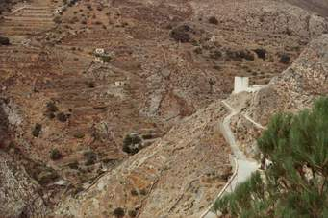
Israel was larger and more powerful than Judah to the south, and in the years following the death of Jeroboam, Israel under King Pekah and Syria under King Rezin partnered and aligned themselves together to attack Judah under King Ahaz.

Slide 16
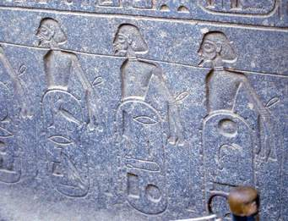
Syro-Ephraimite War was the result of this partnership and forms the background for the beginning of Isaiah’s ministry.

Slide 17
Geopolitics
1 : a study of the influence of such factors as geography, economics, and demography on the politics and especially the foreign policy of a state
2 : a governmental policy guided by geopolitics
3 : a combination of political and geographic factors relating to something (such as a state or particular resources) the geopolitics of oil.

Slide 18
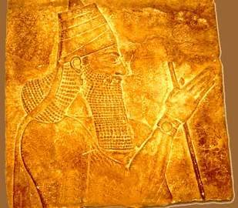
Tiglath-pileser III- rose to power and restored Assyria to military prominence by flexing imperial muscle.
King Ahaz appealed to Tiglath-pilesar for assistance and help during the Syro-Ephramite war.

Slide 19
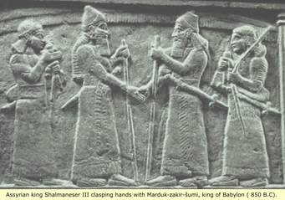
Shalmaneser V in 722 B.C.E destroyed the capital city of Samaria and scattered the inhabitants of Israel. The northern kingdom was gone (Hays, J. Daniel. The Message of the Prophets: A Survey of the Prophetic and Apocalyptic Books of the Old Testament, 37).

Slide 20
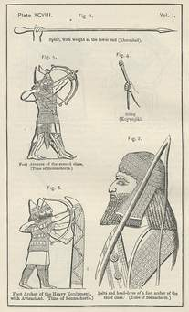
Sennacherib (reigned 705-681 BCE) was the second king of the Sargonid Dynasty of Assyria (founded by his father Sargon II). He is one of the most famous Assyrian kings because of the part he plays in narratives in the biblical Old Testament (II Kings, II Chronicles, and Isaiah) and, since the 19th century CE.

Slide 21
Isaiah is comprised of sixty-six chapters.
One of the longest books of the Bible.
Until the late 19th century the entire book was understood as being written by the prophet Isaiah, son of Amoz.
Isaiah son of Amoz was believed to have lived in Jerusalem in the late eighth and early 7th centuries.

Slide 22
Premodern Scholars including Rabbi Ben Ibn Ezra in the twelfth century, recognized some challenges to this assumption.
Work in the 18th and 19th centuries culminated in the commentary on Isaiah by German scholar Bernhard Duhm who argued for three Isaiah’s.

Slide 23
Abraham ben Meir ibn Ezra, (born 1092/93, Tudela, Emirate of Saragossa—died 1167, Calahorra, Spain), poet, grammarian, traveller, Neoplatonic philosopher, and astronomer, best known as a biblical exegete whose commentaries contributed to the Golden Age of Spanish Judaism.

Slide 24
He travelled to North Africa and possibly to Egypt. Primarily known as a scholar and poet up to that point, in about 1140 Ibn Ezra began a lifelong series of wanderings throughout Europe, in the course of which he produced distinguished works of biblical exegesis and disseminated biblical lore.
In about 1140 Ibn Ezra began a lifelong series of wanderings throughout Europe, in the course of which he produced distinguished works of biblical exegesis and disseminated biblical lore.

Slide 25
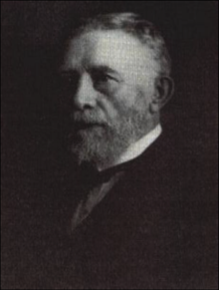
Bernhard Lauardus Duhm (October 10, 1847 – November 1, 1928) was a German Lutheran theologian born in Bingum, today part of Leer, East Frisia or (Lower Saxony).
He pioneered the theory that their were multiple authors of the book of Isaiah and was the first to identify its servant songs.

Slide 26
First Isaiah or Isaiah of Jerusalem---Chapters 1 through 39---
Deutero or Second Isaiah ---Chapters 40 through 55—dating to the sixth century
Trito or Third Isaiah, Chapters 56-66, a century or more later.
Many scholars suggest it is the result of a lengthy process of formation.

Slide 27
The entire anthology shares a common vocabulary, frequently referring to YHWH as “the holy One of Israel” and making repeated mention of justice and righteousness, and is pervaded by the view that Jerusalem/Zion is central to YHWH’s plans.
Zion refers to a frequent poetic term for Jerusalem.

Slide 28
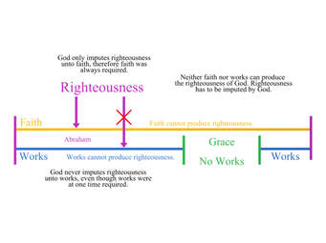
Think about righteousness in relationship to covenant agreements and relationships and concepts and perceptions outlined and identified in the understanding of Maat.

Slide 29
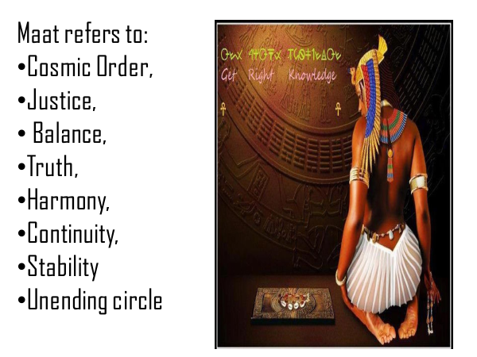

Slide 30
Biblical criticism is understood as a discipline that studies textual, compositional, and historical questions surrounding the Old and New Testaments. It lays the groundwork for meaningful and credible interpretation of the Bible.
Criticism in this sense means “to judge or discern”.

Slide 31
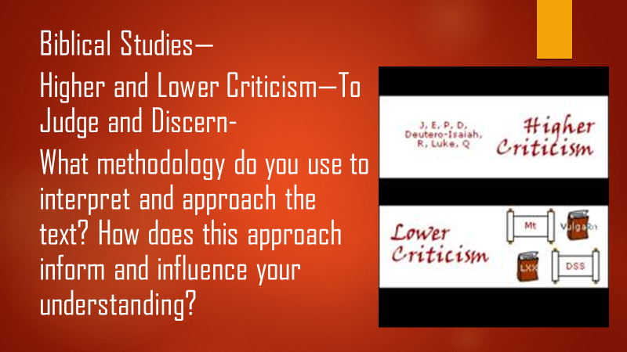

Slide 32
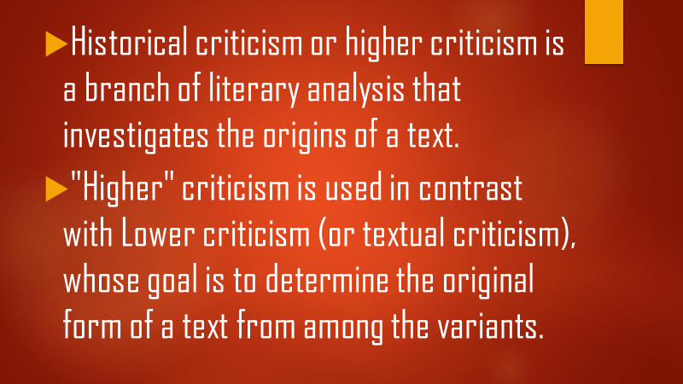

Slide 33
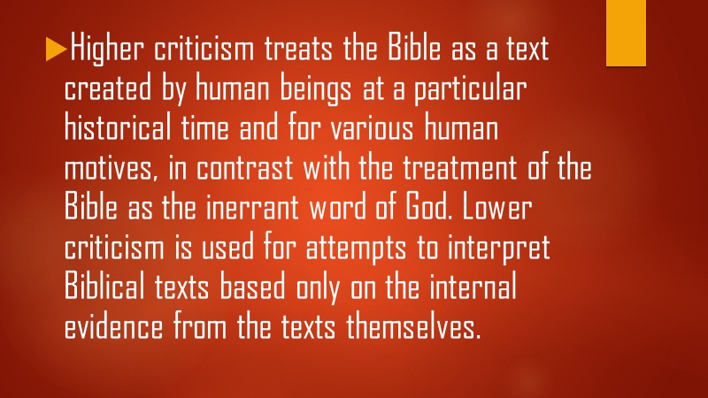

Slide 34
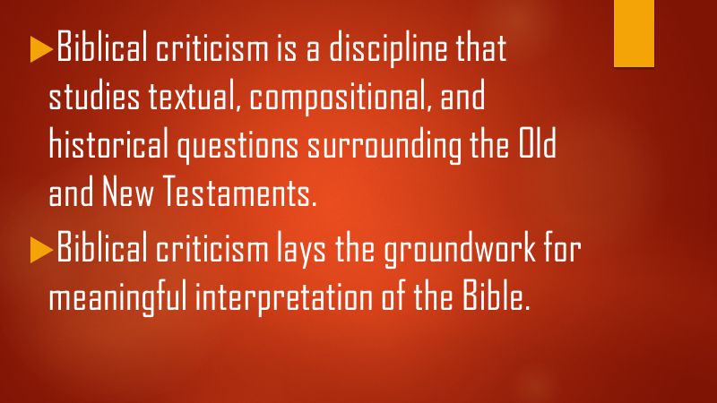

Slide 35
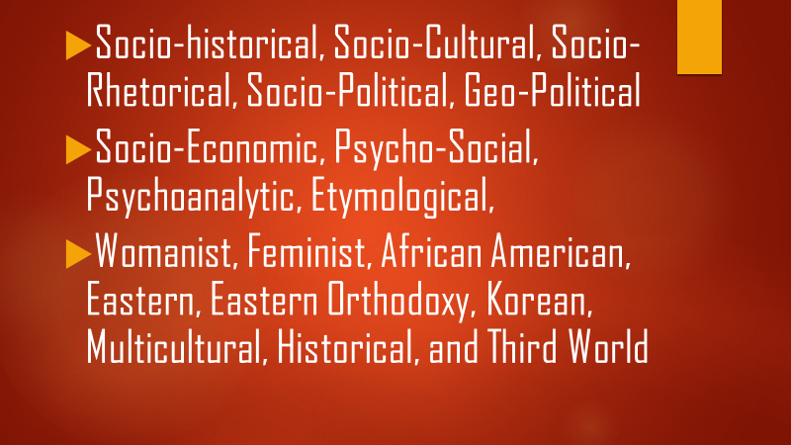

Slide 36
The presupposition and assumption is that an eighth-century BCE prophet in Jerusalem could not know about details that would happen in the sixth century. Events such as:
Fall of Jerusalem to the Babylonians in 586 B.C.E. (repeatedly mentioned in Isaiah 40-55)
Rise to power of Cyrus the Great the Persian king in 559 (Isaiah 44:28 and 45:1)
Fall of Babylon to Cyrus in 539 (Isaiah 47 and 48:14)

Slide 37
Because of the previous beliefs, many scholars argue that the result of a lengthy process of formation, which began with the collection of oracles of Isaiah of Jerusalem.
To this nucleus later writings were attached, and many additions were made to earlier parts.
The entire anthology shares a common vocabularly.

Slide 38
Anthology means, a collection of selected literary pieces or passages or works of art or music.
Marc Brettler, the Dora Golding Professor of Biblical Studies at Brandeis University, warns that “If there is one point that I hope people will remember, it’s the danger of saying, ‘The Bible says …’ and then filling in that sentence with just one single thought, because very, very often, in almost anything that you could ask, the Bible has more than one perspective” (https://www.faithandleadership.com/marc-brettler-danger-saying-bible-says).

Slide 39
  Beginning in the latter of the twentieth century , some scholars have focused more on the final form of the book of Isaiah than on its hypothetical literary history.
  This type of approach is called “canonical criticism” which emphasizes the traditional shape of the book and its unifying themes rather than its compositional history (Both taken from Michael Coogan, The Old Testament, 2014, 333).

Slide 40
This approach recognizes that communities of faith from the late biblical period onward viewed the book as a single work containing a coherent and divinely inspired message.
It also understands the processes that led to the final form of the book were not just mechanical editing or a cut and paste job but the result of a living intellectual tradition (Both taken from Michael Coogan, The Old Testament, 2014, 333).

Slide 41
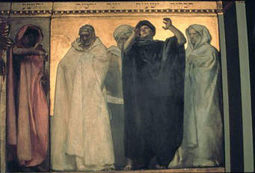
The School of Isaiah
Isaiah has several references to Isaiah writing down the words of the prophet (Isaiah 30:8)
Isaiah 8:1-3 and 8:16 also suggest disciples responsible for the writings and prophecies.

Slide 42
The School of Isaiah or Disciples of Isaiah are presumably those responsible for collecting and preserving the prophet’s oracles like Jeremiah’s scribe Baruch a century later.
II Chronicles 26:22 also records that Isaiah was a writer .
Many scholars argue that Isaiah had disciples like the sons of the prophet (earlier tradition) and that during his time or after a train of thought formed (Coogan).

Slide 43
Isaiah’s three-point standard pre-exilic message
You’ve broken the covenant (through idolatry, social injustice, religious ritualism). So repent!
No repentance? The judgment? Judgment will also come on the nations.
Yes there is hope beyond the judgment for a glorious future restoration both for Judah/Israel and for the nations (J. Daniel Hays and Tremper Longman III, The Message of the Prophets, 98).

Slide 44
Hays and Longman suggest:
Isaiah 1-39 focuses on judgment but also contains glimpses of deliverance
Isaiah 40-55 focuses on deliverance and restoration through the Servant but also contains glimpses of judgment
Isaiah 56-66 focuses on righteous living by YHWH’s true prophet/servants in the meantime(J. Daniel Hays and Tremper Longman III, The Message of the Prophets, 100).

Slide 45
Isaiah 1-3---The Covenant Lawsuit
Isaiah launches into a scathing diatribe against the people of Judah for their repeated and blatant covenant violation (especially of Deuteronomy).
YHWH states that “YHWH” has raised children but they have not only rebelled but no longer know this G-D.
Forsaken YHWH, implying a broken relationship, spurned YHWH, which means despise YHWH, turned their back which is a sign of disrespect of the king.

